Slide 1

GLOBAL
ROASTED COFFEE
MARKET REPORT 2024
Global,Regional,CountryAnalysis

Slide 2

INTRODUCTION
Roasting coffee transforms the chemical and physical properties of green coffee beans into roasted coffee products. The roasting process is what produces the characteristic flavor of coffee. Due to the association of health benefits, including lowering the risk of diabetes, lowering the risk of getting Alzheimer's and Parkinson's, preventing heart failure, assisting in the good health of the liver and stomach, and others, coffee consumption has increased significantly across the board for all age groups. This factor leads to an increase in the market.

Slide 3


KEY INSIGHTS
MARKET SIZE
USD 41.9 billion
2022
FORECAST
USD 60.9 billion
2030
20₋23
CAGR 4.8%
2030

Slide 4
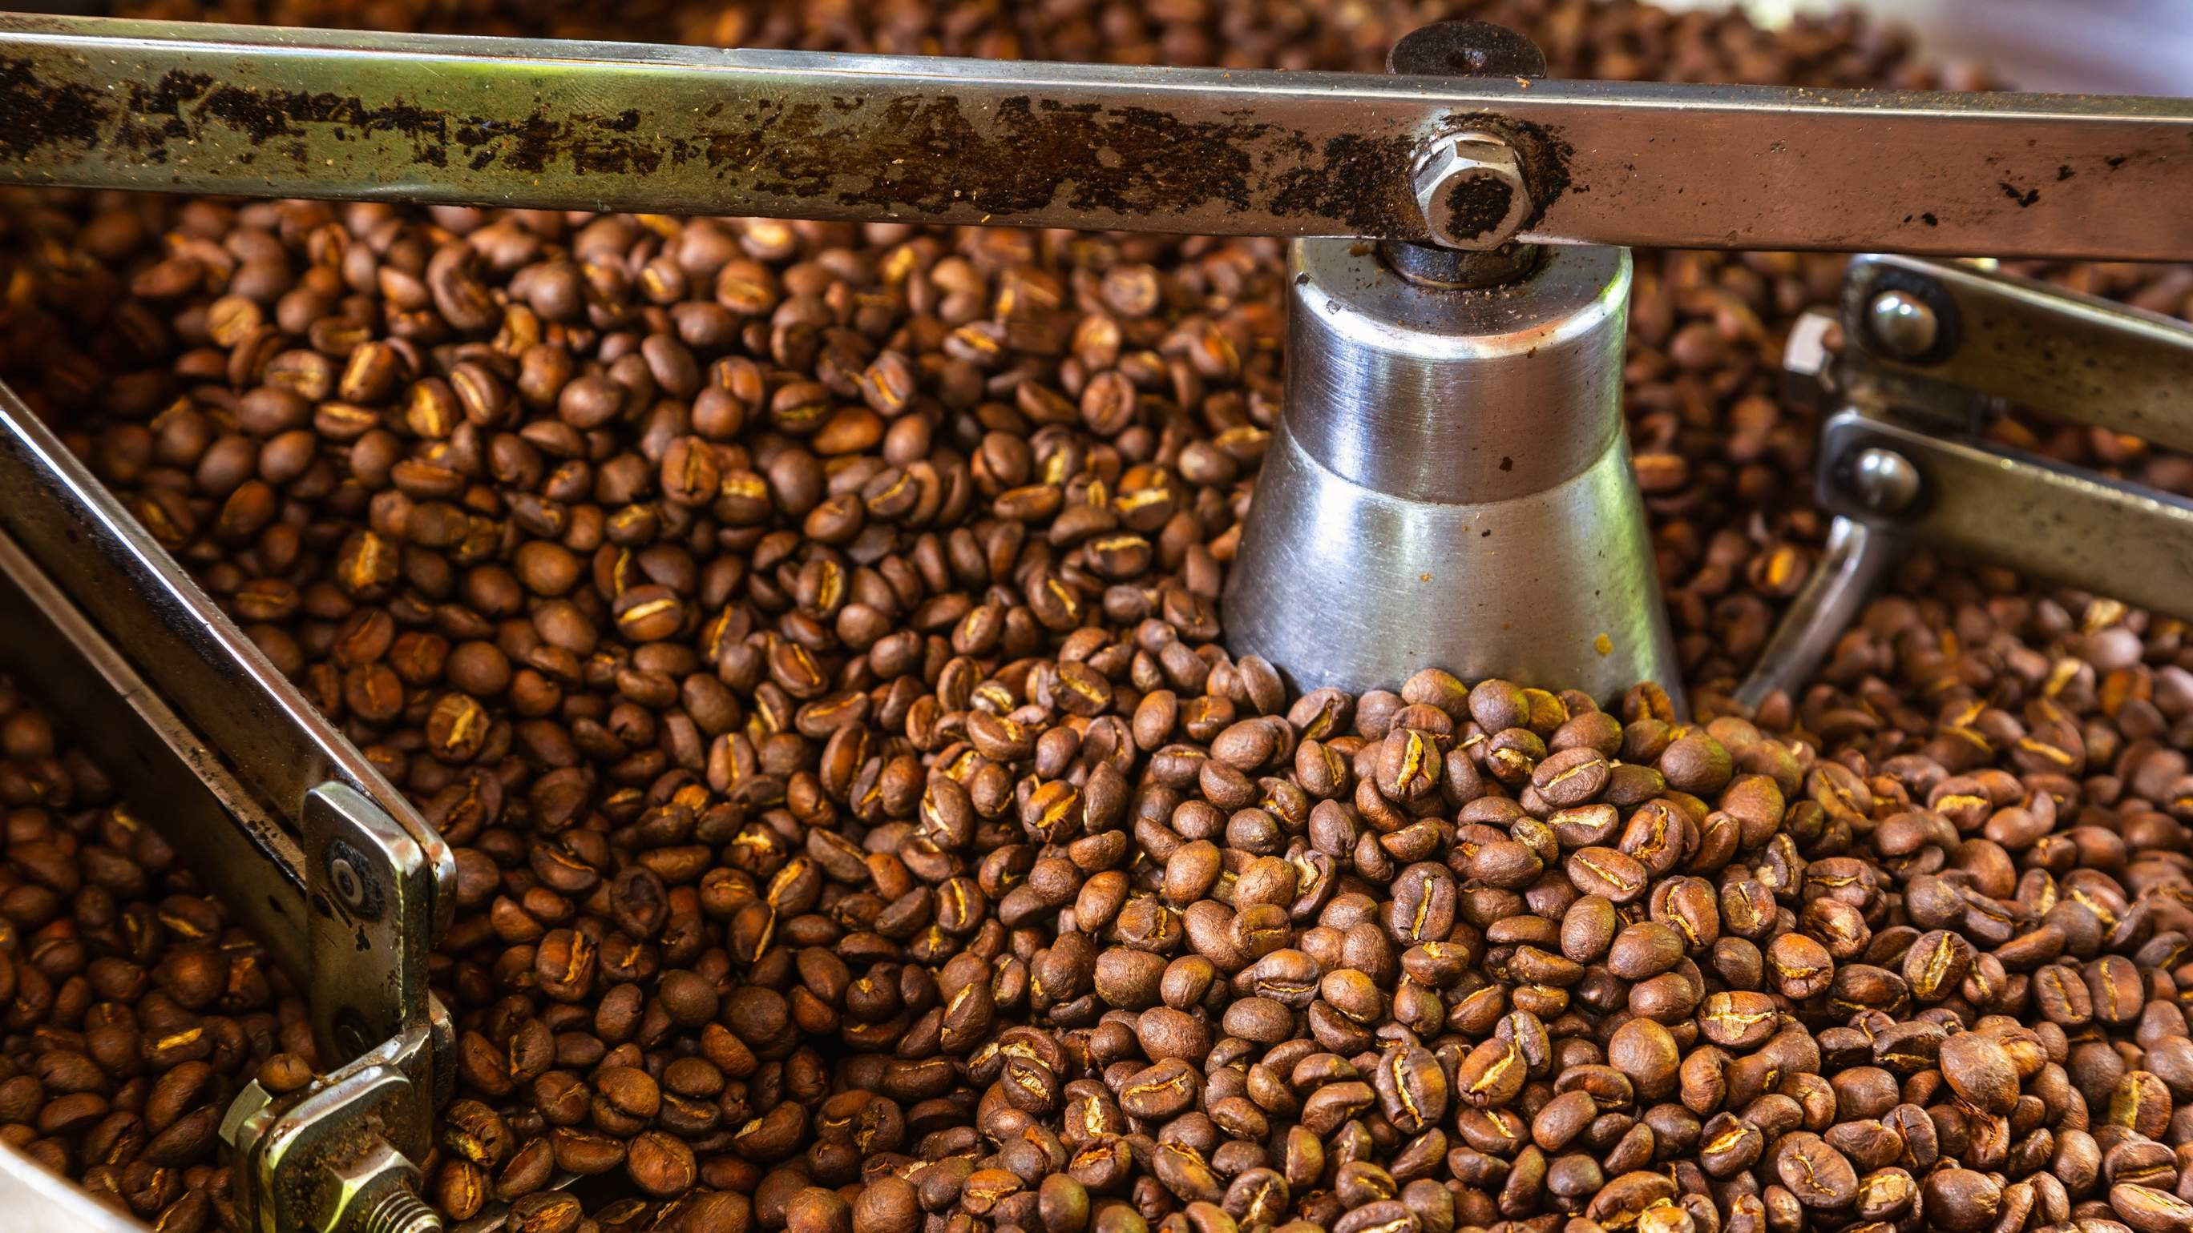
REVENUE MARKET SHARE BY SEGMENTS 2022
Arabica Robusta
By Type
Convenience Stores Foodservice and Restaurants
Online Stores
Application Segment
Distribution Channel
B2B B2C

Slide 5
Global Roasted Coffee Market Revenue share for 2022
Europe

Slide 6

Drivers
An increase in the number of coffee users is expected to boost the Roasted coffee market Increasing favorable preferences and demand for fresh coffee are expected to boost the Roasted coffee market
External environmental factors affect the taste and quality of coffee proved to be a restraining factor in the Roasted coffee market
Restraints

Slide 7

AUTHOR'S PERSPECTIVE
The Global Roasted Coffee Market is witnessing significant growth in the near future.
Arabica coffee is one of the highly popular coffee with enthusiastic experts as the beans are the most flavorful and sweet of all.
The B2B segment dominates the market with a revenue share of 50% over the forecast period. Moreover, the sales of the product are boosting across the globe due to the growing number of cafes and coffee outlets.
Additionally, roasted coffee is highly served by various businesses in the hospitality industry including hotels, restaurants, and others which is expected to propel the industry in the coming years

Slide 8
KEY PLAYERS

Slide 9


Contact us
For Full Report
COGNITIVE MARKET RESEARCH
Tel: + 1 312 - 376 - 8303 | + 44 020 - 8123 - 0732
India: ( + 91 ) 983 - 496 - 8611
sales@ cognitivemarketresearch. com
Access the Full Report : http://tinyurl.com/3n8pzjjb
Please visit our website:
https://www.cognitivemarketresearch.com

