Slide 1
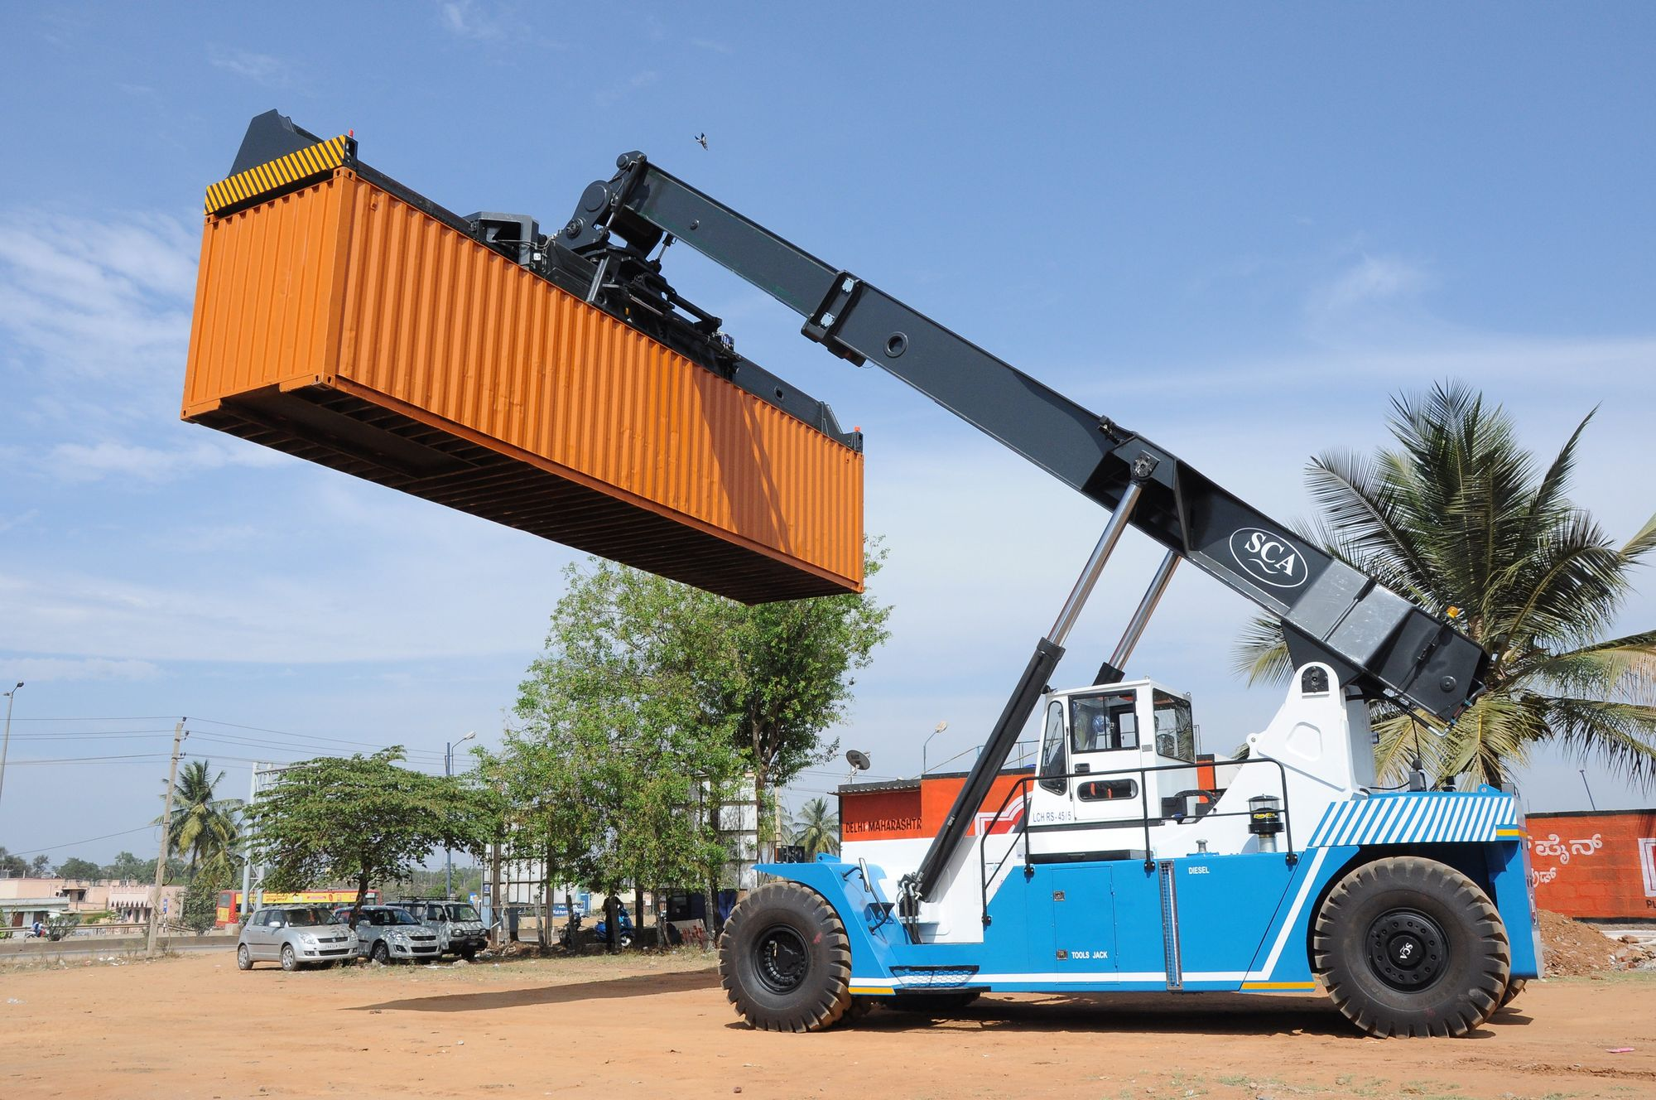
GLOBAL REACH STACKER
MARKET REPORT 2024
Global,Regional,CountryAnalysis

Slide 2
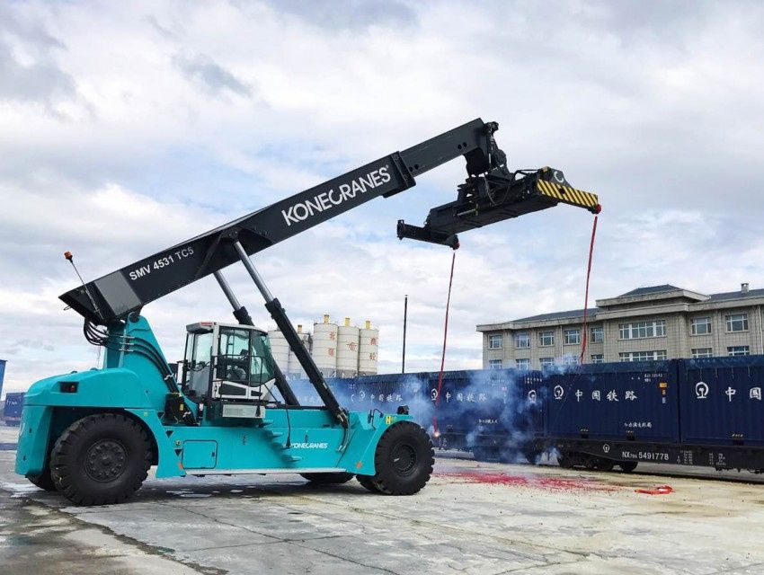
INTRODUCTION
There are numerous heavy-duty vehicles built to serve diverse industries, such as excavators, forklifts, trucks, cranes, and so on. A reach stacker is a truck that is used to move containers, semi-trailers, and loose products. Reach Stacker refers to an off-road truck-like cargo container handler that uses an overhead telescopic boom to reach over two or more cargo container stacks and lift the containers from the top.

Slide 3
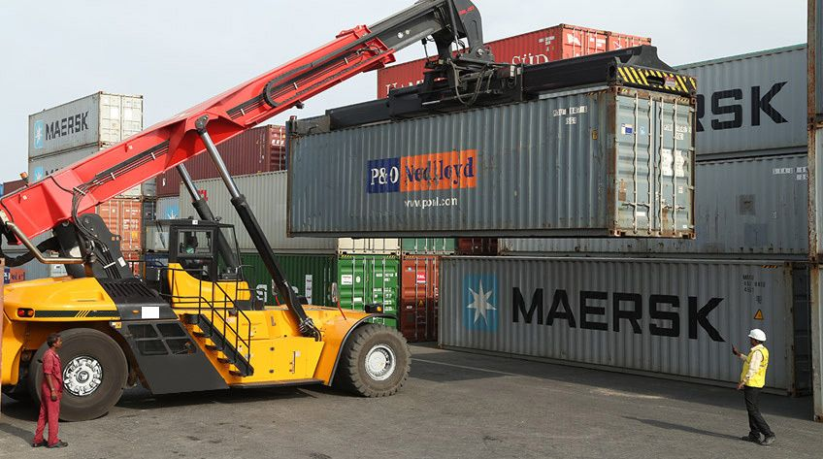

KEY INSIGHTS
FORECAST
$647.57 Million
2028
2023-
2030
CAGR
4.17%

Slide 4
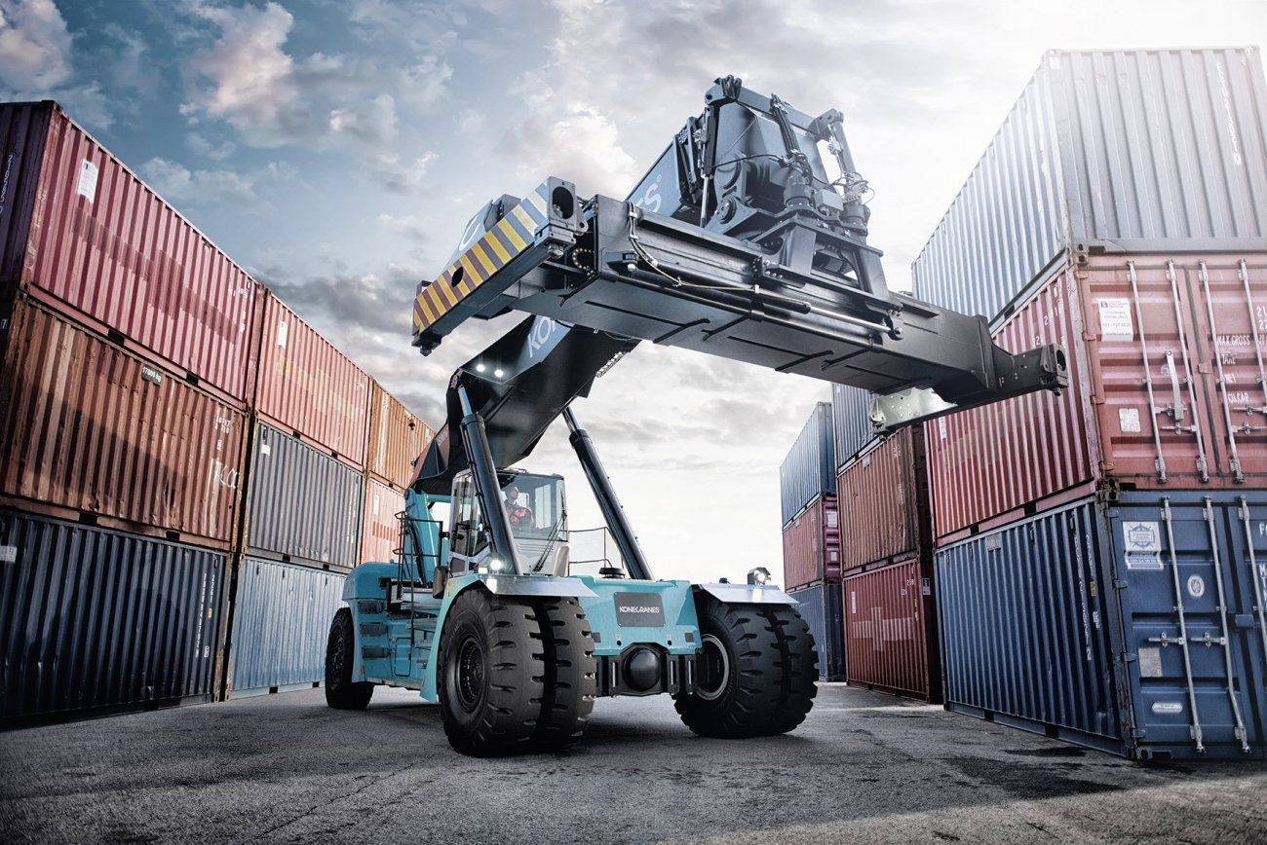
REVENUE MARKET SHARE BY SEGMENTS 2022
By Tonnage
Low
USD 318.39 Million
by application
Sea Ports
USD 387.25 Million
Powertrain Segment
IC Engine Vehicle
USD 460.83 Million

Slide 5

GLOBAL REACH STACKER MARKET REVENUE SHARE FOR 2022
Asia Pacific
USD 287.77 Million

Slide 6
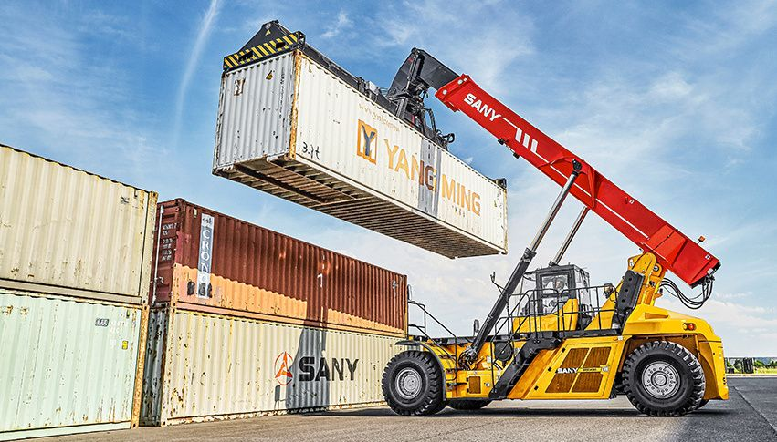
High usage of reach stackers at ports
Drivers
Fluctuation and Inconsistency in raw material prices
Trends

Slide 7
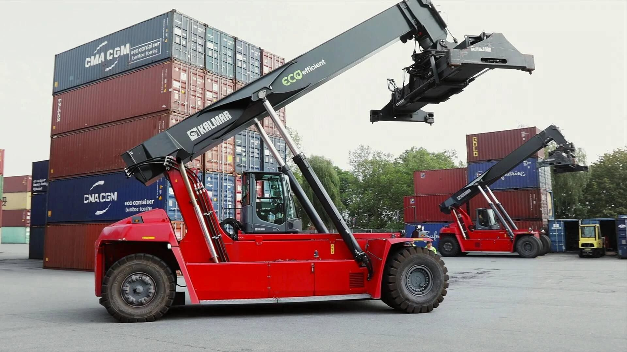
AUTHOR'S PERSPECTIVE
  The Global Reach Stacker Market revenue in 2016: USD 503.84 Million
  Low held for largest share of total revenue generated in 2019
  IC Engine Vehicle held the maximum share of total revenue generated in 2019
  Sea Ports held the maximum share of total revenue generated in 2019
  High usage of reach stackers at ports drives the growth of market
  Boom in logistic industry automatically drives the growth of global reach stacker market
  Fluctuation and inconsistency in raw material prices along with supply chain disruption can hamper growth in some of the underdeveloped regions which may restrict the growth of reach stacker market
  Rising industrialization in developing nations will propel the transport of goods which will create lucrative opportunities for the growth of reach stacker market.

Slide 8










KEY PLAYERS

Slide 9


Contact us
For Full Report
COGNITIVE MARKET RESEARCH
Tel: +1 312-376-8303 | +44 020-8123-0732
India: (+91) 983-496-8611
sales@cognitivemarketresearch.com
Access the Full Report : https://tinyurl.com/ynwceczf
Please visit our website:
https://www.cognitivemarketresearch.com

