Slide 1
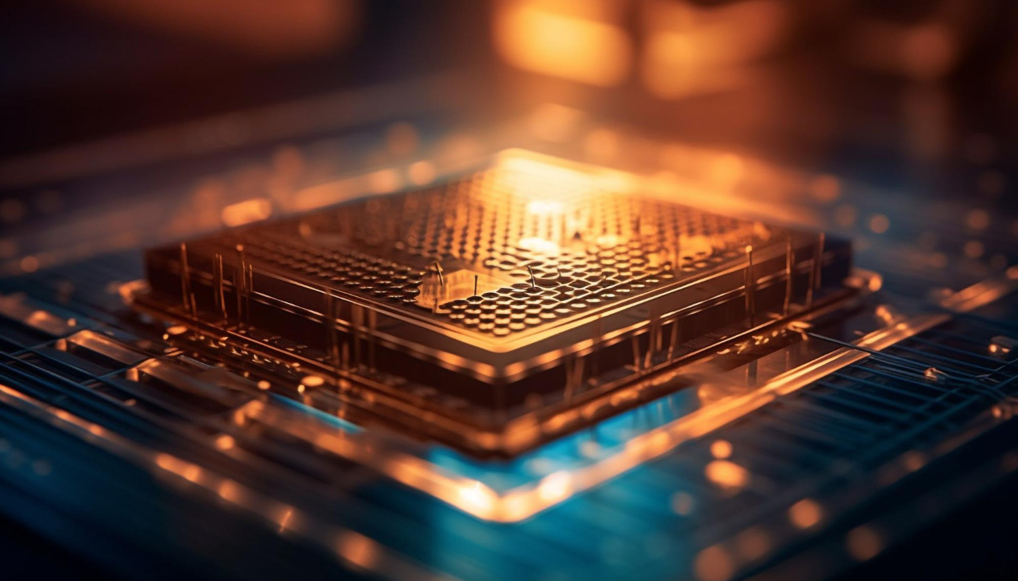
Quantum Computing Market Report

Slide 2
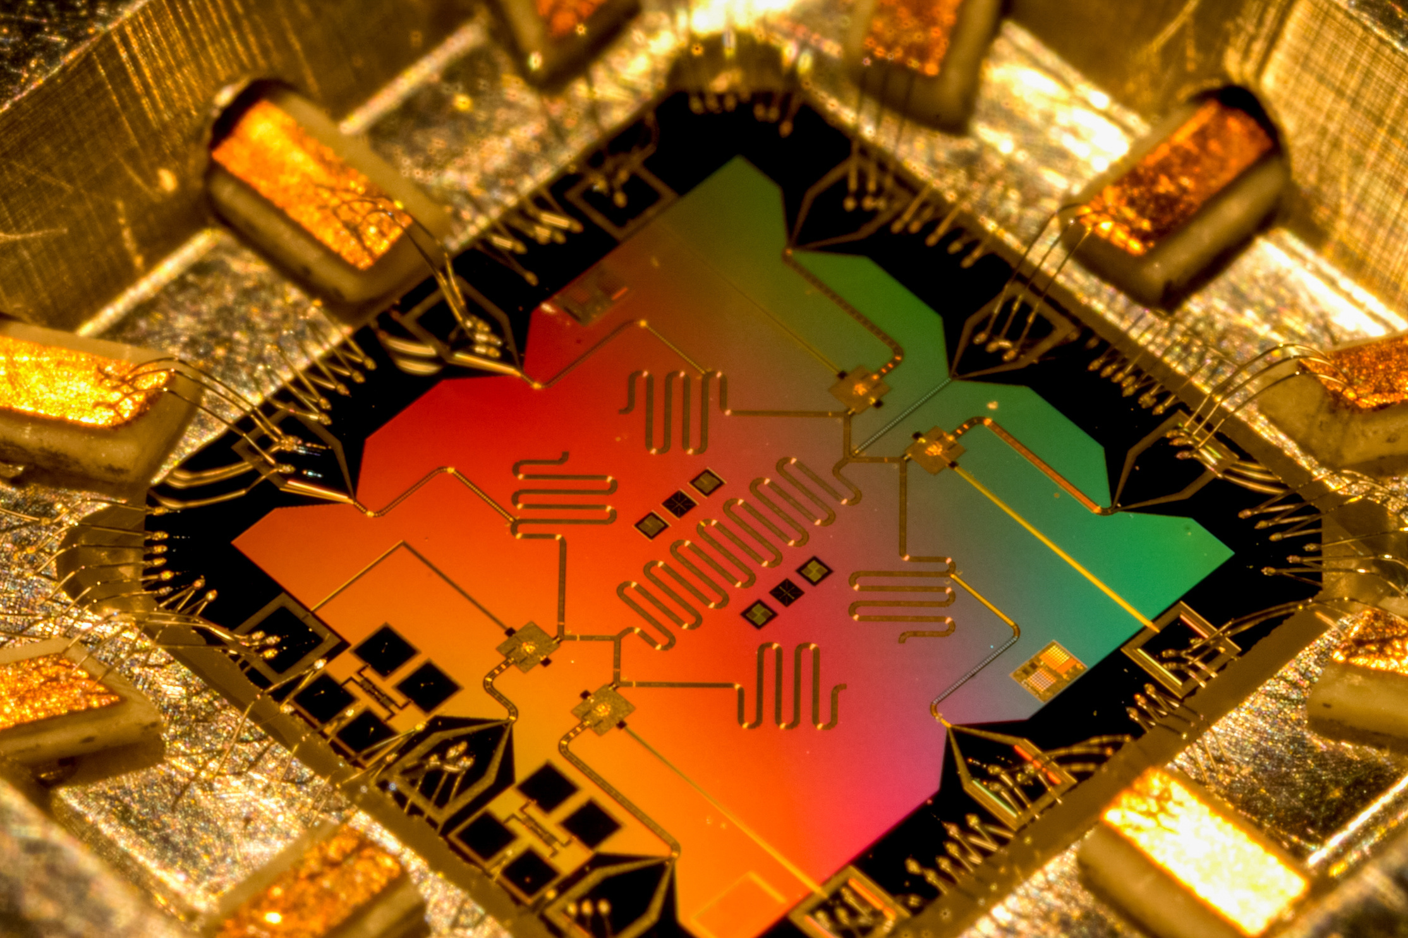
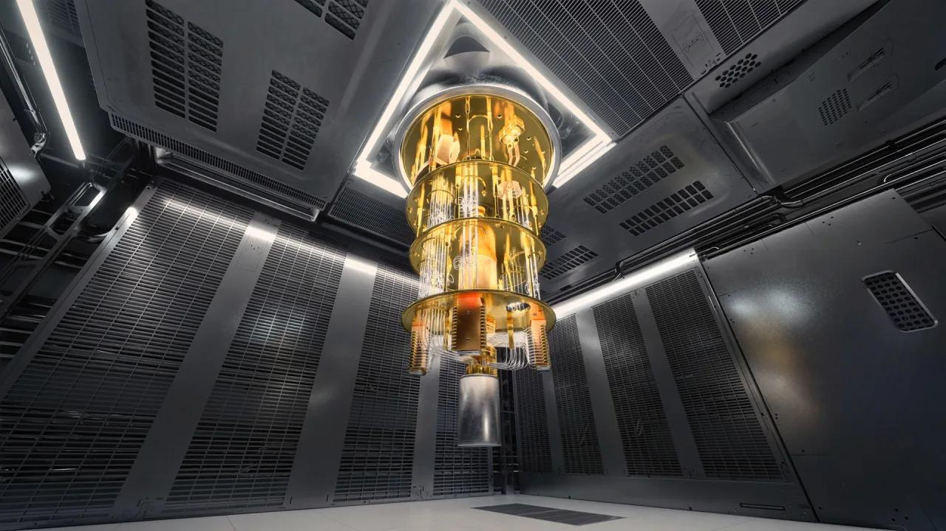
What is Quantum Computing?
Quantum computing is a type of computing that focuses on developing computer technologies that use quantum physics to process information at the atomic and subatomic level. It is a rapidly emerging advanced technology that follows the laws of quantum mechanical procedures to solve more complex problems.

Slide 3

Key Insights
MARKET SIZE (2022)
0.52 Billion
FORECAST (2030)
4.67 Billion
CAGR (2022-2030)
32.5%

Slide 4
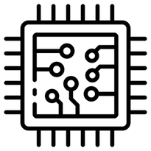


REVENUE MARKET SHARE BY SEGMENTS 2022
BFSI: 29.3%
Hardware: 45.6%
Cloud: 65.7%
Machine Learning: 32.1%

Slide 5



Global Quantum Computing Revenue Share for 2022
The North American market accounts for the highest share in terms of revenue in the global quantum computing market. It is expected to maintain its dominance in the global market during the forecast period.
North America:
32.1%

Slide 6

Drivers
Restraints
Increasing adoption of quantum computing in BFSI Sectorn increasing investments in quantum computing technology by Governments
Complexity of implementation and operation Need For Highly Skilled Employees

Slide 7
AUTHOR'S PERSPECTIVE
Hardware was the leading segment with 45.34% share of total
Quantum Computing market in 2022
By application, the market is categorized into optimization, machine
learning, finacial services, biomedical simulation, electronic material
discovery, and others.
The cloud segment accounts for the highest share in terms of revenue
in the global market, due to the need for cloud-based computing
solutions is increase

Slide 8


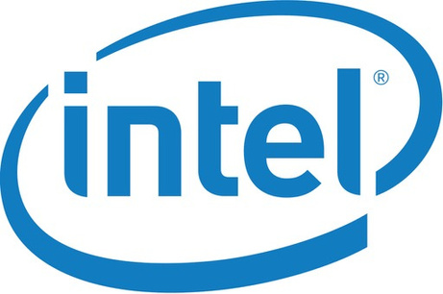


Key Players

Slide 9


For Full Report
Contact us
COGNITIVE MARKET RESEARCH
Tel: +1 312-376-8303 | +44 020-8123-0732
India: (+91) 983-496-8611
sales@cognitivemarketresearch.com
Access the Full Report : http://tinyurl.com/3z8n8fhh
Please visit our website:
https://www.cognitivemarketresearch.com

