Slide 1
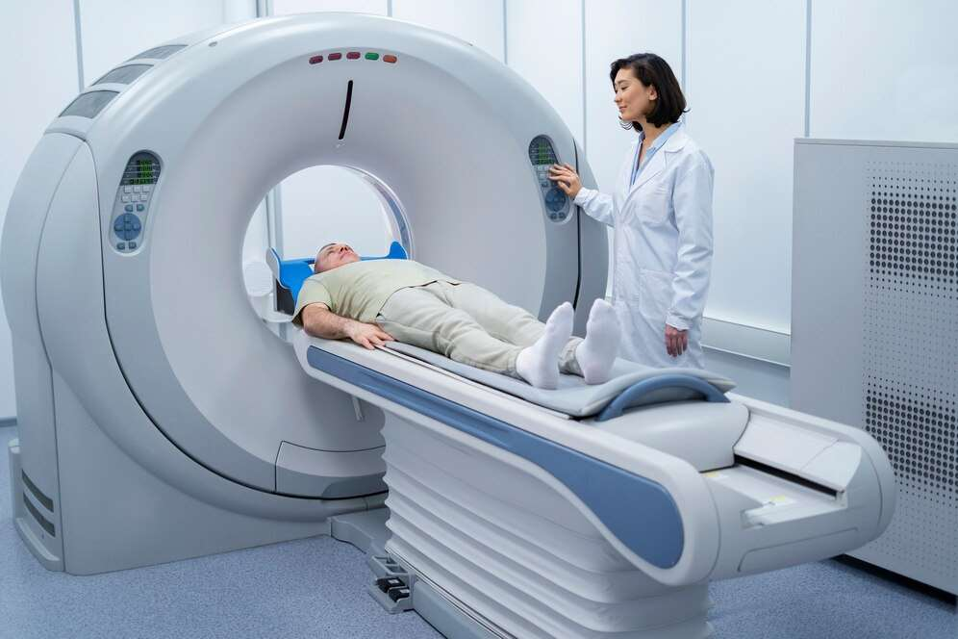
GLOBAL
PROTON THERAPY
MARKETREPORT
2024
Global,Regional,CountryAnalysis

Slide 2
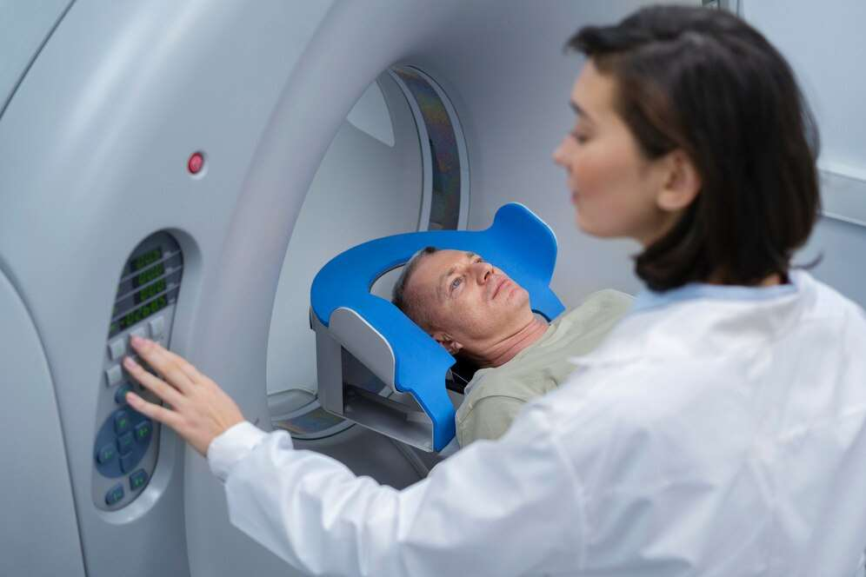
INTRODUCTION
Proton Therapy is a proton beam treatment and it is a type of external beam radiation therapy system that uses proton rather than X-rays to provide treatment to cancer patients. These protons used in radiation therapy helps to kill cancer cells that destroy healthy cell of the body decreasing the immunity of a patient. This treatment is a type of external beam radiation therapy and it painlessly delivers radiation through the skin from a machine outside the body.

Slide 3
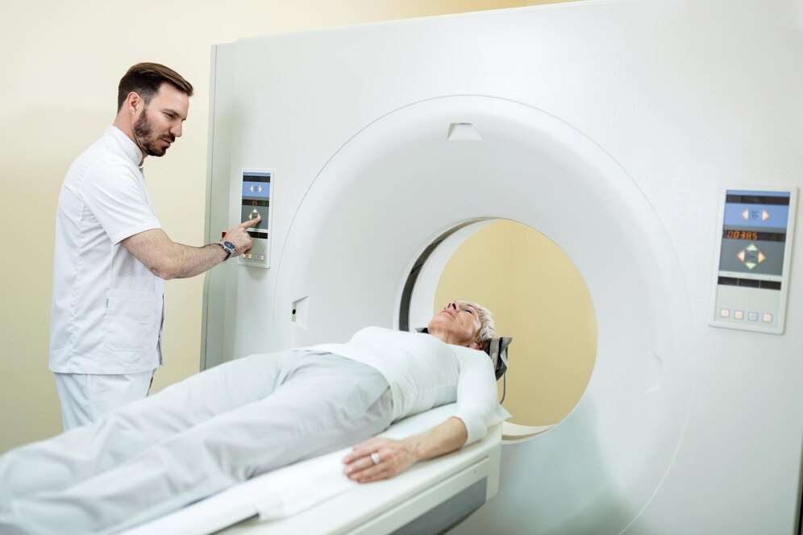

KEY INSIGHTS
MARKET SIZE
USD 451.48 Million
2021
FORECAST
USD 2,661.12 Million
2028
CAGR
13.49%
2023- 2030

Slide 4
REVENUE MARKET SHARE BY SEGMENTS 2022
Application Segment
Lung Cancer
USD 566.42 Million
End User Segment
Single Room
USD 1,805.91 Million

Slide 5

Global Proton Therapy Market Revenue share for 2022
Europe
USD 1,027.46 Million

Slide 6
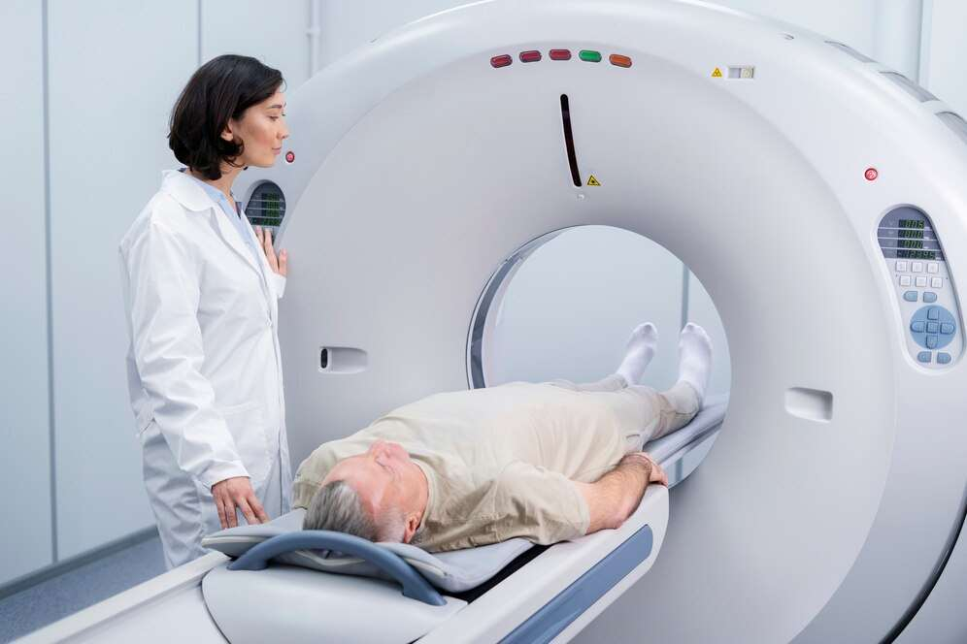
Increasing Prevalence of Cancer
Drivers
Lack of trained professionals
Restraints

Slide 7
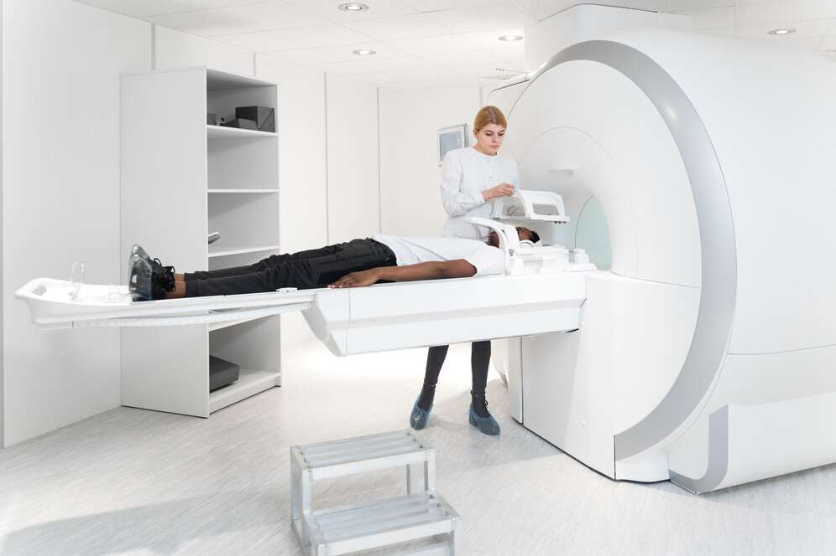
AUTHOR'S PERSPECTIVE
  The Global Proton Therapy Market is witnessing significant growth in the near future.
  In 2023, the Lung Cancer segment accounted for noticeable share of global Proton Therapy Market and is projected to experience significant growth in the near future.
  The Single Room segment is expected to expand at the significant CAGR retaining position throughout the forecast period.

Slide 8
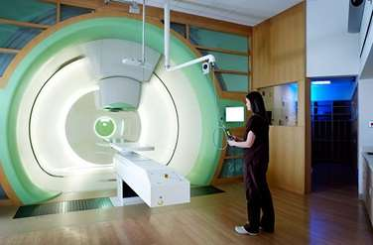

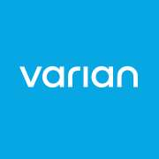





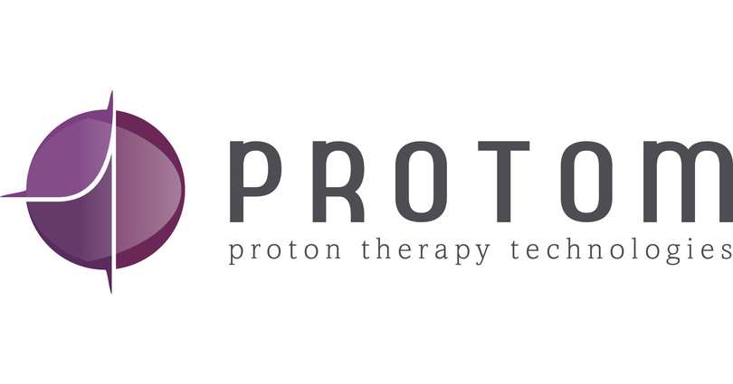
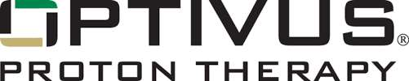
KEY PLAYERS

Slide 9
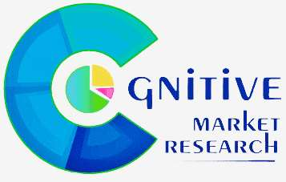
For Full Report
Contact us
COGNITIVE MARKET RESEARCH
Tel: +1 312-376-8303 | +44 020-8123-0732
India: (+91) 983-496-8611
sales@cognitivemarketresearch.com
Access the Full Report : https://tinyurl.com/525zs7ax
Please visit our website:
https://www.cognitivemarketresearch.com

