Slide 1

GLOBAL
PRIVATE INVESTIGATION SERVICES
MARKET REPORT
2024
Global,Regional,CountryAnalysis

Slide 2

INTRODUCTION
Private investigation services are a crucial source of collecting information related to surveillance activities, offering evidence, and unearthing crimes. It offers surveillance and investigation in business traction, civil cases, and criminal cases like missing persons, etc. Technology advancements, including AI-driven solutions, increased productivity and widened the market growth.

Slide 3


KEY INSIGHTS
MARKET SIZE
USD 18.5 billion
2022
CAGR
4.90%
2023- 2030

Slide 4

REVENUE MARKET SHARE BY SEGMENTS 2022
  Civil Investigation
  Economic Crime Investigation
Type Segment
  Personal
  Business
Application Segment

Slide 5

Global Private Investigation Services Market Revenue share for 2024
North America

Slide 6

  Fast Growing Competition Among the Businesses Boost Market Growth
  Rising Financial Fraud is Driving Market Growth
Drivers
High Cost for Appointing Private Investigators to Boost the Market Growth
Restraints

Slide 7

AUTHOR'S PERSPECTIVE
  The Global Private Investigation Services Market is witnessing significant growth in the near future.
  The private investigators look for the missing person by conducting inquiries at their last known address, having background checks into organizations, checking with friends and family, and contacting banks utilizing details gained from a client or other source in order to establish current bank accounts held by the subjects.
  The Investigation Agency offers security for celebrities during public appearances and offers bodyguards for private events.

Slide 8


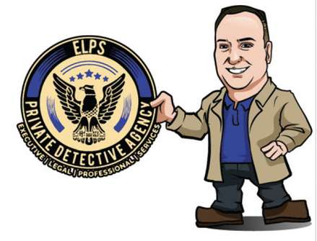



KEY PLAYERS

Slide 9


For Full Report
Contact us
COGNITIVE MARKET RESEARCH
Tel: +1 312-376-8303 | +44 020-8123-0732
India: (+91) 983-496-8611
sales@cognitivemarketresearch.com
Access the Full Report : https://tinyurl.com/ycy3m748
Please visit our website:
https://www.cognitivemarketresearch.com

