Slide 1


PRESERVED EGG
MARKET REPORT
2024
Qualitative Analysis + Quantitative Analysis

Slide 2
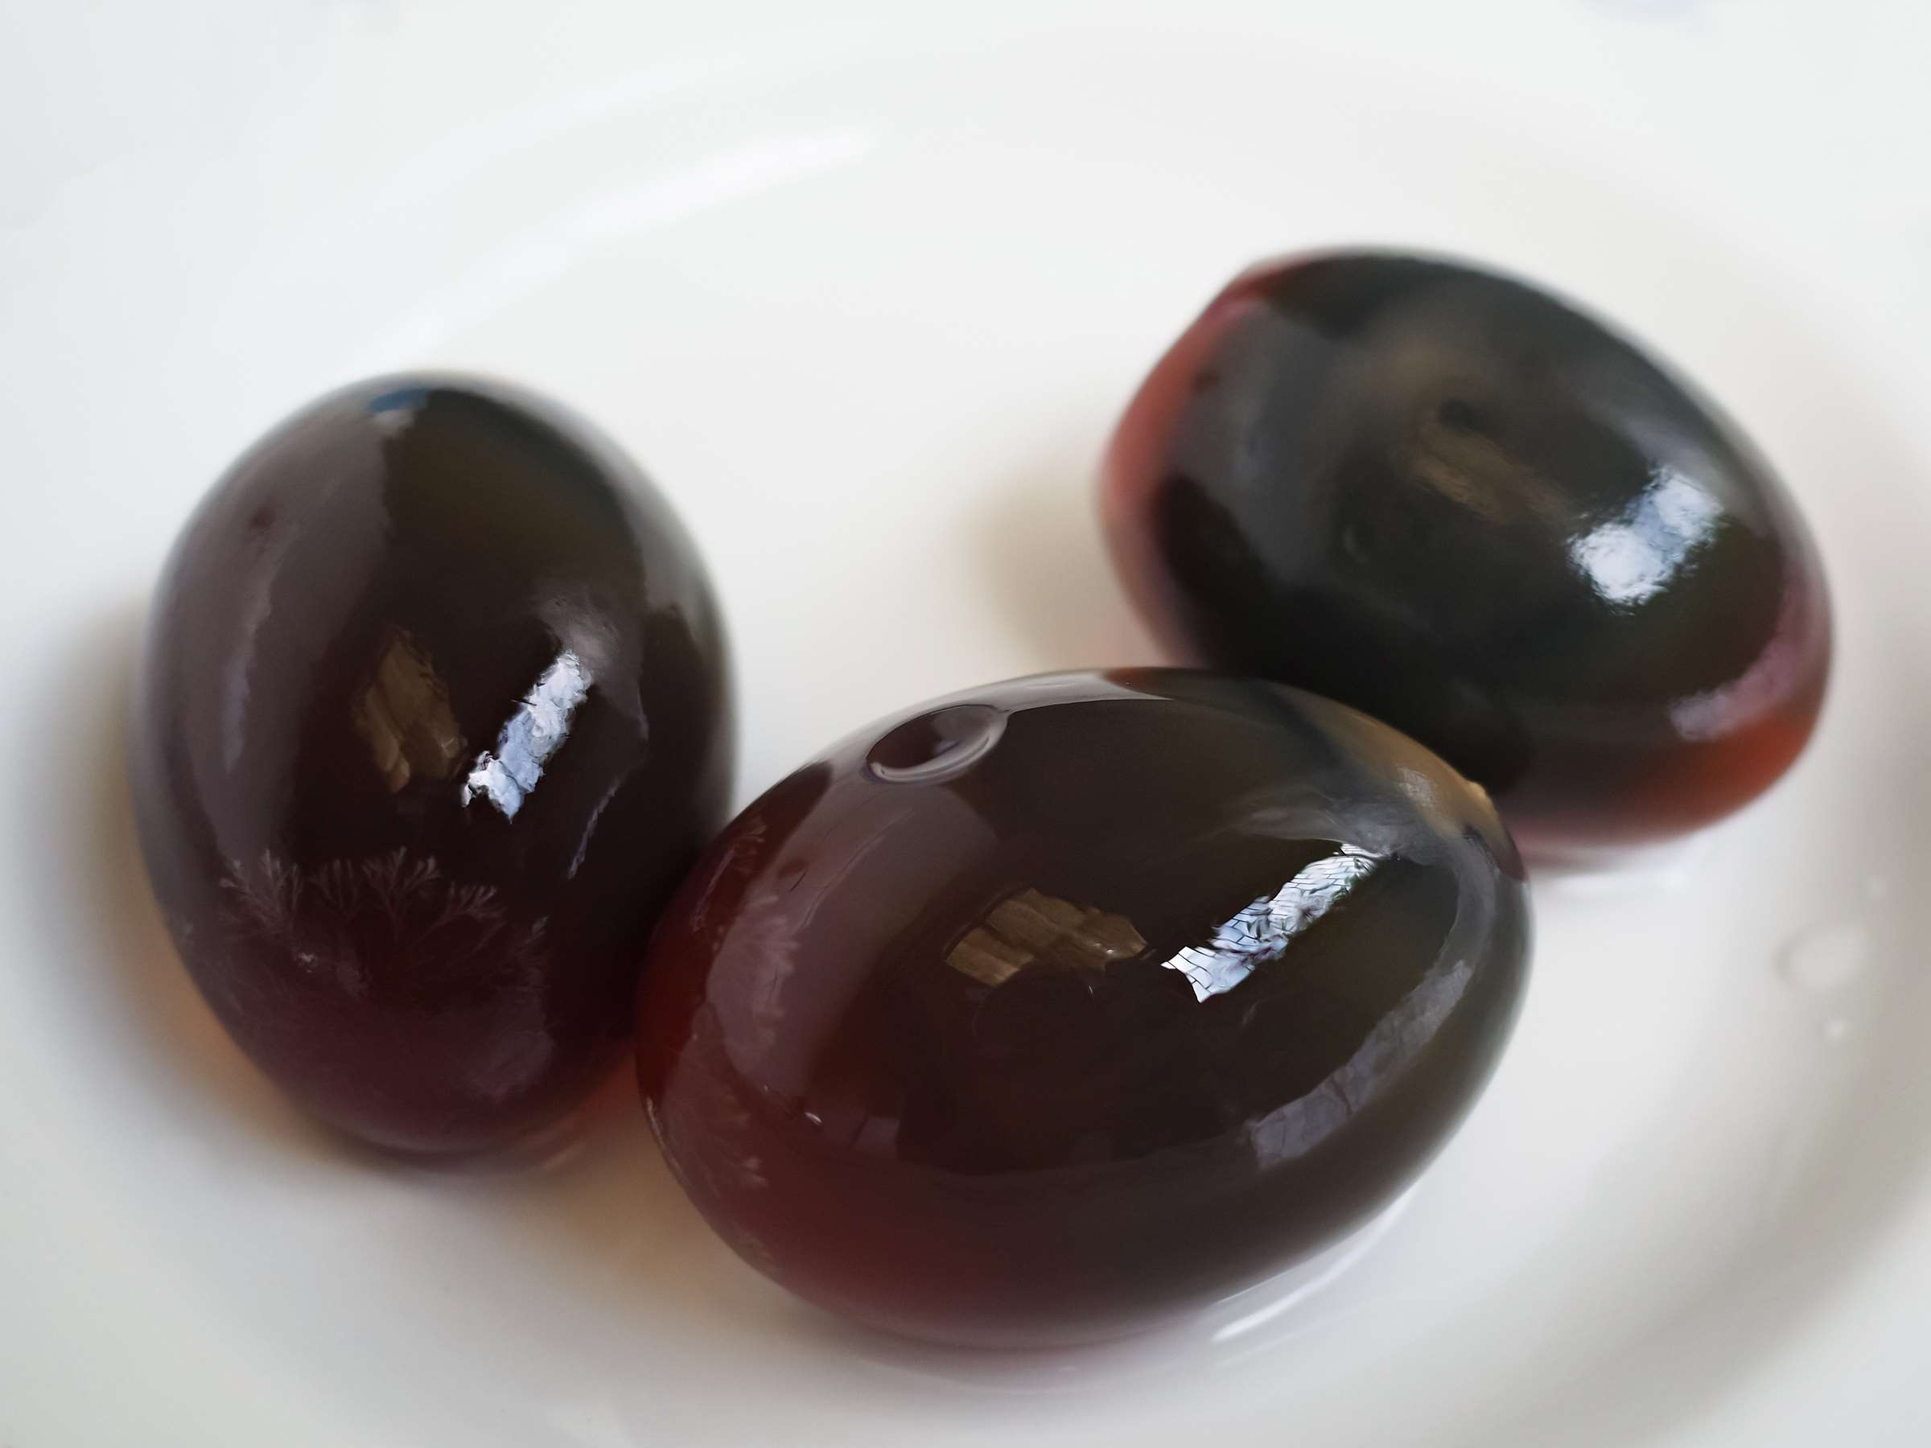
INTRODUCTION
This market offers a variety of preserved egg varieties with distinct flavours and textures, including those produced from duck and chicken eggs. The need for novel flavours, healthier substitutes with lower sodium and cholesterol content, and the growth of vegan preserved egg products manufactured from plant-based materials like tofu or algae-based alternatives are some of the emerging trends in the worldwide preserved egg market. The emergence of processed goods such preserved egg tofu, oatmeal, and snacks has increased consumer demand for novel flavor experiences and increased market potential.

Slide 3
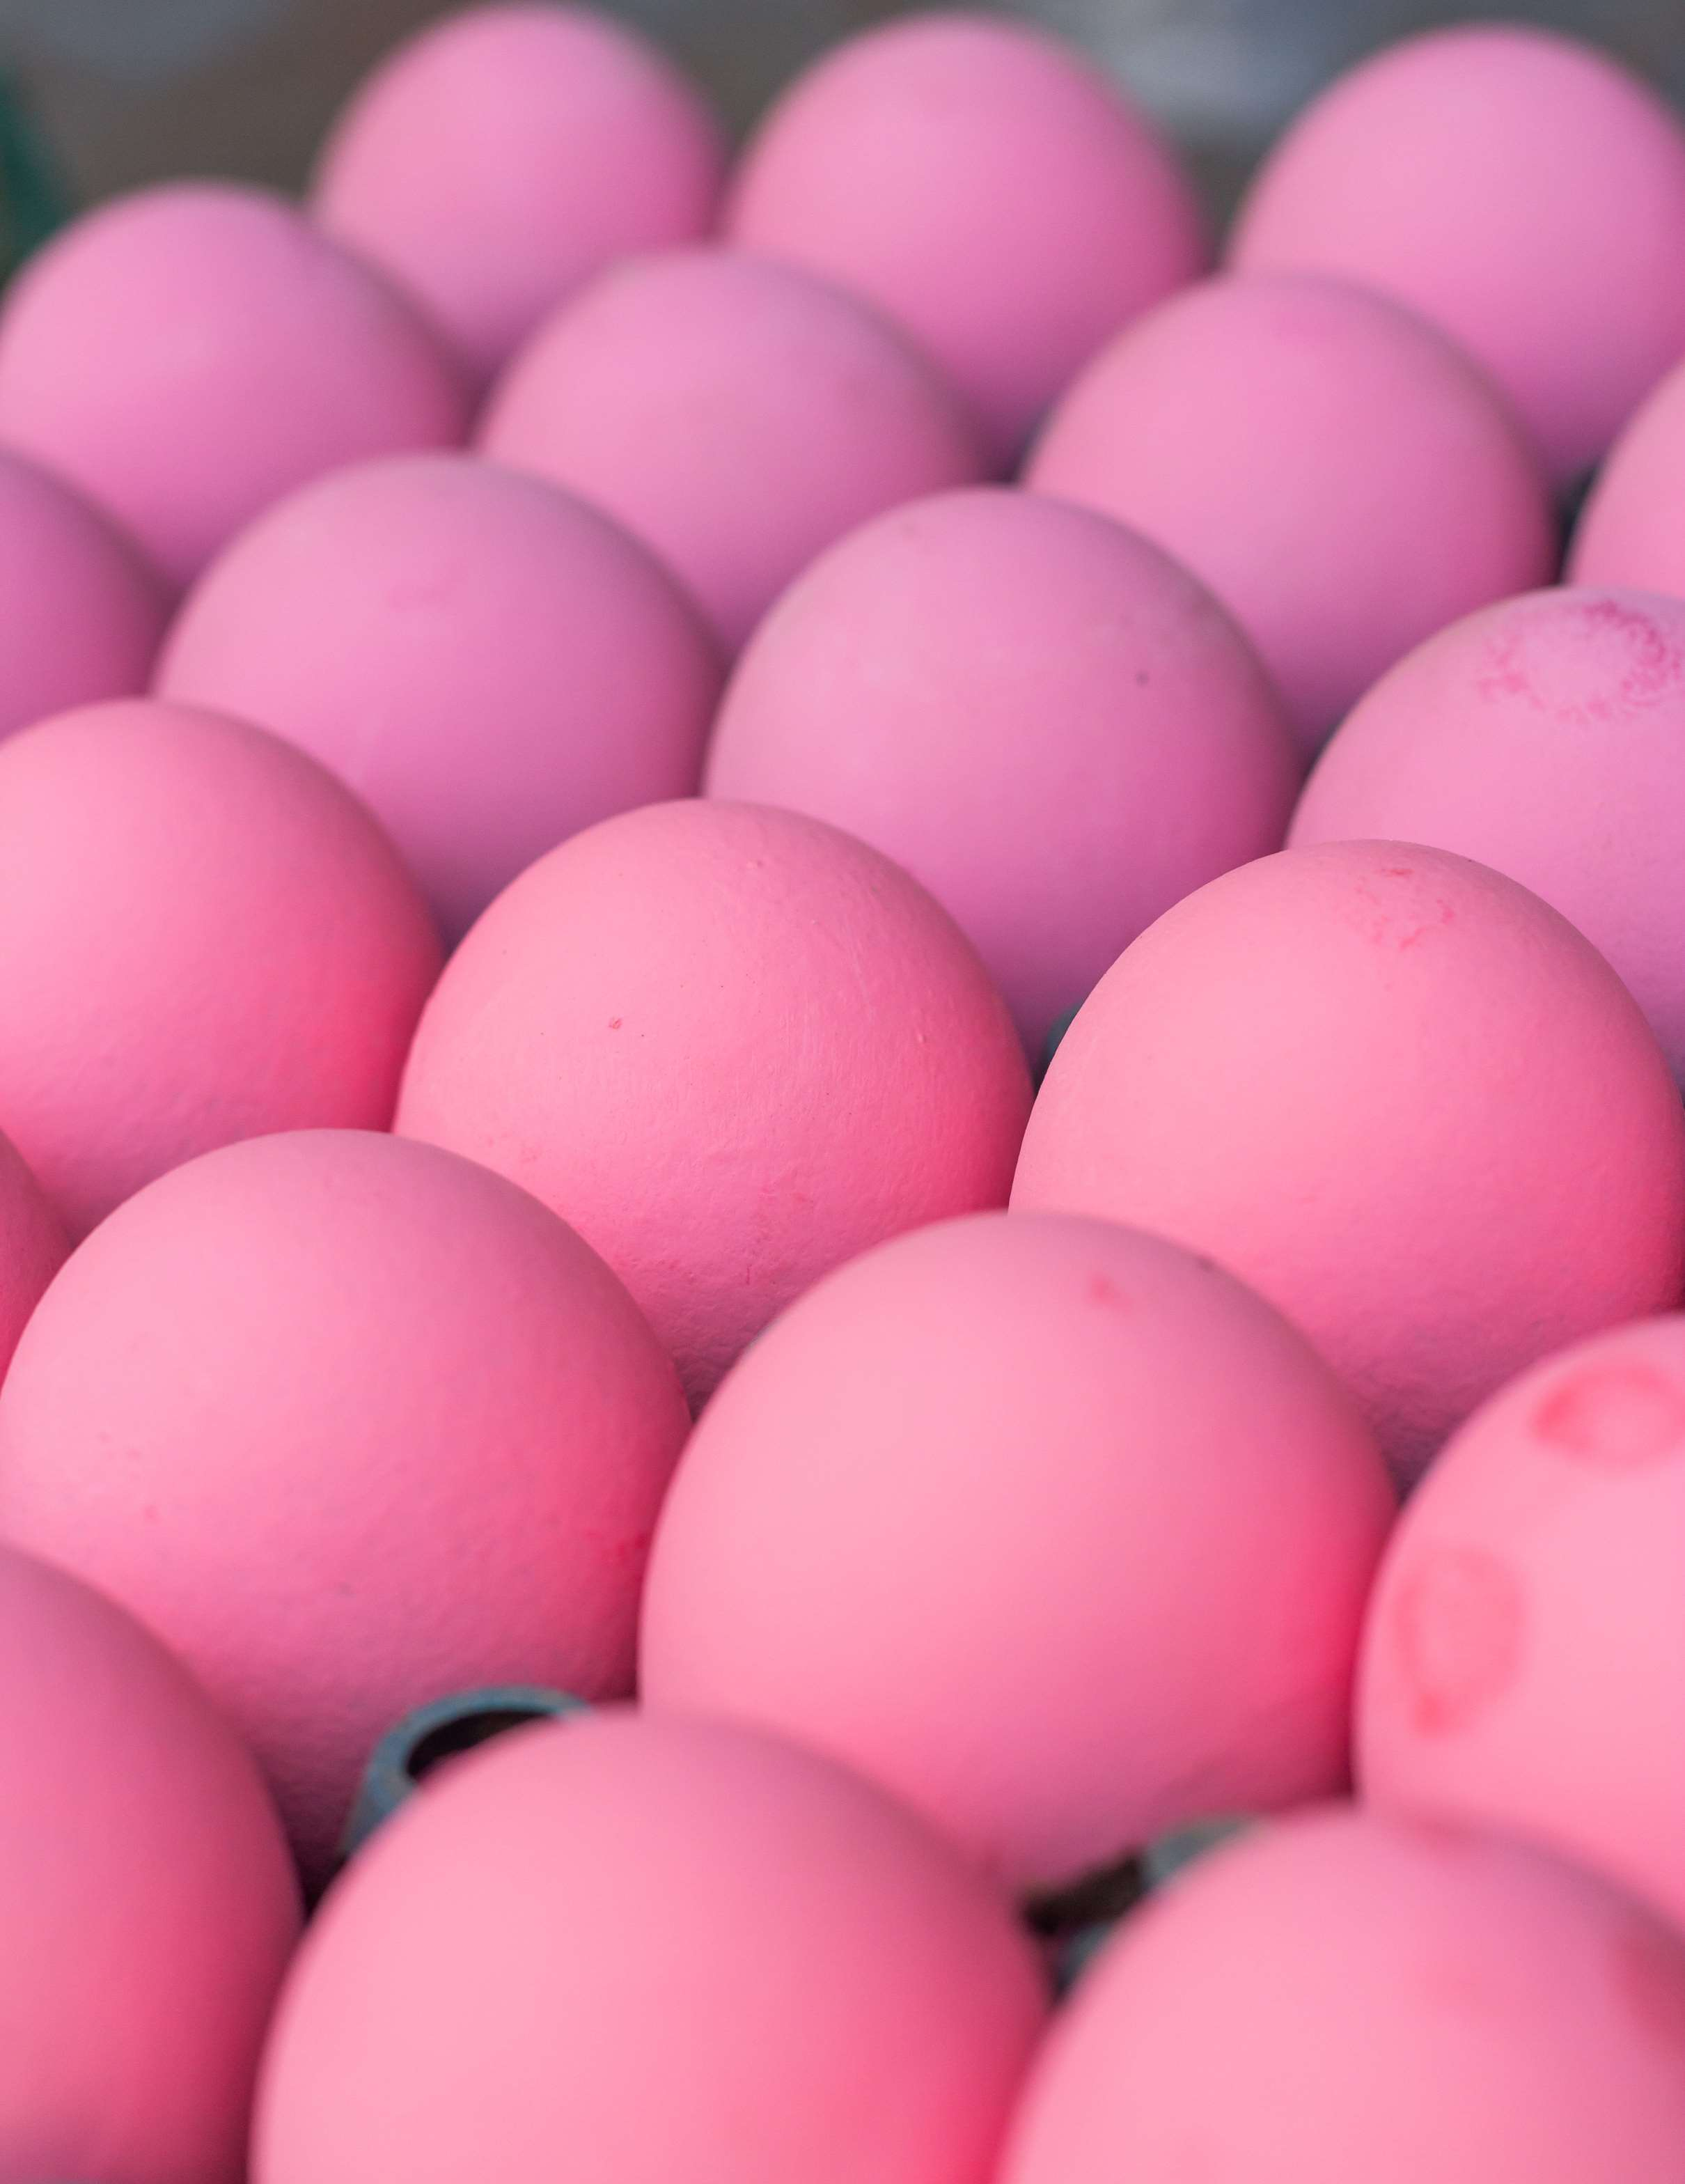

KEY INSIGHTS
CAGR
4.00%
2024- 2031

Slide 4
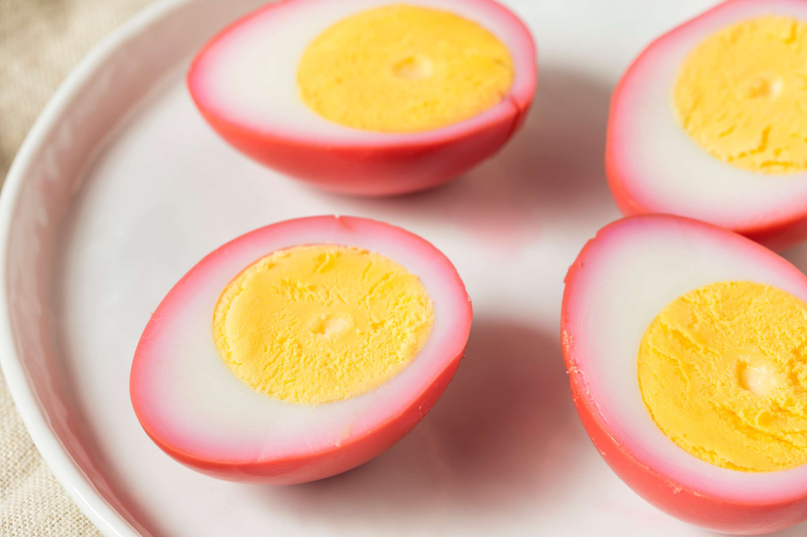
REVENUE MARKET SHARE BY SEGMENTS 2024
  Chicken Egg
  Duck Egg
  Quail Egg
Type Segment
  Supermarkets
  Convenience Stores
  Online Retail
  Specialty Stores
Distribution Channel
  Household
  Catering Enterprises
  Food Processing
Application Segment
  Pickle
  Century Egg
  Salted
Preservation Process Segment
  Glass Jar
  Plastic Container
  Vacuum Packaging
Packaging Type Segment

Slide 5

REGION ANALYSIS
NORTH AMERICA
Europe
Asia Pacific
Latin America
MIDDLE EAST AFRICA
40%
30%
23%
5%
2%
North America Preserved Egg Market Revenue share for 2024 is 40%

Slide 6

  Increasing Consumer Knowledge of Ethical Sourcing and Sustainable Food Production Globally
  Increasing Curiosity for Trying out New and Unusual Foods to Propel Market Growth
Drivers
Restraints
Worries about Potential Health Risks

Slide 7
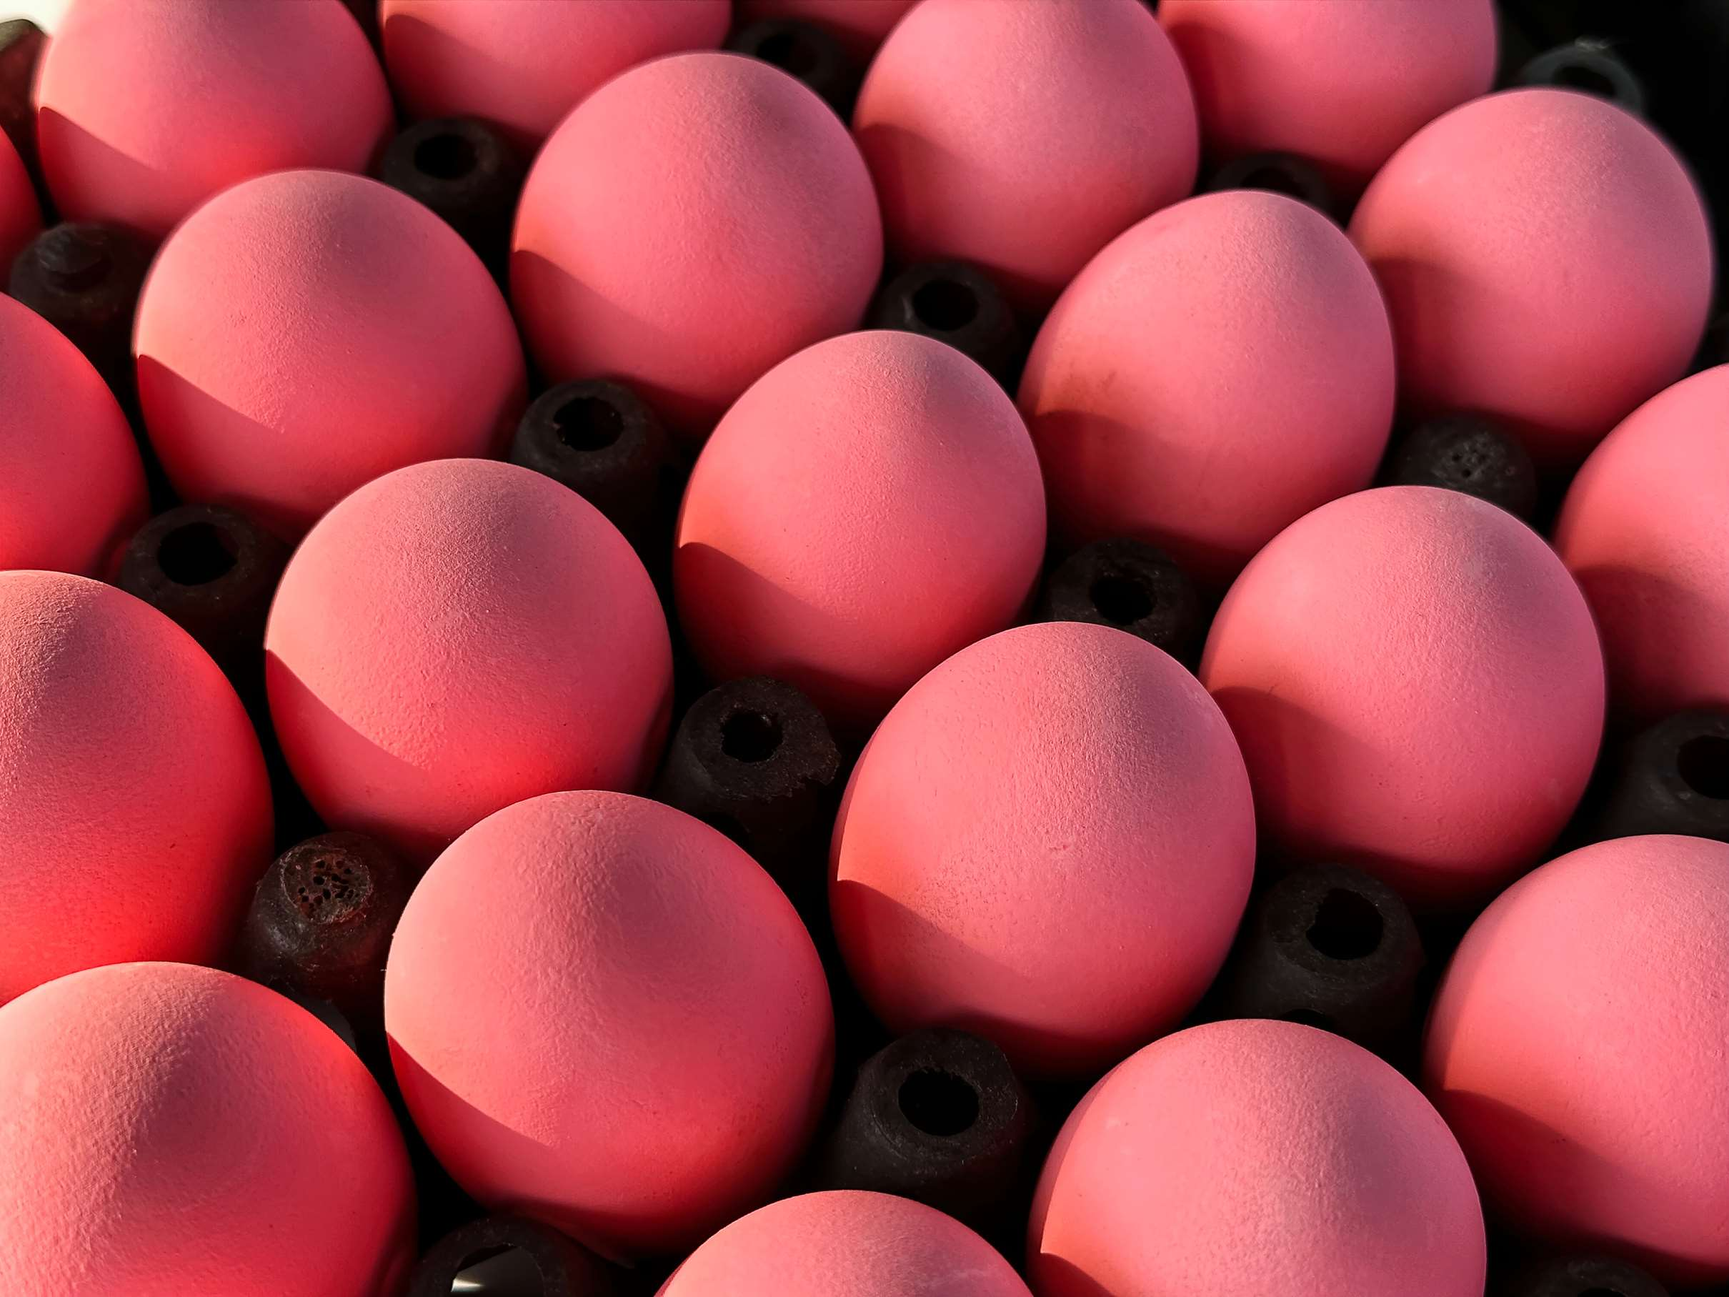
AUTHOR'S PERSPECTIVE
  The global Preserved Egg market will expand significantly by 4.00% CAGR between 2024 to 2031.
  They are widely available, well-known, and versatile enough to fit into a range of culinary techniques, preserved chicken eggs are likely seeing growth in the market. Preserved Egg, pivotal in identifying potential drug candidates, becomes indispensable tools, propelling market growth.
  The household segment dominates the market. This is because chicken eggs are widely used in homes for egg preservation and are easily obtainable, cheaply priced, and suitable for a variety of culinary purposes.

Slide 8






KEY PLAYERS

Slide 9


For Full Report
Contact us
COGNITIVE MARKET RESEARCH
Tel: +1 312-376-8303 | +44 020-8123-0732
India: (+91) 983-496-8611
sales@cognitivemarketresearch.com
Access the Full Report : https://tinyurl.com/3bujmree
Please visit our website:
https://www.cognitivemarketresearch.com

