Slide 1
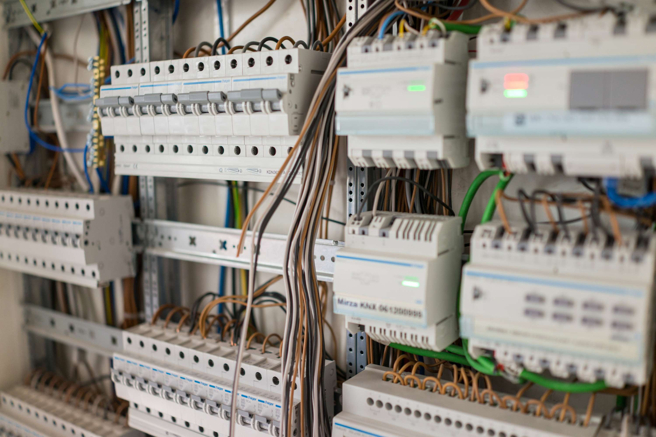
GLOBAL
POWER DISTRIBUTION CABINETS
MARKET REPORT 2024
Global,Regional,CountryAnalysis

Slide 2
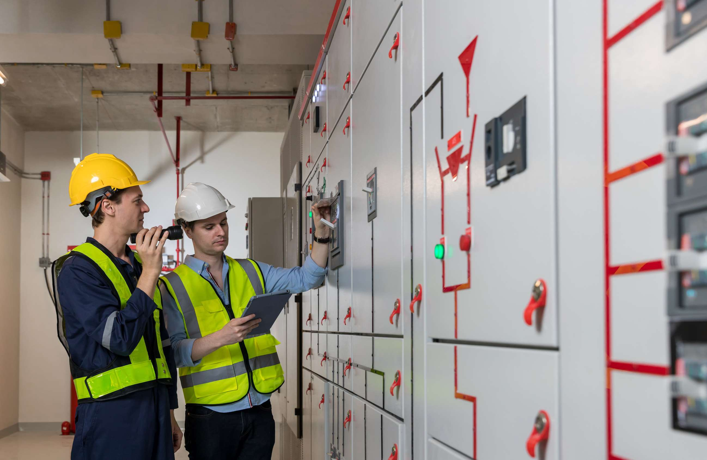
INTRODUCTION
A power distribution cabinet is a device designed to supply and redistribute electrical energy, safeguard electrical power lines, and protect overload and short circuit currents. Furthermore, when fitted with power meters, the system enables for the measurement of energy usage.

Slide 3


KEY INSIGHTS
MARKET SIZE
USD 4,489.85 Million
2022
FORECAST
USD 7,150.51 Million
2029
CAGR
6.87%
2023- 2030

Slide 4

REVENUE MARKET SHARE BY SEGMENTS 2022
Low voltage
USD 2,897.34 Million
Type analysis

Slide 5

Global Power Distribution Cabinets Market Revenue share for 2022
North America
USD 2,473.79Million

Slide 6
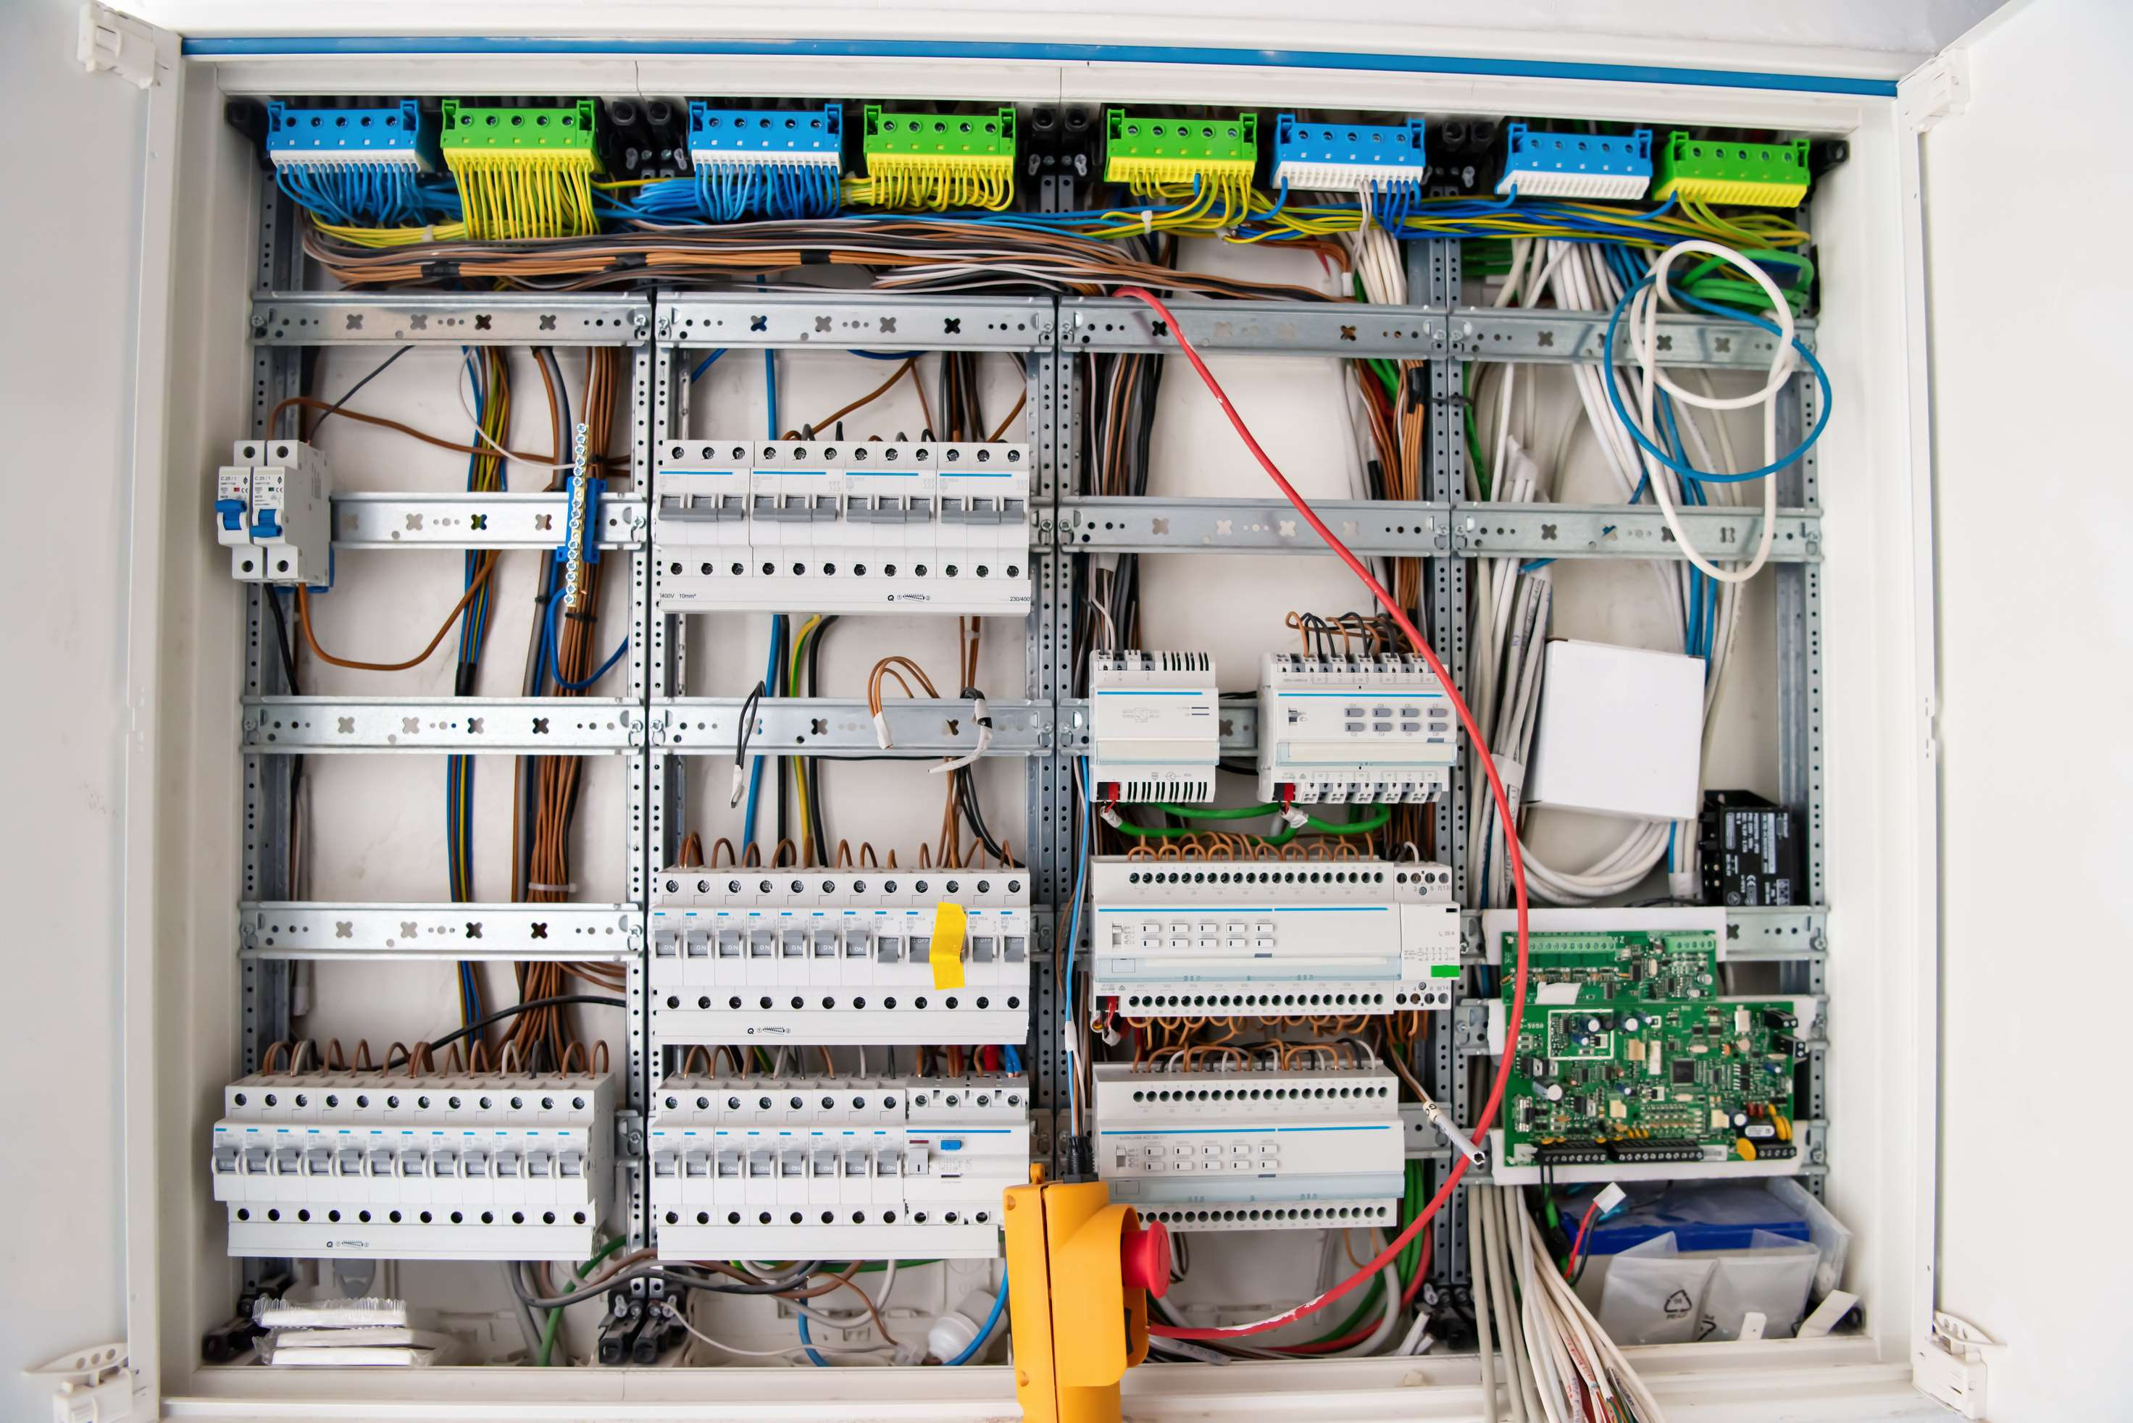
The key factors which influence the overall sales demand for Power Distribution Cabinets Industry in a positive way.
Drivers
Some of the restraining factors including strict government regulations, supply chain disruptions, and changing consumer preferences are affecting the market growth in the near future
Restraints

Slide 7

AUTHOR'S PERSPECTIVE
  The Global Power Distribution Cabinets Market revenue in 2017: USD 3,483.78 Million
  Total revenue expected in year 2029: USD 7,150.51 Million
  CAGR from 2022-2029 is expected to be: 6.87%
  Based on Type segment, the market is segmented into Low voltage, Middle voltage, and High voltage
  Low voltage held for largest share of total revenue generated in 2020

Slide 8
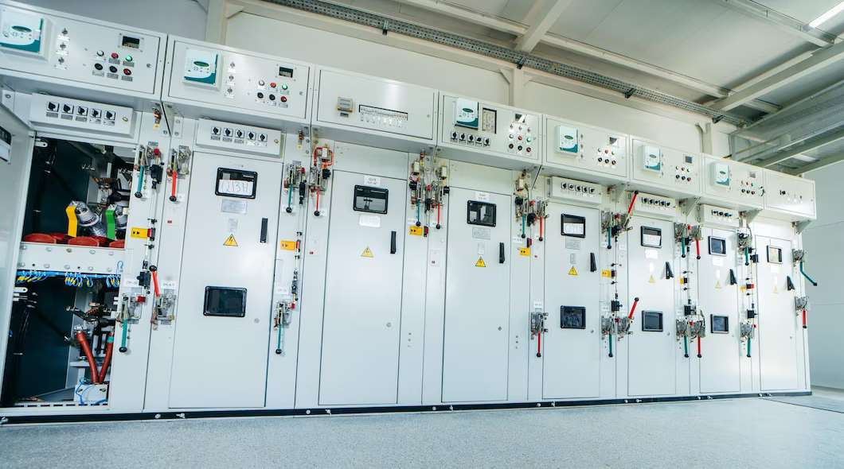










KEY PLAYERS

Slide 9


For Full Report
Contact us
COGNITIVE MARKET RESEARCH
Tel: +1 312-376-8303 | +44 020-8123-0732
India: (+91) 983-496-8611
sales@cognitivemarketresearch.com
Access the Full Report : https://tinyurl.com/muau4rsa
Please visit our website:
https://www.cognitivemarketresearch.com

