Slide 1
GLOBAL POGO STICKS
MARKET REPORT 2024
Global,Regional,CountryAnalysis

Slide 2
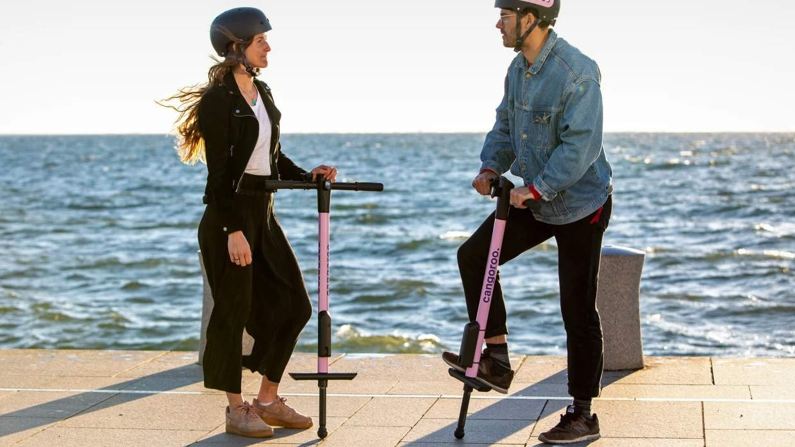
INTRODUCTION
The pogo stick market is a subset of the leisure and athletic goods business, distinguished by its distinct and ageless appeal. Pogo sticks are basic yet creative devices that allow users to bounce and leap in a fun and difficult way. They serve a wide spectrum of ages, from youngsters to adults, making them adaptable to target demographics. The market fluctuates in demand due to trends and marketing efforts, but it remains a popular choice for outdoor recreation, fitness, and skill development.
Manufacturers are constantly working to improve the design, safety, and performance of pogo sticks to attract customers looking for an energetic and exhilarating leisure experience. Pogo sticks' ongoing appeal demonstrates its enduring existence in outdoor recreation.

Slide 3


KEY INSIGHTS
CAGR 4.5%
2023
-
2030

Slide 4


REVENUE MARKET SHARE BY SEGMENTS 2022
Vurtego Flybar BowGo
Type Segment
Application Segment
Adults Children

Slide 5
Global Pogo Sticks Market Revenue share for 2022
North America 38%

Slide 6

Growing Awareness of the Health Benefits of Pogo Sticks to Propel Market Growth
Drivers
Safety Concerns to Restrict Market Growth
Restraints

Slide 7

AUTHOR'S PERSPECTIVE
The Global Pogo Sticks Market is witnessing significant growth in the near future.
Vurtego distinguishes itself by providing high-performance, customizable air-powered Pogo sticks for people of all ages and skill levels.
Vurtego's dedication to quality, safety, and customer satisfaction has helped it build a dedicated fan base, growing its footprint and contributing to the growth of the Pogo Sticks market by providing an interesting and new alternative to classic models.
Pogo sticks are a fantastic answer for parents who want to encourage physical exercise while limiting screen time.

Slide 8
KEY PLAYERS

Slide 9


Contact us
For Full Report
COGNITIVE MARKET RESEARCH
Tel: + 1 312 - 376 - 8303 | + 44 020 - 8123 - 0732
India: ( + 91 ) 983 - 496 - 8611
sales@ cognitivemarketresearch. com
Access the Full Report : http://tinyurl.com/ycfcrpdy
Please visit our website:
https://www.cognitivemarketresearch.com

