Slide 1

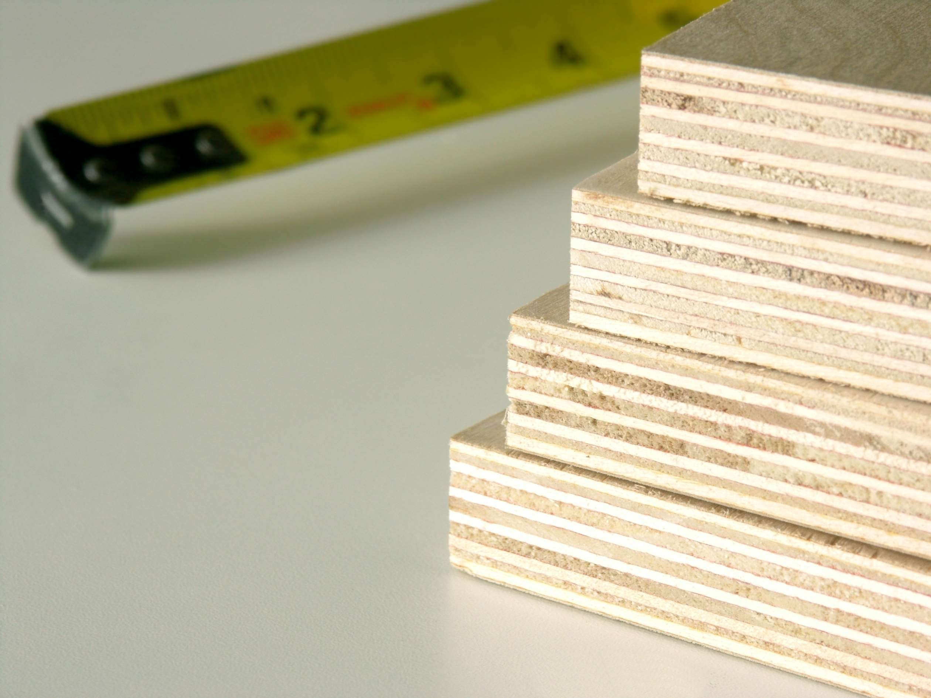
PLYWOOD
MARKET REPORT
2024
Qualitative Analysis + Quantitative Analysis

Slide 2
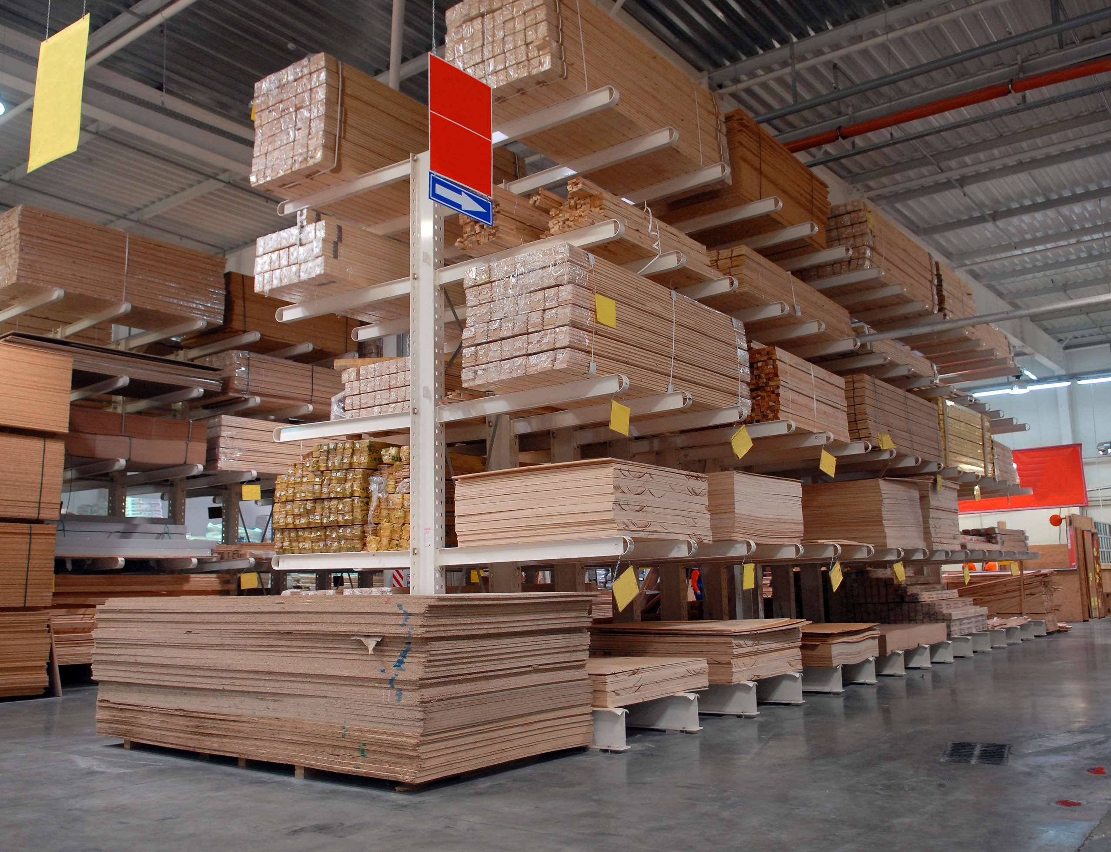
INTRODUCTION
Plywood is a versatile engineered wood product composed of thin layers of wood veneer bonded together with adhesives under high pressure and heat. This construction technique gives plywood exceptional strength, stability, and resistance to warping or twisting compared to solid wood. It is commonly used in construction, furniture making, and interior finishing due to its cost-effectiveness, durability, and ease of customization. Plywood comes in various grades and thicknesses to suit different applications, from structural support in building projects to decorative paneling. Its widespread availability and adaptability make plywood a fundamental material in the global construction and woodworking industries.

Slide 3
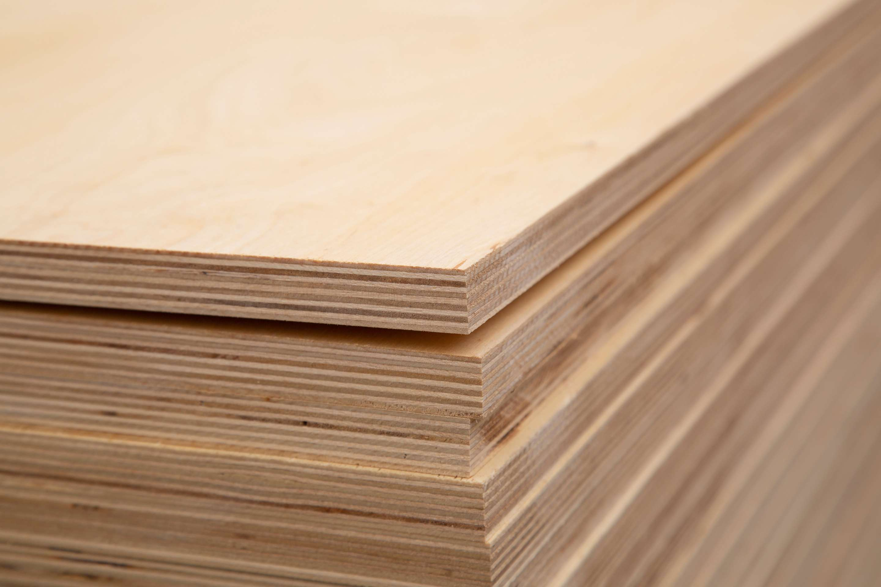

KEY INSIGHTS
MARKET SIZE
USD 55812.2 million
2024
CAGR
7.00%
2024- 2031

Slide 4
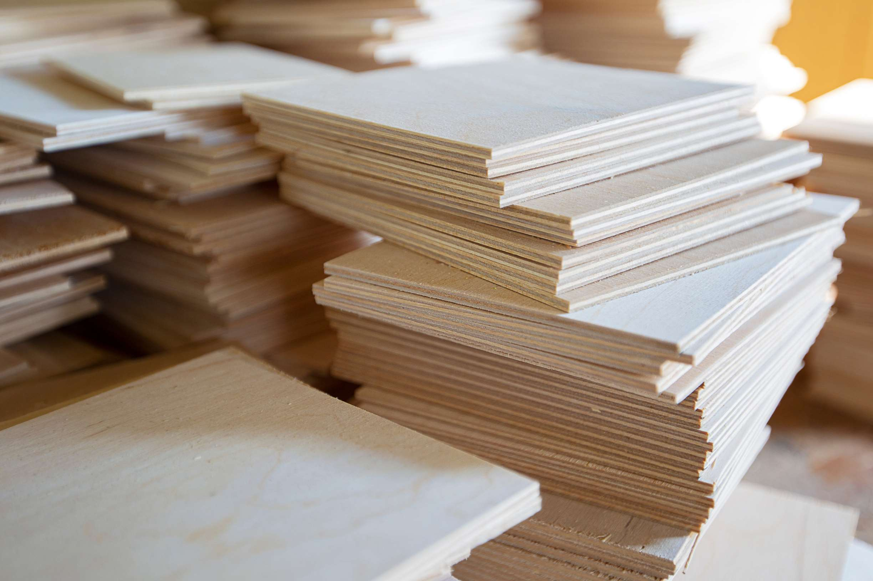
REVENUE MARKET SHARE BY SEGMENTS 2024
  3 ply
  5 ply
  7 ply
Ply Segment
  MR Grade
  BWR Grade
  Fire Resistant Grade
  BWP Grade
  Structural Grade
Grade Segment
  <8mm
  8mm-18mm
  >18mm
Thickness Segment

Slide 5

North America
40%
North America Plywood Market Revenue share for 2024 is 40%

Slide 6
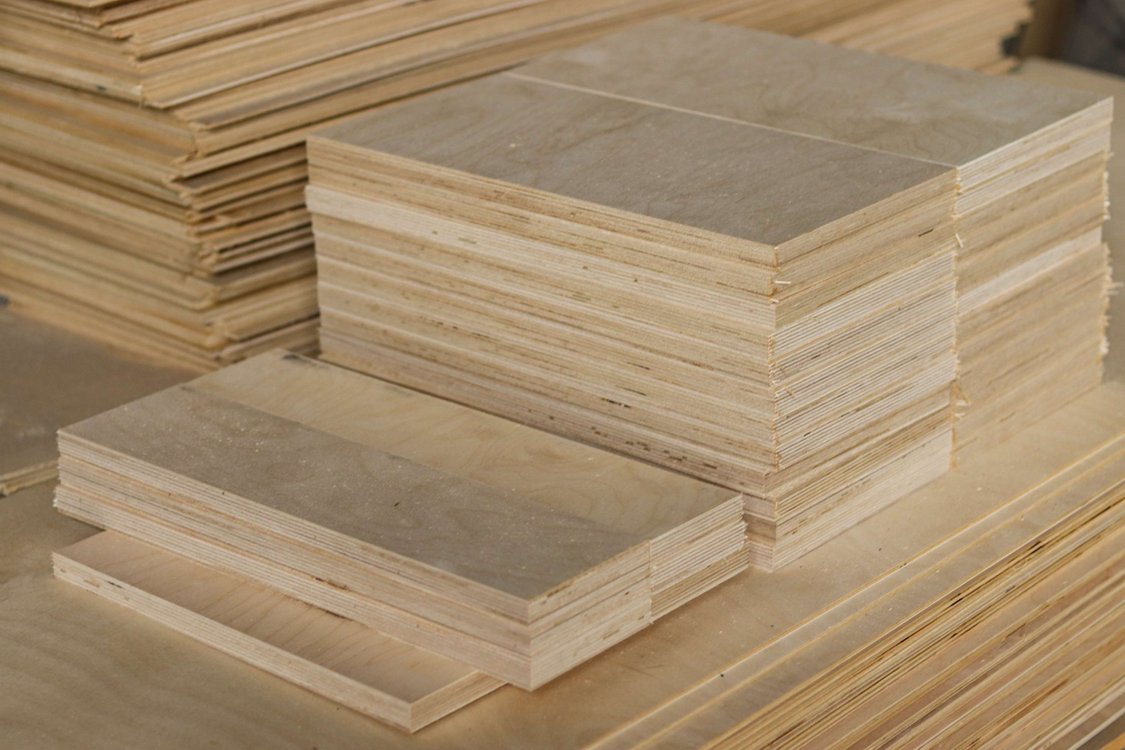
  Construction Industry Growth to Increase the Demand Globally
  Increased Demand for Furniture to Propel Market Growth
Drivers
Fluctuating Raw Material Costs to Limit the Sales
Restraints

Slide 7
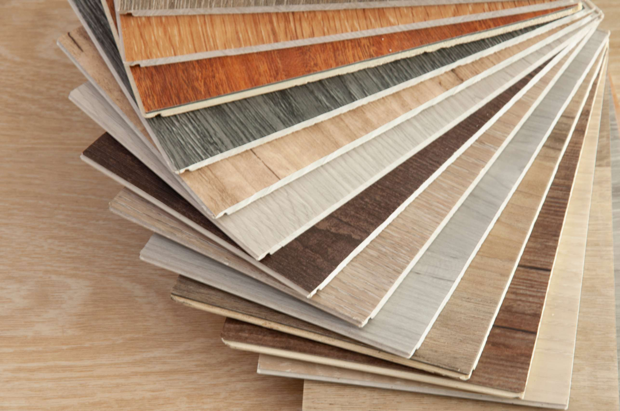
AUTHOR'S PERSPECTIVE
  The global plywood market will expand significantly by 7.00% CAGR between 2024 to 2031.
  Hardwood stands out as the dominating category due to its luxurious appearance, long-lasting durability, and high resale value. Consumers prefer hardwood for its aesthetic appeal and perceived quality, driving demand in luxury furniture and premium construction projects.
  The 3 ply is building wall as it is favored for its structural integrity and ease of installation in building wall applications.
  Its lightweight nature and standardized dimensions simplify construction processes, reducing labor costs and project timelines.

Slide 8











KEY PLAYERS

Slide 9


For Full Report
Contact us
COGNITIVE MARKET RESEARCH
Tel: +1 312-376-8303 | +44 020-8123-0732
India: (+91) 983-496-8611
sales@cognitivemarketresearch.com
Access the Full Report : https://tinyurl.com/27z7pu35
Please visit our website:
https://www.cognitivemarketresearch.com

