Slide 1
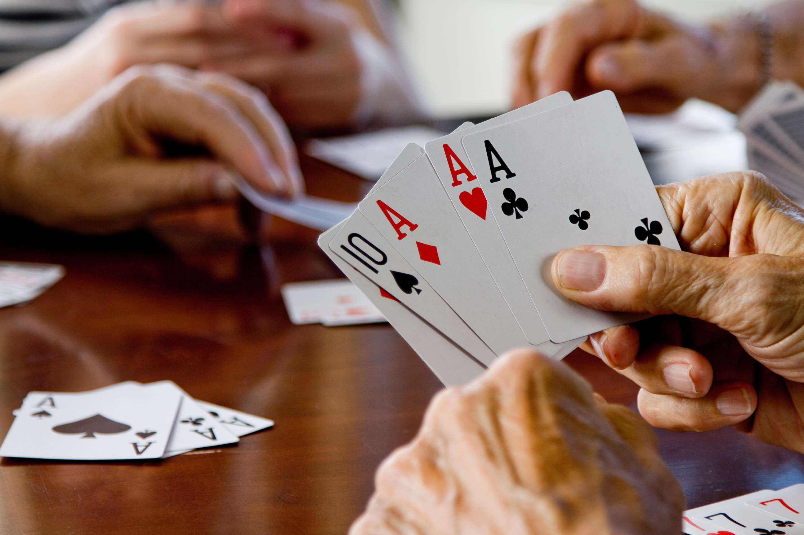
GLOBAL
PLAYING CARDS
MARKET REPORT
2024
Global,Regional,CountryAnalysis

Slide 2

INTRODUCTION
Playing card games is one of the most popular family pastimes worldwide. Playing cards and board games have many advantages, such as improved math skills and logical thinking, better mental health, help with concentration, patience and discipline, relaxation and unwinding, improved personal development, and how to cope with losing. Rise in many game bars & cafes, growth in the popularity of such games among the young population, and increase in crowdfunding platforms for designers & manufacturers.Increased popularity and number of live casinos helped expand the Chinese playing cards & board games market.

Slide 3


KEY INSIGHTS
MARKET SIZE
USD 5.9 billion
2023
CAGR
3%
2023- 2030

Slide 4

REVENUE MARKET SHARE BY SEGMENTS 2022
  Cardboard
  Plastic Coated Paper
  Cotton Paper Blend
  Plastic
Type Segment
  Online
  Offline
Distribution Channel
  Home Entertainment
  Casino
  Others
Application Segment
End-User Segment
  Adult
  Children
  Traditional
  Custom
  Collectible
Product Industry

Slide 5

Global Playing Cards Market Revenue share for 2024
North America
38%

Slide 6
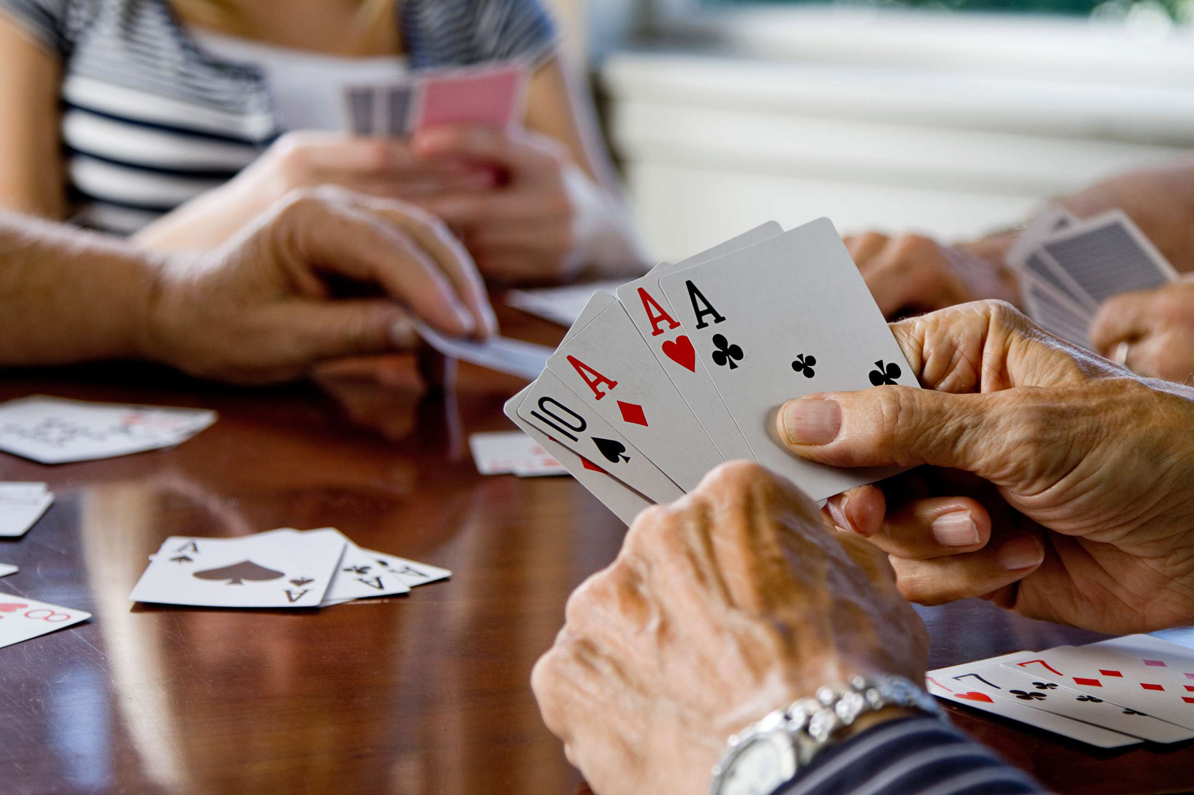
Escalating Influence of Social Media to Propel Market Growth
Drivers
Increasing Tariffs and the Emergence of New Manufacturing Hubs Hinder Market Growth.
Restraints

Slide 7

AUTHOR'S PERSPECTIVE
  The Global Playing Cards Market is witnessing significant growth in the near future.
  Plastic-coated paper cards are favored in professional gaming environments, such as casinos and tournaments, where the cards are subjected to frequent use and demand higher quality standards.
  Families often engage in card games like Uno, Go Fish, or Crazy Eights, creating an enjoyable bonding experience.
  Casinos often prefer specialized decks with features like security measures to prevent cheating and maintain fairness.
  Custom playing cards offer a canvas for creativity, enabling businesses and individuals to imprint their logos, artwork, or messages, thus serving aseffective marketing tools or cherished mementos.
  Card games provide children valuable learning experiences, including cognitive skills, numeracy, and social interaction.

Slide 8









KEY PLAYERS

Slide 9


For Full Report
Contact us
COGNITIVE MARKET RESEARCH
Tel: +1 312-376-8303 | +44 020-8123-0732
India: (+91) 983-496-8611
sales@cognitivemarketresearch.com
Access the Full Report : https://tinyurl.com/2yn722wp
Please visit our website:
https://www.cognitivemarketresearch.com

