Slide 1
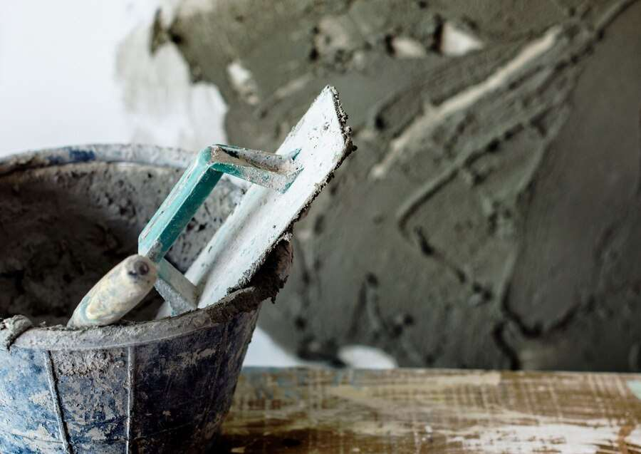
GLOBAL
PLASTER MORTAR
MARKET REPORT 2024
Global,Regional,CountryAnalysis

Slide 2
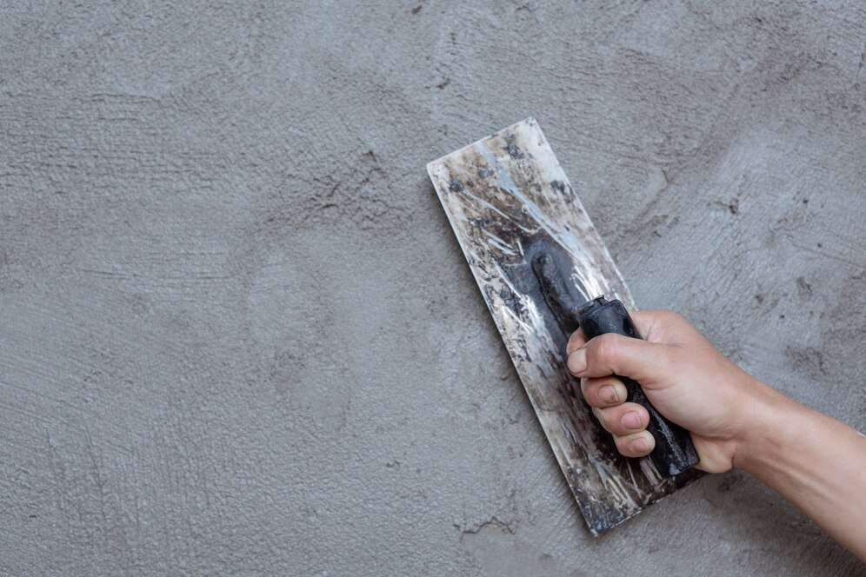
INTRODUCTION
Mortar is a binding agent, which is made by mixing cement and fine aggregates such as sand, or sawdust with water. Mortar is used to bind different building blocks like bricks, and stones. Mortar adds a decorative pattern in the construction of buildings or other structures.

Slide 3
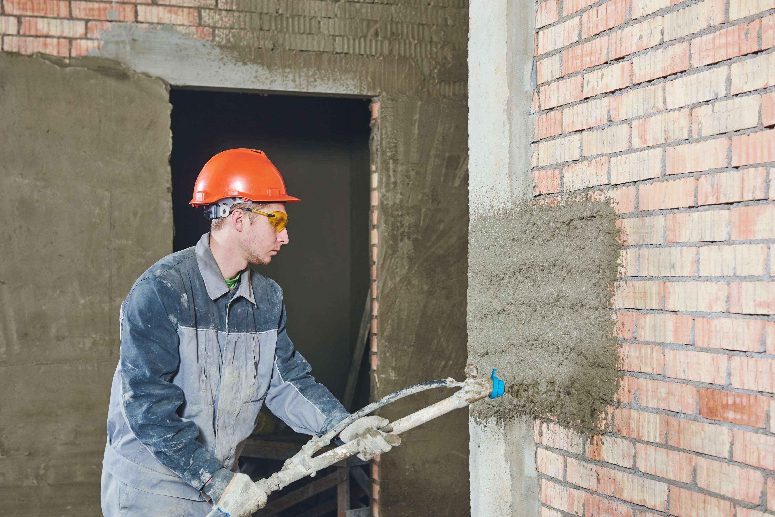

KEY INSIGHTS
MARKET SIZE
USD 10,543.97 Million
2029
CAGR
6.72%
2023- 2030

Slide 4
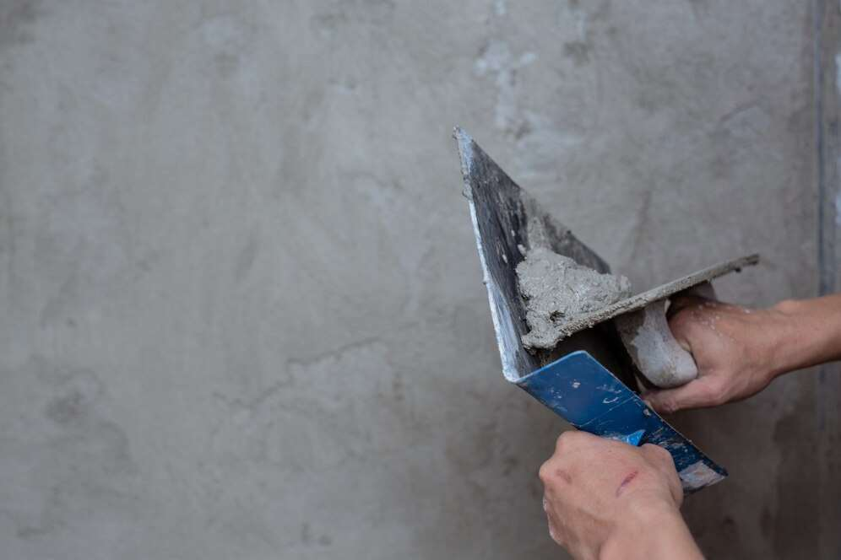
REVENUE MARKET SHARE BY SEGMENTS 2022
Premixed Mounting Mortars
USD 3,467.71 Million
By Type
Construction Industry
USD 5,528.63 Million
By Application

Slide 5
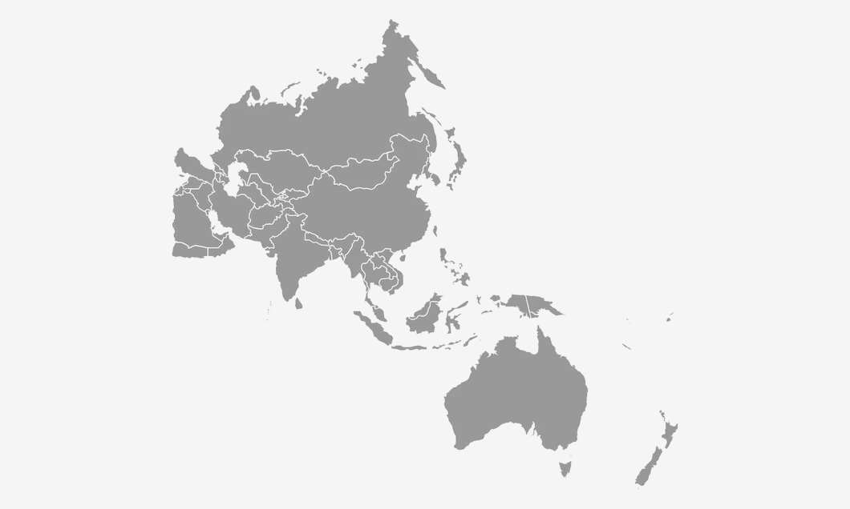
Global Plaster Mortar Market Revenue share for 2022
Asia Pacific
USD 3,351.93 Million

Slide 6
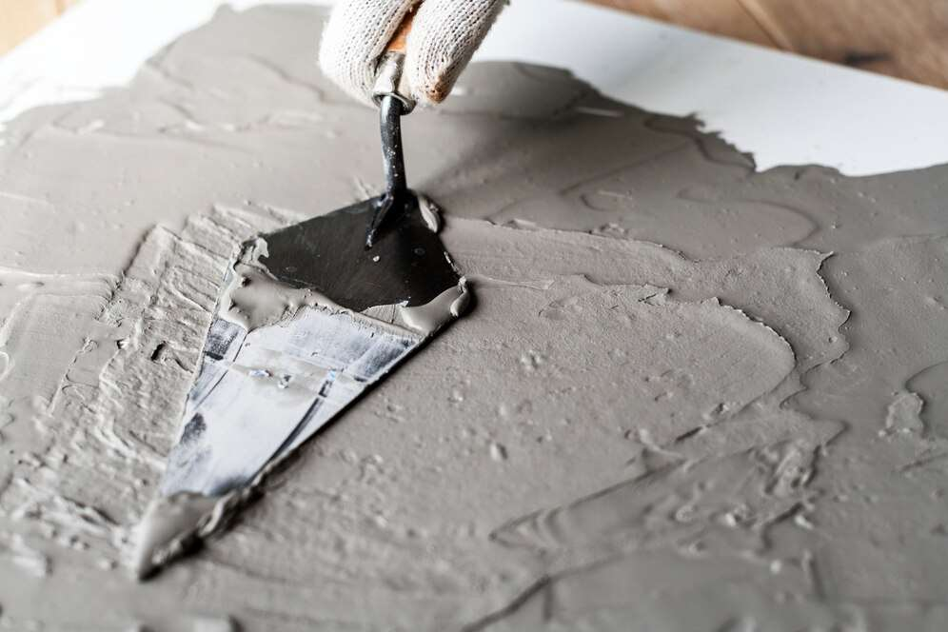
Rising building & construction industry
Drivers
Fluctuation and inconsistency in raw material prices
Restraints

Slide 7
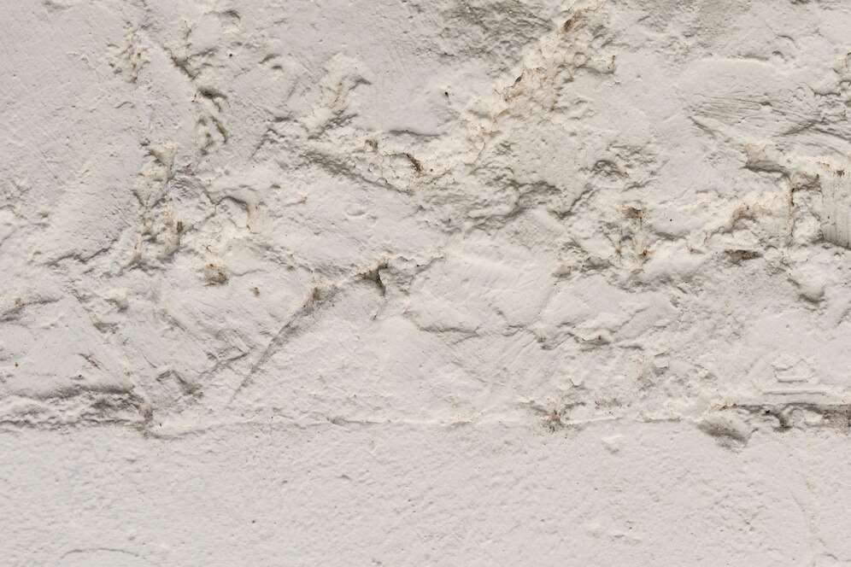
AUTHOR'S PERSPECTIVE
  Global Plaster Mortar Market Report 2023 talks about crucial market insights with the help of segments and sub-segments analysis.
  Premixed Mounting Mortar is a mixture of cement, graded sand and additives for improved workability, better bonding and for water retention.
  Plaster mortars are widely used in construction industry for joining stones, bricks, blocks and for rendering it on the interior & exterior wall surfaces & ceiling of the buildings, houses and others.
  Plaster mortars are used in home decoration industry for decorating internal walls and ceilings.

Slide 8
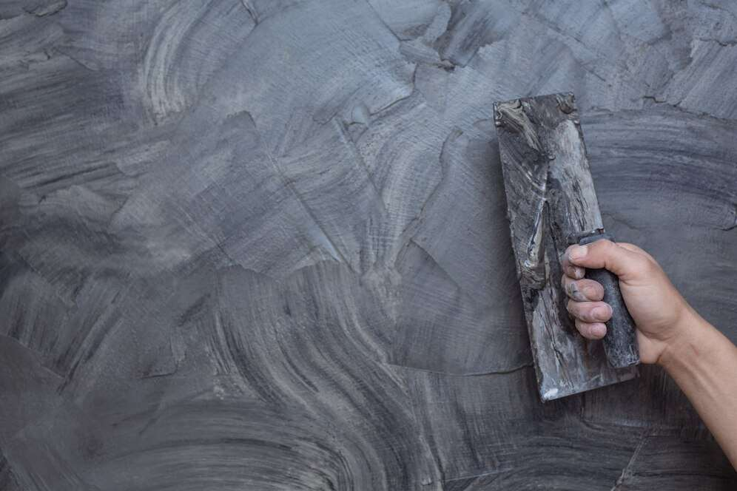



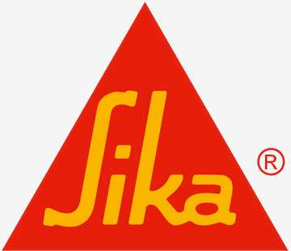





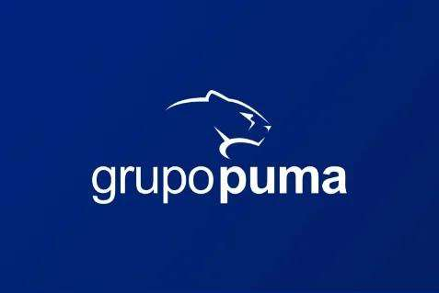


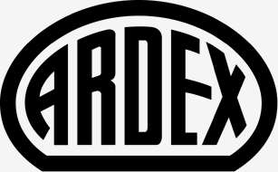

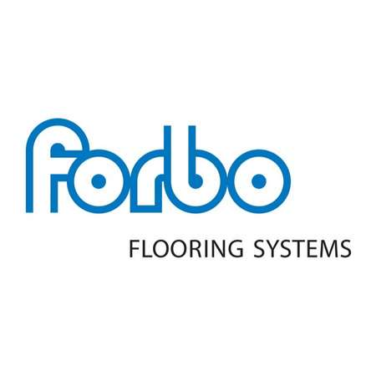
KEY PLAYERS

Slide 9


For Full Report
Contact us
COGNITIVE MARKET RESEARCH
Tel: +1 312-376-8303 | +44 020-8123-0732
India: (+91) 983-496-8611
sales@cognitivemarketresearch.com
Access the Full Report : https://tinyurl.com/yc87e2da
Please visit our website:
https://www.cognitivemarketresearch.com

