Slide 1


PLANT EXTRACT
MARKET REPORT
2024
Qualitative Analysis + Quantitative Analysis

Slide 2
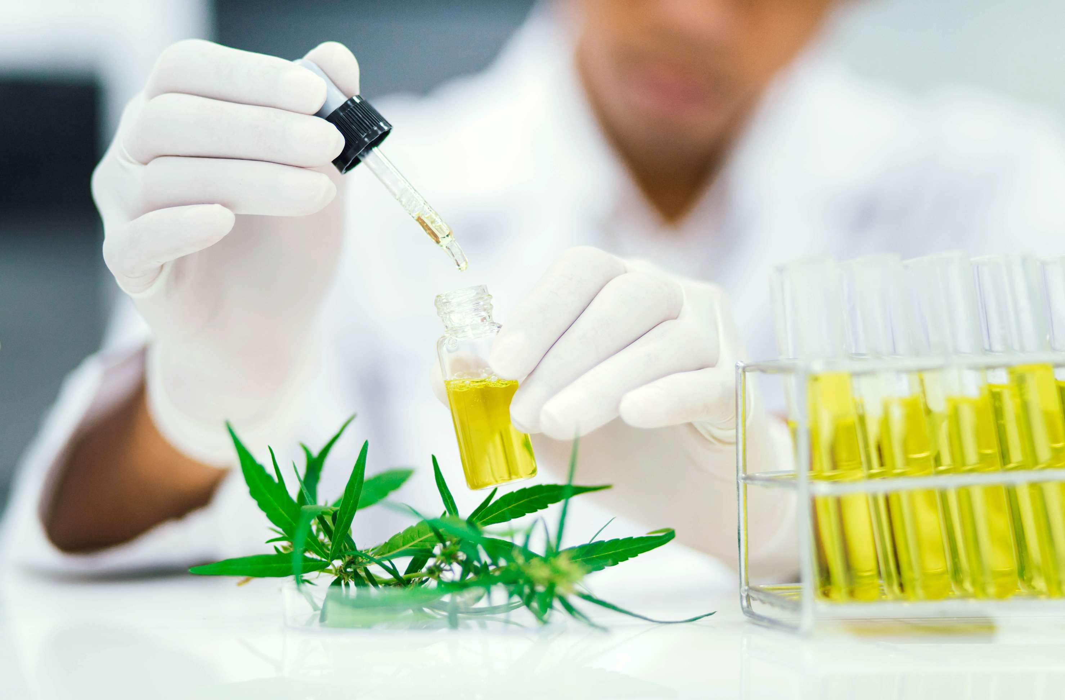
INTRODUCTION
The Plant extract market encompasses the trade, manufacturing, and utilization of focused materials derived from botanical sources. These extracts incorporate bioactive compounds consisting of phytochemicals, important oils, and antioxidants acquired through various extraction methods like solvent extraction, steam distillation, and cold pressing. Plant extracts are located in big packages across various industries, such as pharmaceuticals, meals and liquids, cosmetics, and nutraceuticals. They are valued for their therapeutic residences, flavoring and coloring competencies, and purposeful attributes, which include antimicrobial and antioxidant homes.

Slide 3
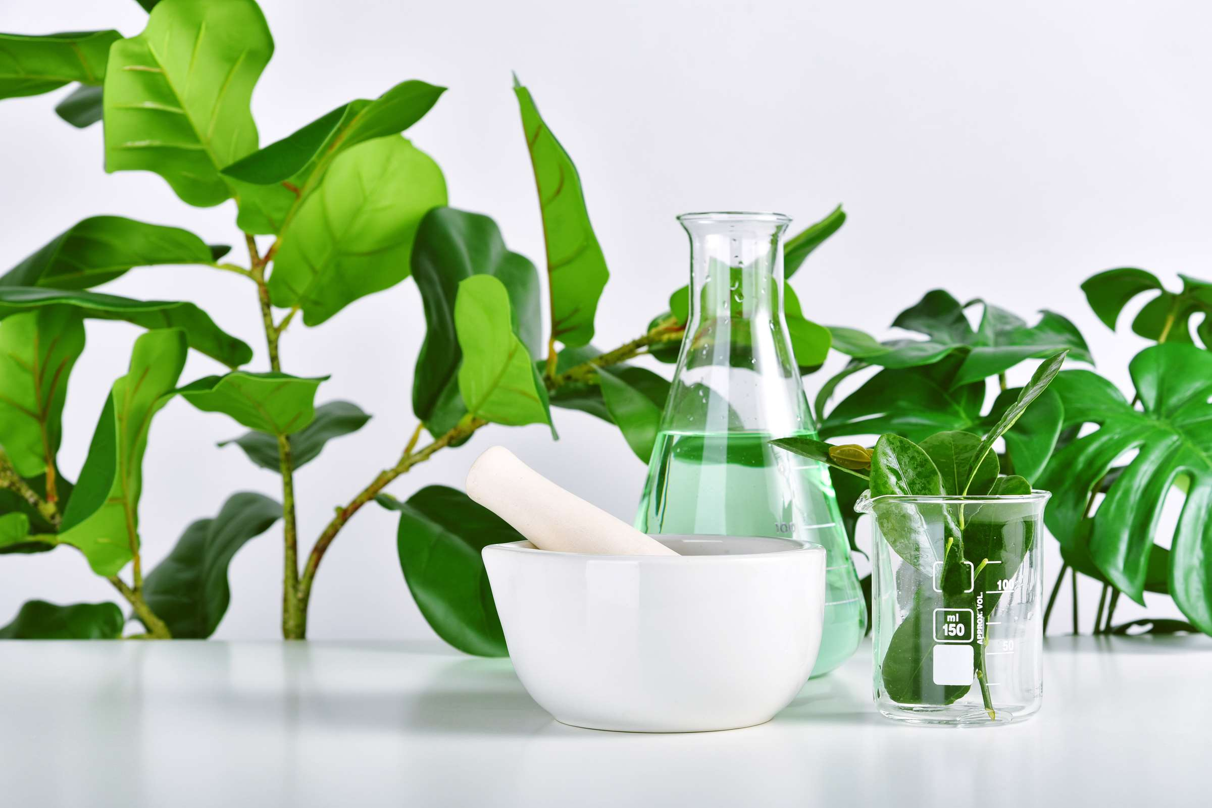

KEY INSIGHTS
MARKET SIZE
USD 35125.2 million
2024
CAGR
11.00%
2024- 2031

Slide 4

REVENUE MARKET SHARE BY SEGMENTS 2024
Product Segment
  Oleoresins
  Essential oils
  Powder
  Liquid
Form Segment
  Medicinal & dietary supplements
  food and beverage industry
Application Segment
  Maceration
  Infusion
  Decoction
  Percolation
  Soxhlet
  Fruits
  Flowers and bulbs
  Leaves
  Barks & stems
  Rhizomes & roots
Method Segment
Source Segment Analysis

Slide 5

REGION ANALYSIS
NORTH AMERICA
Europe
Asia Pacific
Latin America
MIDDLE EAST AFRICA
40%
30%
23%
5%
2%
North America Plant Extract Market Revenue share for 2024 is 40%

Slide 6
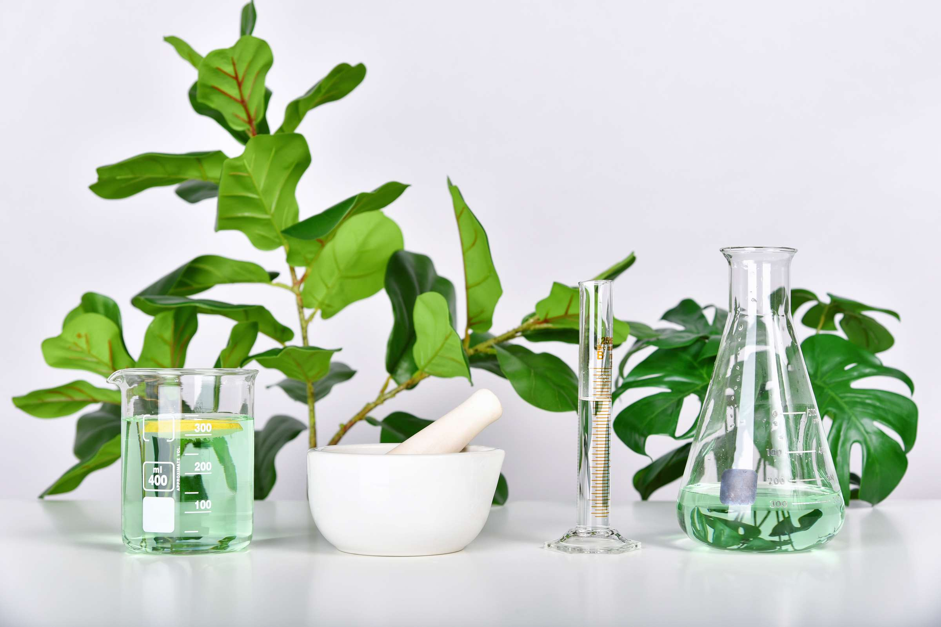
  Technological Advancements in Extraction Techniques and Processing Methods Improve the Efficiency
  Increasing Consumer Awareness Towards Health and Wellness Drives the Demand for Plant Extracts
Drivers
Limitations in Extraction Technologies and Processing Methods may Hinder the Efficiency
Restraints

Slide 7
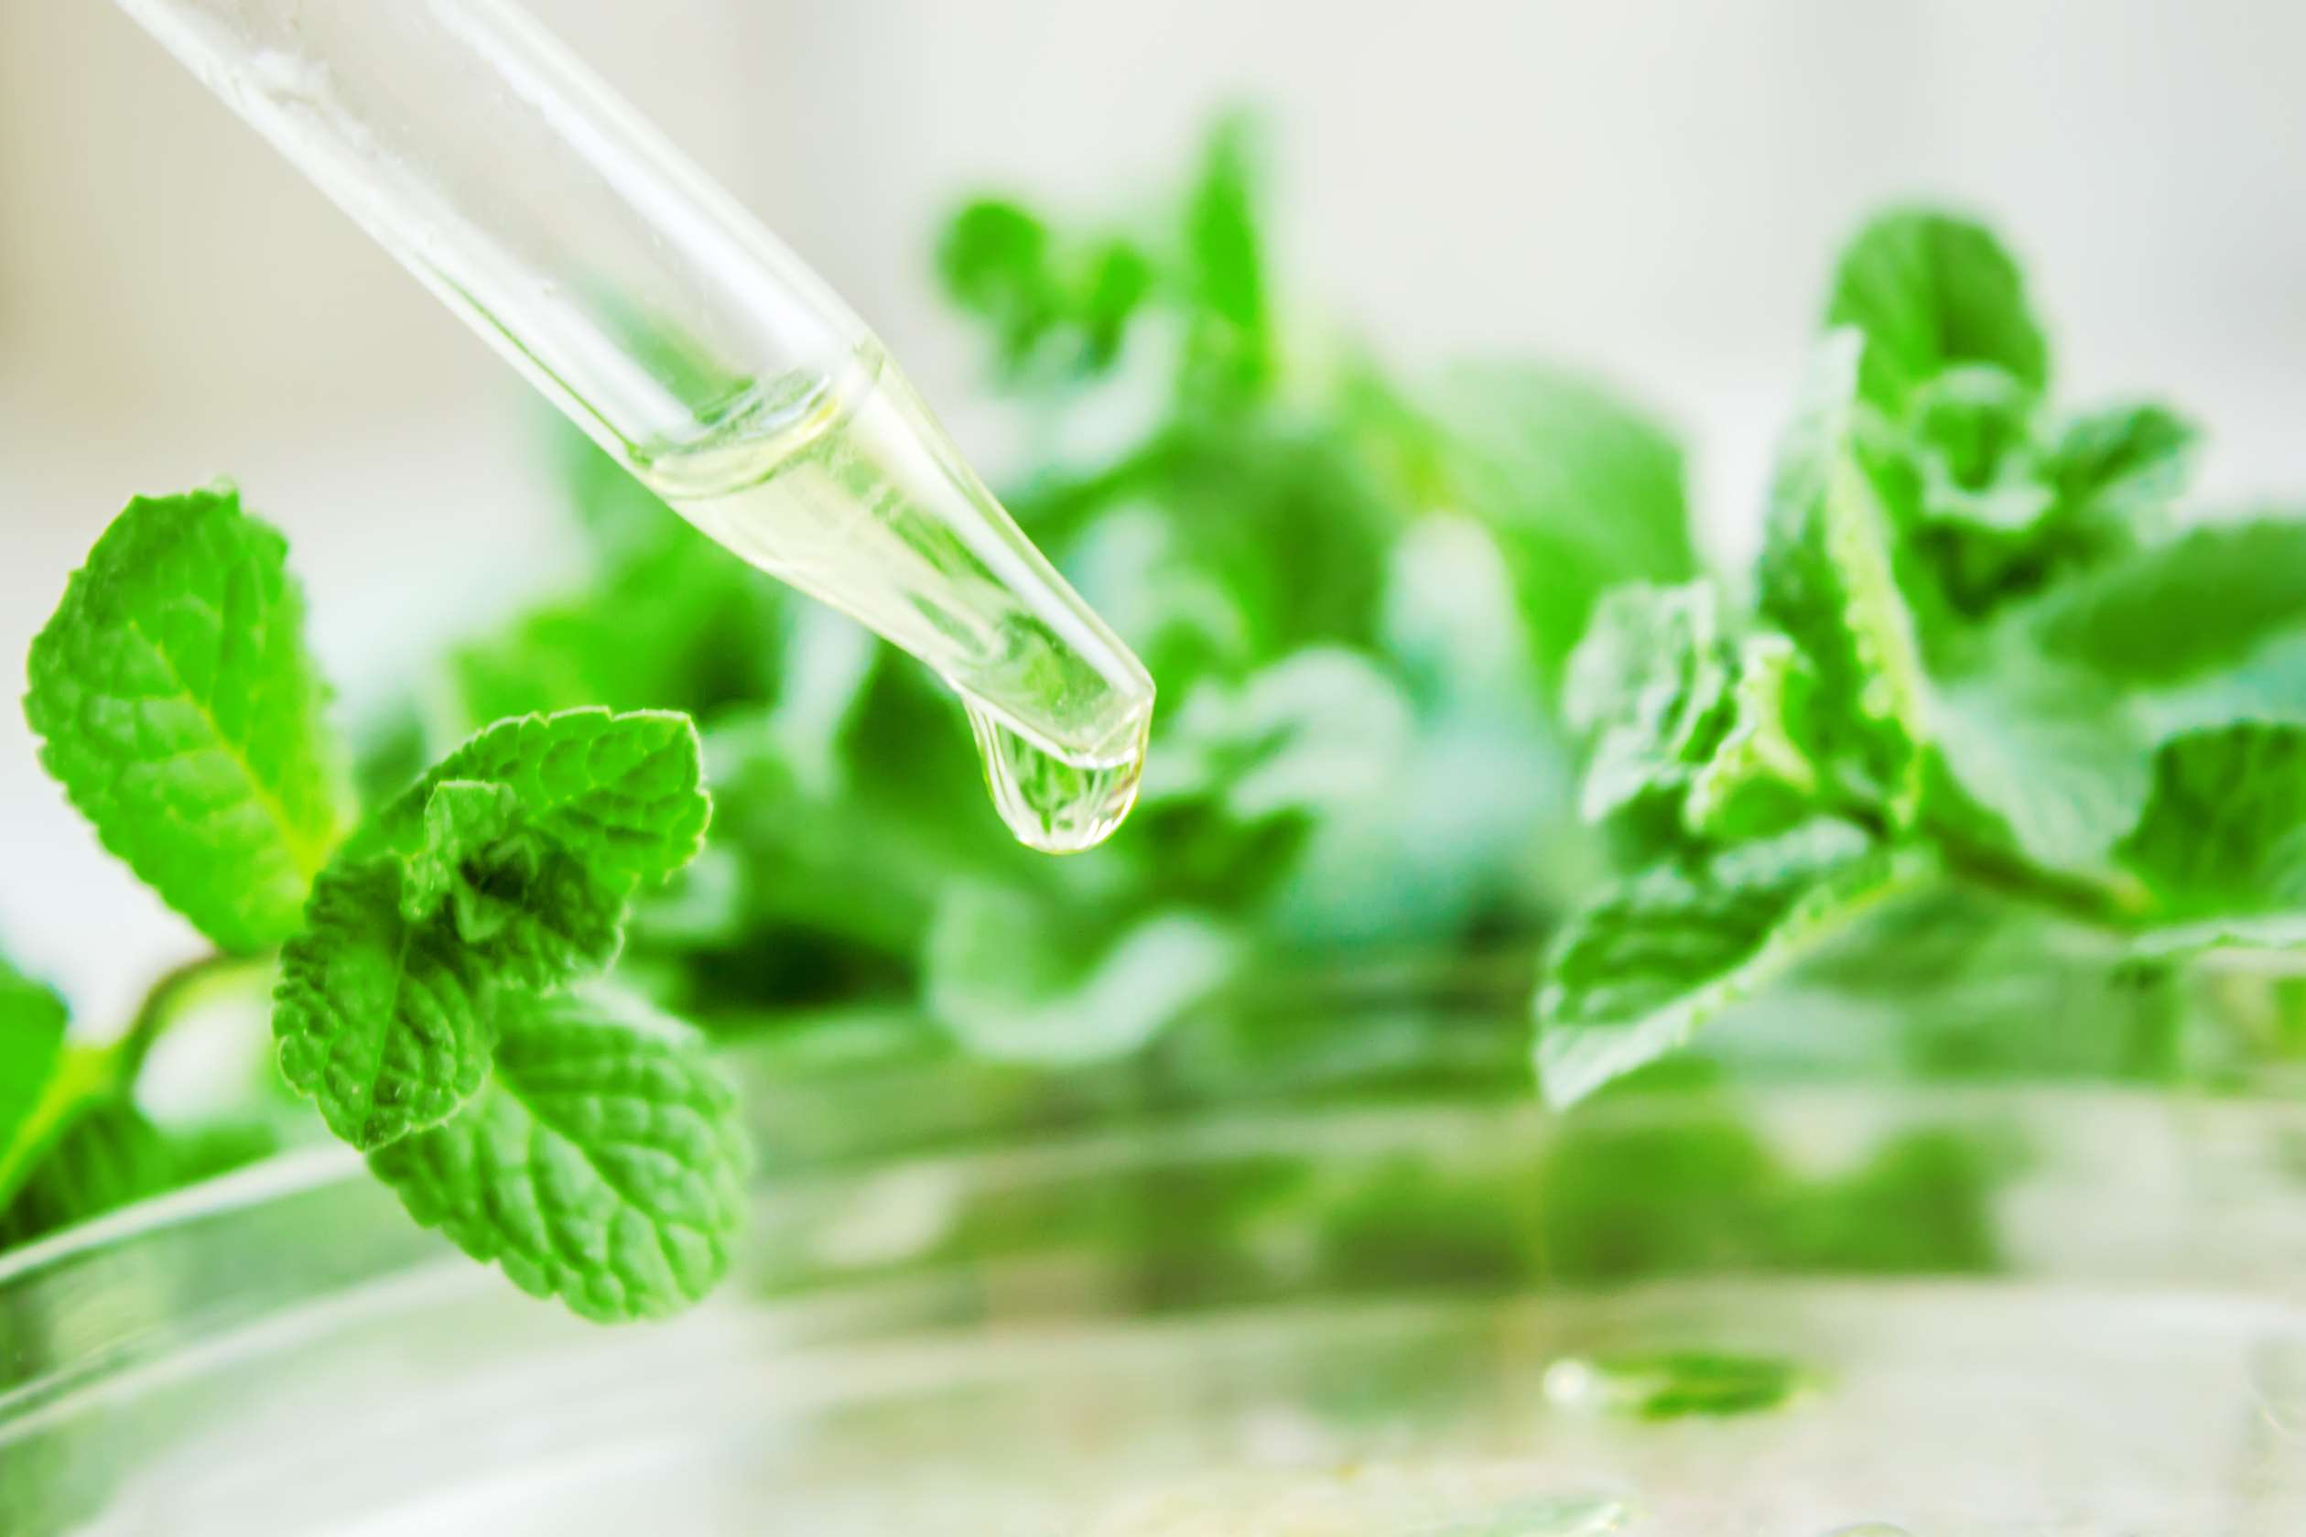
AUTHOR'S PERSPECTIVE
  The global Plant Extract Market will expand significantly by 11.00% CAGR between 2024 to 2031.
  There is rising awareness about health and wellness, expanding applications in pharmaceuticals and cosmetics, advancements in extraction technologies, and growing research and development initiatives.
  In the food and beverage segment, plant ingredients act as natural flavor enhancers, colorants, and active ingredients to meet the growing demand for cleaner labels.
  Consumers want healthy and natural choices, and botanical extracts that enhance the flavor, texture, and nutritional value of various foods and formulated beverages provide solutions.

Slide 8


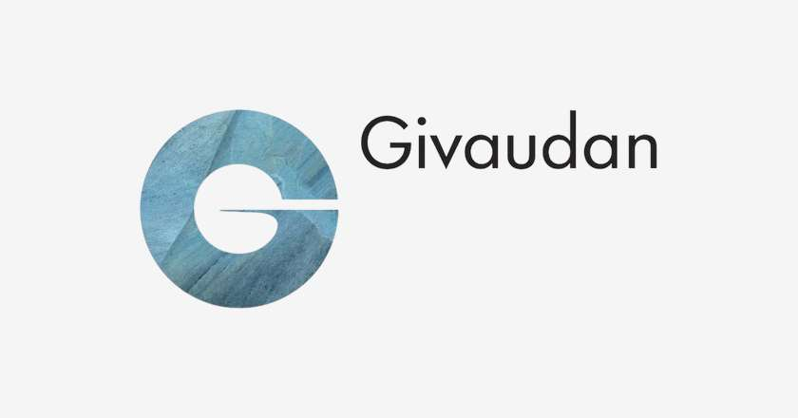





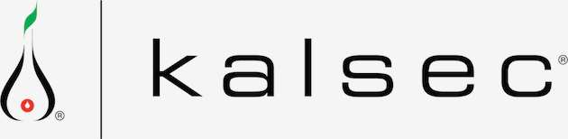
KEY PLAYERS

Slide 9


For Full Report
Contact us
COGNITIVE MARKET RESEARCH
Tel: +1 312-376-8303 | +44 020-8123-0732
India: (+91) 983-496-8611
sales@cognitivemarketresearch.com
Access the Full Report : https://tinyurl.com/4ztjcy4k
Please visit our website:
https://www.cognitivemarketresearch.com

