Slide 1
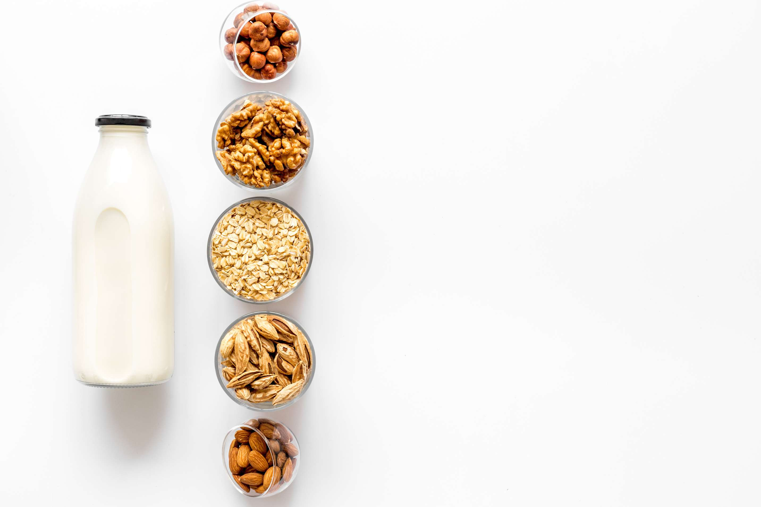

PLANT BASED MILK
MARKET REPORT
2024
Qualitative Analysis + Quantitative Analysis

Slide 2
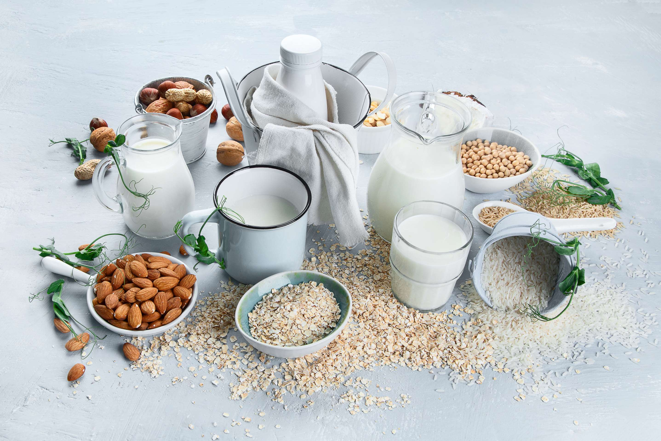
INTRODUCTION
The plant-based milk market has emerged as a dynamic and rapidly growing segment within the broader food and beverage industry. Fueled by increasing consumer awareness of health, environmental, and ethical considerations, plant-based milk alternatives have gained popularity as viable substitutes for traditional dairy milk. With a diverse array of options, including soy, almond, oat, coconut, and others, the market offers choices to cater to various dietary preferences and requirements, from vegan and lactose-free diets to gluten-free and nut-free alternatives.

Slide 3

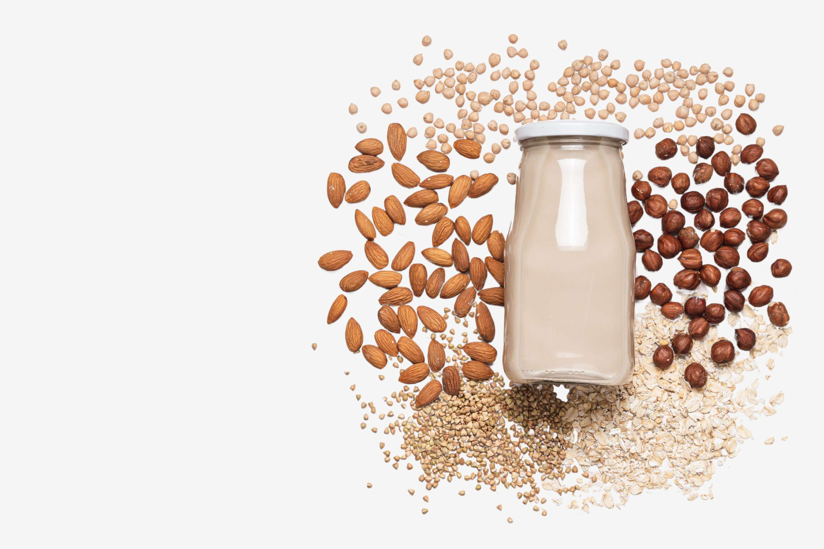

KEY INSIGHTS
MARKET SIZE
USD 3151.2 million
2024
CAGR
11.00%
2024- 2031

Slide 4
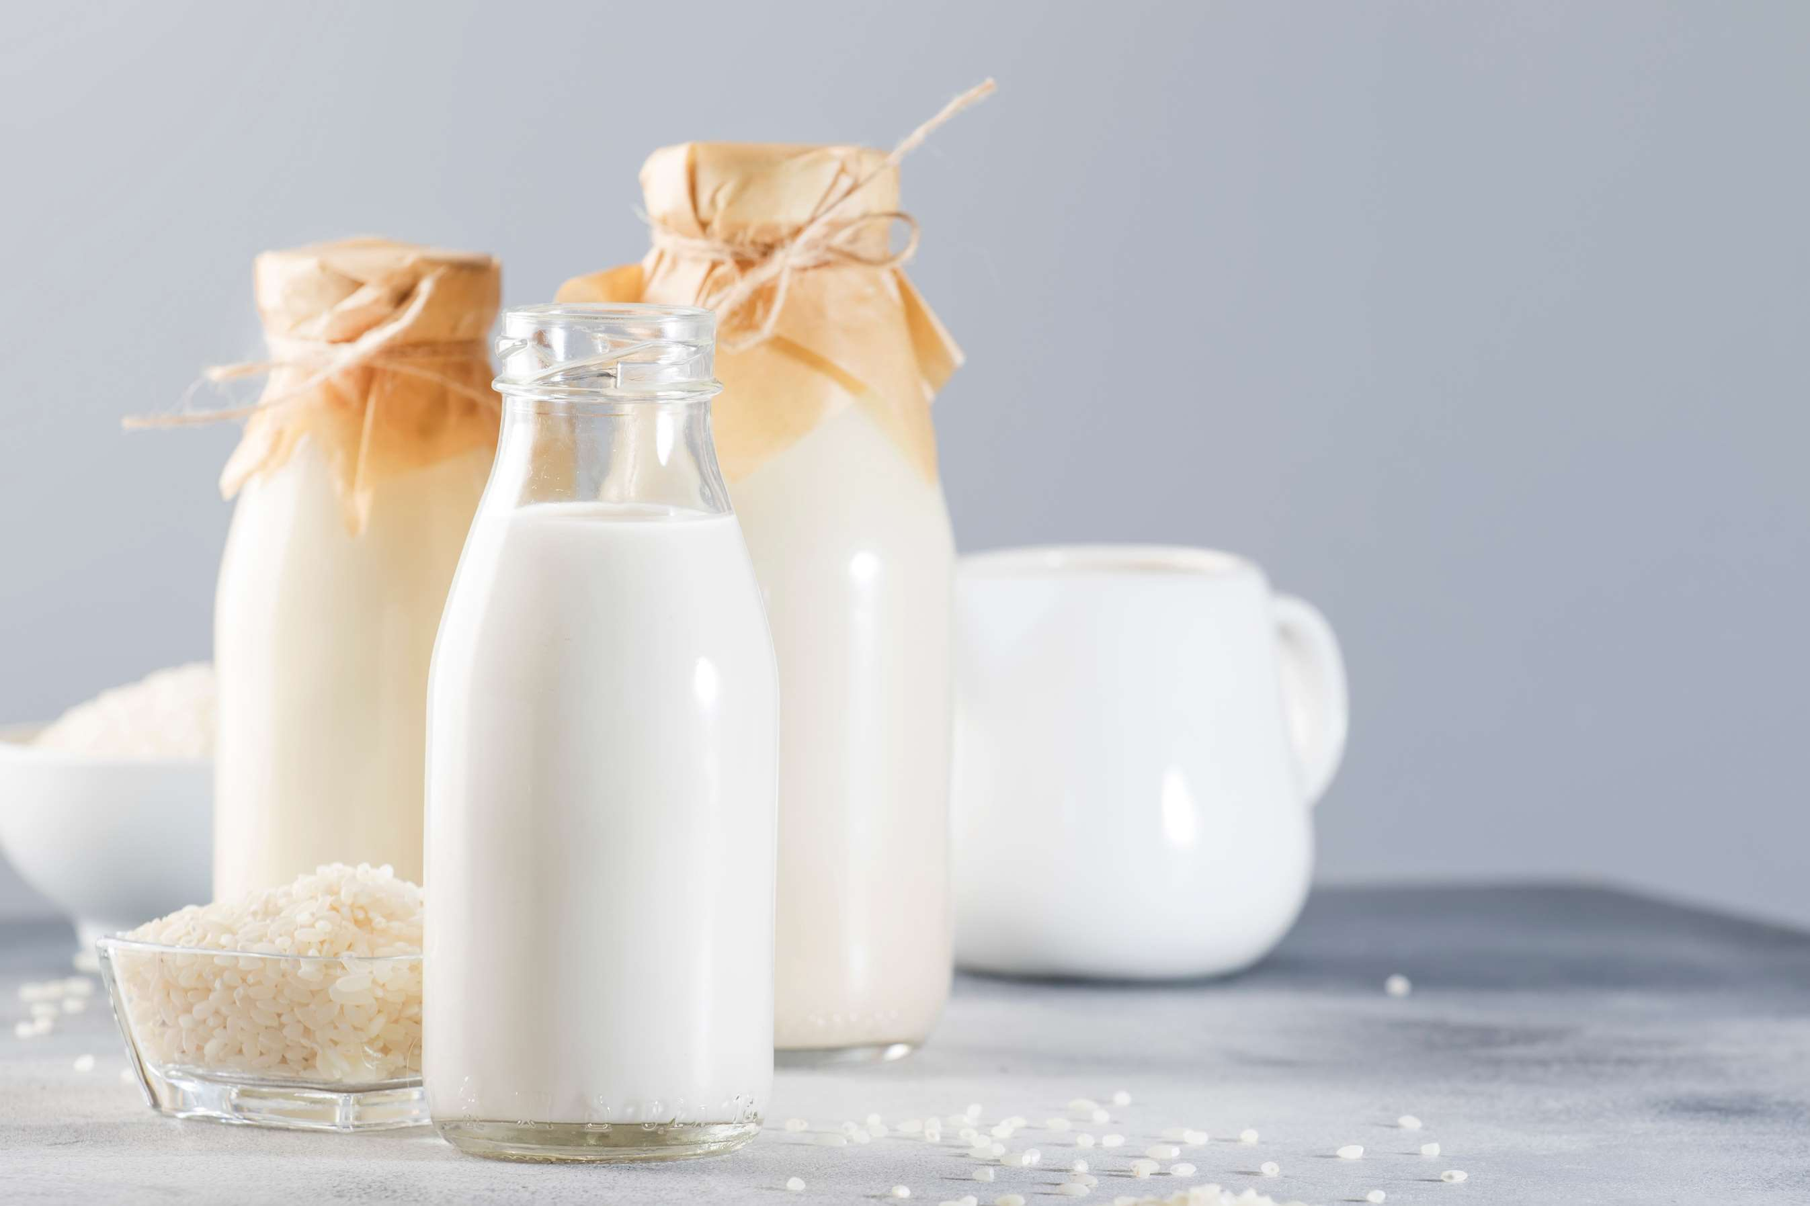
REVENUE MARKET SHARE BY SEGMENTS 2024
  Soy Milk
  Almond Milk
  Coconut Milk
  Cashew Milk
  Hemp Seed Milk
Category Segment
  Organic
  Conventional
Type Segment
  Infant Formula
  Dairy Products
  Milk
  Cheese
  Yogurt
  Chocolate
  Vanilla
  Strawberry
  Coconut
  Mocha
End-Use Segment
Flavor Segment
  Direct Sales
  Indirect Sales
  Modern Trade
  Convenience Store
  Departmental Store
  Liquid
  Powder
Form Segment
Sales Segment

Slide 5

North America
40%
North America Plant Based Milk Market Revenue share for 2024 is 40%

Slide 6
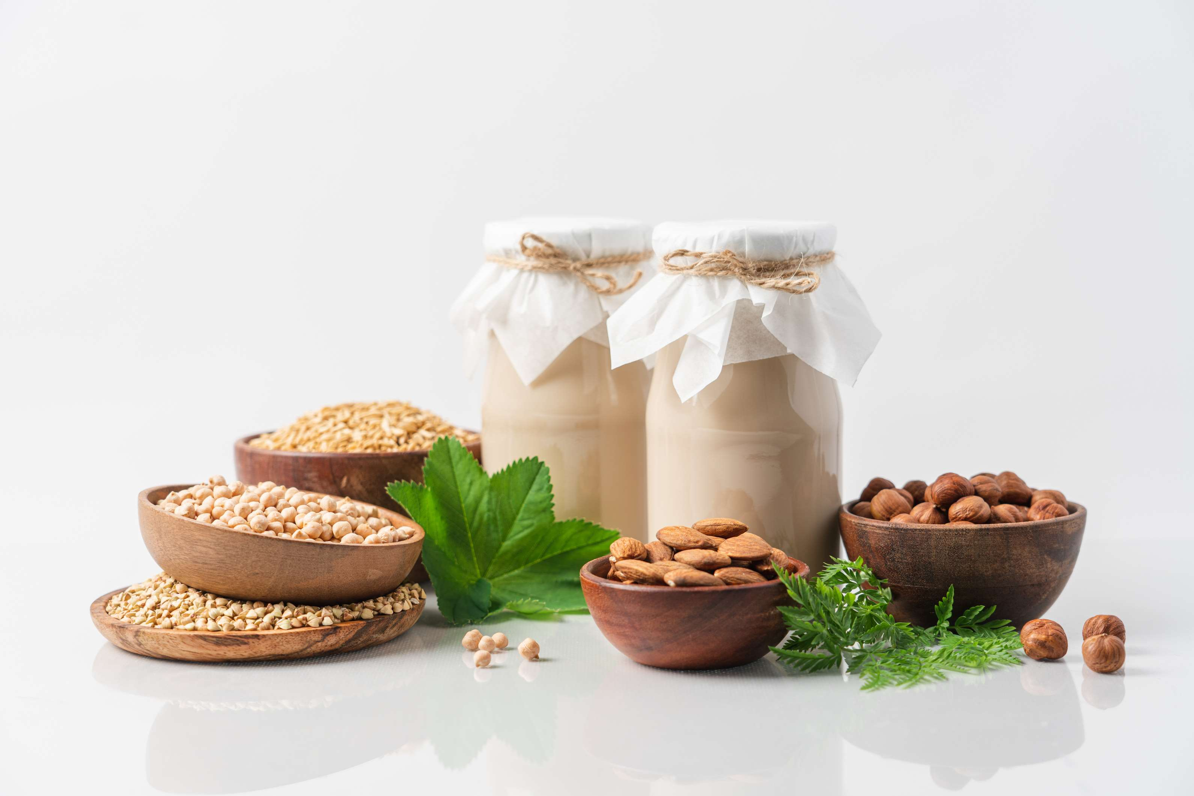
  Health Consciousness to Increase the Demand Globally
  Dietary Preferences and Restrictions to Propel Market Growth
Drivers
Taste and Texture to Limit the Sales
Restraints

Slide 7
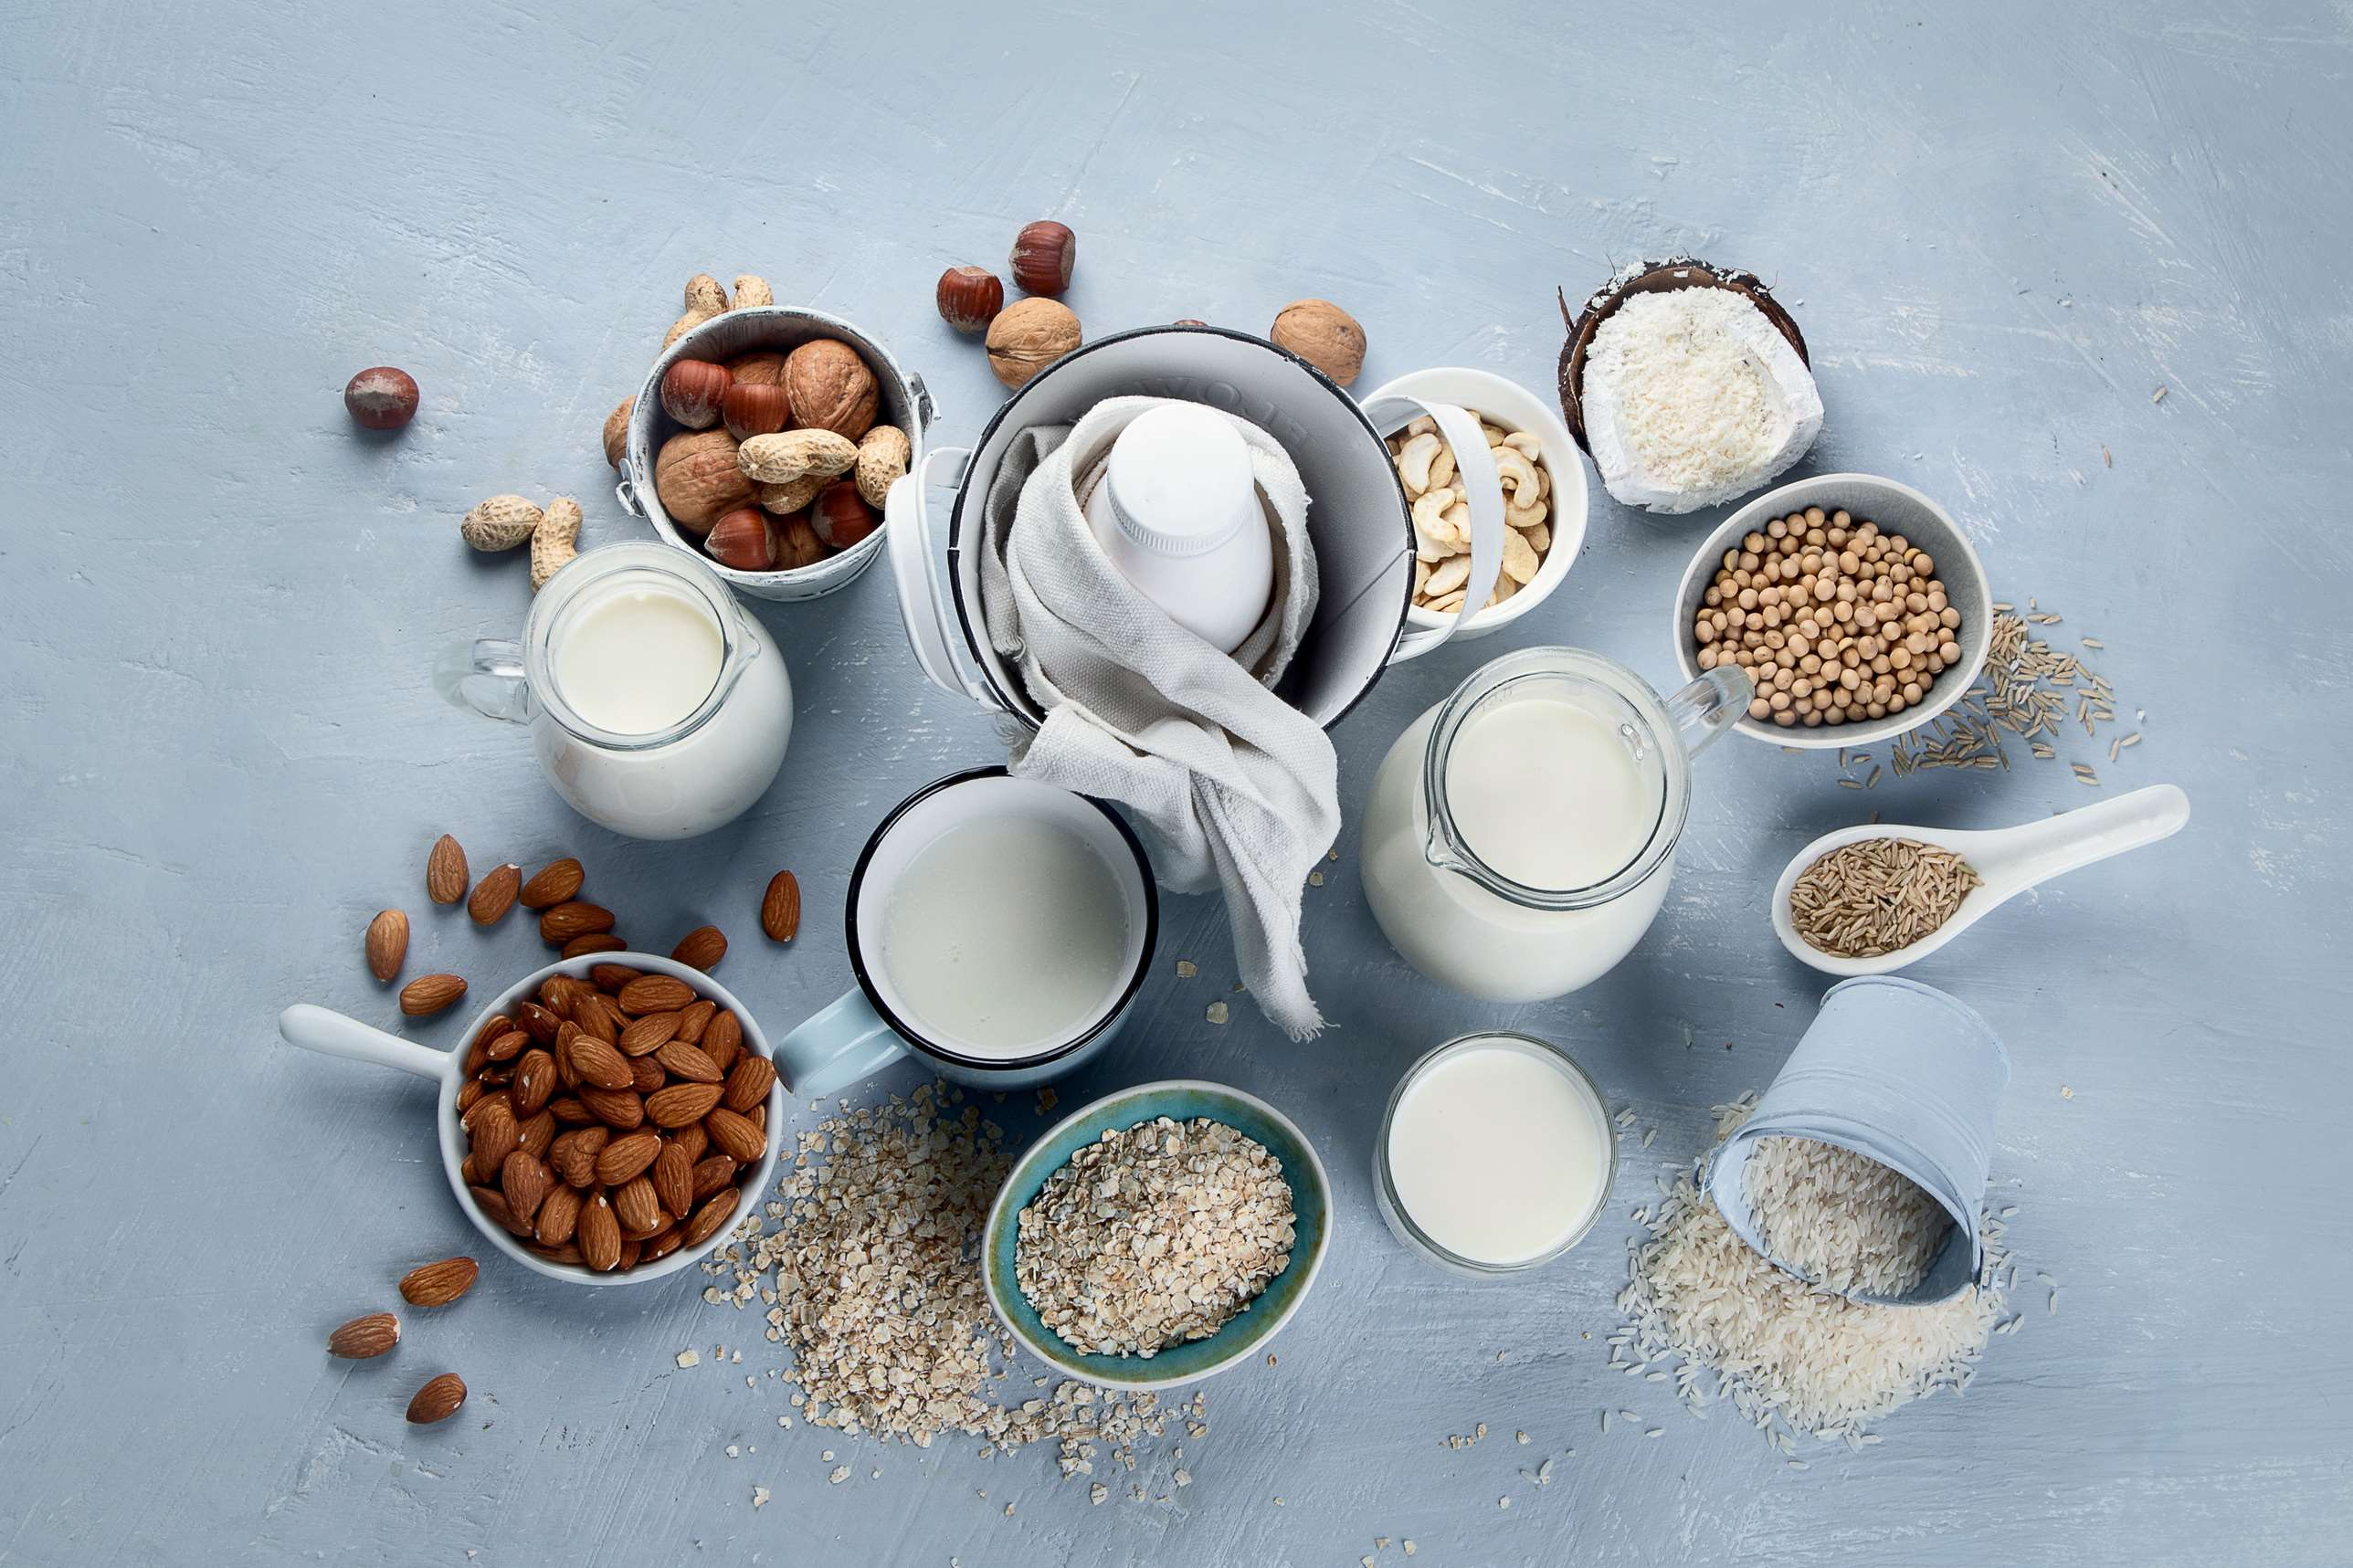
AUTHOR'S PERSPECTIVE
  The global plant-based milk market will expand significantly by 11.00% CAGR between 2024 and 2031.
  The Soy Milk segment is set to rise as consumers increasingly seek versatile and nutritionally dense alternatives to dairy milk. Soy milk offers a rich source of protein, essential amino acids, and calcium, making it a popular choice for individuals looking to maintain a balanced diet.
  Growing awareness of health issues related to dairy consumption, such as lactose intolerance, allergies, and concerns about hormones and antibiotics in conventional dairy products, has led consumers to seek healthier alternatives. Plant-based milk offers options that are often lower in calories, cholesterol-free, and may contain beneficial nutrients like vitamins and minerals.

Slide 8
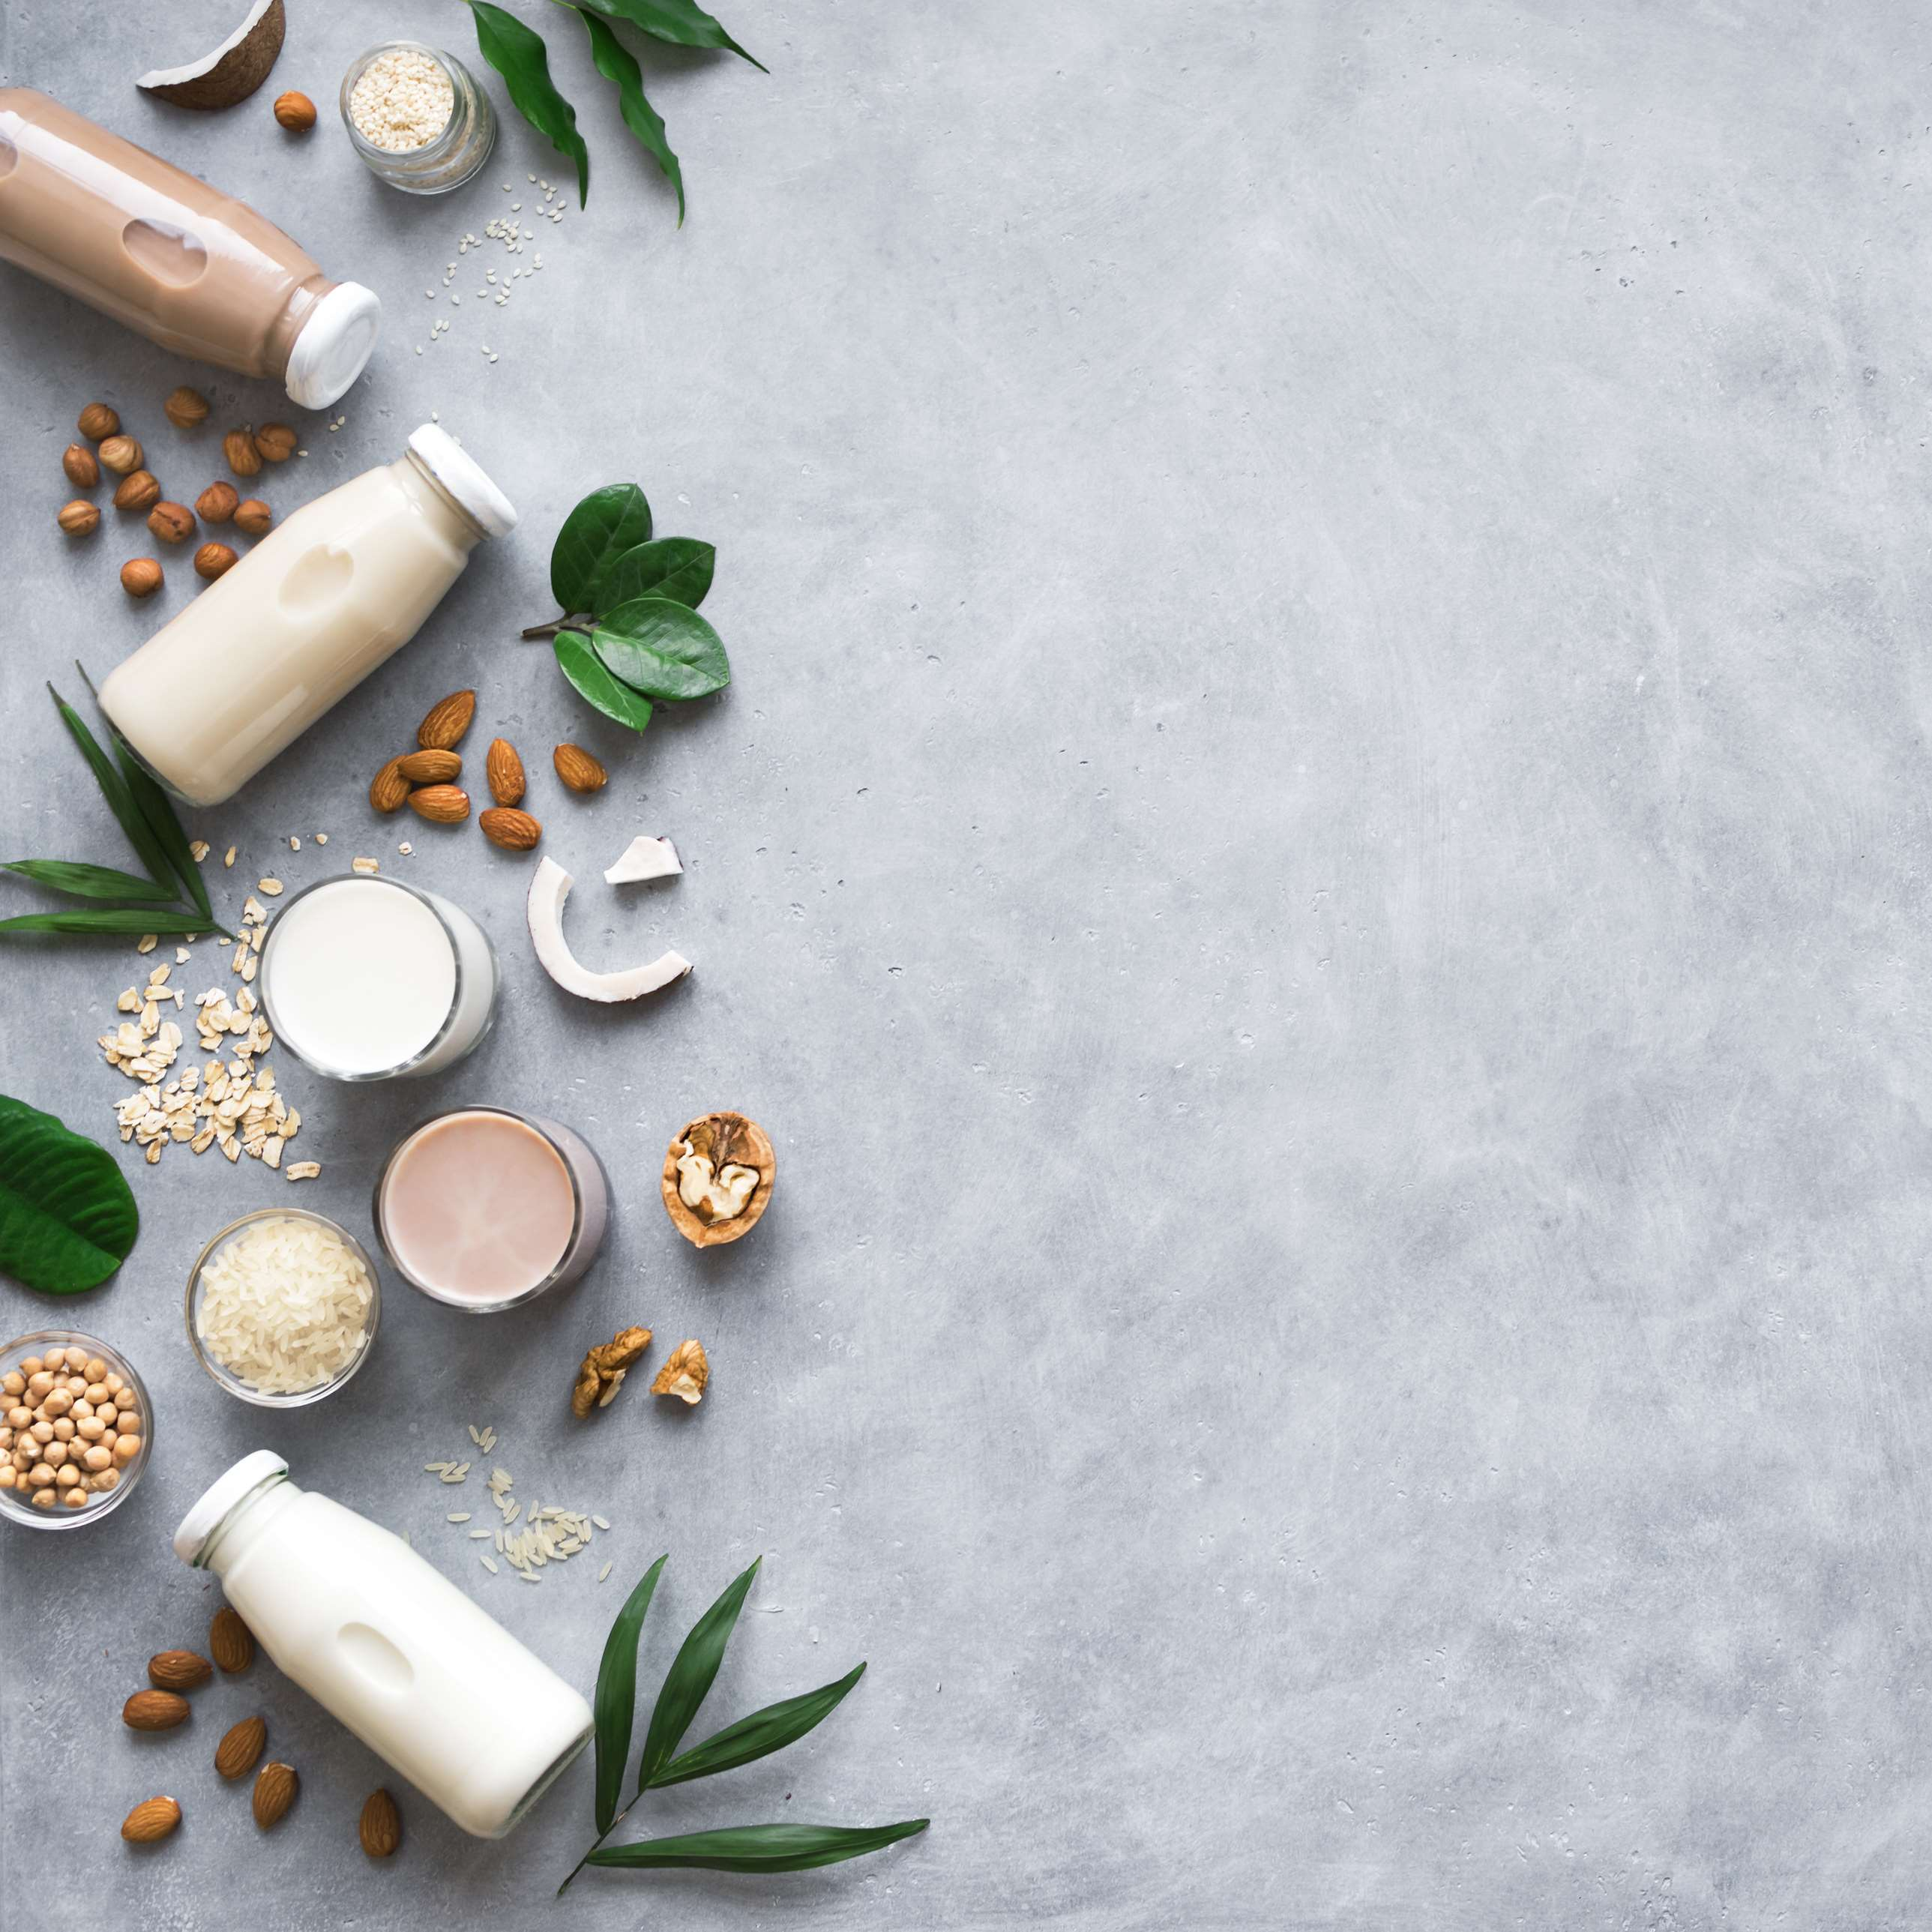
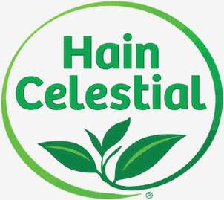
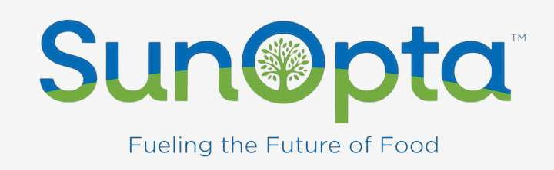





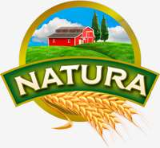
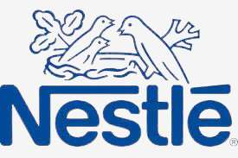
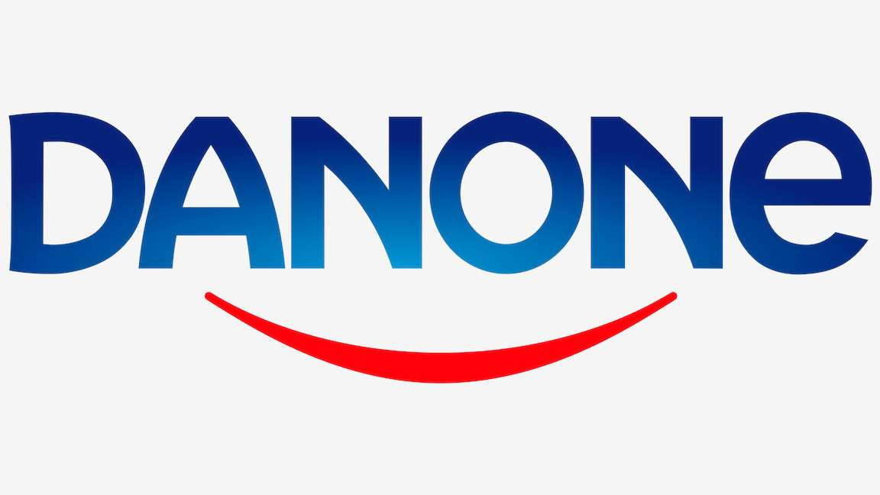
KEY PLAYERS

Slide 9


For Full Report
Contact us
COGNITIVE MARKET RESEARCH
Tel: +1 312-376-8303 | +44 020-8123-0732
India: (+91) 983-496-8611
sales@cognitivemarketresearch.com
Access the Full Report : https://tinyurl.com/mk5fp378
Please visit our website:
https://www.cognitivemarketresearch.com

