Slide 1

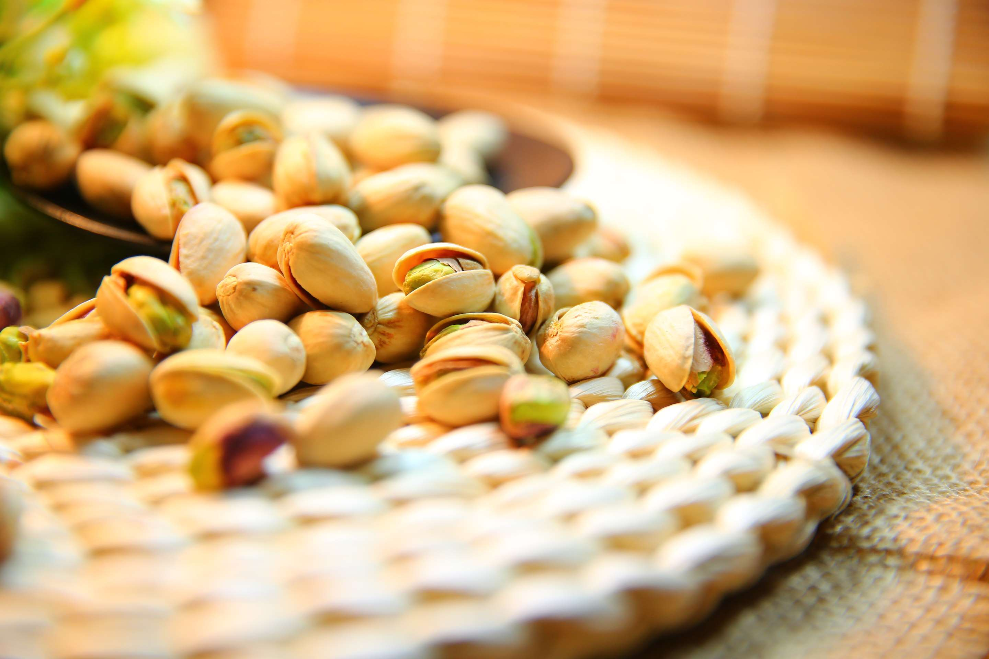

PISTACHIO NUTS
MARKET REPORT
2024
Qualitative Analysis + Quantitative Analysis

Slide 2
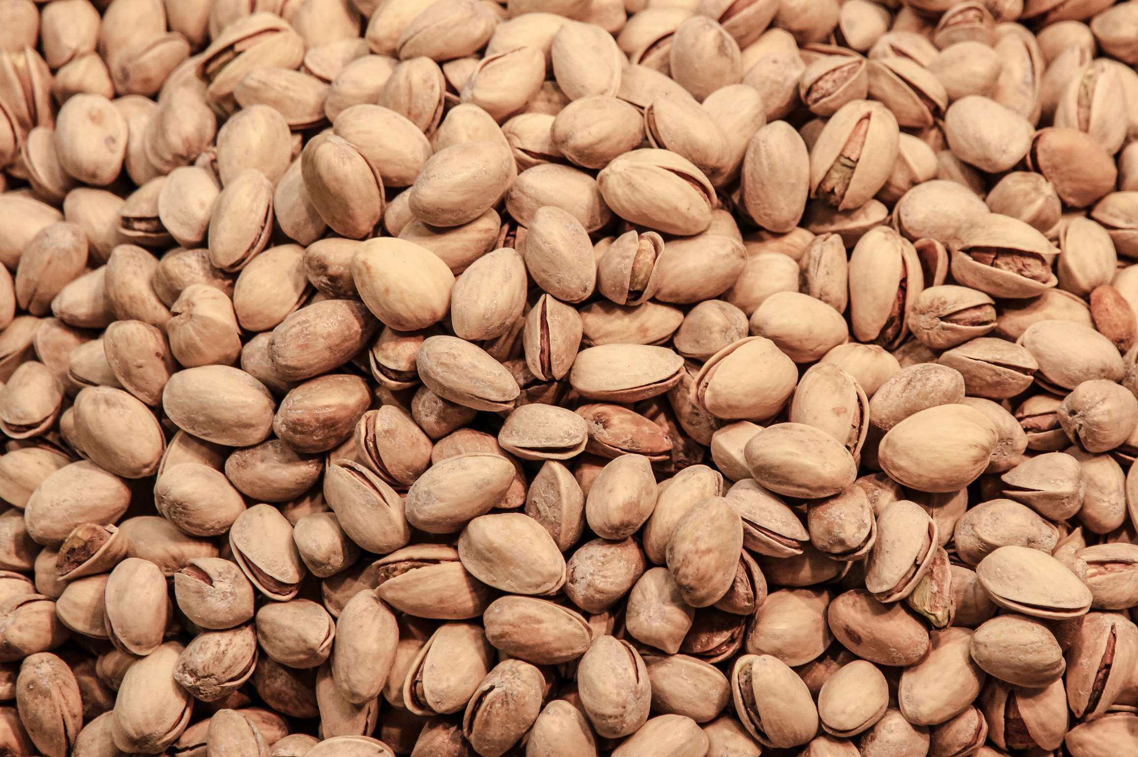
INTRODUCTION
Pistachios, derived from the Pistachia Vera plant, are packed with a wide array of essential nutrients that contribute to overall well-being. They are rich in proteins, dietary fibers, vitamins like K and B-6, thiamin, minerals including copper, phosphorus, manganese, iron, magnesium, as well as beneficial compounds like γ-tocopherol, phytosterols, and xanthophyll carotenoids.

Slide 3
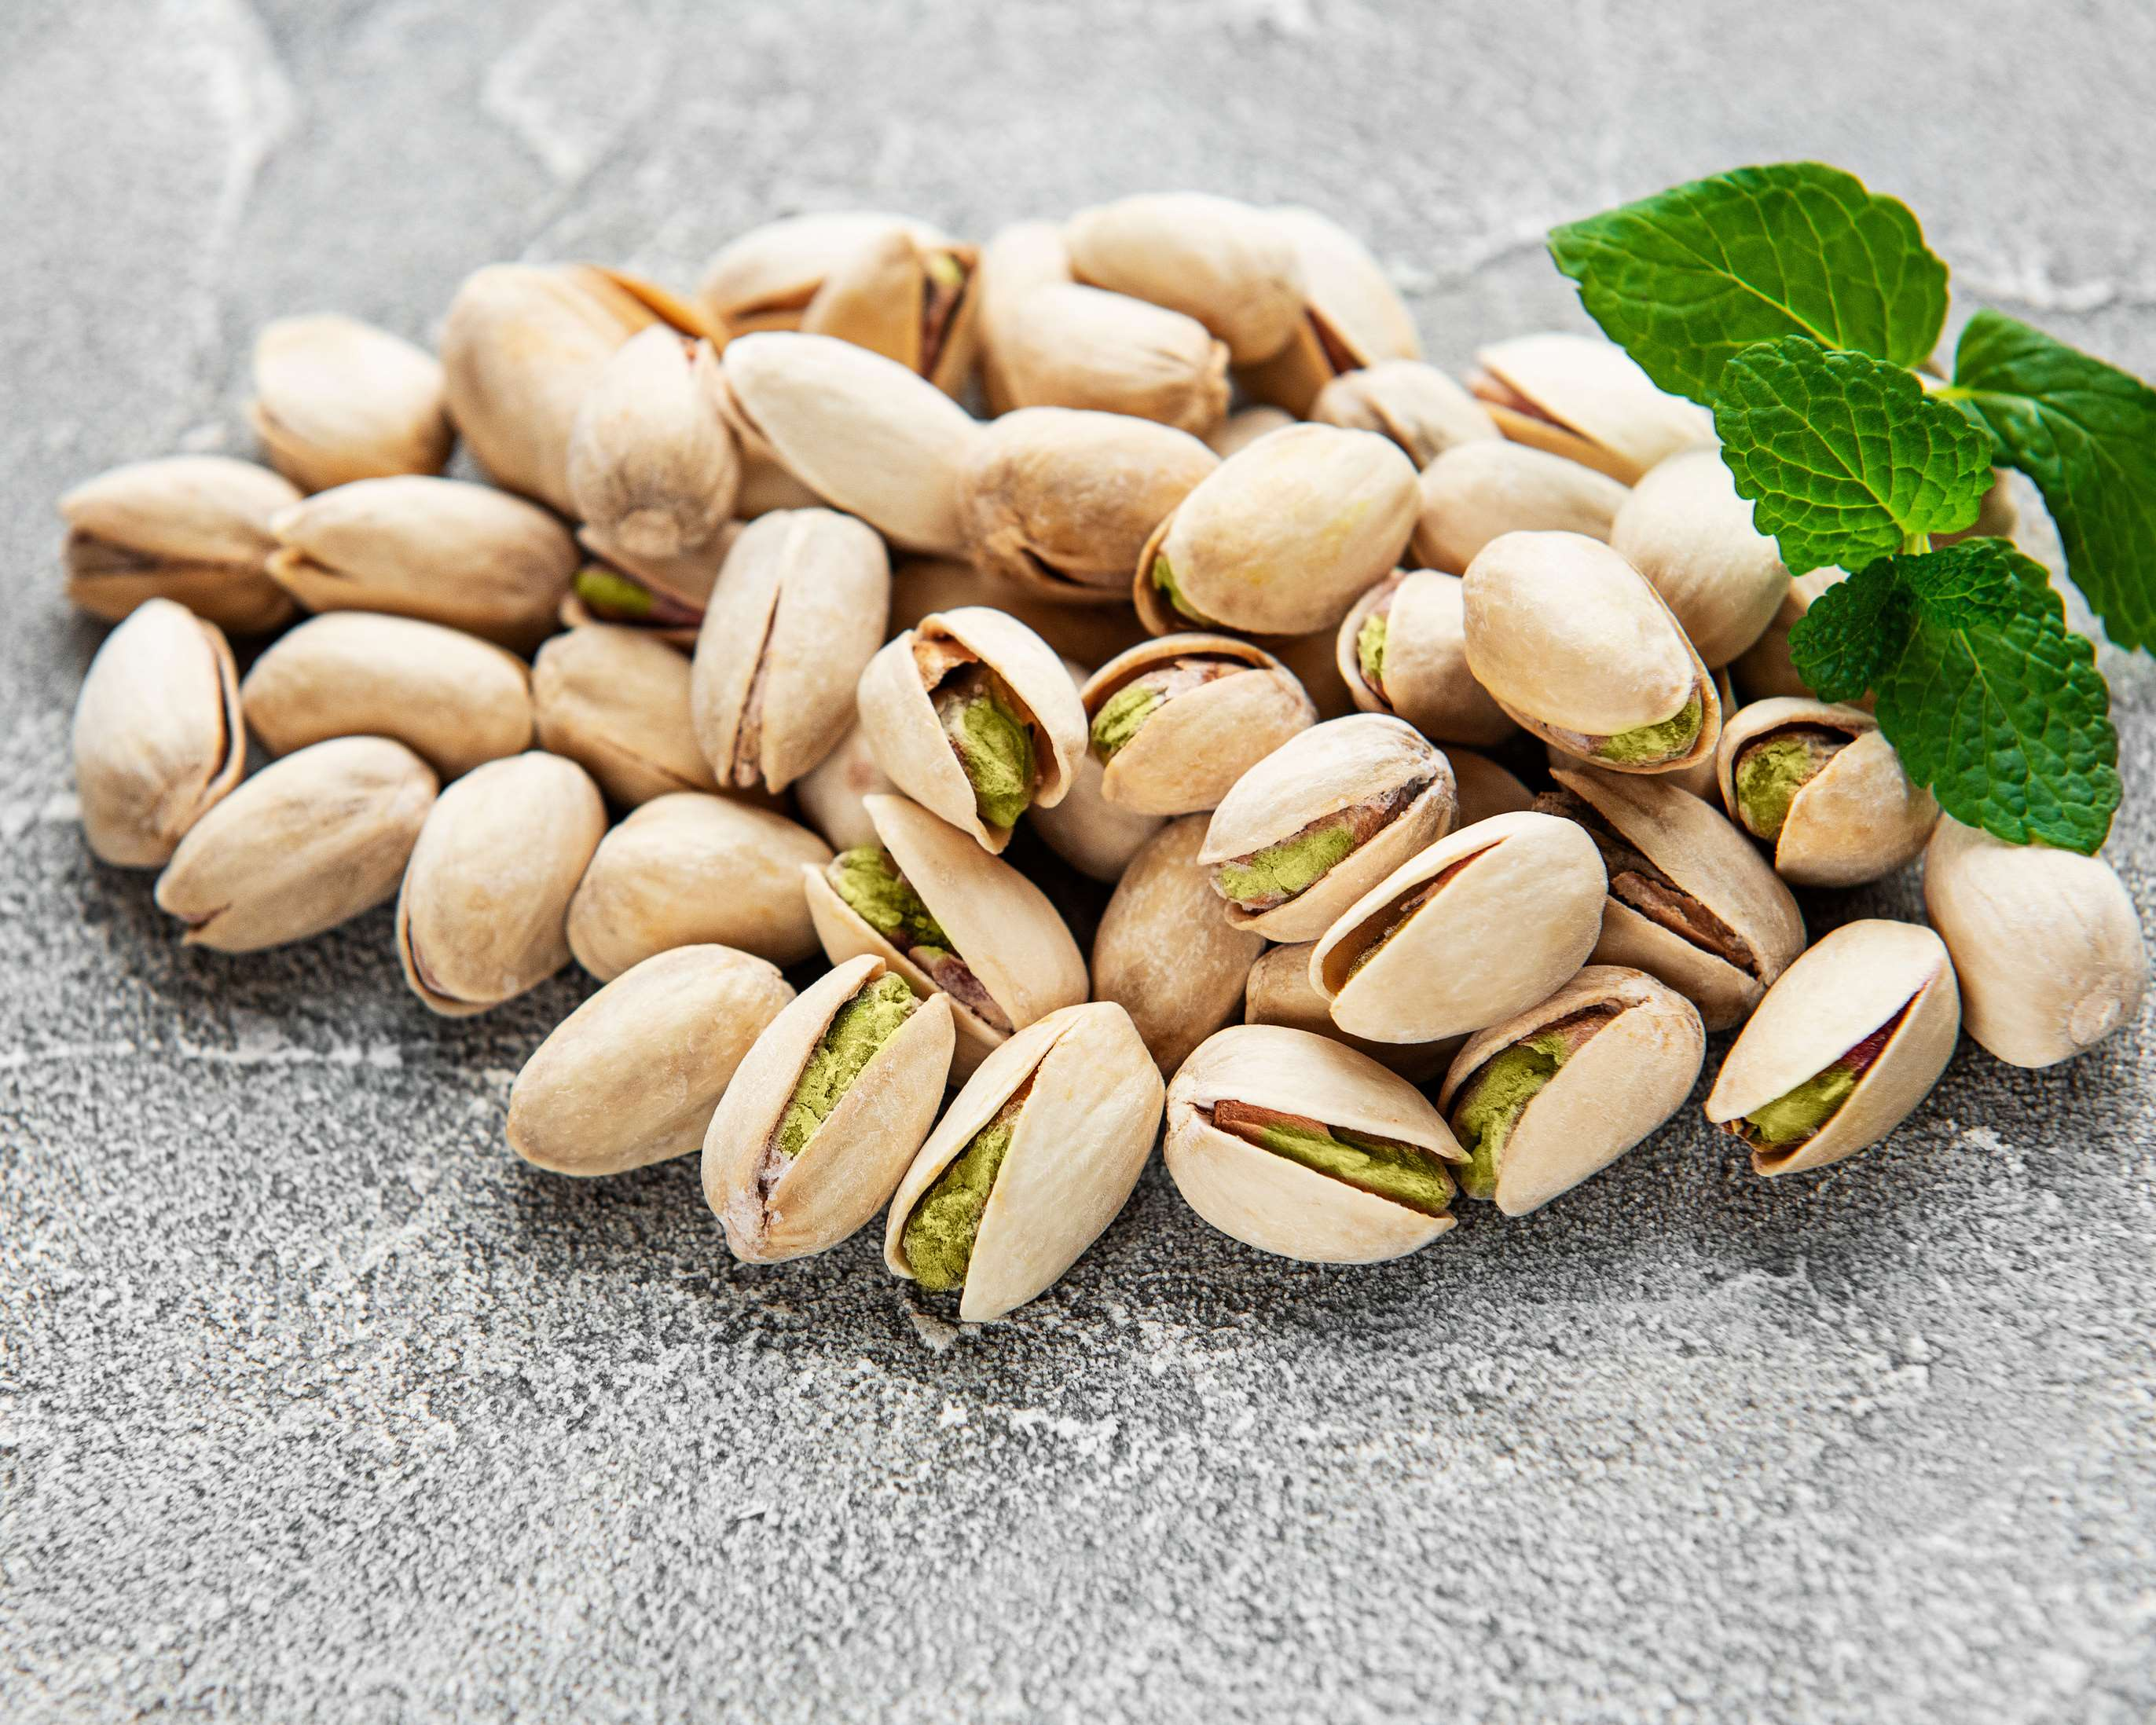

KEY INSIGHTS
CAGR
4.00%
2024- 2031

Slide 4
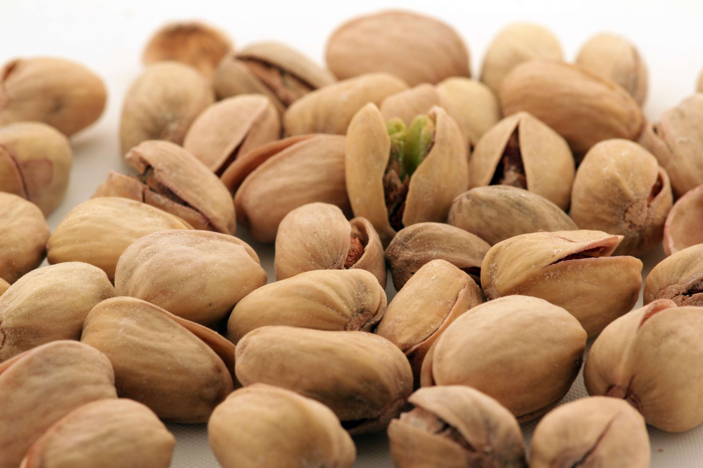
REVENUE MARKET SHARE BY SEGMENTS 2024
  Short Fruit Pistachio Nuts
  Long Fruit Pistachio Nuts
  Whole
  Powdered
  Roasted
  Splits
Type Segment
Form Segment
  Bakery & Confectionery
  Flavored Drink
  Breakfast Cereals
  Snacks
  Butter and Spread
  Dairy Products
  Wholesaler/Distributor
  Modern Trade
  Convenience Stores
  Online Sales
End-Use Segment
Distribution Channel

Slide 5
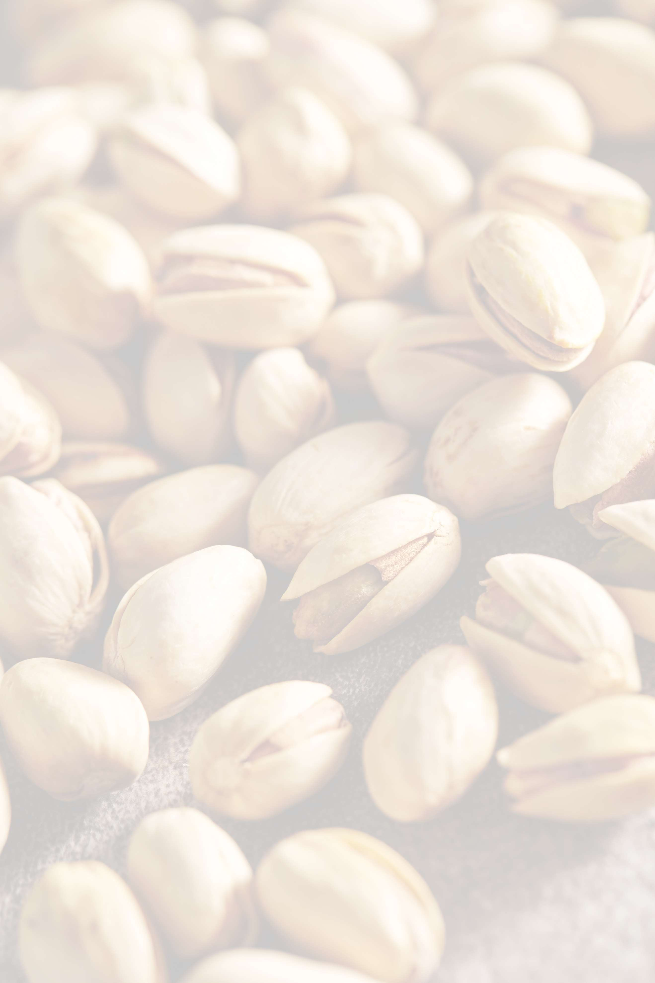

North America
40%
North America Pistachio Nuts Market Revenue share for 2024 is 40%

Slide 6
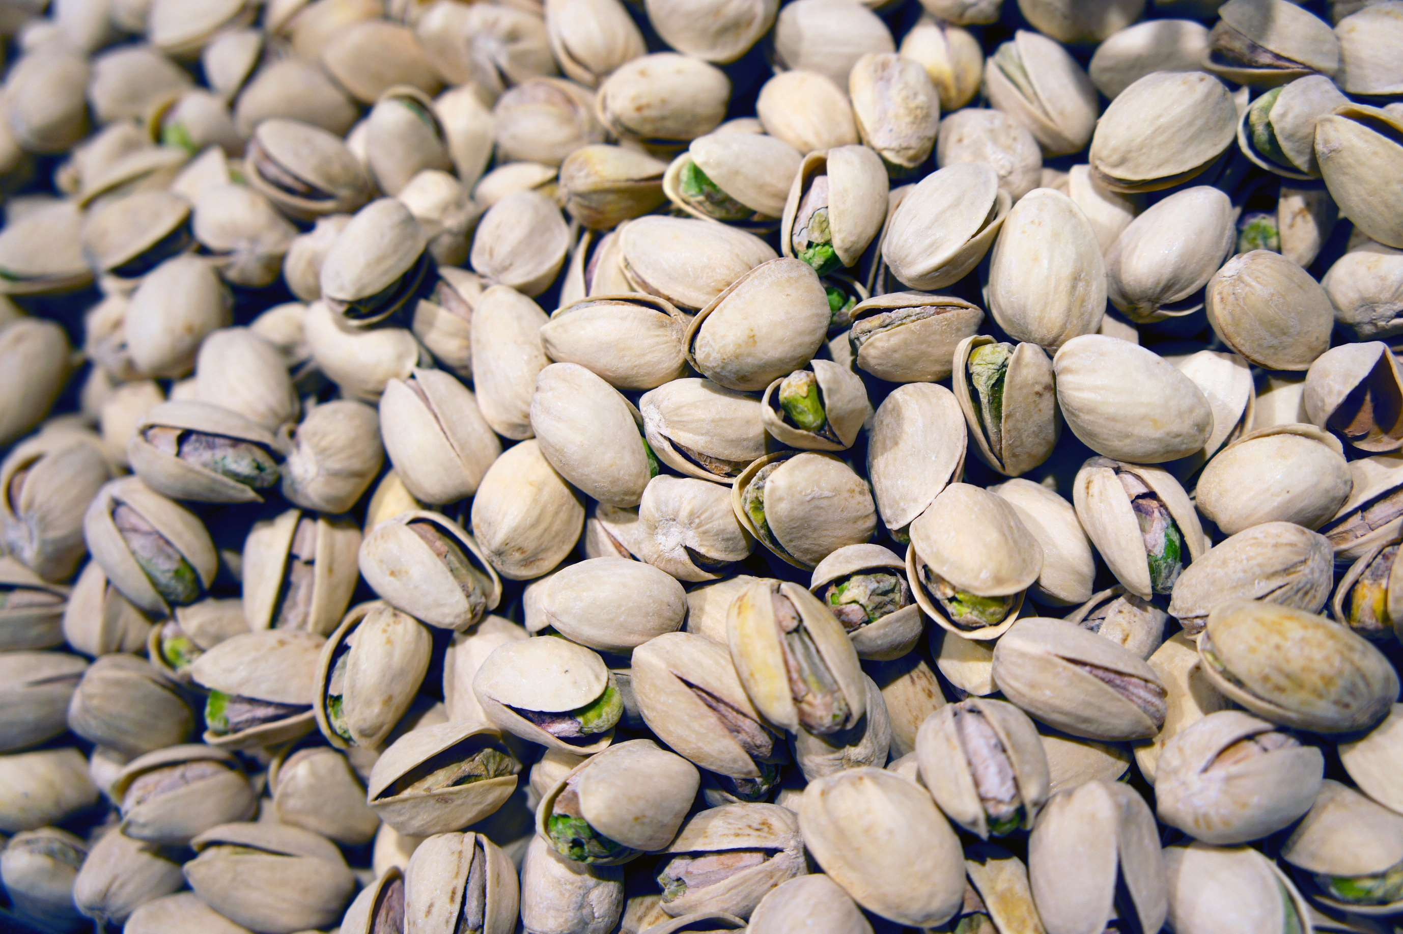
  Growing Awareness about Health to Boost Market Growth
  Surging Demand in the Food and Cosmetic Sectors to Boost Market Growth
Drivers
High Cost of Pistachios and Contamination Concerns Impacts the Pistachio Market Growth
Restraints

Slide 7
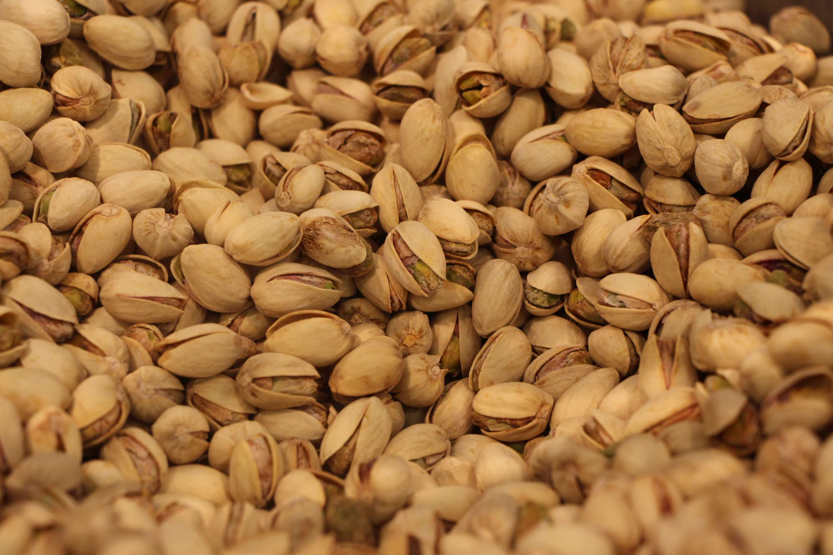
AUTHOR'S PERSPECTIVE
  The global Pistachio nuts market will expand significantly by 4.00% CAGR between 2024 to 2031.
  The largest segment in the Pistachio Nuts market is Long Fruit Pistachio Nuts. These nuts are prized for their larger size and distinctive flavor profile, making them a preferred choice for premium snack offerings, gourmet products, and ingredient use in upscale recipes.
  The main drivers of the growth of the Pistachio Nuts market are Growing awareness about health and Surging Demand in the Food and Cosmetic Sectors

Slide 8




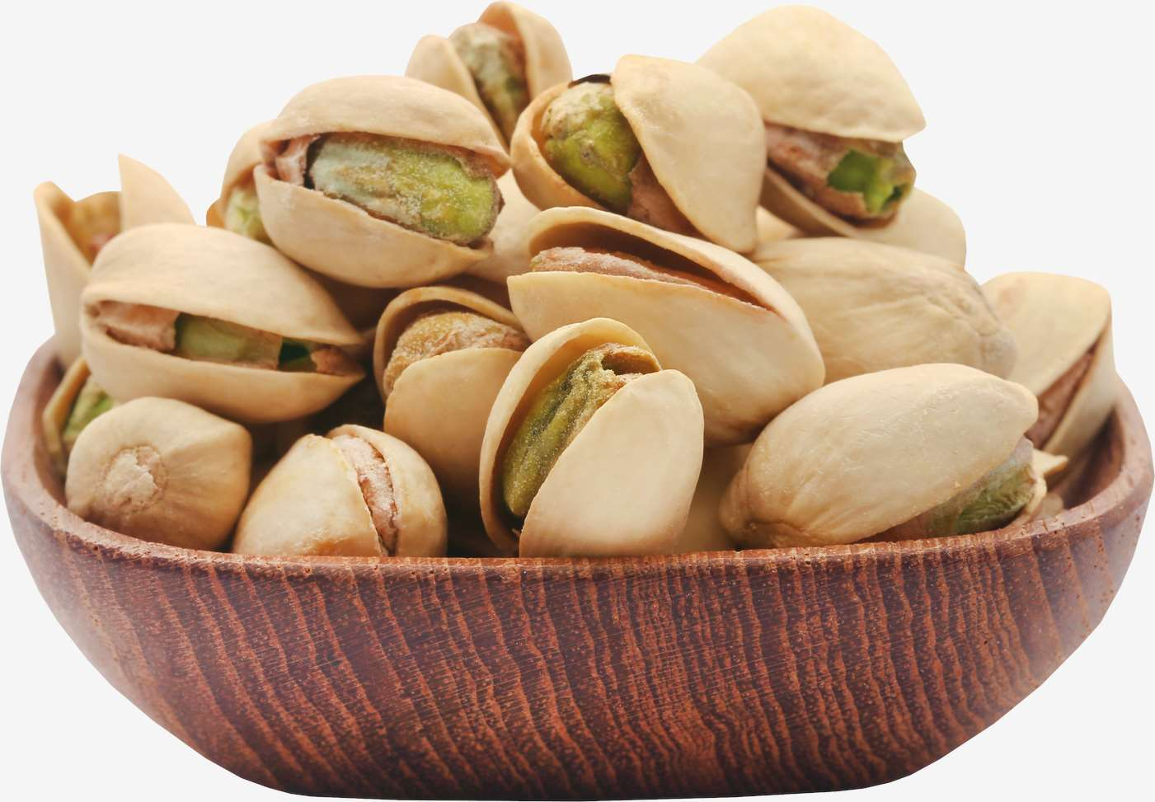





KEY PLAYERS

Slide 9


For Full Report
Contact us
COGNITIVE MARKET RESEARCH
Tel: +1 312-376-8303 | +44 020-8123-0732
India: (+91) 983-496-8611
sales@cognitivemarketresearch.com
Access the Full Report : https://tinyurl.com/yywac23x
Please visit our website:
https://www.cognitivemarketresearch.com

