Slide 1


PET PRODUCT
MARKET REPORT
2024
Qualitative Analysis + Quantitative Analysis

Slide 2

INTRODUCTION
The Pet product marketplace contains a large array of products and services designed to fulfill the needs and alternatives of pup proprietors for their animal companions. This marketplace consists of several lessons along with Pet food, treats, toys, grooming merchandise, accessories, healthcare devices, and services like veterinary care and Pet grooming. It caters to a various style of pets, consisting of dogs, cats, birds, fish, small mammals, and reptiles. The market is driven by factors such as the growing pet possession quotes, the humanization fashion of treating pets as a circle of relatives members, growing attention to Pet fitness and nutrition, and advancements in Pet care technology. With a focal point on improving the well-being and happiness of pets, the Pet product marketplace maintains to conform and innovate to fulfill the evolving dreams of pup proprietors

Slide 3


KEY INSIGHTS
MARKET SIZE
USD 296815.2 million
2024
CAGR
5.00%
2024- 2031

Slide 4

REVENUE MARKET SHARE BY SEGMENTS 2024
  Pet Food Products
  Pet Health Products
  Pet Feeding Products
  Pet Clothing Products
  Pet Cleaning Products
  Pet Beauty Products
  Pet Toys Products
  Other Pet Products
  Cat
  Dog
  Fish
  Rabbit
Application Segment
Type Segment
  Supermarkets
  E-Commerce
  Specialized Pet Shops
Distribution channel

Slide 5

REGION ANALYSIS
NORTH AMERICA
Europe
Asia Pacific
Latin America
MIDDLE EAST AFRICA
USD 118726.08 million
USD 89044.56 million
USD 68267.50 million
USD 14840.76 million
USD 5936.30 million
North America held the major market of more than 40% of the global revenue with a market size of USD 118726.08 million in 2024 and will grow at a CAGR of 3.2% from 2024 to 2031.

Slide 6
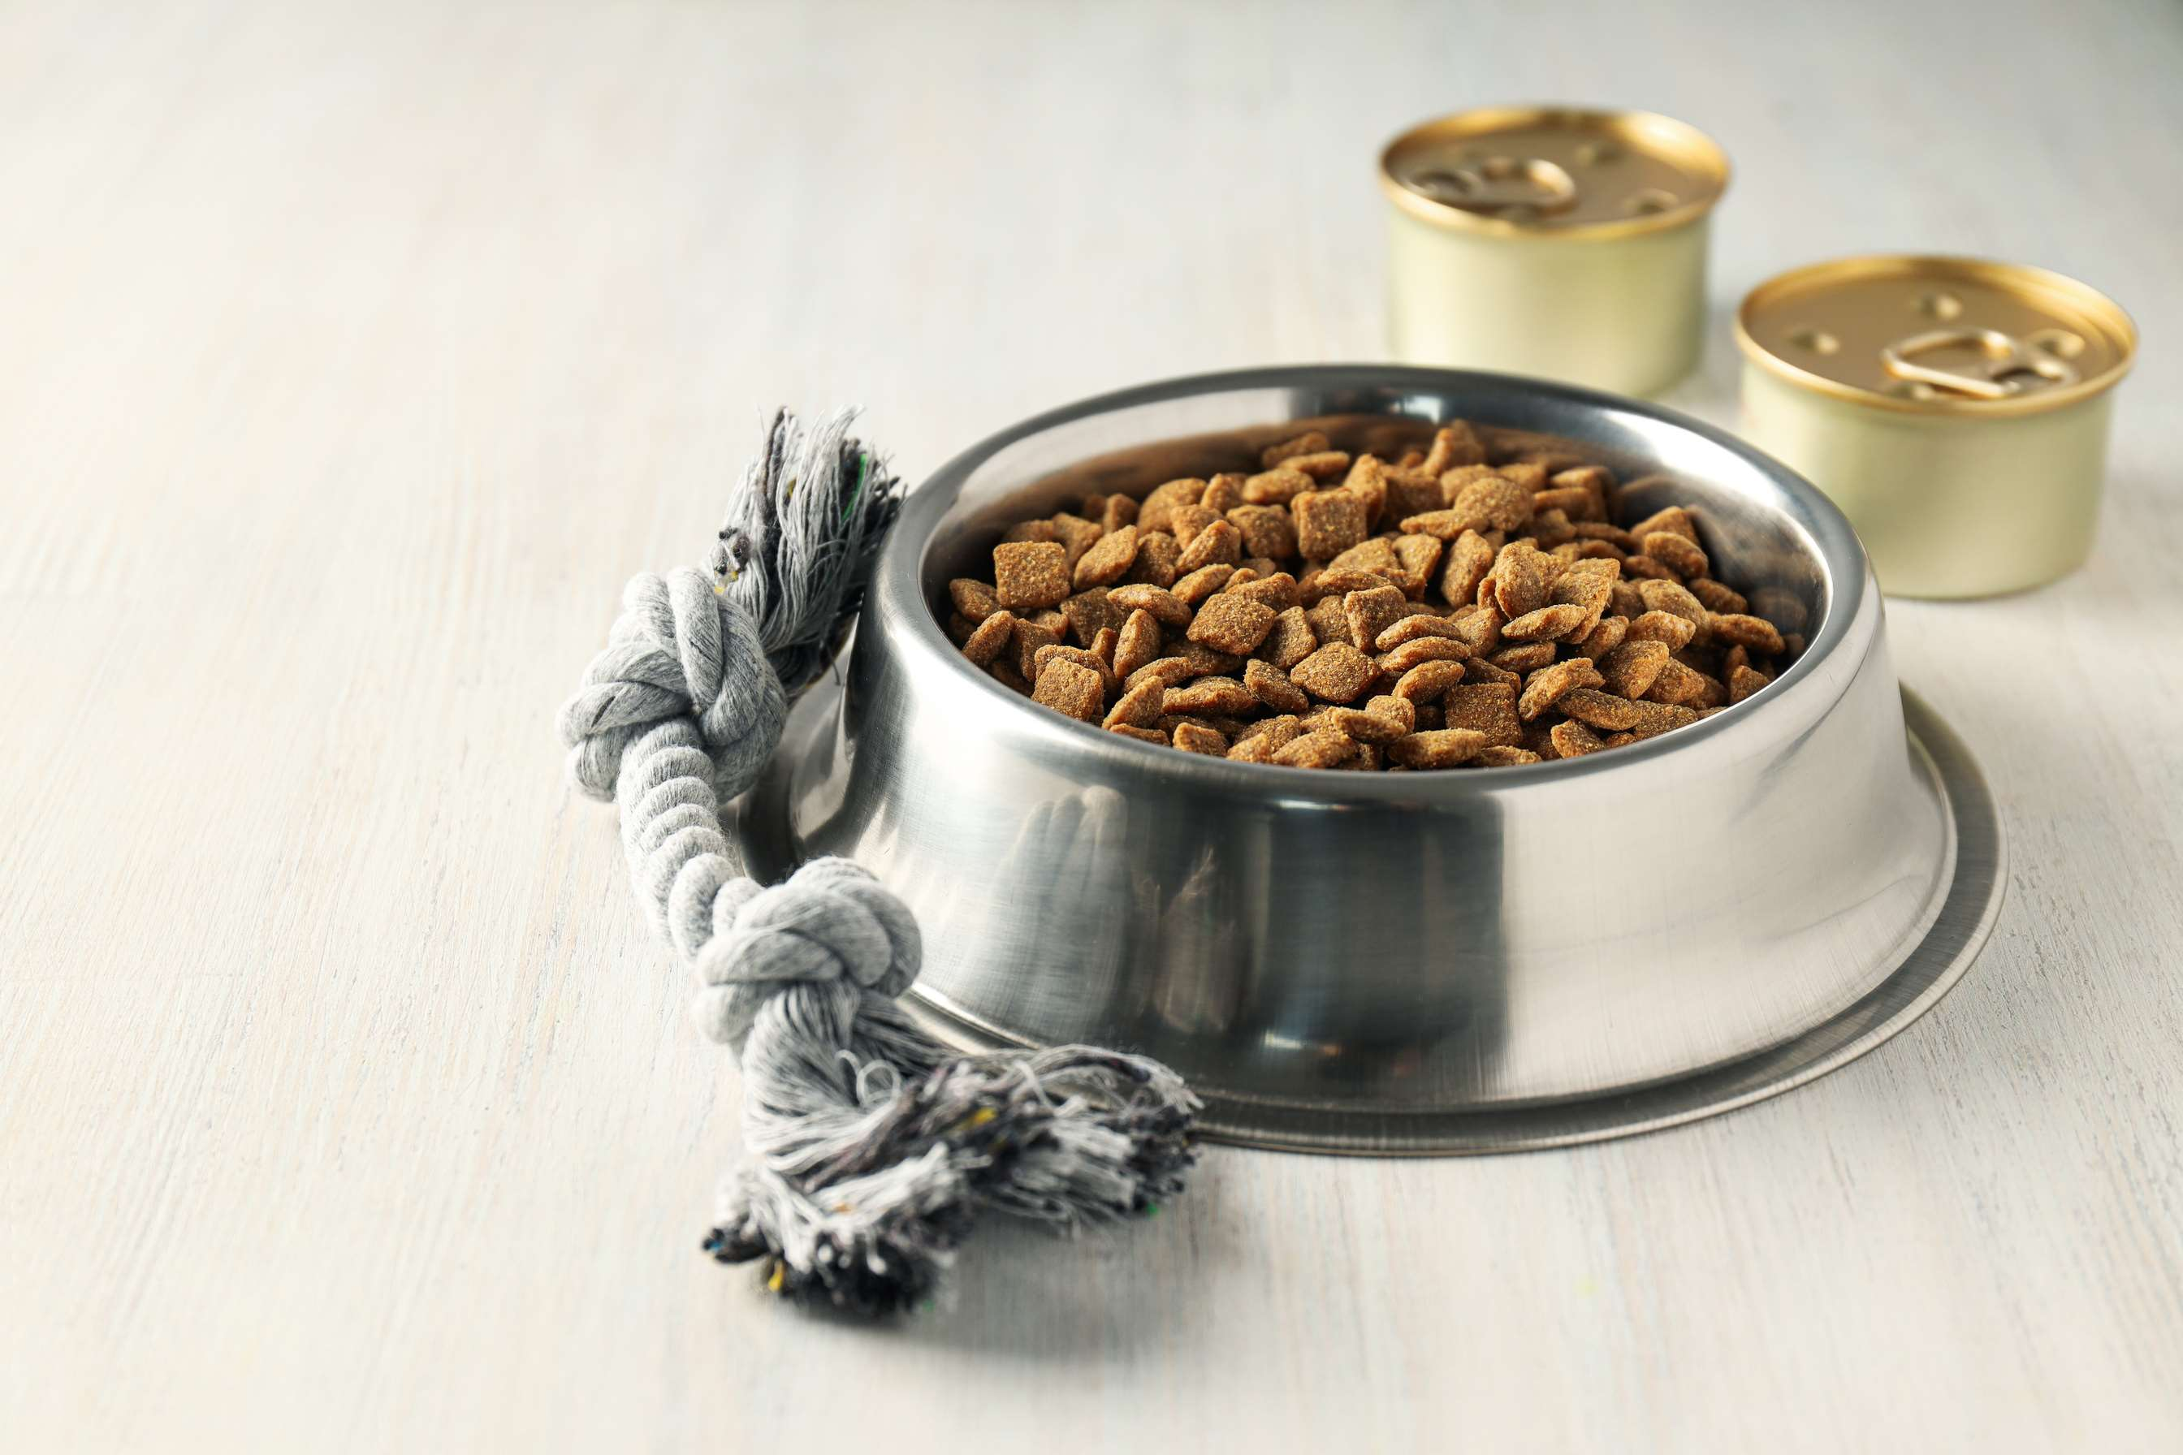
  Increasing pet ownership rates worldwide are driving the demand for a wide range of pet products
  Rising disposable incomes allow pet owners to spend more on premium pet products
Drivers
Stringent regulations governing pet product safety and labeling may pose compliance challenges for manufacturers
Restraints

Slide 7

AUTHOR'S PERSPECTIVE
  The global Pet Product market will expand significantly by 5.00% CAGR between 2024 to 2031.
  The market is driven by factors such as the growing pet possession quotes, the humanization fashion of treating pets as a circle of relatives members, growing attention to Pet fitness and nutrition, and advancements in Pet care technology.
  The phase of pet meals merchandise features a wide variety of items, inclusive of dry and moist food, treats, and distinctiveness diets tailor-made to precise dietary wishes or alternatives.
  It is pushed by elements inclusive of Pet owners' desire for outstanding nutrition and convenience.

Slide 8









KEY PLAYERS

Slide 9


For Full Report
Contact us
COGNITIVE MARKET RESEARCH
Tel: +1 312-376-8303 | +44 020-8123-0732
India: (+91) 983-496-8611
sales@cognitivemarketresearch.com
Access the Full Report : https://tinyurl.com/2fznek5m
Please visit our website:
https://www.cognitivemarketresearch.com

