Slide 1



PERCUSSION INSTRUMENT
MARKET REPORT
2024
Qualitative Analysis + Quantitative Analysis

Slide 2
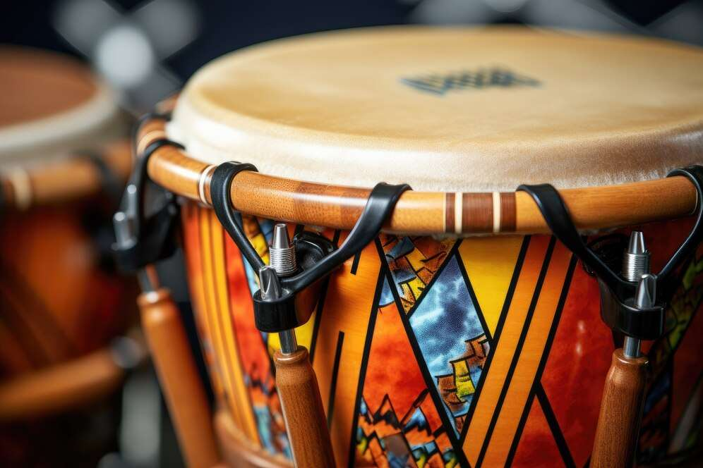
INTRODUCTION
A percussion instrument is any musical instrument that makes a certain sound when it is shaken, hit, or scraped. There are two groups of percussion instruments: idiophones and membranophones. Idiophones are instrumenting whose own substance vibrates to produce sound, such as bells, clappers, and rattles. Membranophones emit sound by the vibration of a stretched membrane, like drums. While most percussion instruments are played by being struck, they can also be played by rubbing, shaking, plucking, and scraping. Percussion instruments are considered a backbone of the music industry, as they are one of the oldest instruments played. They play an important role in any kind of music, such as jazz, pop, rock, or orchestral music, due to their widespread acceptance.

Slide 3


KEY INSIGHTS
MARKET SIZE
$1,746.42 Million
2024
FORECAST
$2,060.94 Million
2030
CAGR
2.39%
2024- 2031

Slide 4

REVENUE MARKET SHARE BY SEGMENTS 2024
  Acoustic
  Electronic
  Online
  Offline
Type Segment
Distribution Channel
  Timpani
  Snare drum
  Bass drum
  Tambourine
  Piano
  Commercial
  Household
End Use Segment
Product
Segment

Slide 5


North America
34.45%
North America Percussion Instrument Market Revenue share for 2024 is 34.45%

Slide 6
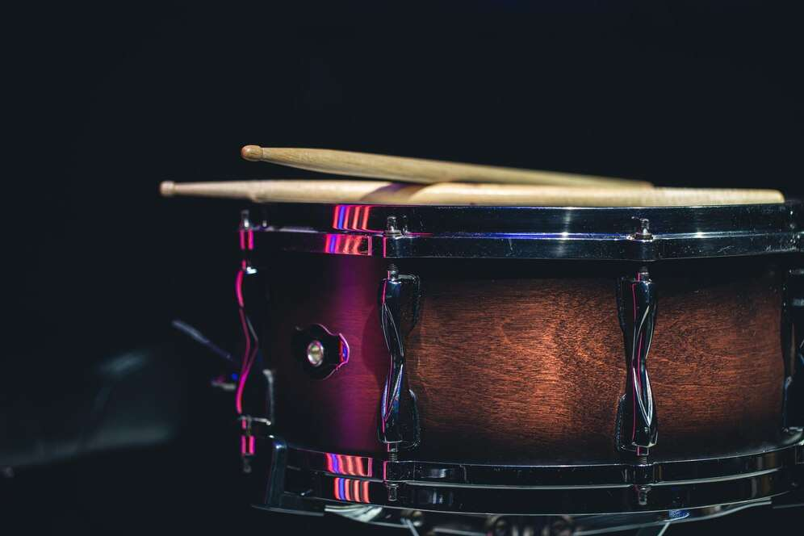
Rising popularity of live musical performances and concerts by professionals and music enthusiast
Drivers
Climate change is a significant issue caused by human activities, with a growing impact on our lives and other species.
Restraints

Slide 7
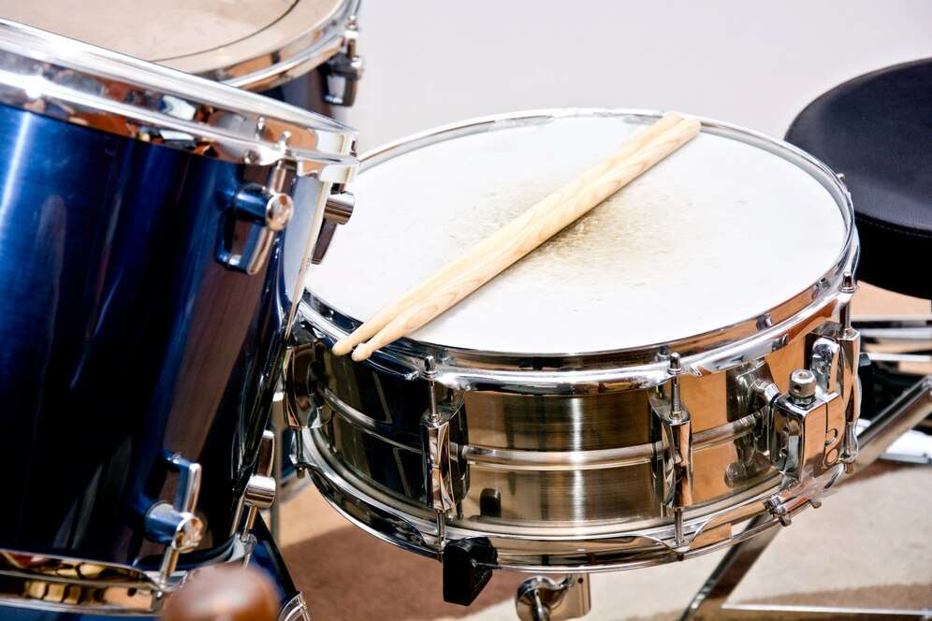
AUTHOR'S PERSPECTIVE
  The Global Percussion Instrument Market is witnessing significant growth in the near future.
  These instruments are well-liked in many musical genres, such as rock, jazz, and classical, because of their genuine, organic tone.
  Roland announced the TD-02K and TD-02KV V-Drums, introducing premium entry-level electronic drum kits renowned for their legendary V-Drums sound and expressive capabilities.
  In 2023, the Acoustic segment accounted for noticeable share of global Percussion Instrument Market and is projected to experience significant growth in the near future.
  The Timpani segment is expected to expand at the significant CAGR retaining position throughout the forecast period.

Slide 8



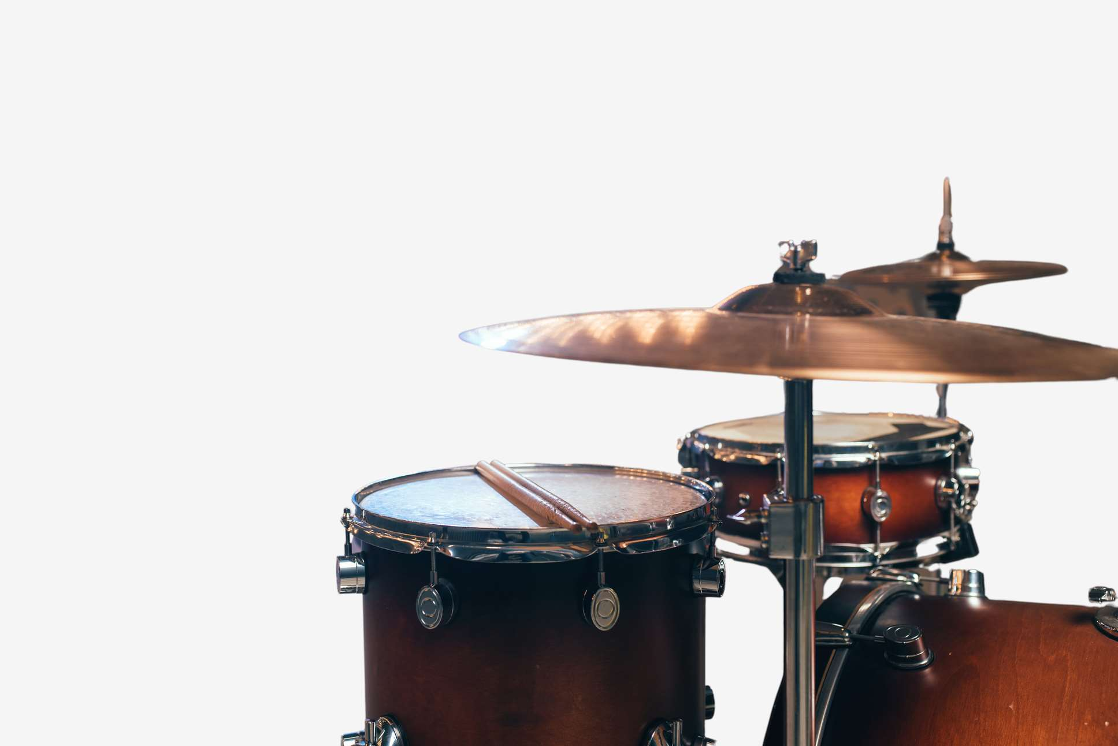



KEY PLAYERS

Slide 9


For Full Report
Contact us
COGNITIVE MARKET RESEARCH
Tel: +1 312-376-8303 | +44 020-8123-0732
India: (+91) 983-496-8611
sales@cognitivemarketresearch.com
Access the Full Report : https://tinyurl.com/38xrhfp6
Please visit our website:
https://www.cognitivemarketresearch.com

