Slide 1

GLOBAL
PEN
MARKET REPORT
2024
Global,Regional,CountryAnalysis

Slide 2

INTRODUCTION
The pen market is witnessing growth due to various factors. Firstly, the continued importance of writing in education, business, and daily life sustains the demand for pens. Additionally, the integration of innovative technologies, such as digital pens and smart pens, has expanded the market's offerings. Stationery trends, personalization options, and the preference for eco-friendly and sustainable writing instruments are driving market growth, appealing to a wide range of consumers and industries.

Slide 3


KEY INSIGHTS
MARKET SIZE
USD 17.2 billion
2023
CAGR
3.0%
2023- 2030

Slide 4

REVENUE MARKET SHARE BY SEGMENTS 2022
  Ball Point
  Fountain
  Gel
Type Segment
  Refillable
  Single-Use
Category Segment
  Supermarkets & Hypermarkets
  Specialty Stores
  Online Retail
Distribution Channel

Slide 5

Global Pen Market Revenue share for 2024
Asia Pacific

Slide 6

Increasing Eco-Friendly and Sustainable Pens to Propel Market Growth
Drivers
Increasing Environmental Concerns Hinder Market Growth
Restraints

Slide 7

AUTHOR'S PERSPECTIVE
  The Global Pen Market is witnessing significant growth in the near future.
  Ball Point pens are available in a wide range of designs, price points, and ink colors, catering to diverse consumer preferences.
  Fountain pens offer a sense of elegance and personalization that other pen types may not provide.
  E-commerce platforms provide consumers with the ability to explore an extensive selection of pens, including niche and specialty items, at their convenience.

Slide 8




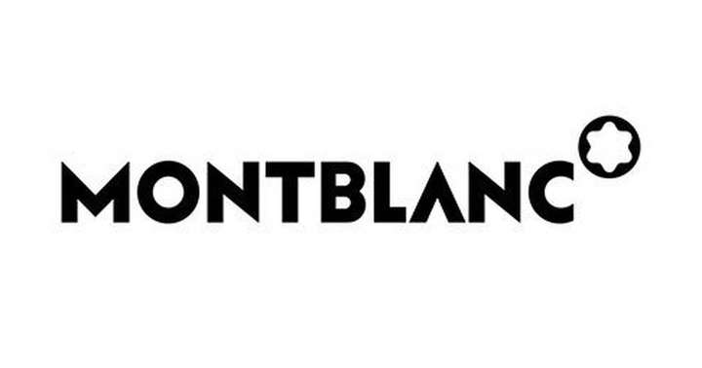






KEY PLAYERS

Slide 9


For Full Report
Contact us
COGNITIVE MARKET RESEARCH
Tel: +1 312-376-8303 | +44 020-8123-0732
India: (+91) 983-496-8611
sales@cognitivemarketresearch.com
Access the Full Report : https://tinyurl.com/4ark26ja
Please visit our website:
https://www.cognitivemarketresearch.com

