Slide 1

GLOBAL
PASTELS
MARKET REPORT 2024
Global,Regional,CountryAnalysis

Slide 2

INTRODUCTION
Pastels are a versatile medium in the art world, consisting of soft, chalk- like sticks of pigment that are widely used for drawing and coloring. They come in various forms, including soft pastels, oil pastels, and pastel pencils, offering artists a range of creative options. Pastels are known for their vibrant and expressive colors, making them a preferred choice for both beginners and professional artists. Their popularity stems from their ease of use, ability to blend and layer colors, and the rich, textured effects they can achieve on various surfaces like paper, canvas, and even fabric.

Slide 3


KEY INSIGHTS
20₋23
CAGR 5.80%
2030

Slide 4

REVENUE MARKET SHARE BY SEGMENTS 2022
Soft Pastel Hard Pastel Oil Pastel Pencil Pastels
Type Segment
Supermarkets/Hypermarkets Convenience Stores Independent Retailers Online Sales
Distribution Channel

Slide 5

Global Pastels Market Revenue share for 2022
Asia Pacific 35%

Slide 6
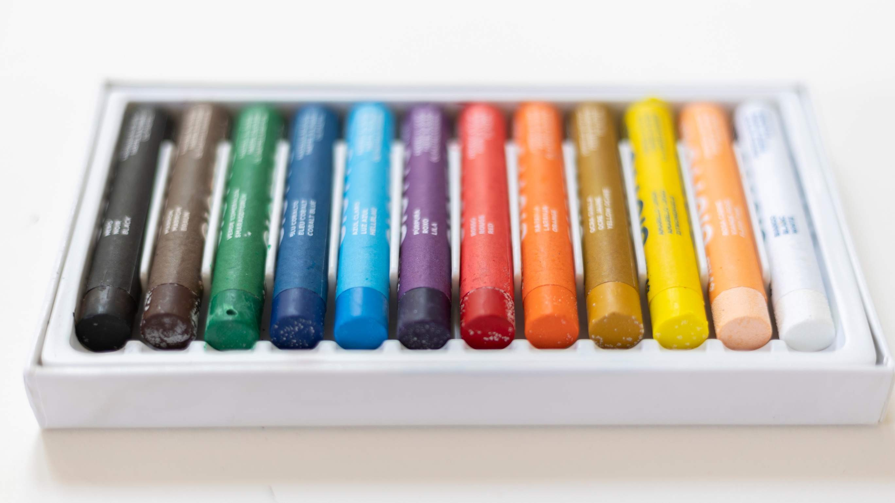
Expanding Popularity of Online Art Communities and Tutorials to Propel Market Growth
Drivers
Rising Competition from Digital Art Media to Restrict Market Growth
Restraints

Slide 7

AUTHOR'S PERSPECTIVE
The Global Pastels Market is witnessing significant growth in the near future.
Soft pastels are available in an extensive color palette, providing artists with a broad spectrum of hues to work with, which appeals to a variety of artistic styles. Artists and enthusiasts are increasingly drawn to oil pastels because they offer a combination of characteristics that include vibrant colors, ease of blending, and the ability to work on various surfaces like paper, canvas, and even fabric.
Additionally, the visibility and accessibility of pastel products in supermarkets and hypermarkets contribute to their dominance, as shoppers are more likely to make spontaneous purchases when they see these items during their shopping trips.

Slide 8
KEY PLAYERS

Slide 9


Contact us
For Full Report
COGNITIVE MARKET RESEARCH
Tel: + 1 312 - 376 - 8303 | + 44 020 - 8123 - 0732
India: ( + 91 ) 983 - 496 - 8611
sales@ cognitivemarketresearch. com
Access the Full Report : http://tinyurl.com/2fasc2up
Please visit our website:
https://www.cognitivemarketresearch.com

