Slide 1

GLOBAL
PAINT DISPENSER
MARKET REPORT 2024
Global,Regional,CountryAnalysis

Slide 2

INTRODUCTION
Paint dispenser is a machine or container, which is designed to release a specific amount of its content usually liquids or powder, fine granular materials. Paint dispenser machine finds its application in automotive paint, architectural paint and decorative paint industry.The paint dispenser machine available as manual and automatic dispenser machine, which dispense custom colour using an automatic tinting solution. Paint dispenser machine is used to dispense several customized colour.

Slide 3


KEY INSIGHTS
MARKET SIZE
USD 506.52 Million
2016
FORECAST
USD 654.96 Million
2028
CAGR
5.59%
2023- 2030

Slide 4
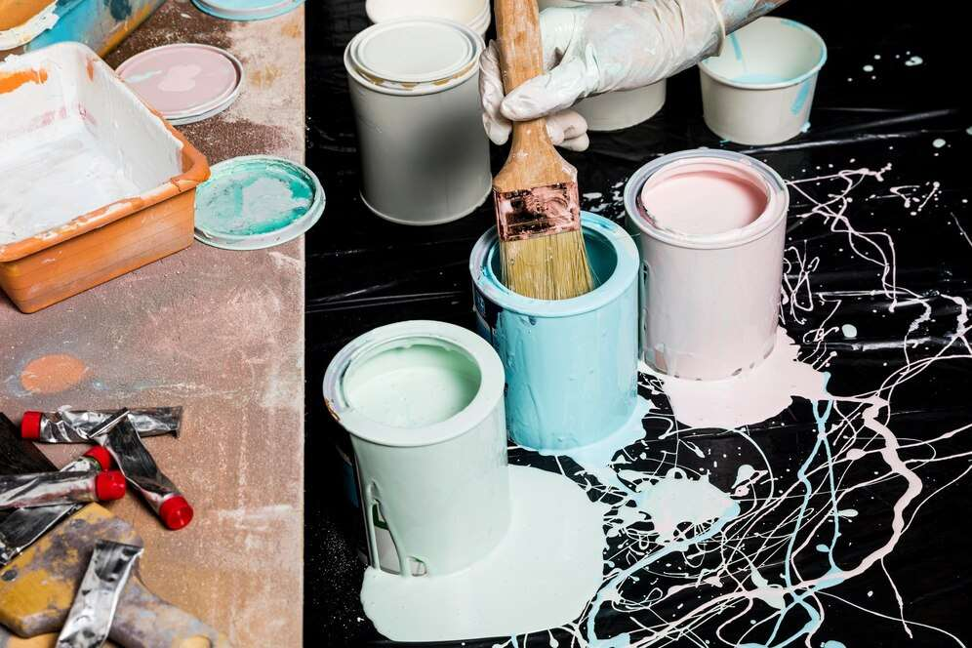
REVENUE MARKET SHARE BY SEGMENTS 2022
Automatic
USD 261.86 Million
By type
Architectural
USD 257.05 Million
By application

Slide 5

Global Paint Dispenser Market Revenue share for 2022
Asia Pacific
USD 70.26 Million

Slide 6
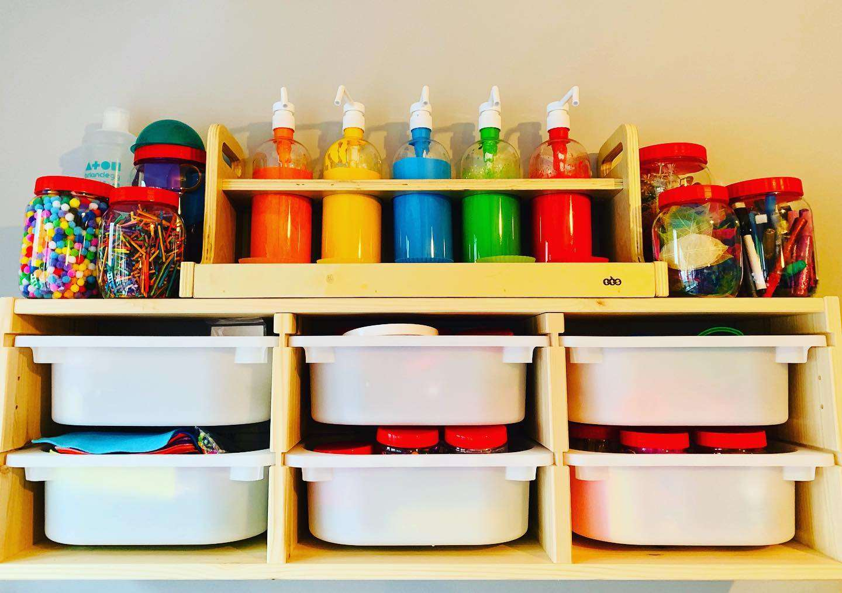
Rapidly growing automotive sector
Drivers
Fluctuation and inconsistency in raw material prices
Restraints

Slide 7

AUTHOR'S PERSPECTIVE
  The Global Paint Dispenser Market revenue in 2016: USD 506.52 Million
  Manual held for largest share of total revenue generated in 2019
  Architectural held maximum share of Paint Dispenser market in 2019
  The rapidly growing automotive sector and textile industry across the globe are some of the factors which are expected to drive the growth of paint dispenser market.
  Fluctuation and inconsistency in raw material prices may restrain the growth of paint dispenser market.
  Rise in global construction industry across the globe is expected to drive the growth of market in the following years.

Slide 8
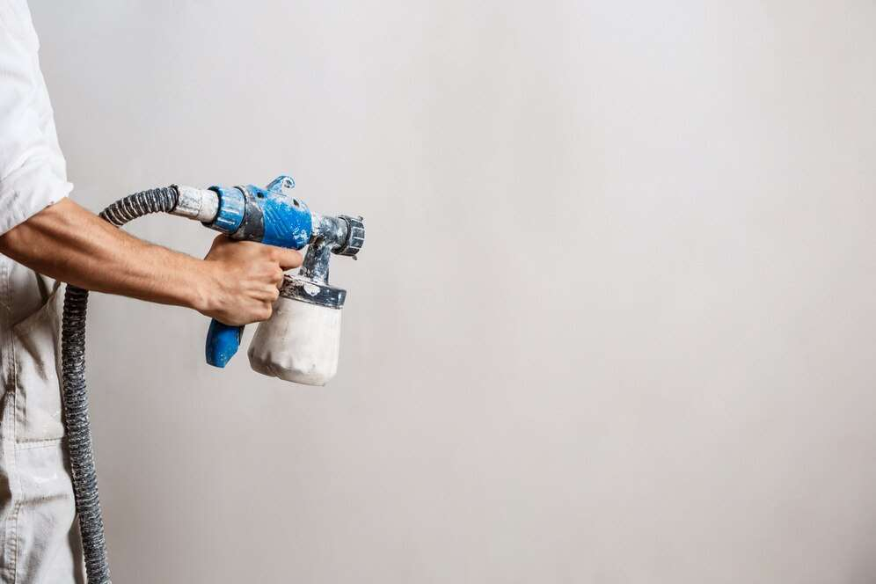









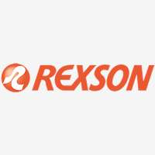

KEY PLAYERS

Slide 9


For Full Report
Contact us
COGNITIVE MARKET RESEARCH
Tel: +1 312-376-8303 | +44 020-8123-0732
India: (+91) 983-496-8611
sales@cognitivemarketresearch.com
Access the Full Report : https://tinyurl.com/5n7jdd4y
Please visit our website:
https://www.cognitivemarketresearch.com

