Slide 1

GLOBAL
PAINT BRUSH SET
MARKET REPORT
2024
Global,Regional,CountryAnalysis

Slide 2
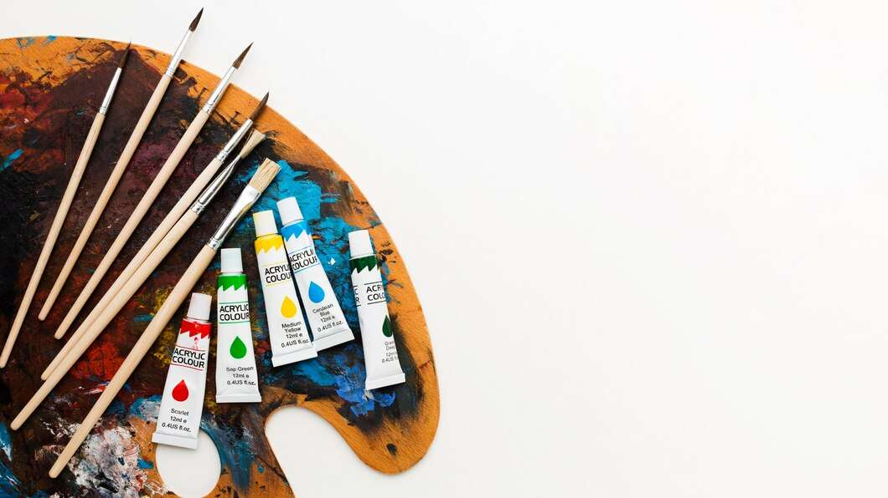
INTRODUCTION
In recent years, the paintbrush set industry has seen tremendous expansion and diversification. These sets, which include a variety of brushes for various painting techniques, appeal to a wide range of customers. Several factors influence the market, including the increase of the worldwide art and craft business, the growing popularity of DIY projects, and the expansion of the building and home renovation sectors. Professional artists, hobbyists, and DIY enthusiasts are among the customers. Furthermore, to accommodate changing consumer tastes, producers have incorporated creative designs and eco-friendly materials. The competitive landscape of the market is defined by both known brands and developing businesses, resulting in a diverse range of alternatives and price ranges.

Slide 3


KEY INSIGHTS
CAGR
5.90%
2023- 2030

Slide 4

REVENUE MARKET SHARE BY SEGMENTS 2022
  Animal Hair
  Synthetic Brush
Type Segment
  Automotive
  Aerospace and Defense
  Construction
Application Segment

Slide 5

Global Paint Brush Set Market Revenue share for 2024
North America
38%

Slide 6

Rising Disposable Incomes to Propel Market Growth
Drivers
Competition from Low-cost Imports to Restrict Market Growth
Restraints

Slide 7

AUTHOR'S PERSPECTIVE
  The Global Paint Brush Set Market is witnessing significant growth in the near future.
  Animal hair brushes, particularly those of high-quality materials such as sable, squirrel, or hog hair, remain a major driver in the paintbrush set market.
  Professional artists and discerning painters like them for their capacity to generate outstanding results, particularly in oil and watercolor painting.
  Paintbrush sets are essential for attaining a high finish when painting walls and ceilings or applying coatings to various surfaces.

Slide 8



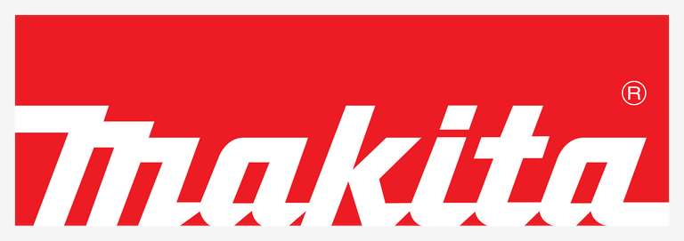







KEY PLAYERS

Slide 9


For Full Report
Contact us
COGNITIVE MARKET RESEARCH
Tel: +1 312-376-8303 | +44 020-8123-0732
India: (+91) 983-496-8611
sales@cognitivemarketresearch.com
Access the Full Report : https://tinyurl.com/4wafrtj9
Please visit our website:
https://www.cognitivemarketresearch.com

