Slide 1

GLOBAL
Packaged Coffee
Market Report 2024

Slide 2
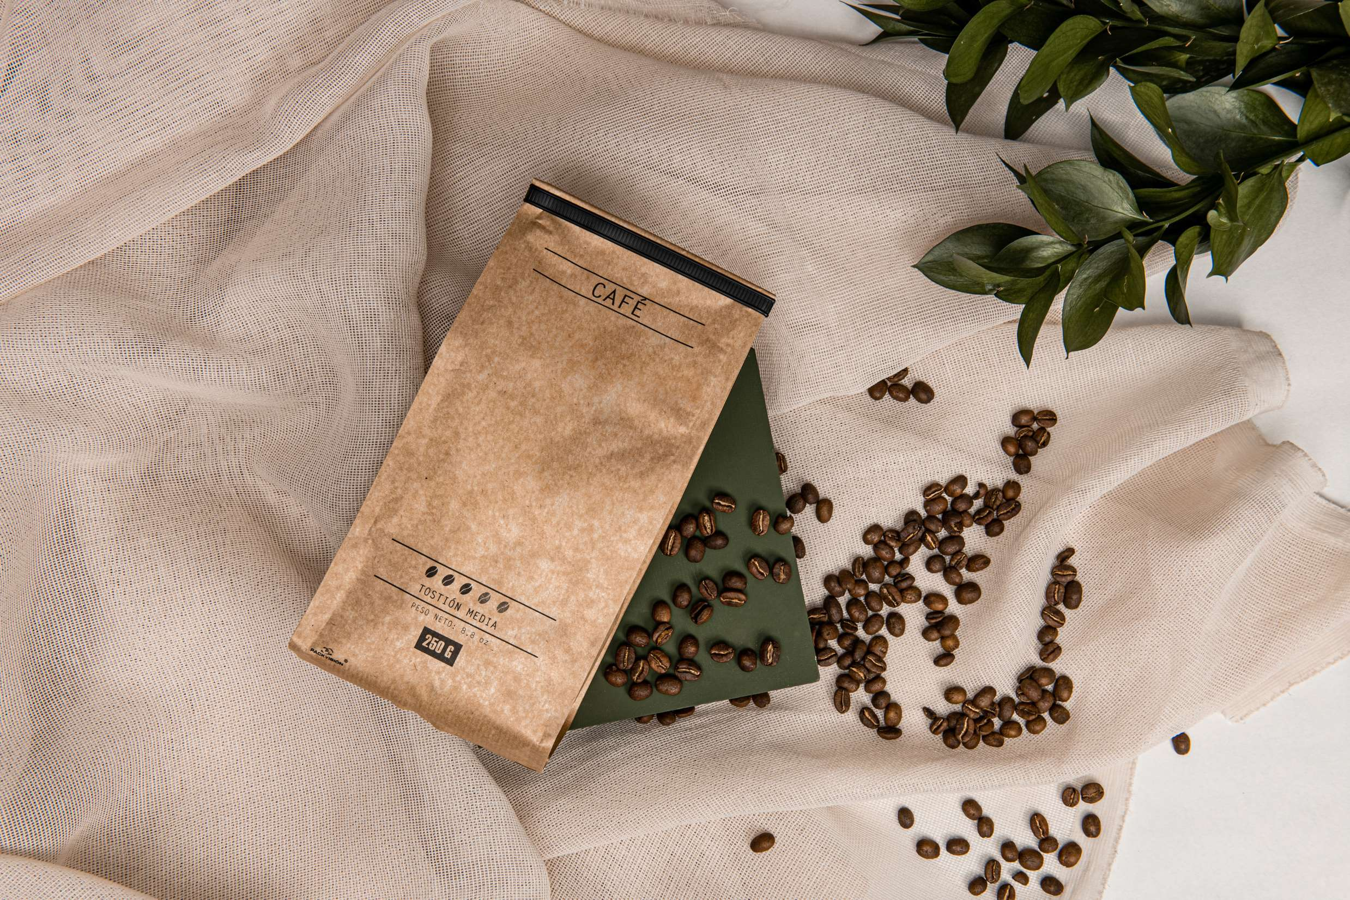
INTRODUCTION
Coffee that has been packaged and sold in a ready-to-drink state is referred to as ready-to-drink coffee. The packaging comes in a variety of forms, including the most popular PET bottles as well as cans, glasses, and tetra packs. The demand for beverages that are ready to drink has increased dramatically in recent years. The adoption of fast-paced lifestyles is the cause of the rising demand. Coffee is one of the most widely consumed beverages in the world and in recent years, demand for packaged coffee has grown significantly. The convenience and instant nature of packaged coffee are the main market drivers, manufacturing companies, distribution, and retailers all have opportunities to grow as a result of the rising demand for this product.

Slide 3

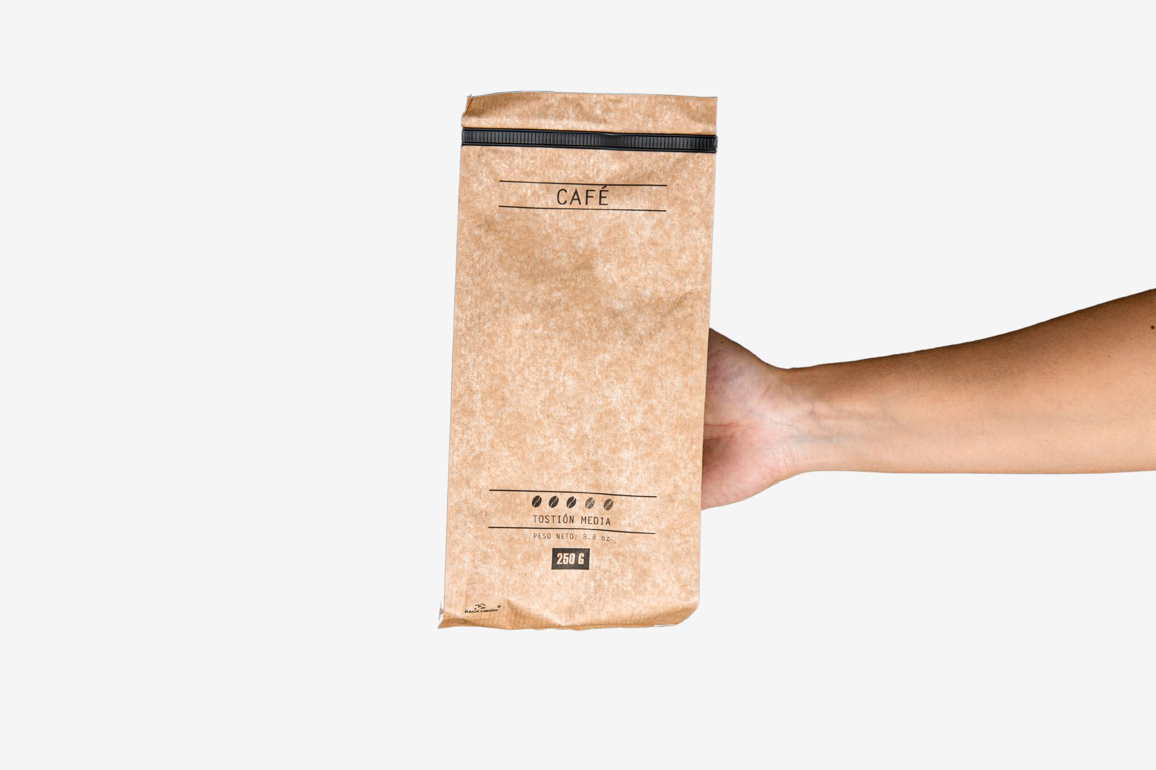

KEY INSIGHTS
MARKET SIZE
USD 27.95 Billion
2022
CAGR
7.2%
2023- 2030

Slide 4
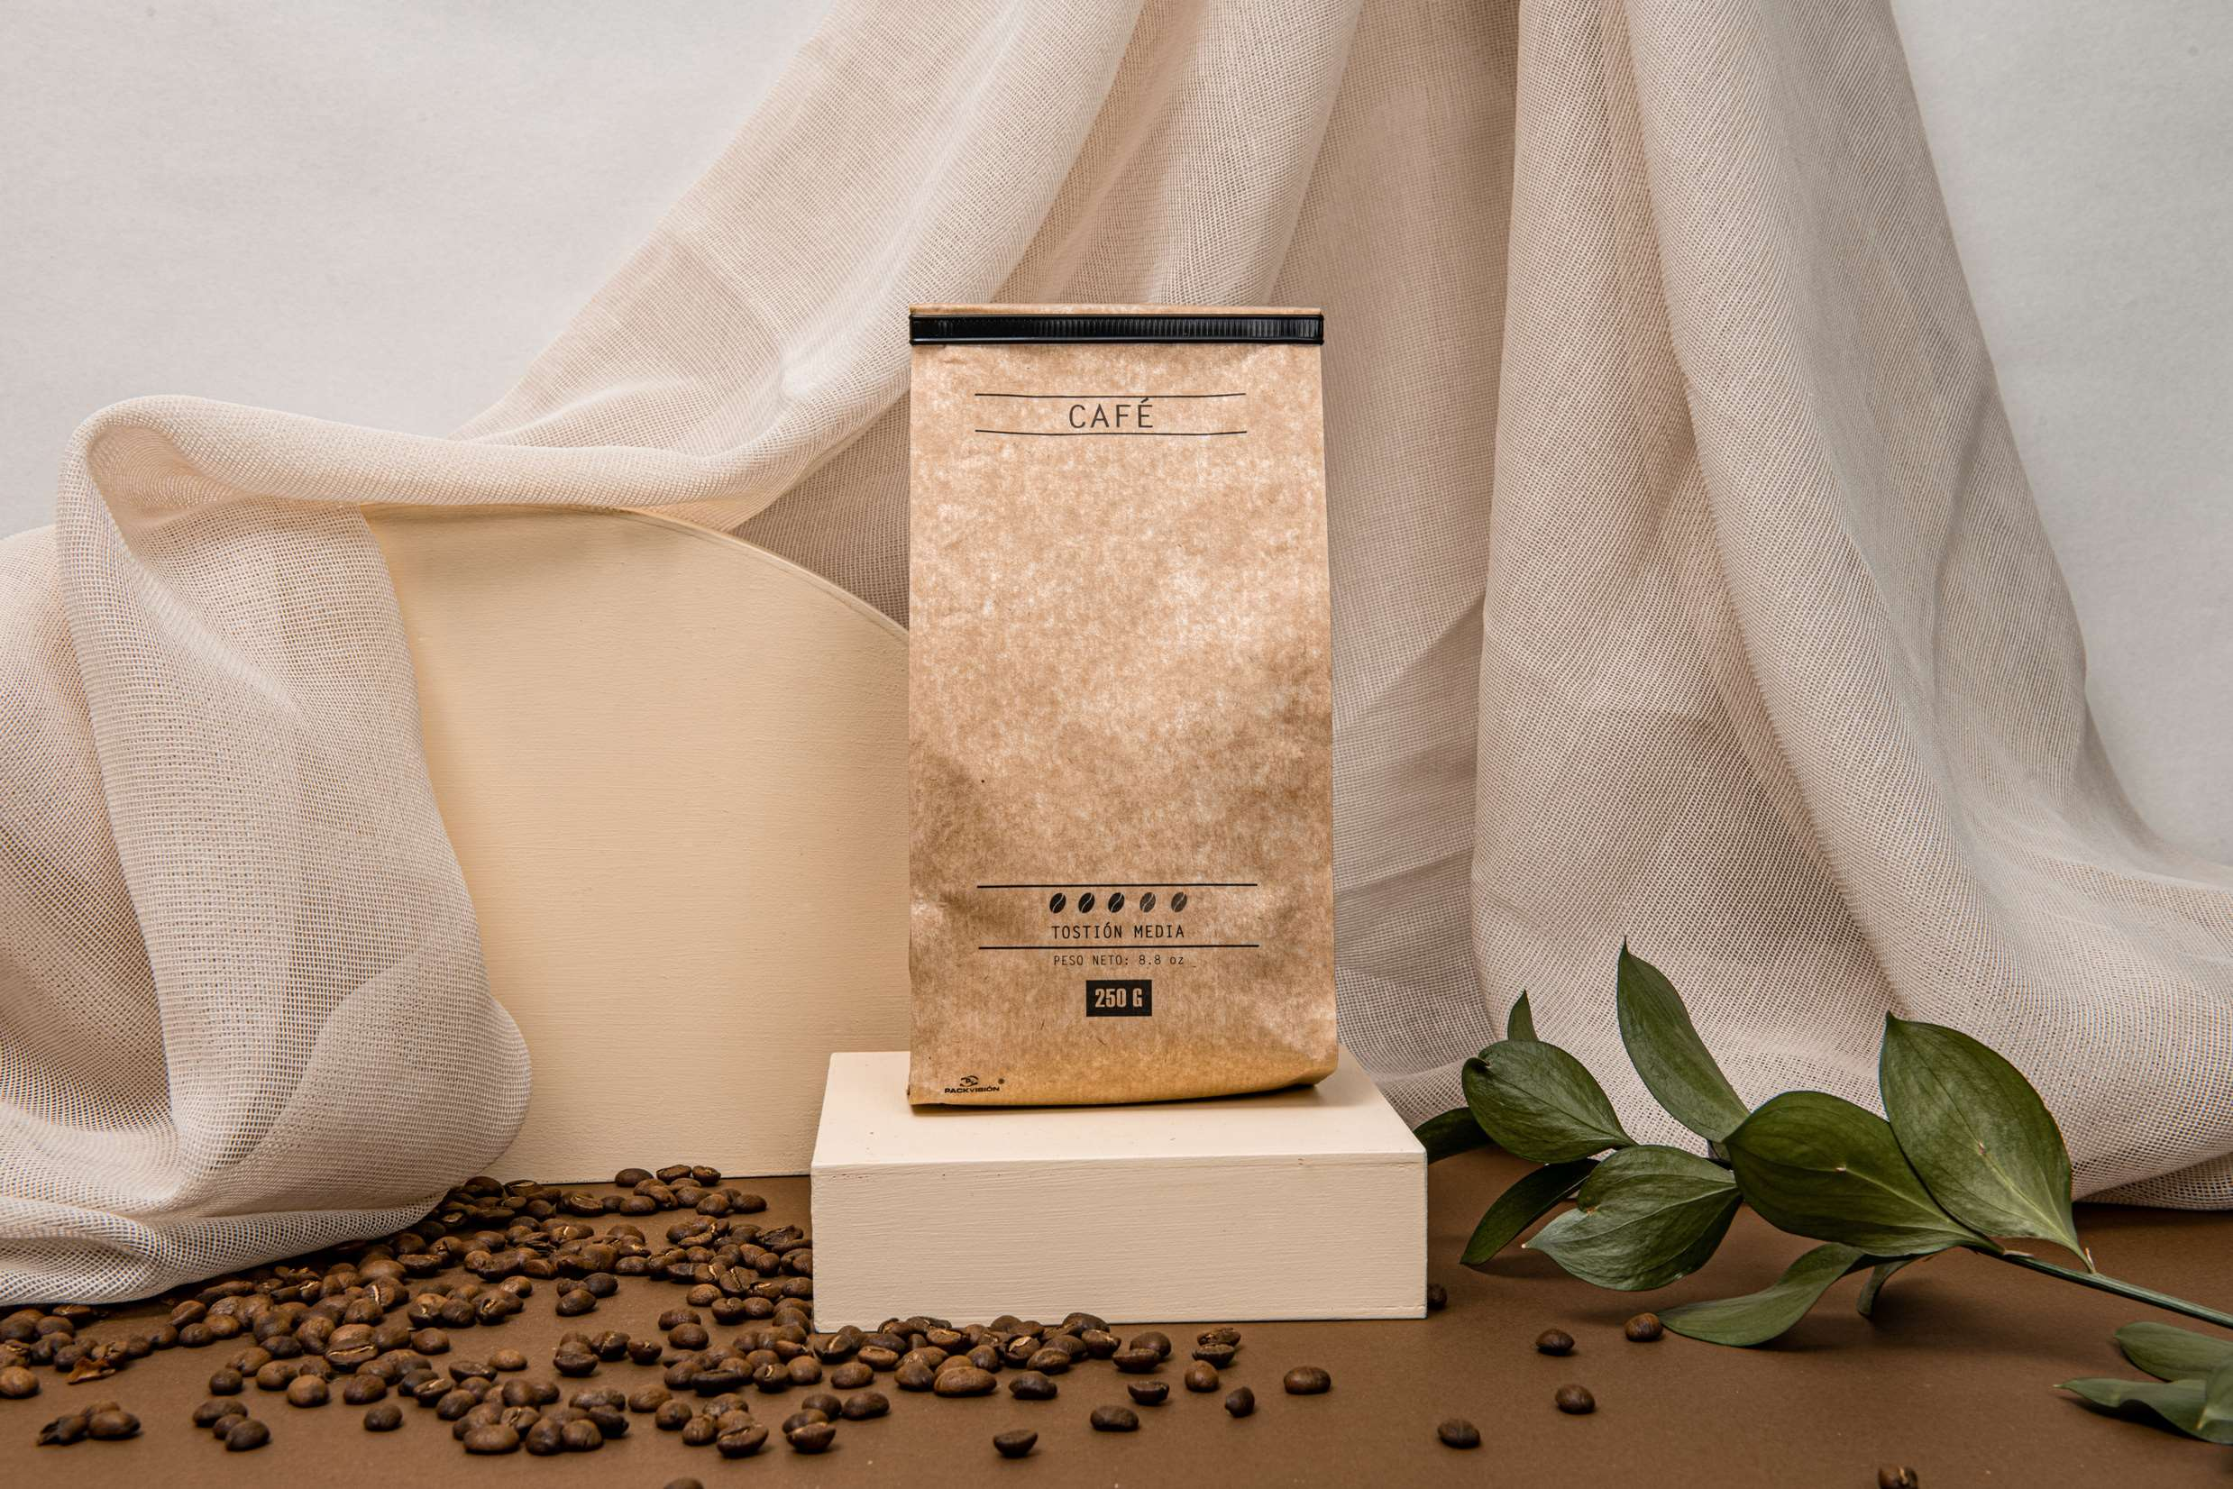
REVENUE MARKET SHARE BY SEGMENTS 2022
Canned segment
  Cans
  Glass bottles
Application Segment
  Residential
  Commercial
  Hypermarkets
  Online
  Business to Business
  Convenience Stores
Distribution Channel

Slide 5

Global Packaged Coffee Market Revenue share for 2022
North America

Slide 6

Increasing demand for ready-to-drink coffee boosts the Packaged Coffee market growth
Drivers
Variation in the cost of raw materials restrains the packaged coffee market
Restraints

Slide 7

AUTHOR'S PERSPECTIVE
  The Global Packaged Coffee Market is witnessing significant growth in the near future.
  In 2023, the Cans segment accounted for noticeable share of global Packaged Coffee Market and is projected to experience significant growth in the near future.
  The Residential segment is expected to expand at the significant CAGR retaining position throughout the forecast period.
  Some of the key companies Hindustan Unilever Limited, TATA Coffee Limited and others are focusing on its strategy building model to strengthen its product portfolio and expand its business in the global market.

Slide 8


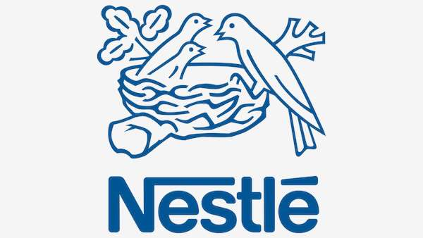
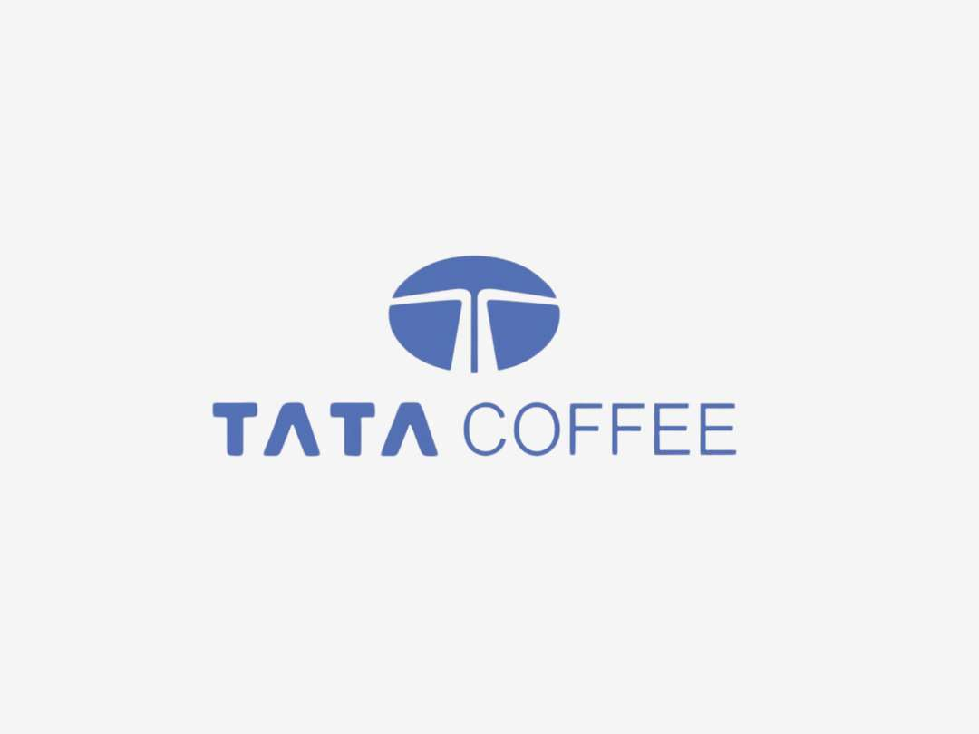


KEY PLAYERS

Slide 9


For Full Report
Contact us
COGNITIVE MARKET RESEARCH
Tel: +1 312-376-8303 | +44 020-8123-0732
India: (+91) 983-496-8611
sales@cognitivemarketresearch.com
Access the Full Report : https://tinyurl.com/5ykehjje
Please visit our website:
https://www.cognitivemarketresearch.com

