Slide 1
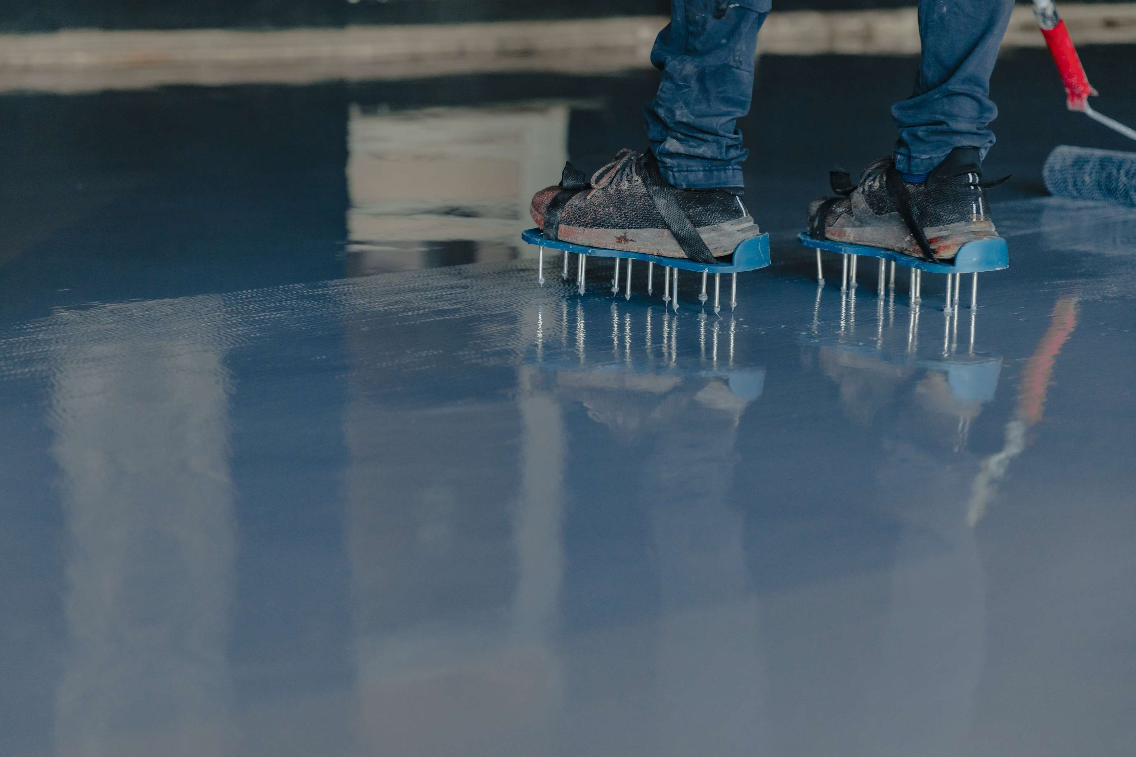
GLOBAL
PMMA RESIN FLOORING
MARKET REPORT 2024
Global,Regional,CountryAnalysis

Slide 2

INTRODUCTION
Poly (methyl methacrylate) (PMMA), often known as acrylic, acrylic glass, perspex, or plexiglass, as well as the trade names and brands Crylux, Plexiglas, Acrylite, Astariglas, Lucite, Perclax, and Perspex, among others (see below), is a transparent thermoplastic that is frequently used in sheet form as a lightweight or shatter-resistant alternative to glass.

Slide 3


KEY INSIGHTS
MARKET SIZE
USD 844.10 Million
2024
FORECAST
USD 2,680.89 Million
2030
CAGR
4.58%
2023- 2030

Slide 4
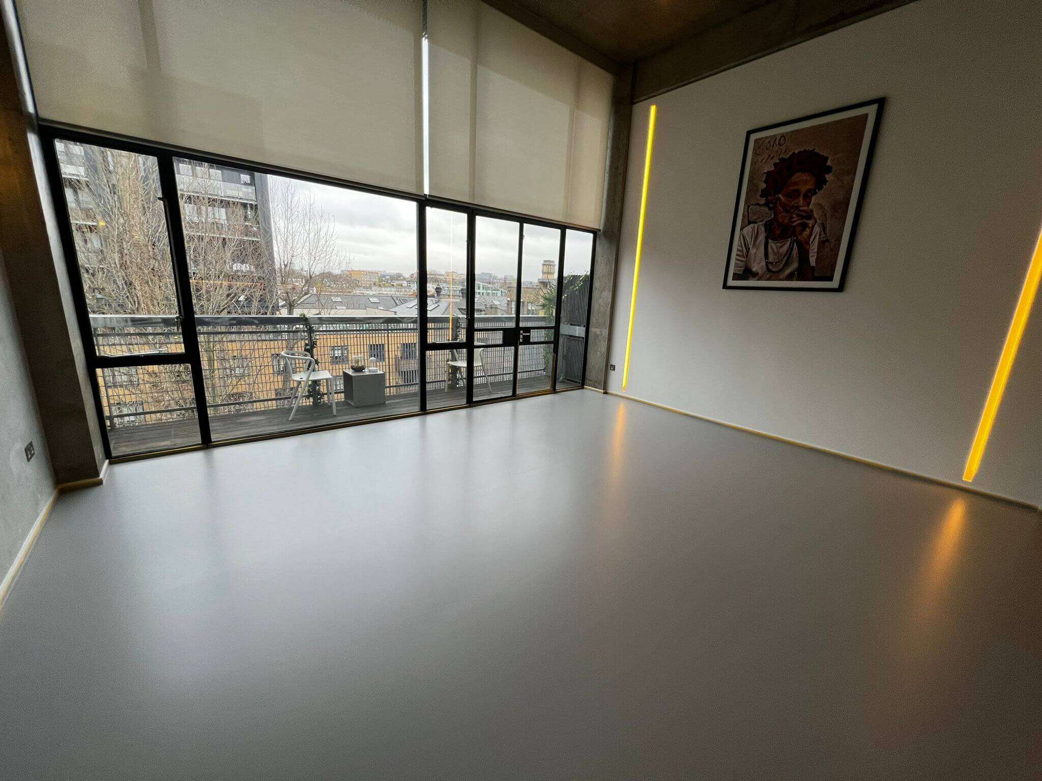
REVENUE MARKET SHARE BY SEGMENTS 2022
Optical Purpose
USD 989.10 Million
By Type
Food production
USD 400.47 Million
By Application
Light Thickness
USD 844.10 Million
Thickness Segment

Slide 5

Global PMMA Resin Flooring Market Revenue share for 2022
Asia Pacific
USD 1,097.82 Million

Slide 6
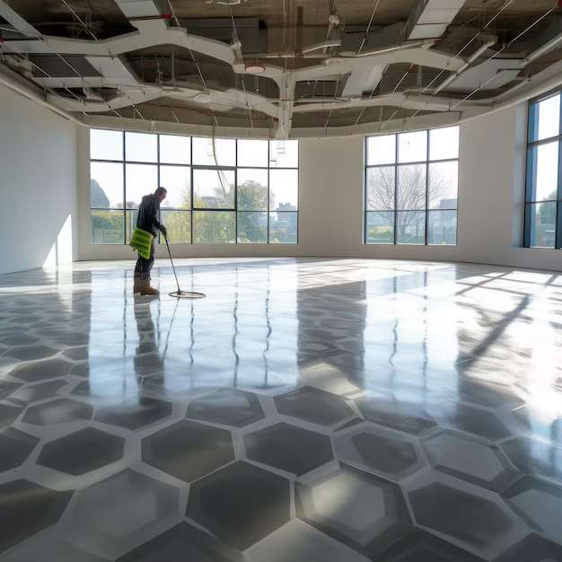
Rise in globalization and increase in the economies
Drivers
High costs of the PMMA resin flooring and Disruption in Supply Chain, owing to the prevalence of the COVID-19
Restraints

Slide 7
AUTHOR'S PERSPECTIVE
  PMMA can be tinted to any colour and embellished with a variety of decorative effects such as patterns, flakes, and even custom designs, logos, and branding.
  This resin creates a shatterproof, glass-like surface that may be installed quickly.
  To satisfy the required criteria for food preparation, flooring and walls must be seamless to eliminate spaces for bacterial development while also being durable enough to endure continuous traffic from forklift trucks, pallet trucks, and other pieces of equipment
  The light thick floorings are commonly used for to handle light foot traffic then a thickness of less than 1 mm is all that is necessary. In some cases, light use may need the use of a vehicle, such as a forklift.

Slide 8
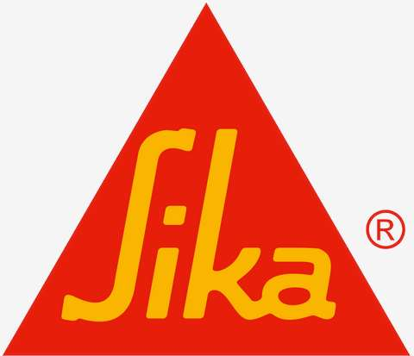





KEY PLAYERS

Slide 9


For Full Report
Contact us
COGNITIVE MARKET RESEARCH
Tel: +1 312-376-8303 | +44 020-8123-0732
India: (+91) 983-496-8611
sales@cognitivemarketresearch.com
Access the Full Report : https://tinyurl.com/yc72nrbn
Please visit our website:
https://www.cognitivemarketresearch.com

