Slide 1

GLOBAL
OUTDOOR PATIO UMBRELLA
MARKET REPORT 2024
Global,Regional,CountryAnalysis

Slide 2

INTRODUCTION
A patio umbrella is defined as an umbrella designed primarily for outdoor recreational use. A patio umbrella protects those who sit beneath it from the sun and other weather conditions.Patio umbrellas are frequently installed in outdoor areas of homes and businesses across the globe for both décor and leisure. It can be utilized in the garden and in places where people dine and relax, such as a restaurant, cafés, or hotels.

Slide 3


KEY INSIGHTS
MARKET SIZE
USD 928.17 Million
2017
FORECAST
USD 1,433.66 Million
2029
CAGR
6.32%
2023- 2030

Slide 4

REVENUE MARKET SHARE BY SEGMENTS 2022
Type segment
Application segment
Wall Mounted Umbrellas
USD 455.05 Million
Residential
USD 443.84 Million
Product Designs
Distribution channel
Table patio umbrella
USD 425.84 Million
Online
USD 572.20 Million

Slide 5
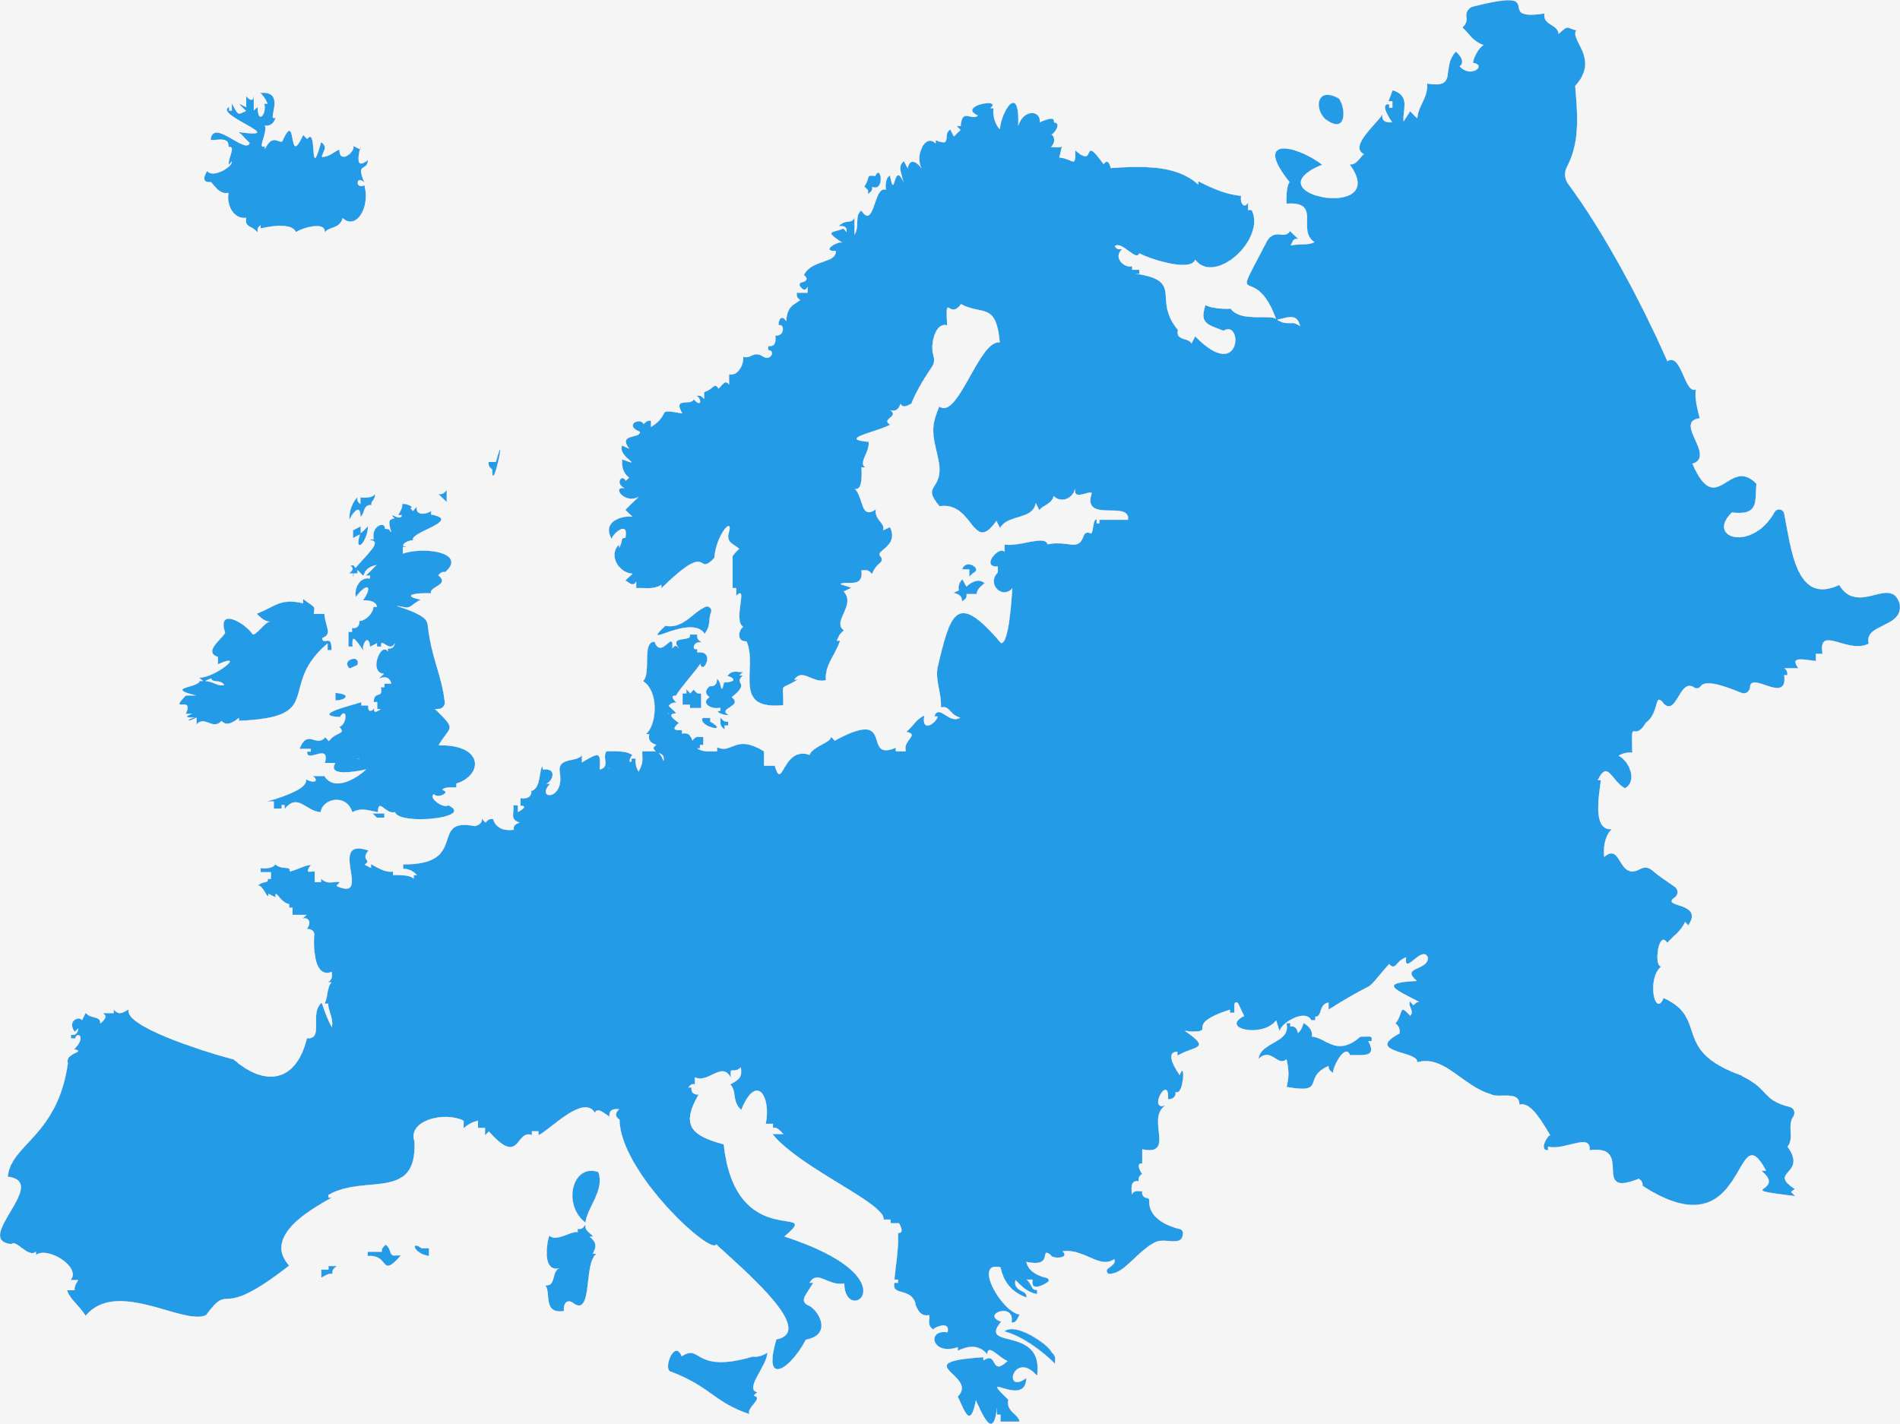
Global Outdoor Patio Umbrella Market Revenue share for 2022
Europe
USD 497.24 Million

Slide 6

Rapidly growing urbanization and changing lifestyle
Drivers
  Limitation on the use of Patio Umbrella
  High cost of the branded patio umbrellas.
Restraints

Slide 7
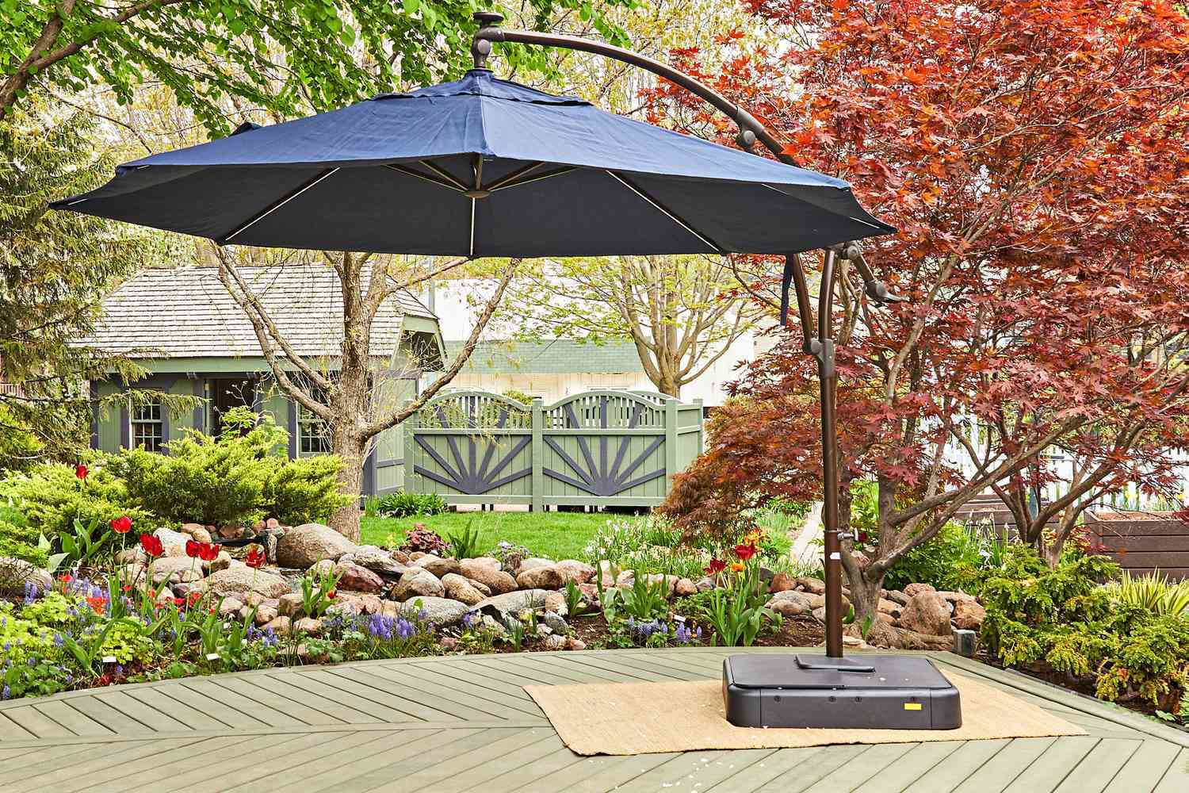
AUTHOR'S PERSPECTIVE
  The Global Optometry EMR Software Market revenue in 2016: USD 1,327.90 Million
  On Premise held for largest share of total revenue generated in 2019
  Small and Medium sized Enterprises (SMEs) held maximum share of Optometry EMR Software market in 2019.
  Speciality Centers held maximum share of Optometry EMR Software market in 2019
  Increasing incidence of visual impairment and rising digitization in healthcare propels the growth of the optometry EMR software market.
  High costs and lack of expertise limit the growth of the optometry EMR software market
  Rising government initiatives will provide enormous growth opportunities for the growth of the optometry EMR software market.

Slide 8













KEY PLAYERS

Slide 9


For Full Report
Contact us
COGNITIVE MARKET RESEARCH
Tel: +1 312-376-8303 | +44 020-8123-0732
India: (+91) 983-496-8611
sales@cognitivemarketresearch.com
Access the Full Report : https://tinyurl.com/4t2rafjx
Please visit our website:
https://www.cognitivemarketresearch.com

