Slide 1

GLOBAL
ORGANIC VEGETABLE SEEDS
MARKET REPORT
2024
Global,Regional,CountryAnalysis

Slide 2
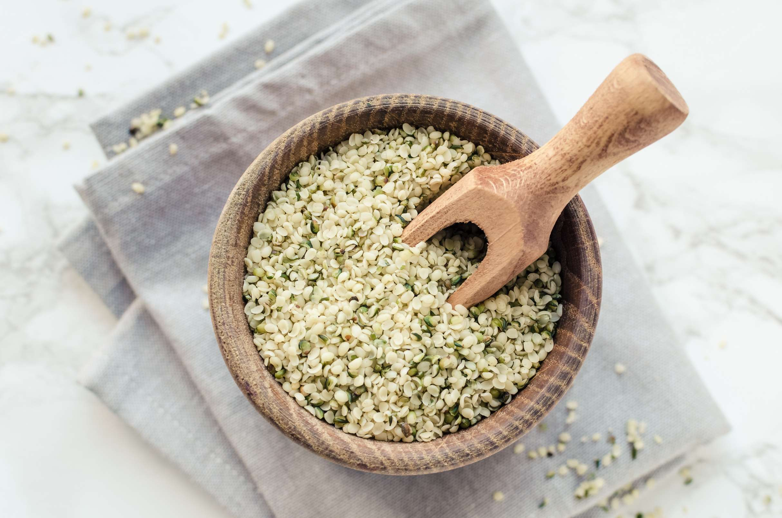
INTRODUCTION
The Organic Vegetable Seeds market is a subset of the larger organic agriculture industry, focusing specifically on the production and distribution of seeds for organic vegetable crops. Organic farming practices emphasize the use of natural fertilizers, crop rotation, and biological pest control methods, avoiding the use of synthetic chemicals and genetically modified organisms.Organic vegetable seeds are in higher demand than organic fruit seeds. Consumers are becoming more aware of the toxic chemical compounds found in their daily vegetable diets, as vegetables are typically grown with fertilisers and harmful pesticides. Organic vegetable seeds are in high demand throughout the world, fuelling the organic vegetable seed market.

Slide 3
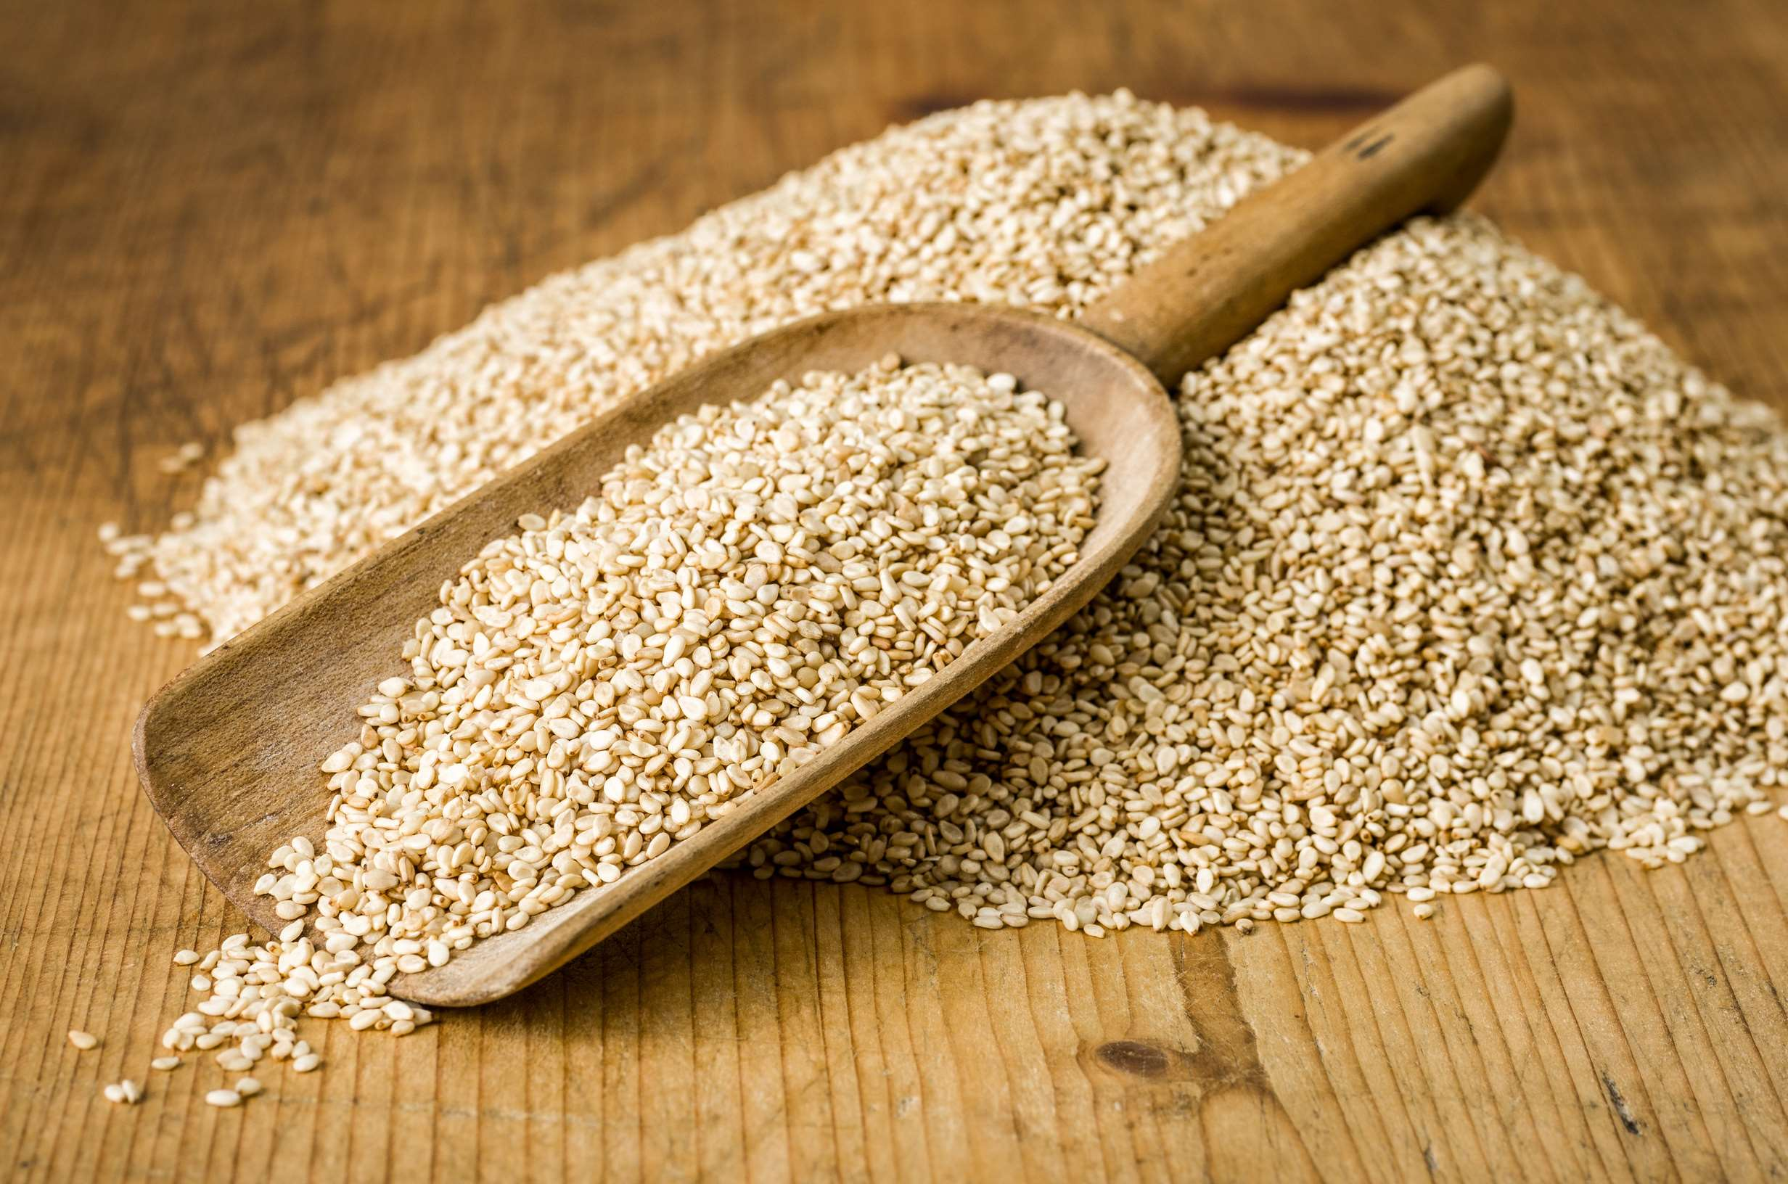

KEY INSIGHTS
MARKET SIZE
USD 3215.2 million
2024
CAGR
13.40%
2024- 2031

Slide 4
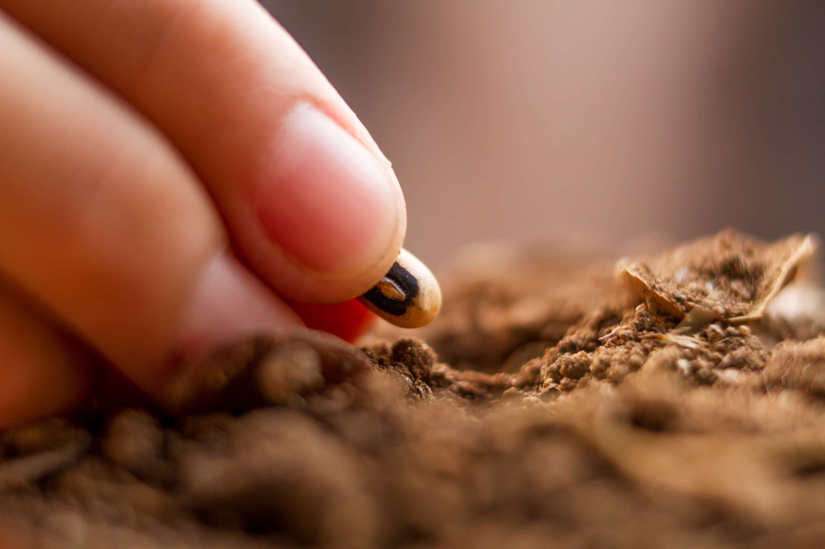
REVENUE MARKET SHARE BY SEGMENTS 2022
Outdoor
  Gardens
  Nurseries
  Field
Indoor
  Greenhouse
  Hydroponics
  Vertical Farming
Type Segment
  Retailers
  Wholesaler
  Cooperatives
  Online Channels
Distribution Channel
  Agriculture
  Horticulture
Application Segment

Slide 5

Global Organic Vegetable Seeds Market Revenue share for 2024
North America
40%

Slide 6
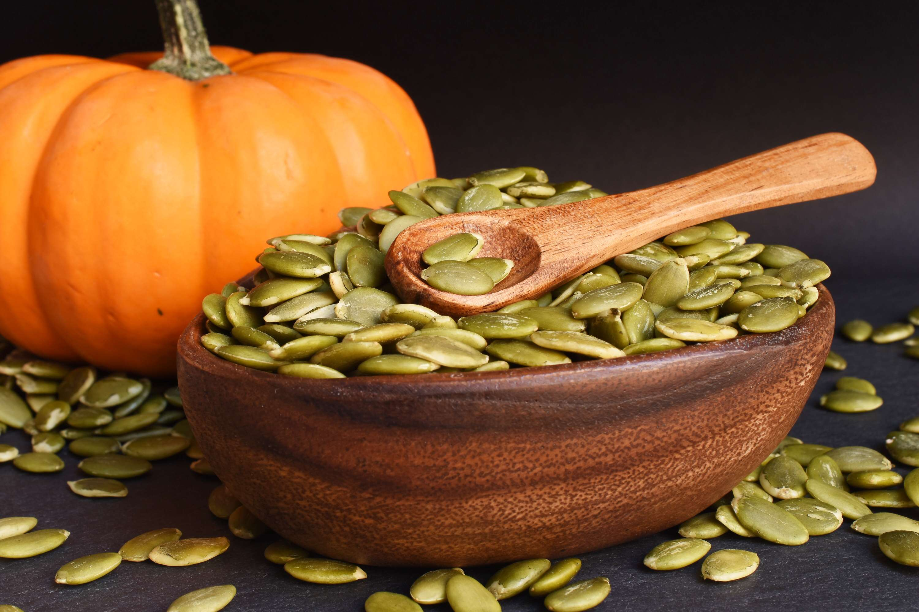
  Increasing Demand for Organic Produce to Increase the Demand Globally
  Government Support and Regulations to Propel Market Growth
Drivers
Higher Cost of Organic Seeds to Limit the Sales
Restraints

Slide 7
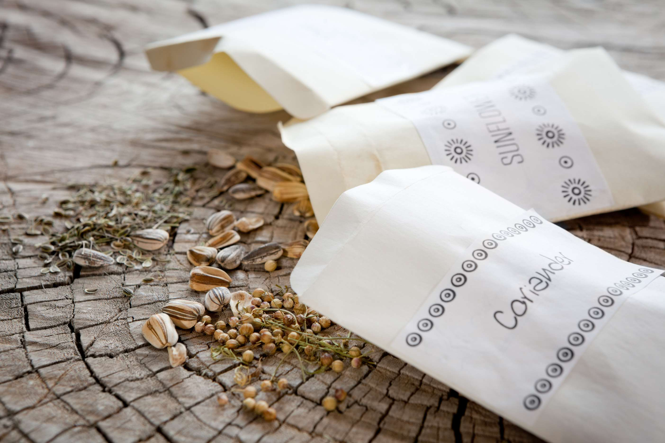
AUTHOR'S PERSPECTIVE
  The global Organic Vegetable Seeds market will expand significantly by 13.40% CAGR between 2024 to 2031.
  The dominant farm type category is outdoor farming. Outdoor farming has been traditionally practiced and accounts for a significant portion of agricultural production globally. Outdoor farming allows for larger-scale cultivation, leveraging natural sunlight and soil nutrients, which are conducive to organic farming practices..
  The dominant category is Agriculture in organic vegetable seed market. The demand for organic vegetable seeds in agriculture is driven by the growing consumer preference for organic produce, which has led farmers to adopt organic farming practices.

Slide 8
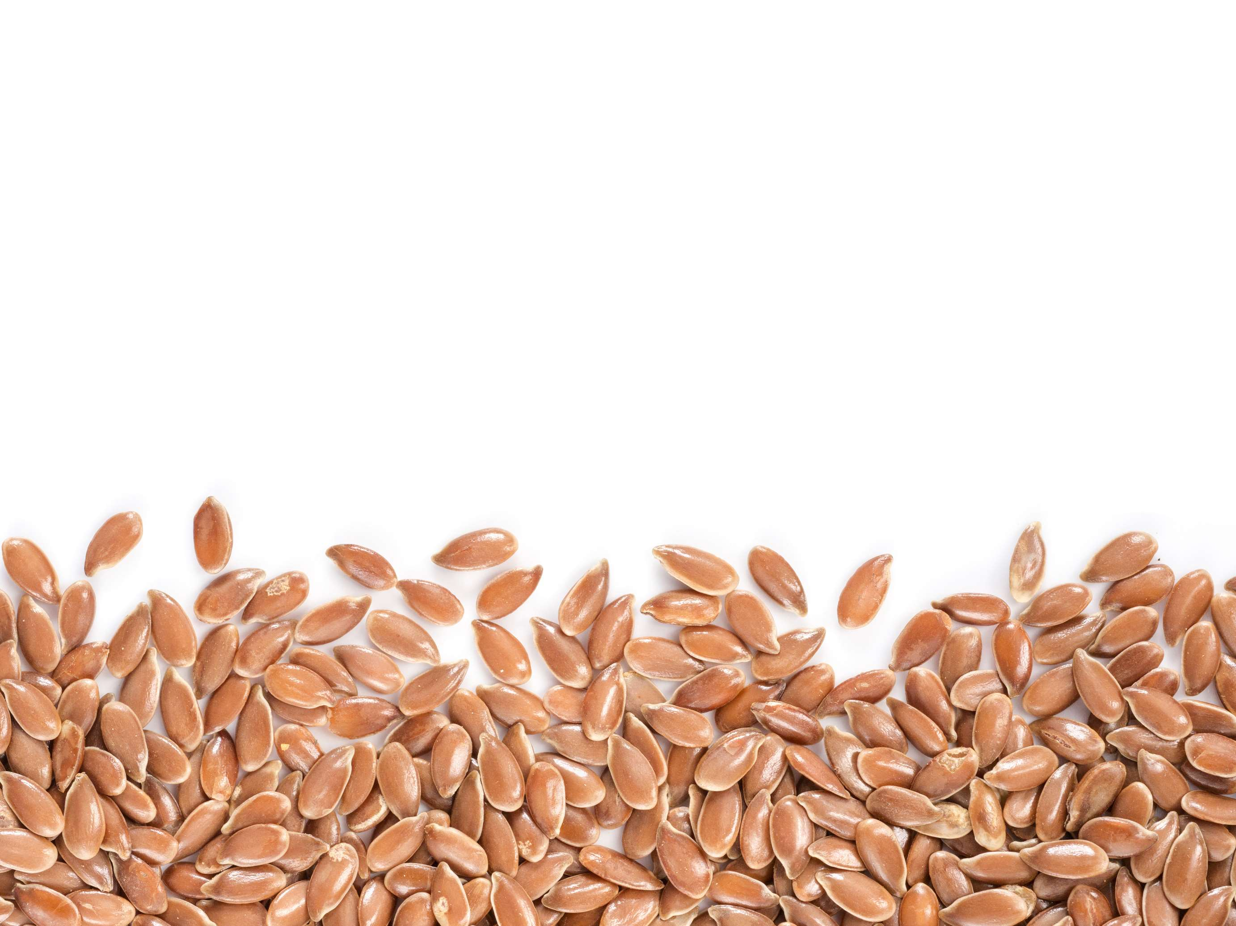





KEY PLAYERS

Slide 9


For Full Report
Contact us
COGNITIVE MARKET RESEARCH
Tel: +1 312-376-8303 | +44 020-8123-0732
India: (+91) 983-496-8611
sales@cognitivemarketresearch.com
Access the Full Report : https://tinyurl.com/4ck9kk7c
Please visit our website:
https://www.cognitivemarketresearch.com

