Slide 1
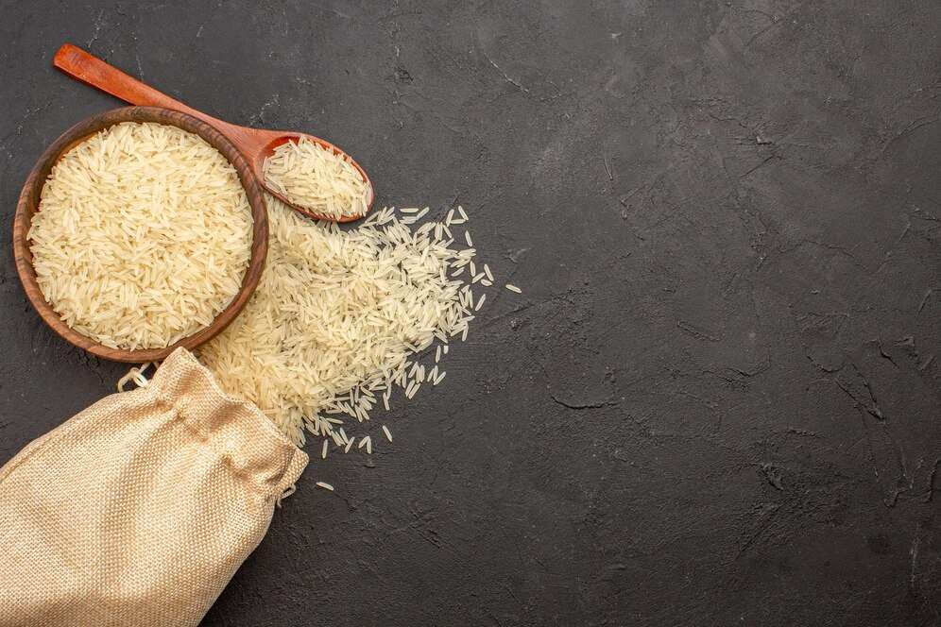

ORGANIC RICE
MARKET REPORT
2024
Qualitative Analysis + Quantitative Analysis

Slide 2
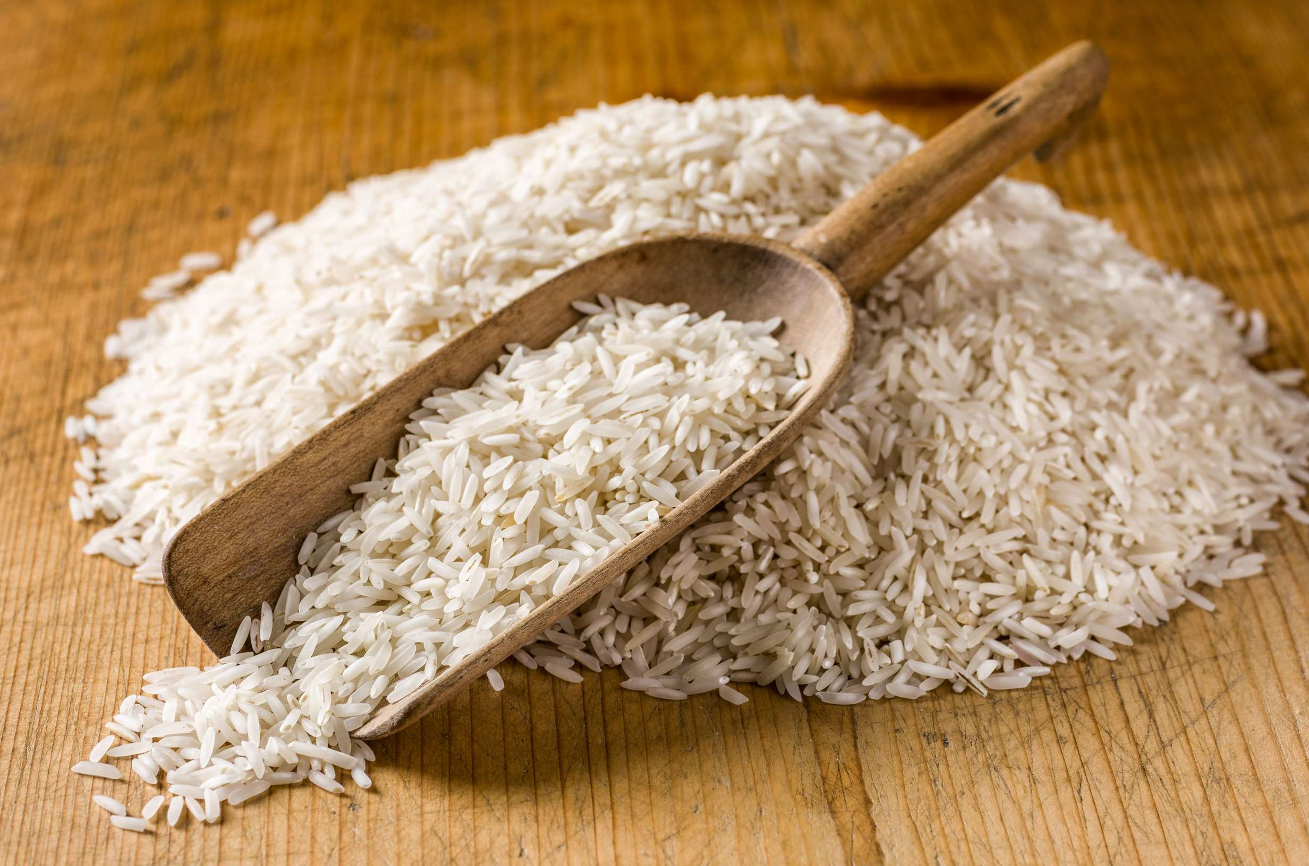
INTRODUCTION
The Organic Rice Market encompasses a segment of the market for intelligent toilets and is expected to continue to develop in the next years because of the rising demand from consumers for portable sanitary hygiene products. These products have a ceramic toilet arrangement, air conditioning, and warming water as standard features. Smart bathroom devices have been observed to have turned into fashion statements in developed nations, including the United States, the United Kingdom, Germany, and France. Industry partners are also offering the latest hygienic technologies, including U.V. lighting, auto flush, Bluetooth connectivity, and automated open seat covers, to clients in order to improve their experience in the bathroom. For manufacturers, increasing the production of organic food is crucial. Following the coronavirus outbreak, there has been a rise in demand for these products.

Slide 3


KEY INSIGHTS
MARKET SIZE
USD 2261.2 million
2024
CAGR
8.10%
2024- 2031

Slide 4
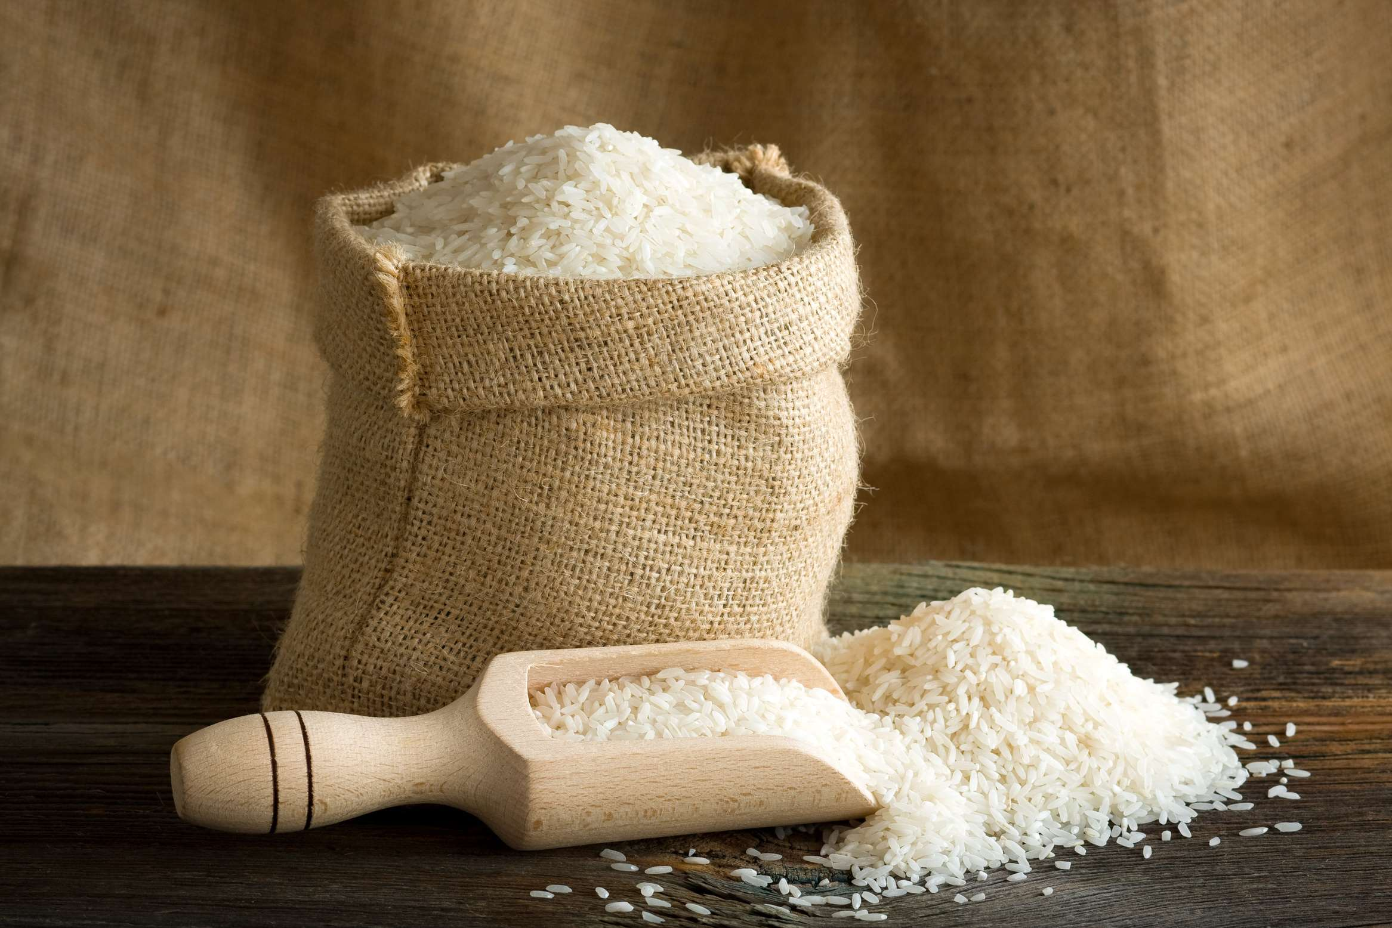
REVENUE MARKET SHARE BY SEGMENTS 2024
  Polished Round-grained Rice Type stands out as the dominating category
  Indica (long-shaped Rice) Type emerges as the fastest-growing category in the Organic Rice Market
Type Segment
  the dominating category is Organic white rice.
  The fastest-growing category in the Organic Rice Market is Organic brown rice.
Rice Type Segment

Slide 5
REVENUE MARKET SHARE BY SEGMENTS 2024
Application Segment
  Direct Edible
  Deep Processing
  Bakery & Confectionary
  Beverages
  Desert & Dairy Products
  Meat
  Poultry & Seafood Products
  Infant Formula
End User Segment

Slide 6

REGION ANALYSIS
NORTH AMERICA
Europe
Asia Pacific
Latin America
MIDDLE EAST AFRICA
40%
30%
23%
5%
2%
North America Organic Rice Market Revenue share for 2024 is 40%

Slide 7
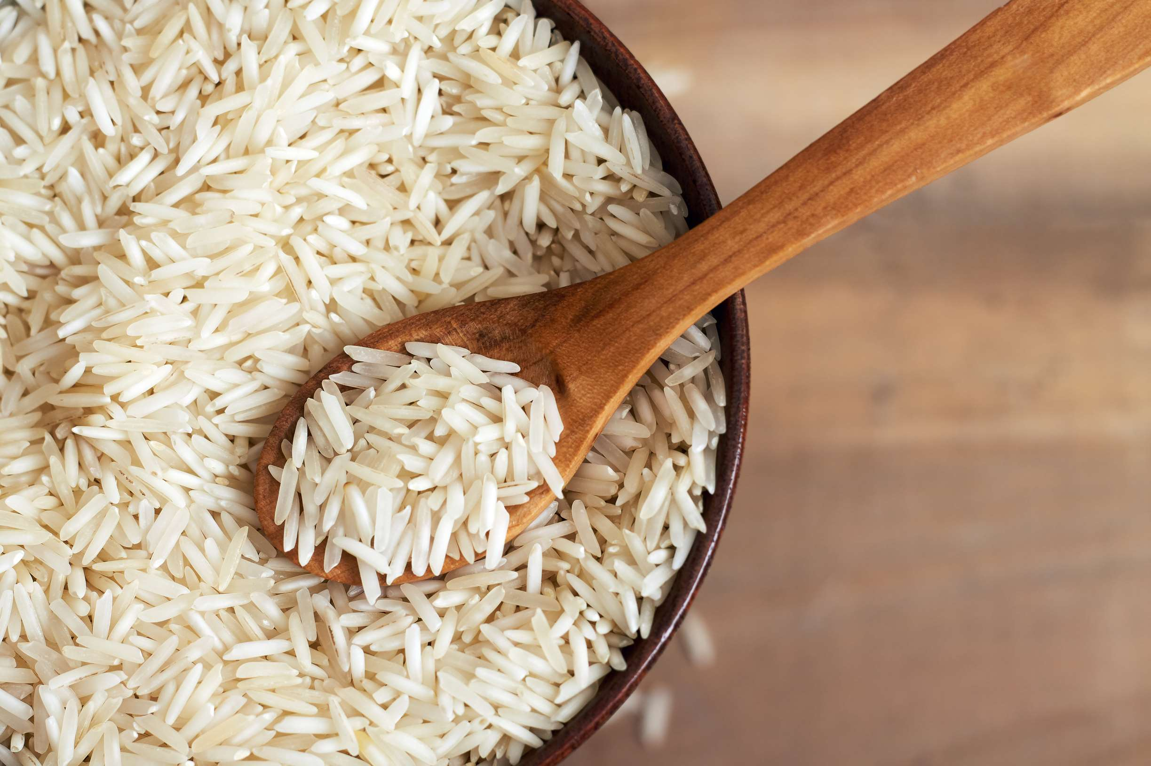
  Rising Interest in Organic Food to Increase the Demand Globally
  Rising Interest in Organic Food to Increase the Demand Globally
Drivers
Restraints
Time-Consuming Procedures to Limit the Sales

Slide 8
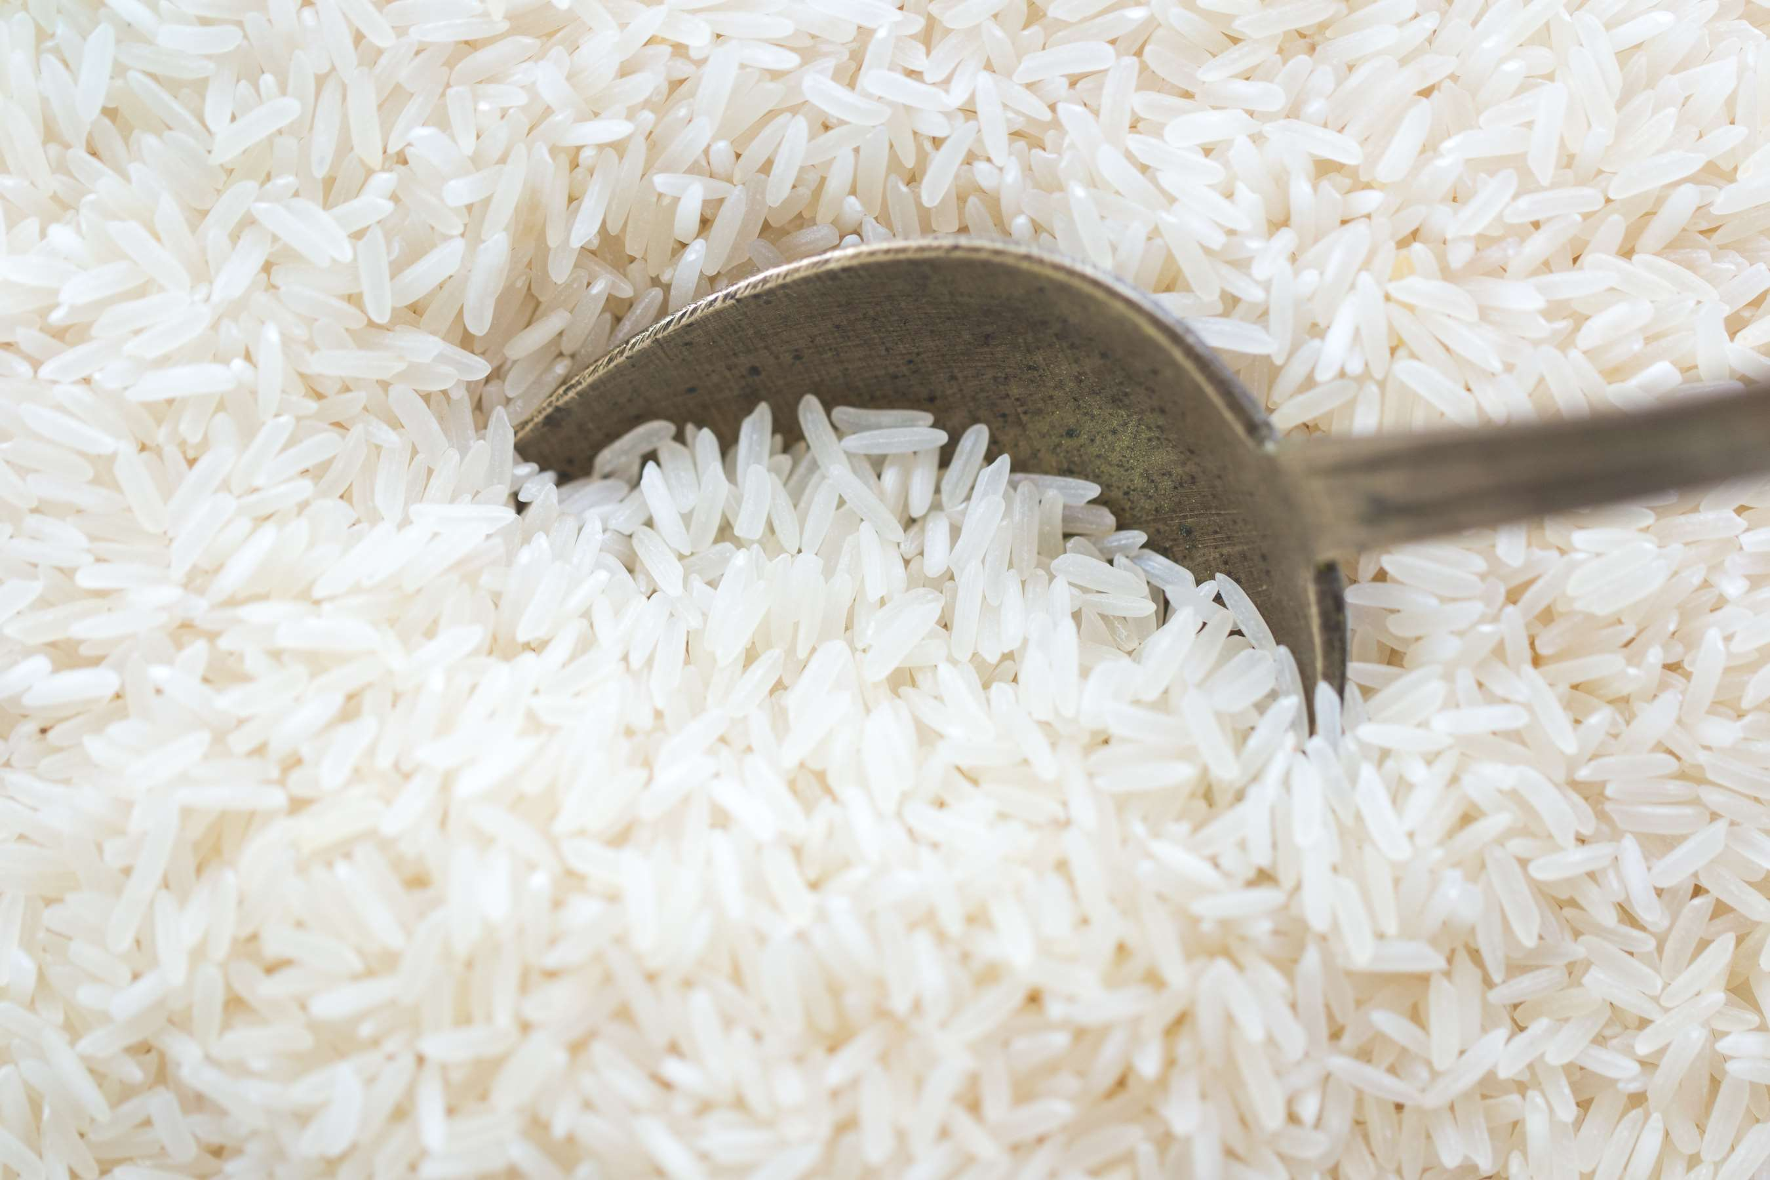
AUTHOR'S PERSPECTIVE
  The global Organic Rice Market will expand significantly by 8.10% CAGR between 2024 to 2031.
  Polished Round-grained Rice Type stands out as the dominating category.
  The sticky feel of polished round-grained rice makes it a popular ingredient in sushi, risotto, and other recipes that call for it.
  The dominating category is Organic white rice.
  White rice is widely available and is preferred for its flavor and texture by many customers.

Slide 9




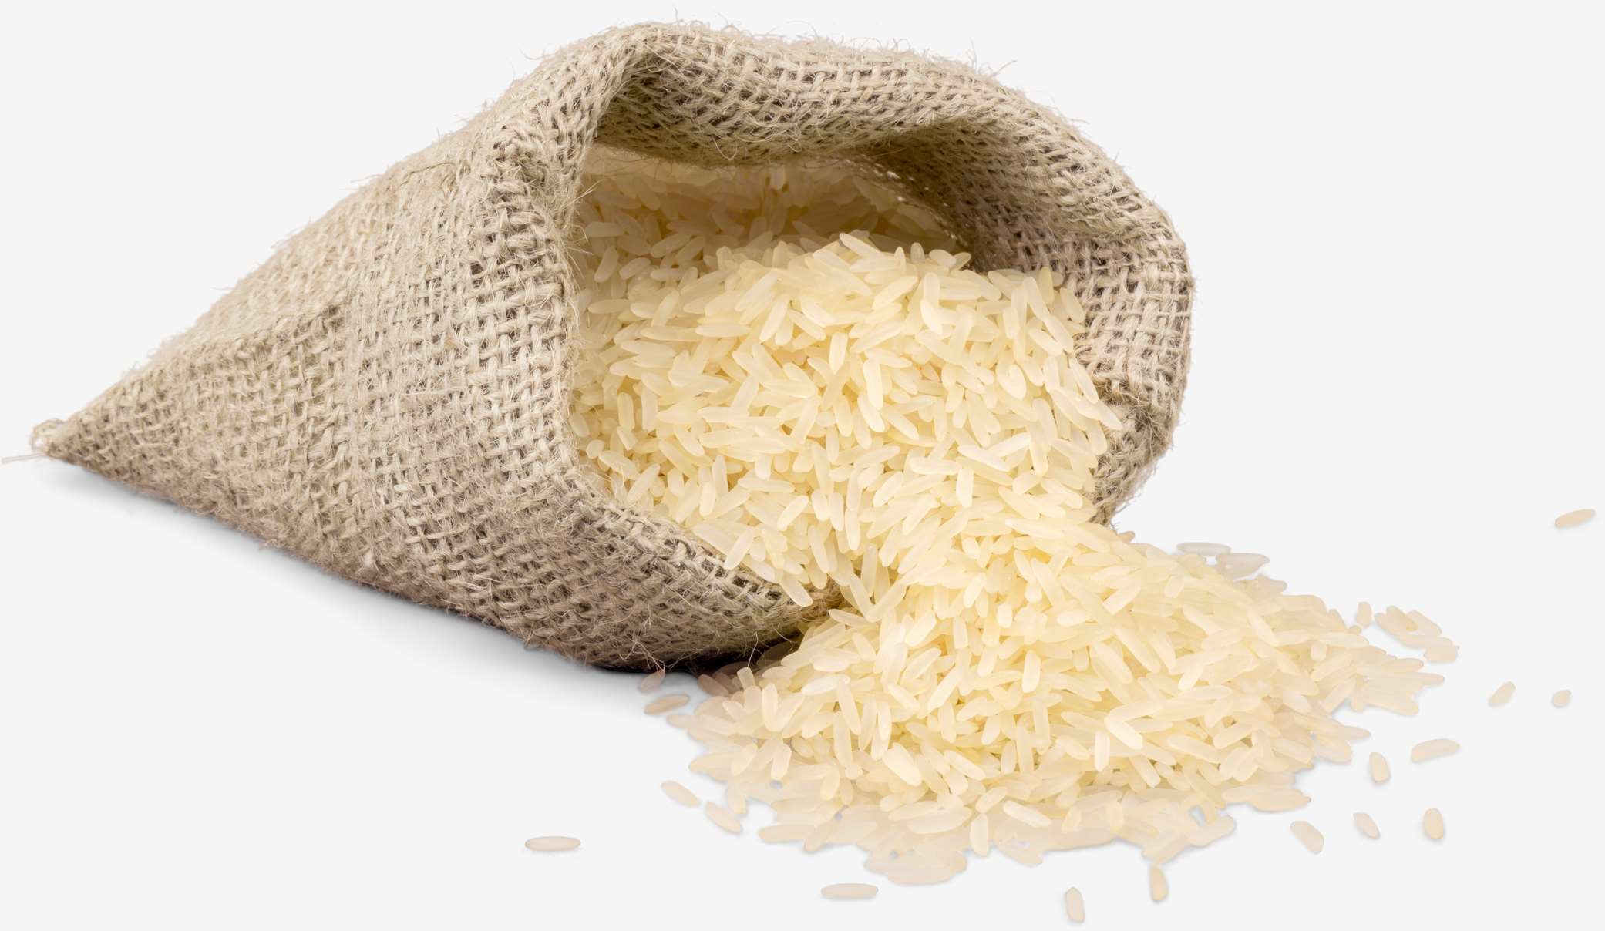



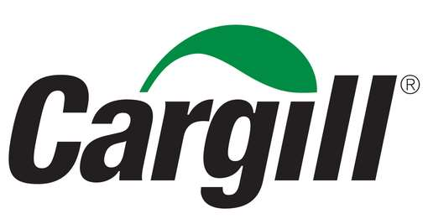

KEY PLAYERS

Slide 10


For Full Report
Contact us
COGNITIVE MARKET RESEARCH
Tel: +1 312-376-8303 | +44 020-8123-0732
India: (+91) 983-496-8611
sales@cognitivemarketresearch.com
Access the Full Report : https://tinyurl.com/mdmb8jwr
Please visit our website:
https://www.cognitivemarketresearch.com

