Slide 1
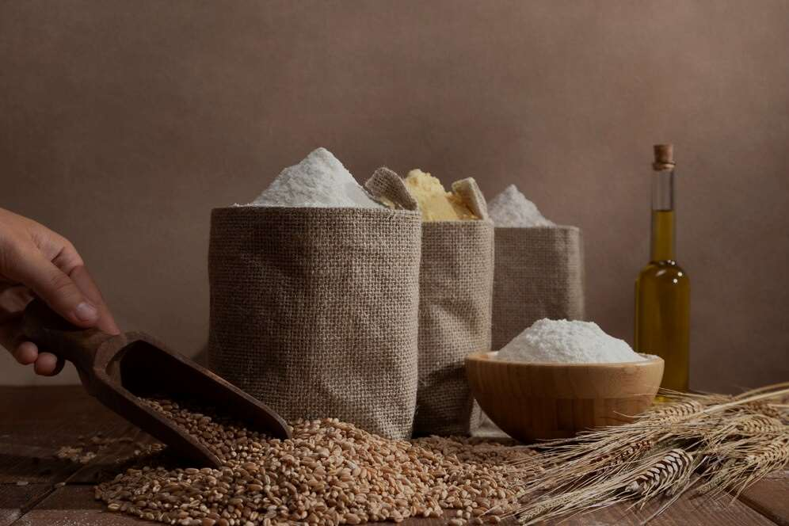

ORGANIC MILLET FLOUR
MARKET REPORT
2024
Qualitative Analysis + Quantitative Analysis

Slide 2
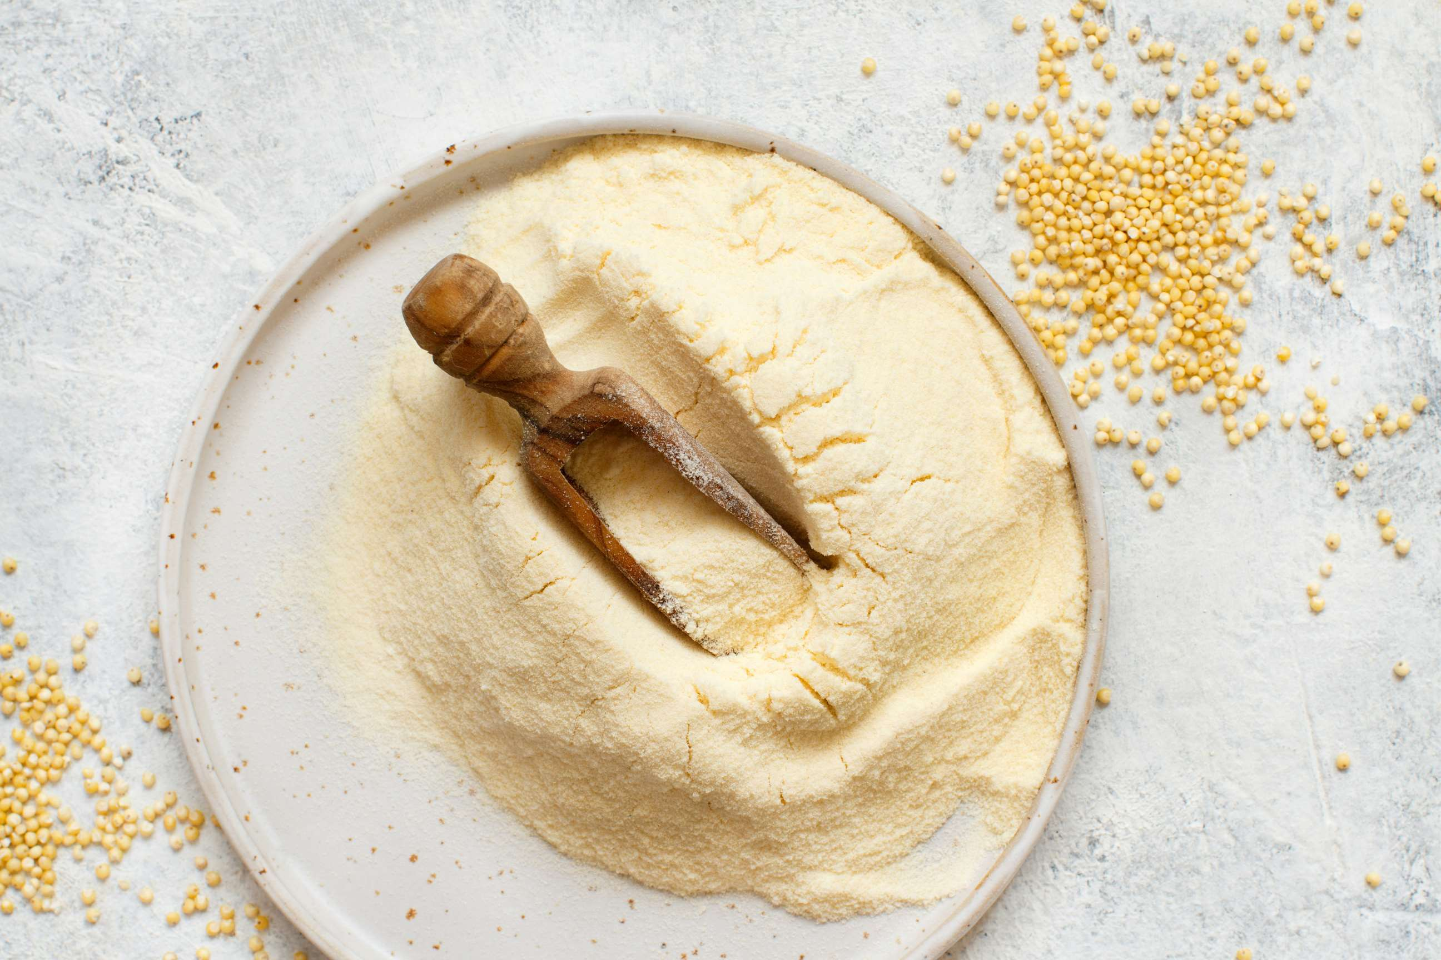
INTRODUCTION
Organic millet flour is a finely ground powder made from organically grown millet seeds. It is gluten-free, nutritious, and versatile, suitable for various culinary applications. The organic millet flour market is experiencing a surge due to favorable government support, fostering growth and sustainability. Government initiatives, such as subsidies for organic farming and infrastructure development, bolster production and distribution. Consumers increasingly seek healthier alternatives, driving demand for millet flour, known for its nutritional benefits. With rising health consciousness and support from authorities, the organic millet flour market is poised for expansion, offering both economic opportunities for farmers and healthier options for consumers, thus contributing to a more sustainable food ecosystem.

Slide 3
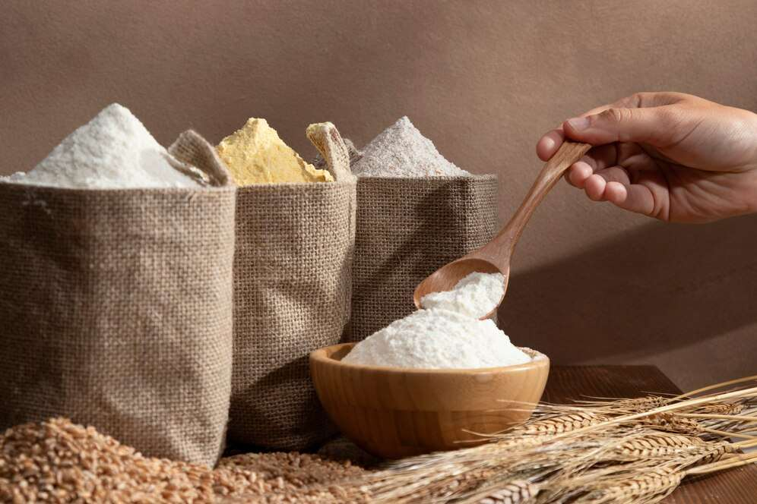

KEY INSIGHTS
MARKET SIZE
USD 5518.2 million
2024
CAGR
4.40%
2024- 2031

Slide 4
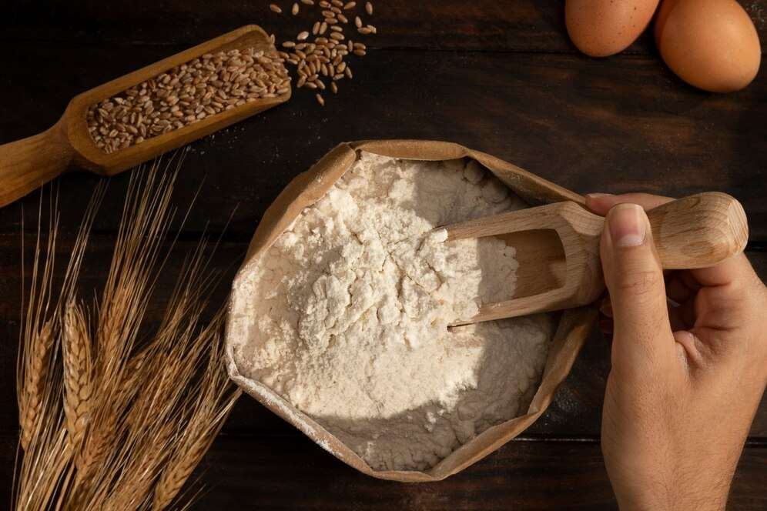
REVENUE MARKET SHARE BY SEGMENTS 2024
  Finger stands out as the dominating category due to an expansion in order for gluten-free and healthy options.
  Pearl emerged as the fastest-growing category in the organic millet flour market. Its nutritional advantages, including high fiber and protein range, appeal to health-conscious customers.
Type Segment
  The household category held the major market share due to increasing awareness of millet's nutritional advantages and its versatility in cooking.
  The fastest-growing category in the organic millet flour market is commercial due to the growing customer need for gluten-free and nutritious options.
End-Use Segment

Slide 5
REVENUE MARKET SHARE BY SEGMENTS 2024
  Hypermarkets/Supermarkets
  Convenience Stores
  Mom & Pop Stores
  Discount Stores
  Food & Drink Specialty Stores
  Independent Small Groceries
  Online Retail
Sales Channel Segment
  Sacks
  Pouches
  Barrels
  Cans
  Others
Packaging Segment

Slide 6

REGION ANALYSIS
NORTH AMERICA
Europe
Asia Pacific
Latin America
MIDDLE EAST AFRICA
40%
30%
23%
5%
2%
North America Organic Millet Flour Market Revenue share for 2024 is 40%

Slide 7
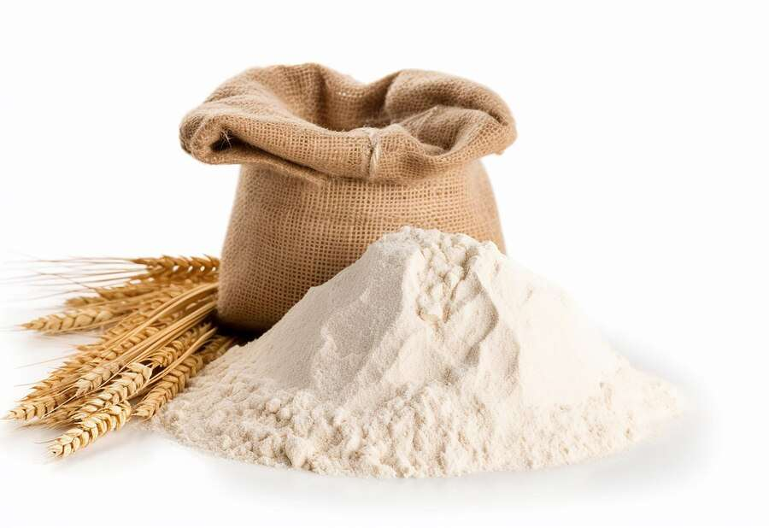
  Health Benefits Associated with Consumption of Millet Flour to Increase the Demand Globally
  Increasing Consumer Preference for Gluten-Free Food Products to Propel Market Growth
Drivers
Competition from Other Gluten-Free Alternatives to Limit Market
Restraints

Slide 8
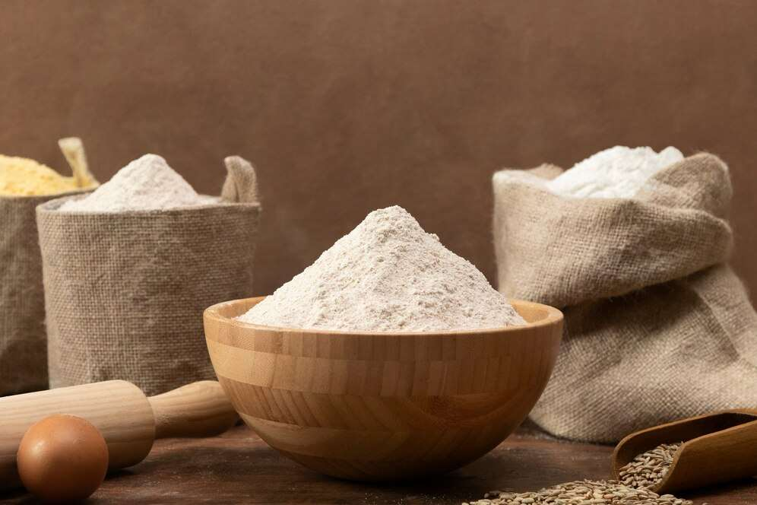
AUTHOR'S PERSPECTIVE
  The global organic millet flour market will expand significantly by 4.40% CAGR between 2024 to 2031.
  Hypermarkets and supermarkets are the dominant category due to health-conscious consumers seeking diverse, gluten-free options.
  Convenience, health awareness, and sustainability drive its growth.
  The dominant category is pouches due to the growing demand for convenient, eco-friendly pouch packaging coupled with the rising popularity of organic millet flour.

Slide 9
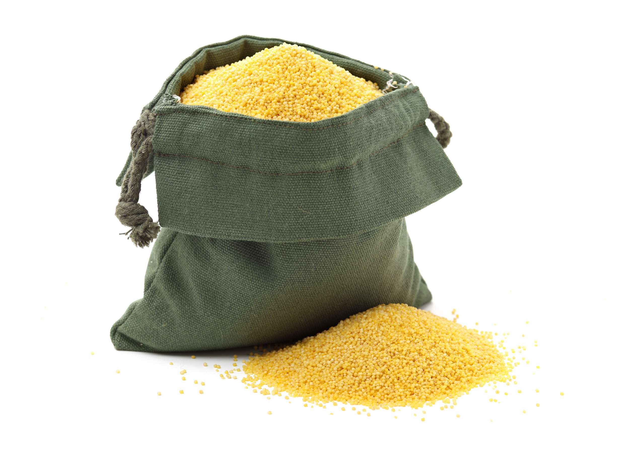



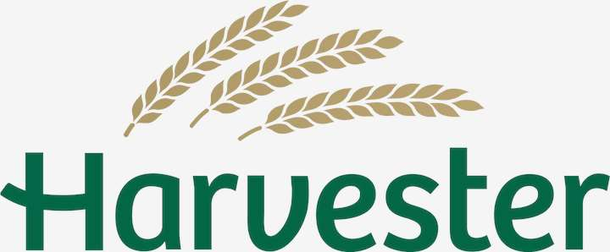
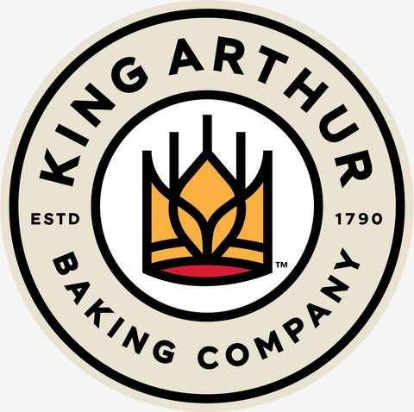



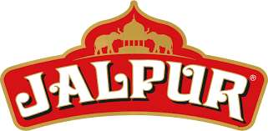
KEY PLAYERS

Slide 10


For Full Report
Contact us
COGNITIVE MARKET RESEARCH
Tel: +1 312-376-8303 | +44 020-8123-0732
India: (+91) 983-496-8611
sales@cognitivemarketresearch.com
Access the Full Report : https://tinyurl.com/3vcuc3wd
Please visit our website:
https://www.cognitivemarketresearch.com

