Slide 1
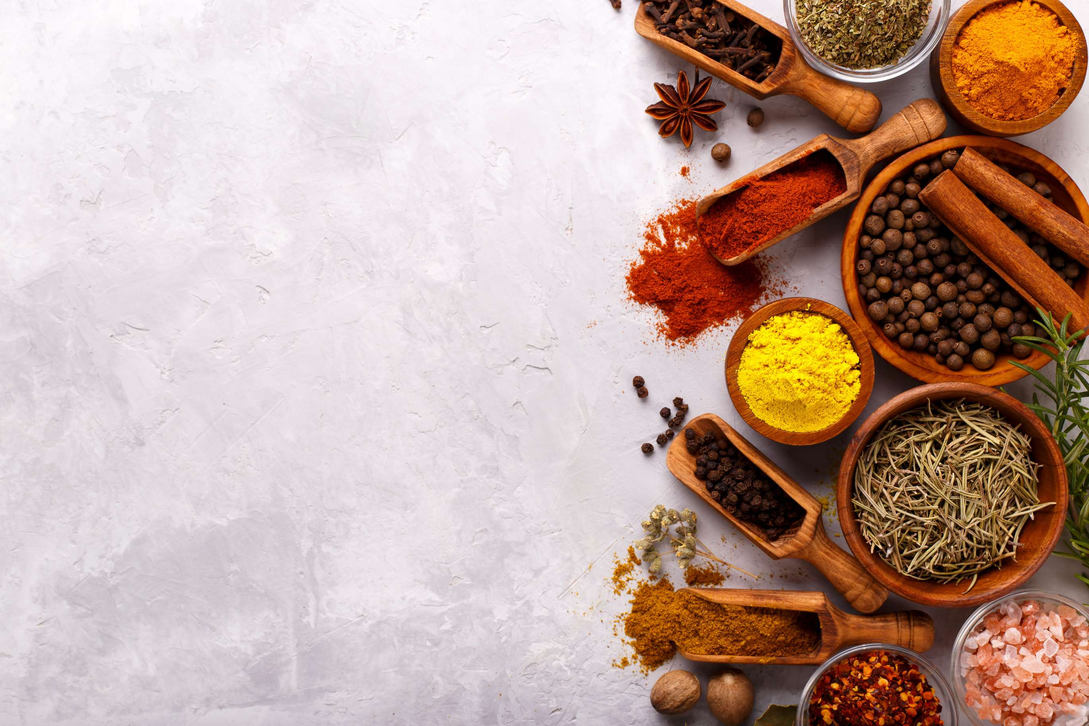
GLOBAL
ORGANIC HERBS & SPICES
MARKET REPORT
2024
Global,Regional,CountryAnalysis

Slide 2
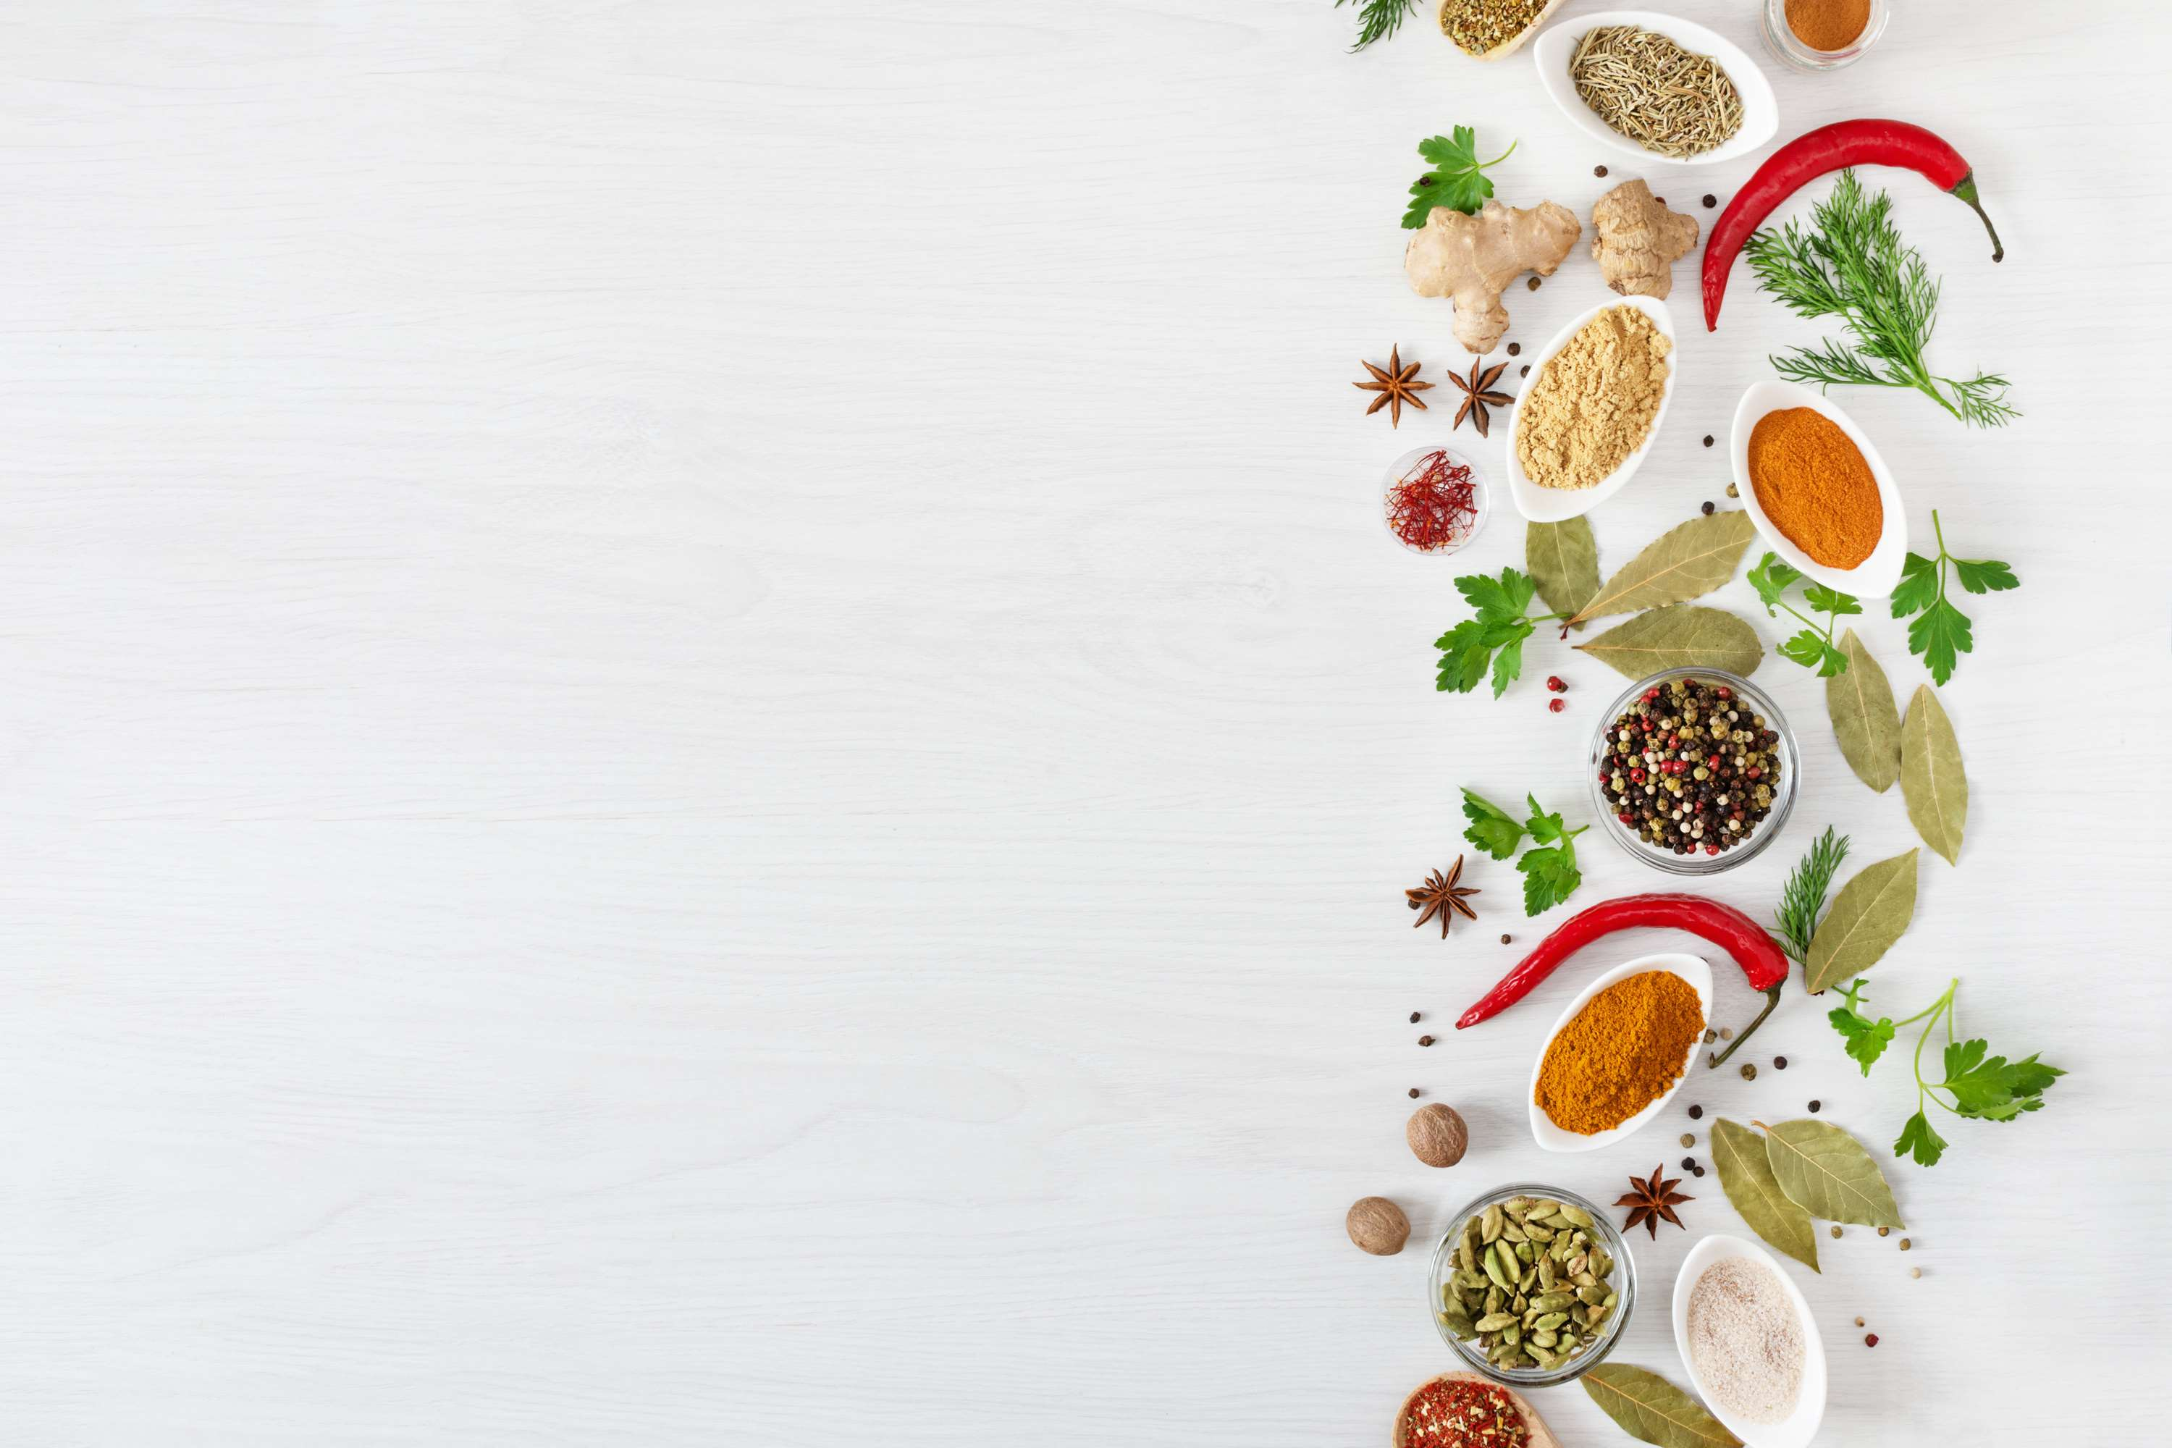
INTRODUCTION
The organic herbs and spices market is witnessing steady growth and evolving consumer preferences driven by a rising demand for natural, chemical-free, and sustainably sourced ingredients. With increasing awareness of the health benefits associated with organic products and growing concerns about the environmental impact of conventional farming practices, consumers are turning to organic herbs and spices as preferred choices for enhancing flavor and nutrition in their culinary endeavors. This shift towards organic alternatives is underpinned by a broader movement towards healthier and more conscious living, where consumers prioritize products that align with their values of health, sustainability, and ethical sourcing.

Slide 3
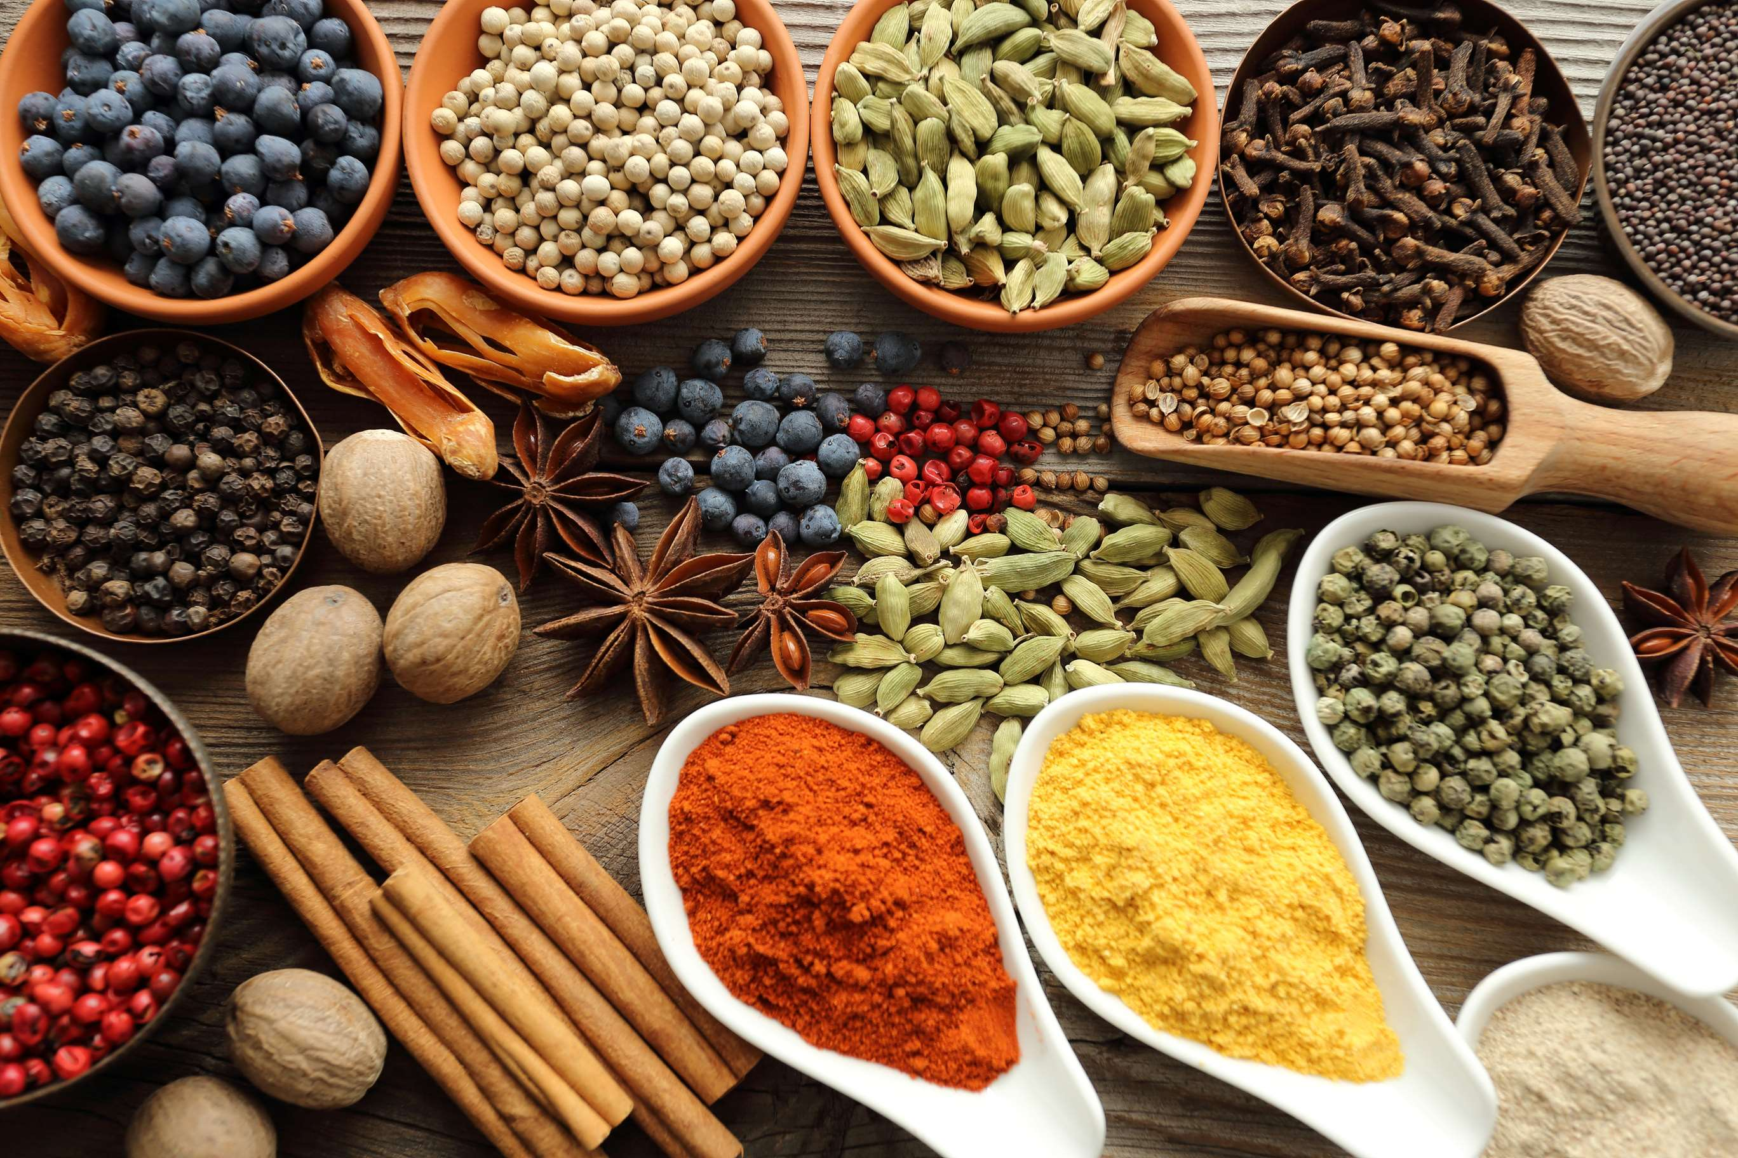

KEY INSIGHTS
MARKET SIZE
USD 239.2 million
2024
CAGR
4.30%
2024- 2031

Slide 4
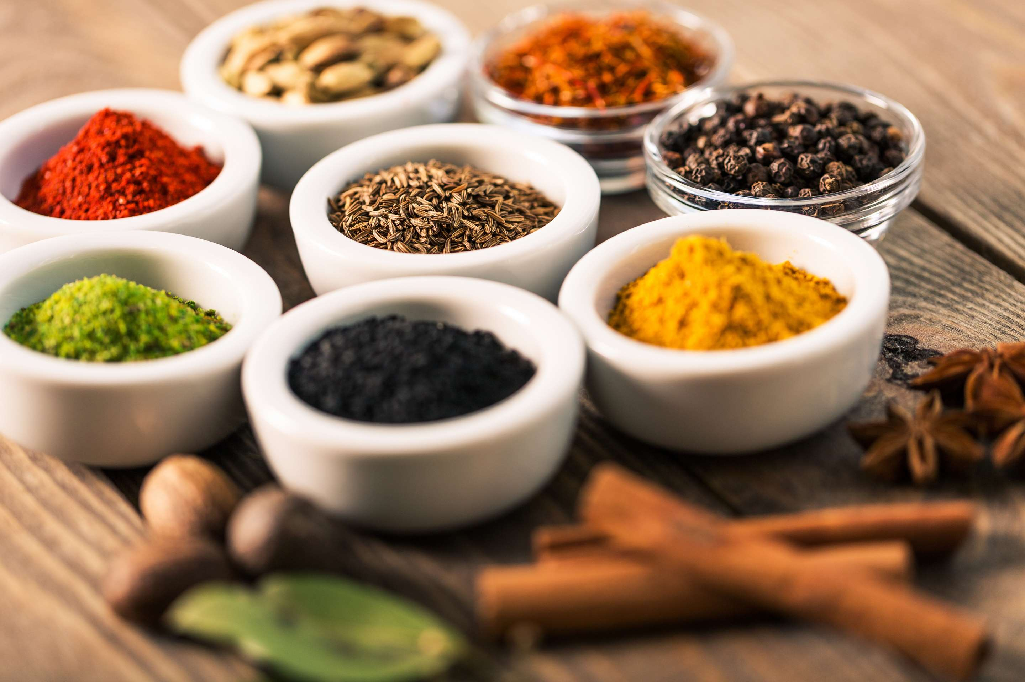
REVENUE MARKET SHARE BY SEGMENTS 2022
  Chilies
  Garlic
  Ginger
  Turmeric
  Cumin
  Pepper
  Cinnamon
  Cloves
  Cardamom
  Organic Spices and Herbs
  Conventional Spices and Herbs
Type Segment
Nature Segment
  Basil
  Mint
  Marjoram
  Parsley
  Oregano
  Sage
  Bay Leaves
  Dill
  Thyme
  Whole
  Powder
  Crushed/Chopped
  Essential oil
Form Segment
Herbs Type Segment

Slide 5

Global Organic Herbs and Spices Market Revenue share for 2024
North America
40%

Slide 6
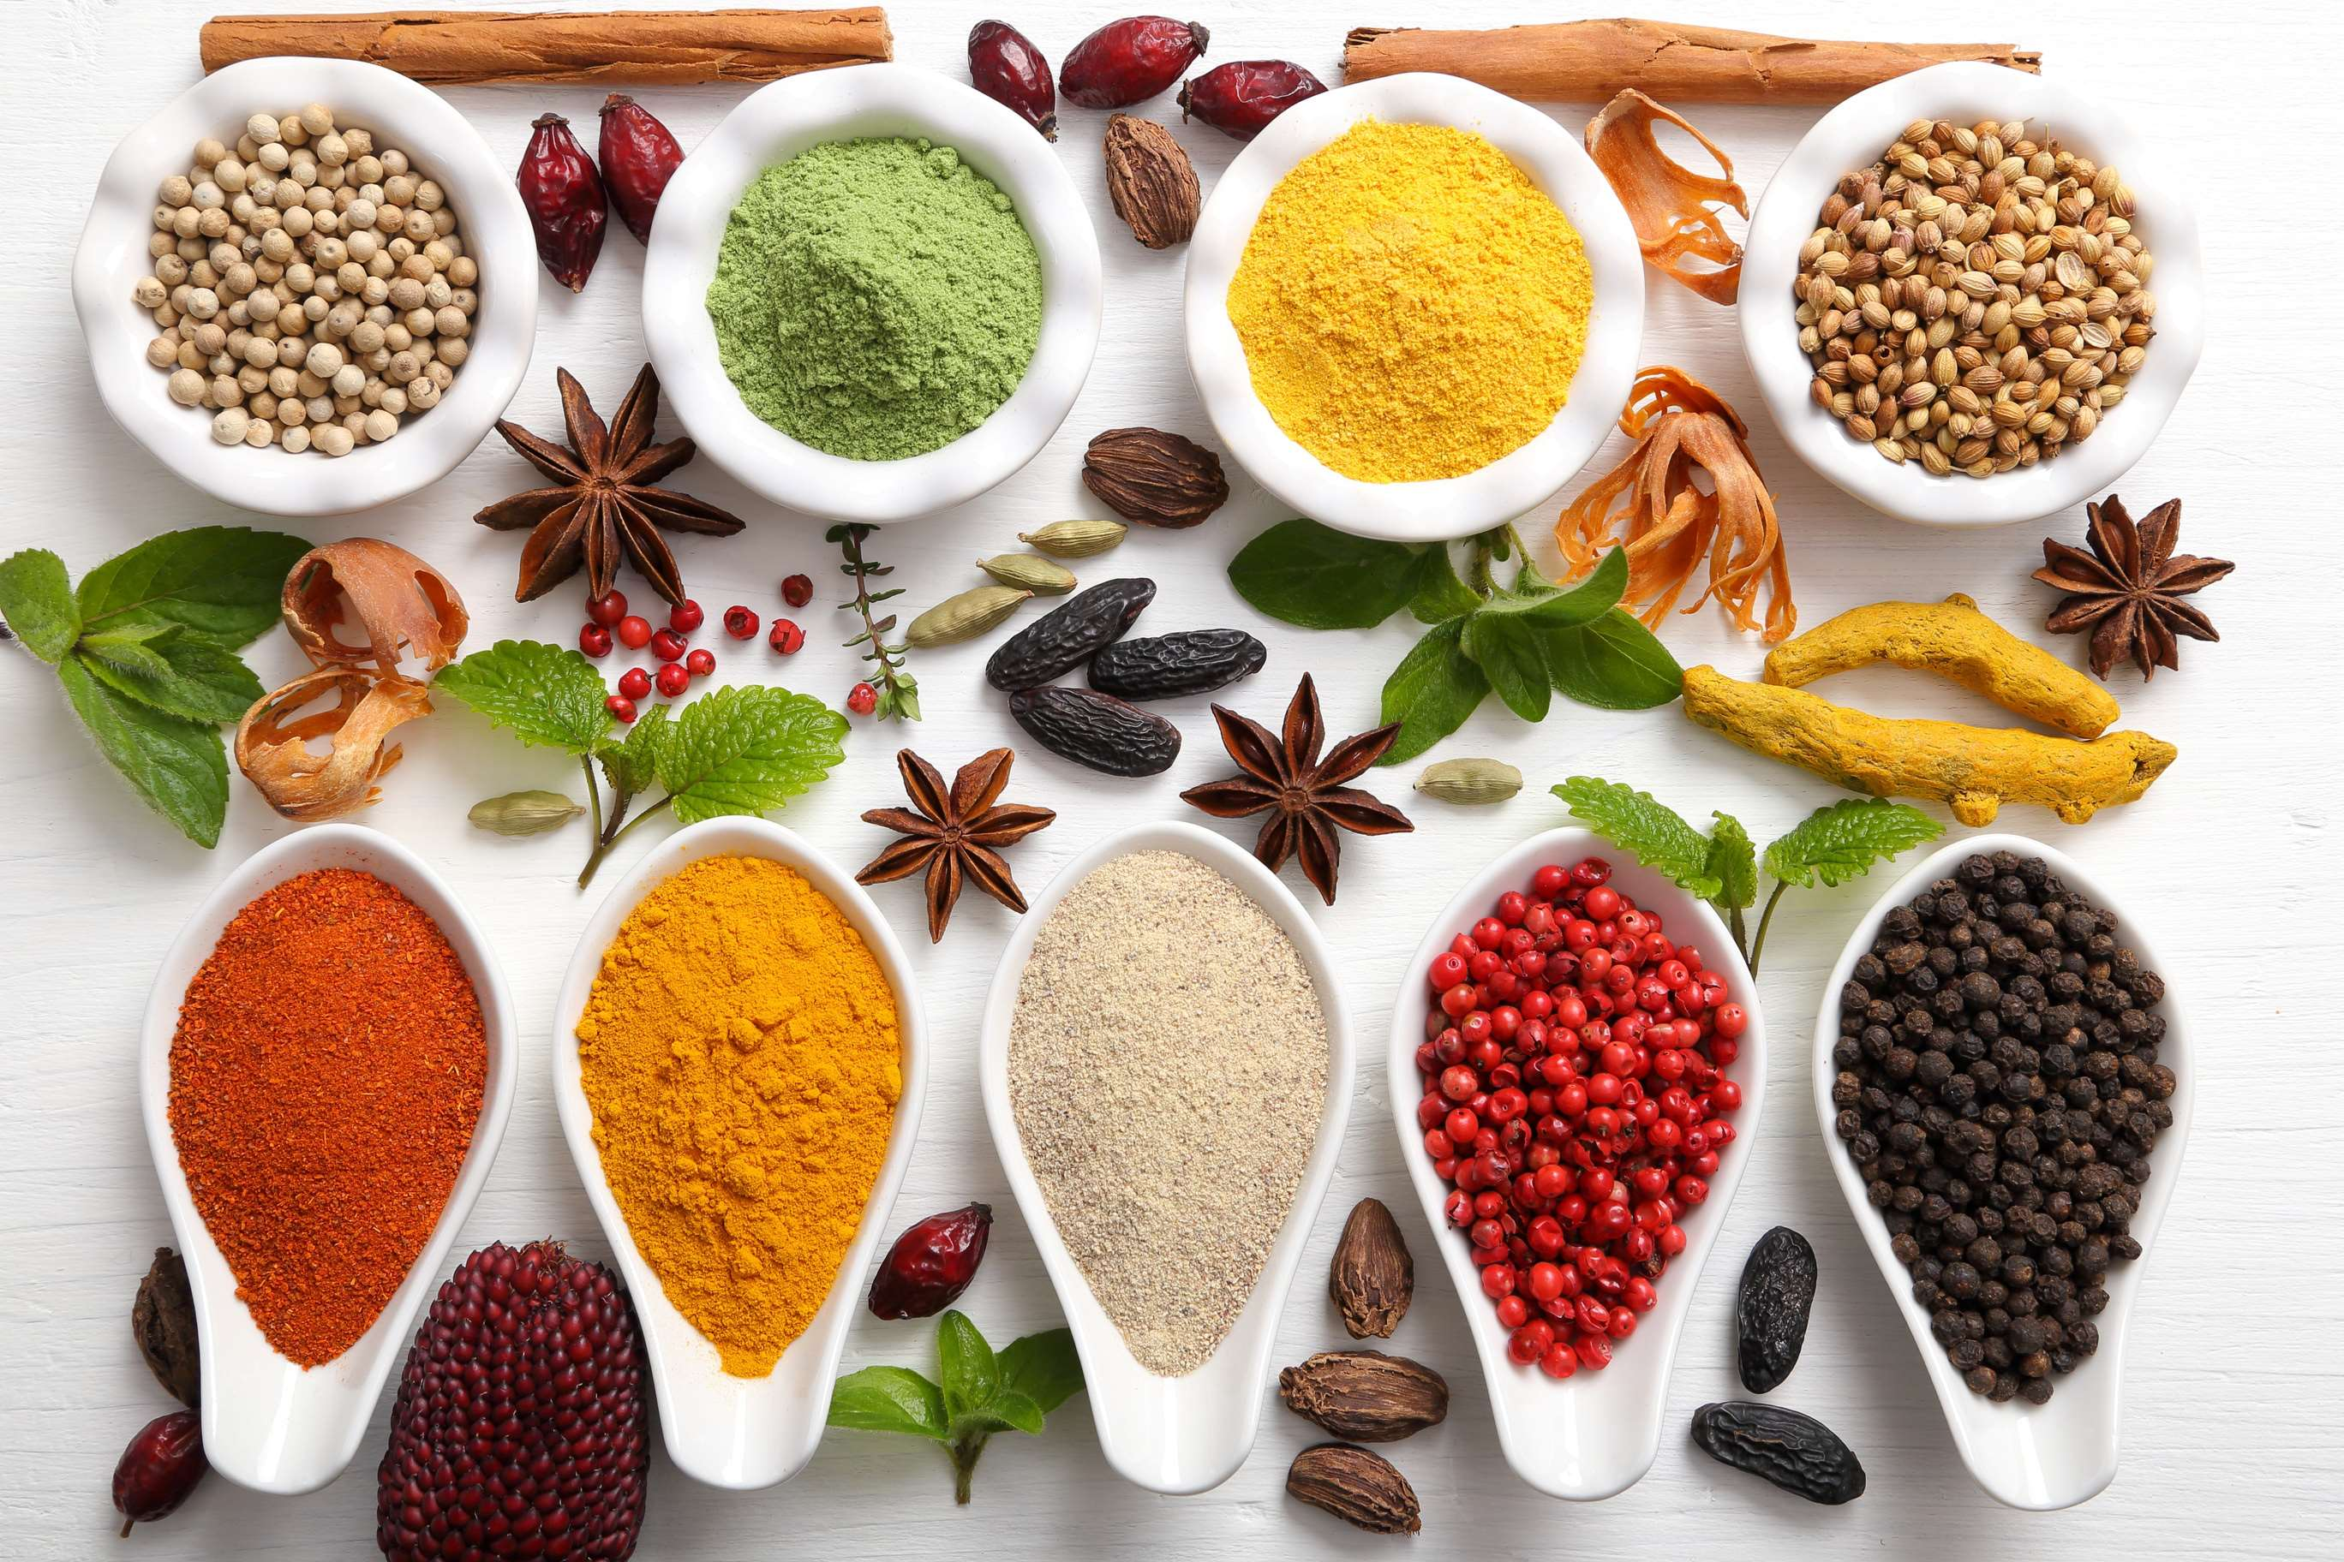
  Preference for Natural and Chemical-Free Products to Increase the Demand Globally
  Rising Demand for Organic Food to Propel Market Growth
Drivers
Perceived Quality Variability to Limit the Sales
Restraints

Slide 7

AUTHOR'S PERSPECTIVE
  The global Organic Herbs and Spices Market will expand significantly by 4.30% CAGR between 2024 to 2031.
  The Chilies segment is set to rise. Chilies, also known as hot peppers or chili peppers, are a staple ingredient in many cuisines worldwide, adding heat, flavor, and depth to dishes.
  Within the organic sector, the demand for organic chilies is on the rise, driven by several key factors.
  Increasing awareness among consumers about the health benefits of organic products, including herbs and spices, is a significant driver.
  Organic herbs and spices are perceived as healthier options due to their lack of synthetic pesticides, herbicides, and GMOs.

Slide 8
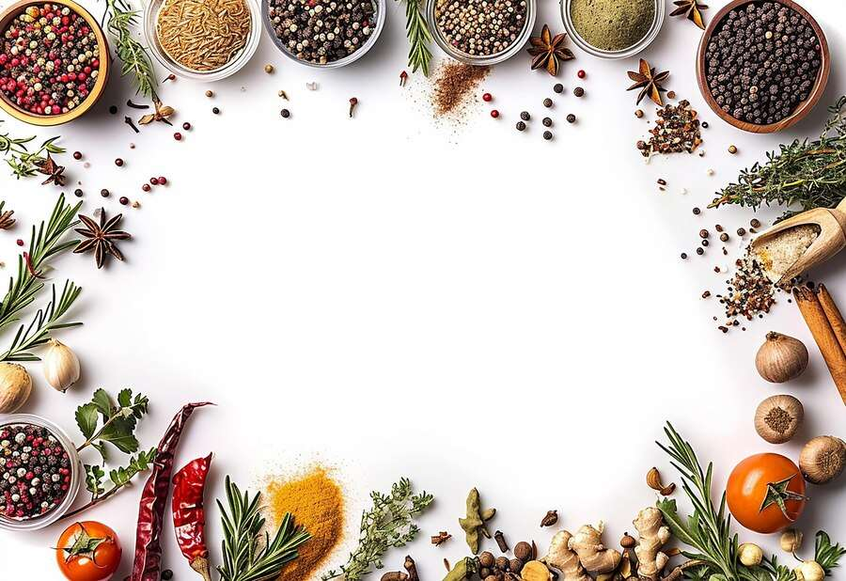


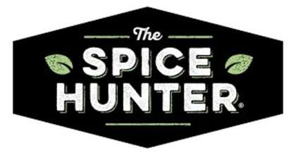
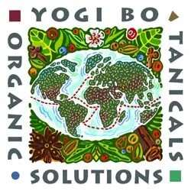



KEY PLAYERS

Slide 9


For Full Report
Contact us
COGNITIVE MARKET RESEARCH
Tel: +1 312-376-8303 | +44 020-8123-0732
India: (+91) 983-496-8611
sales@cognitivemarketresearch.com
Access the Full Report : https://tinyurl.com/5xambdzt
Please visit our website:
https://www.cognitivemarketresearch.com

