Slide 1

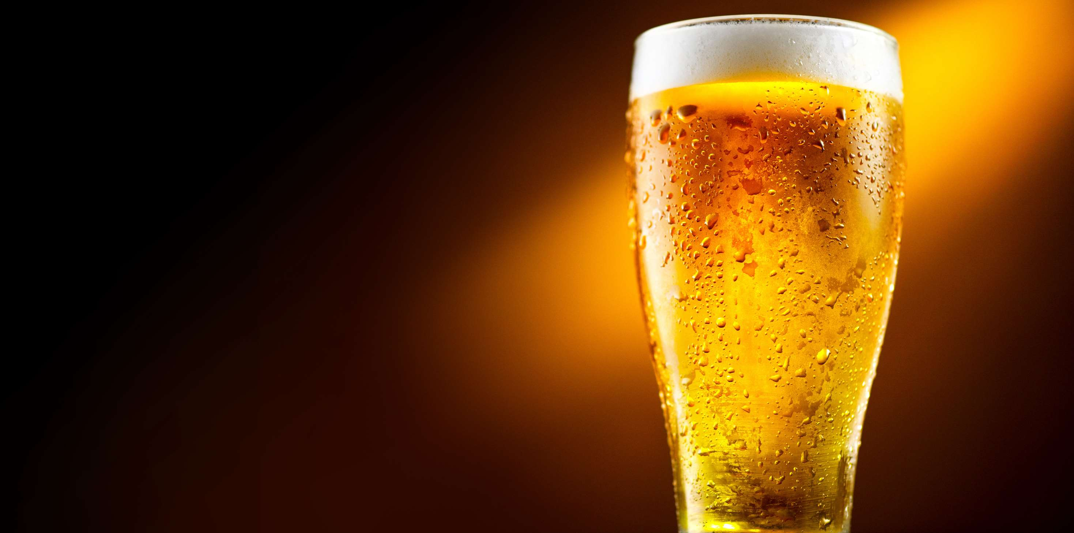
ORGANIC BEER
MARKET REPORT
2024
Qualitative Analysis + Quantitative Analysis

Slide 2
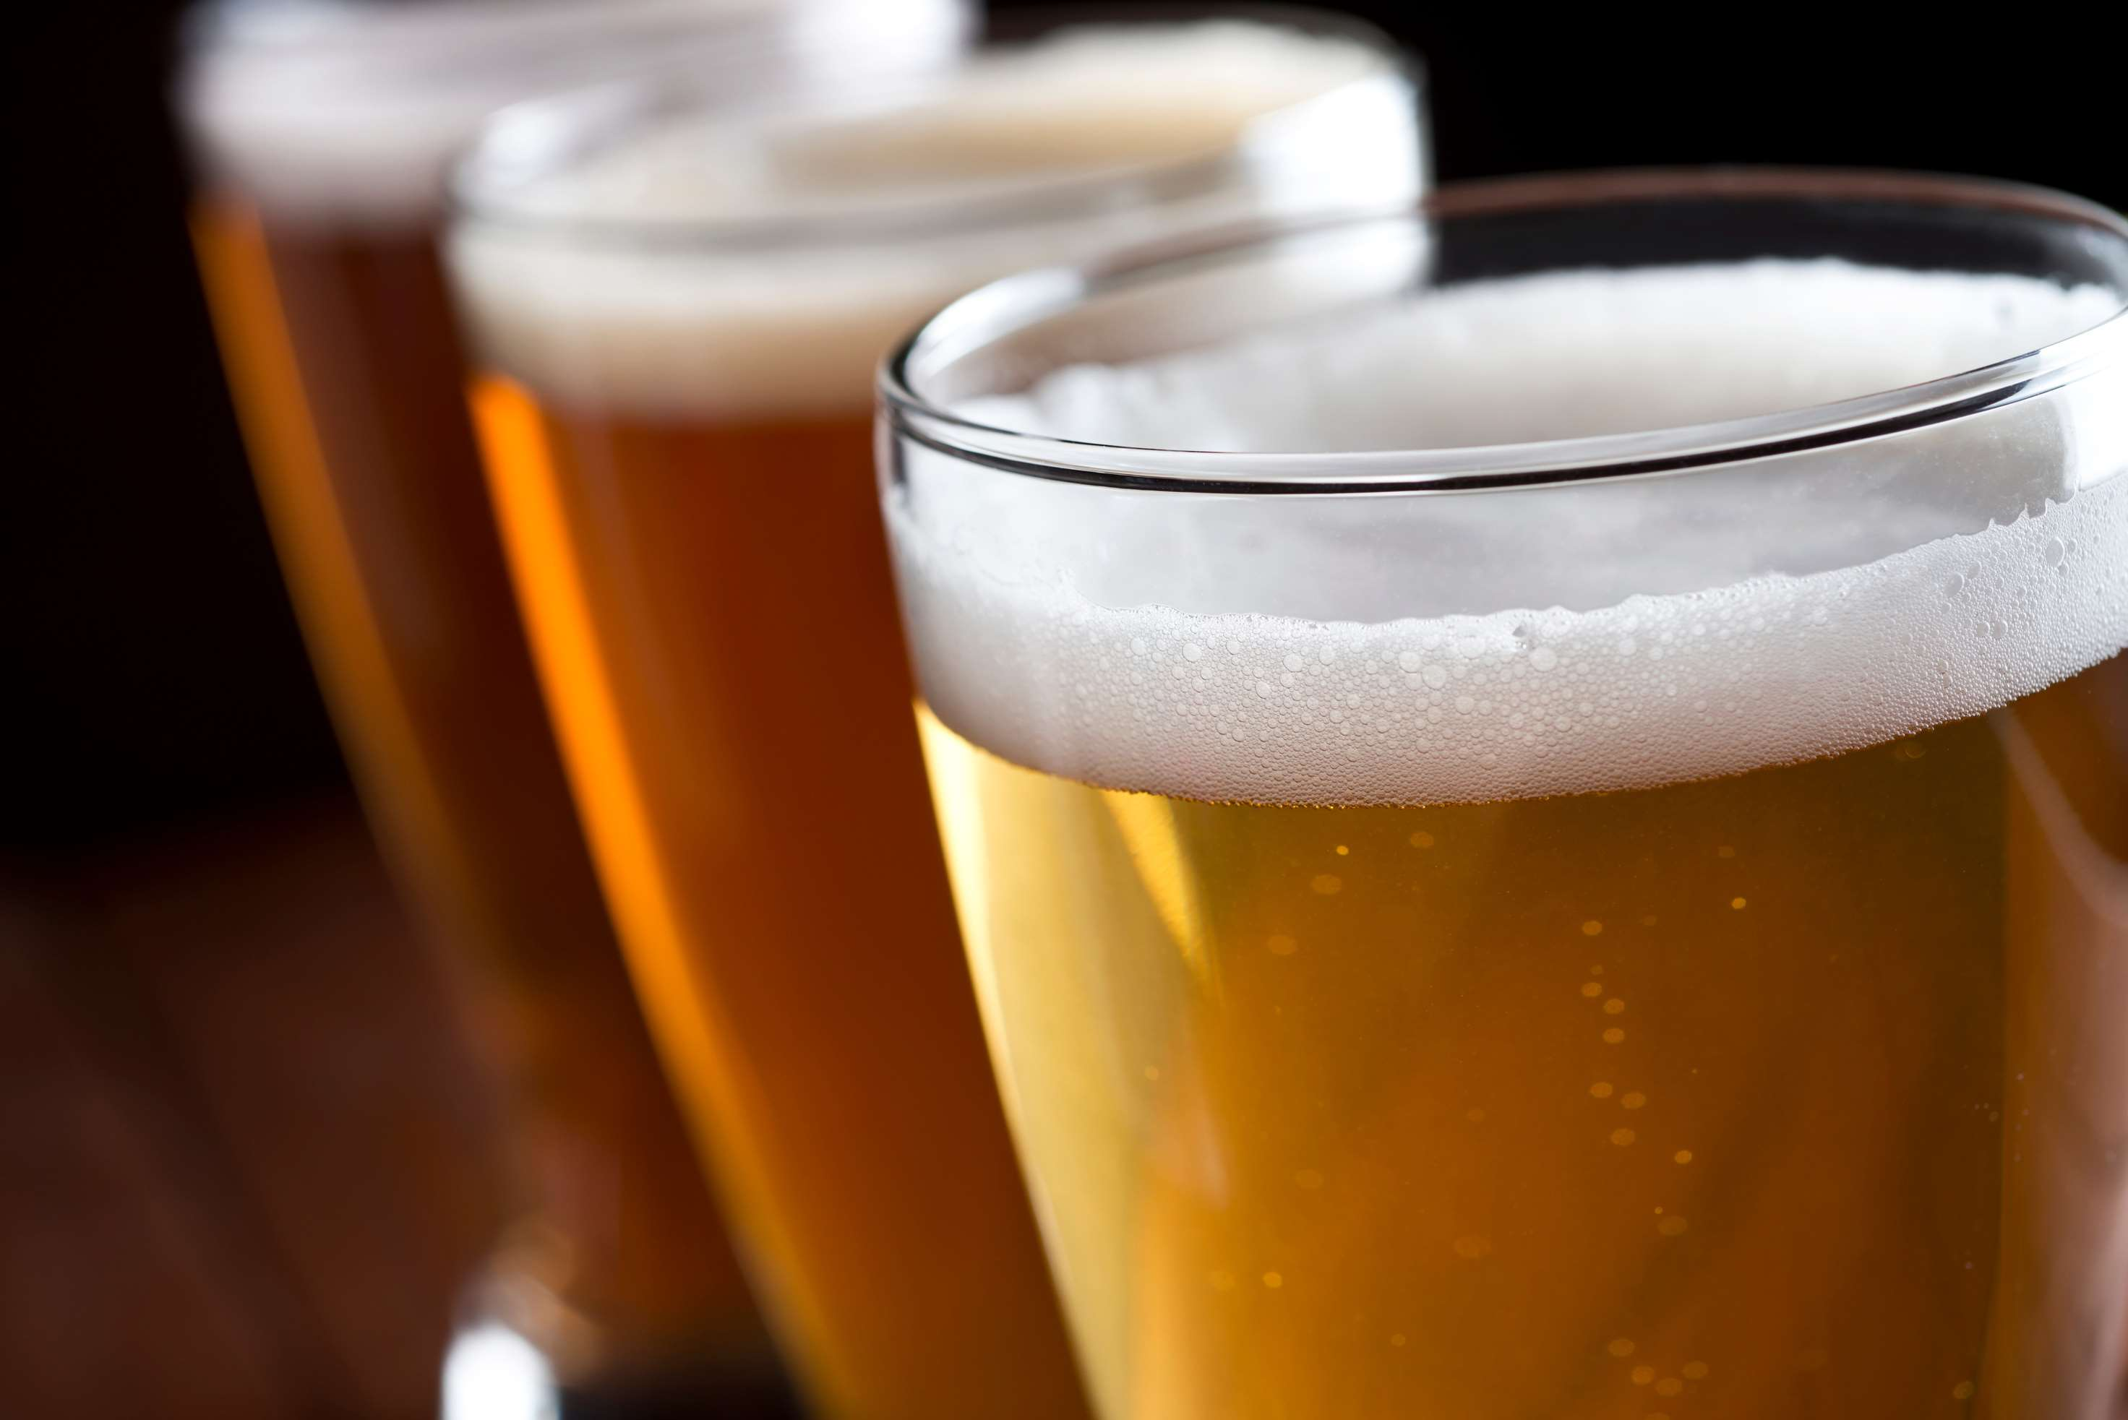
INTRODUCTION
Organic beer is brewed using ingredients grown without synthetic pesticides, herbicides, or fertilizers. It adheres to strict organic farming standards, ensuring environmental sustainability and minimizing chemical residues in the final product. Organic certification guarantees the beer is made with organic malt, hops, yeast, and water, meeting organic production criteria. One of the key drivers propelling the growth of the organic beer market is the growth of the craft beer segment. Craft beer's popularity stems from its artisanal quality, diverse flavors, and unique brewing techniques, appealing to consumers seeking authentic and high-quality beverages.

Slide 3


KEY INSIGHTS
MARKET SIZE
USD 8695.2 million
2024
CAGR
7.90%
2024- 2031

Slide 4
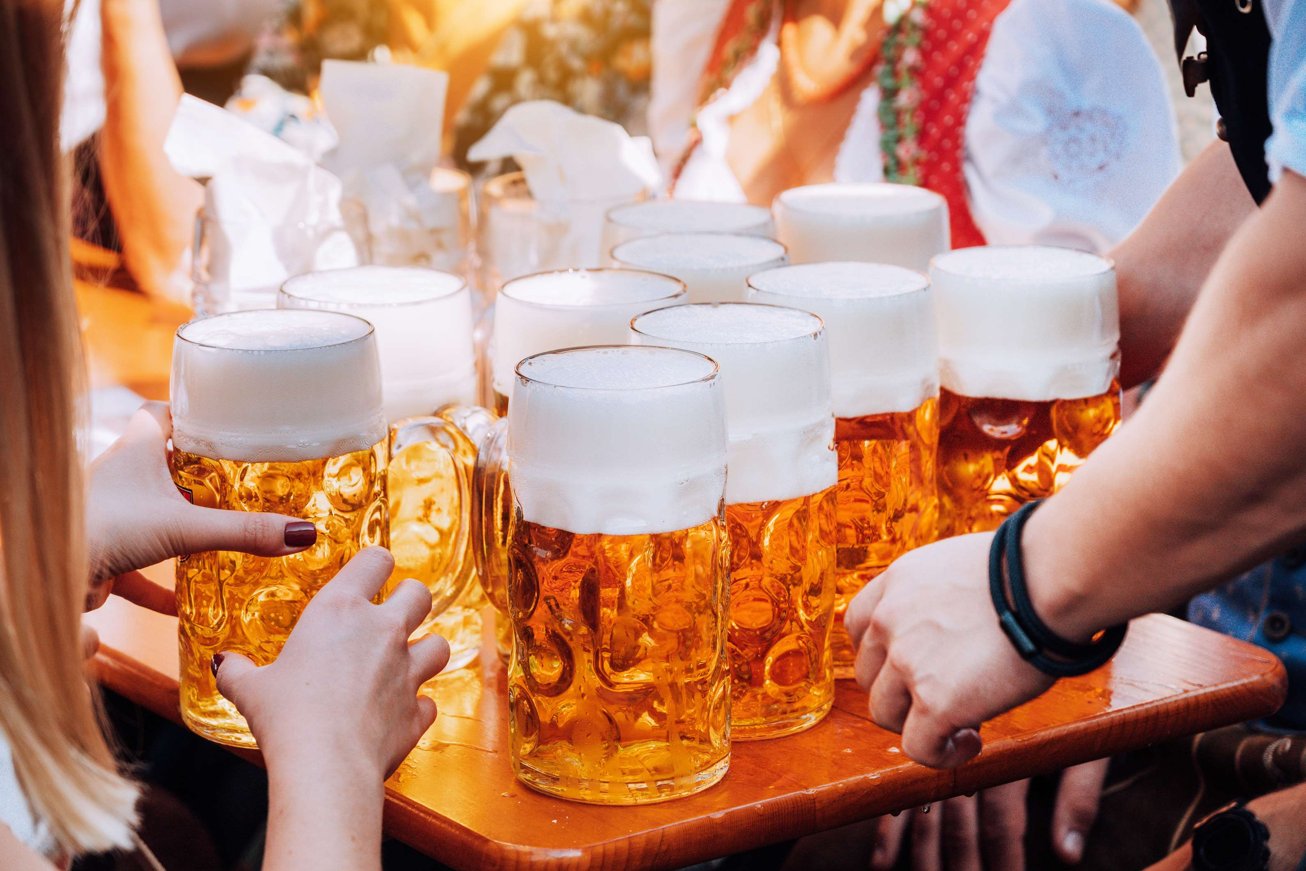
REVENUE MARKET SHARE BY SEGMENTS 2024
  Popular Price
  Premium Price
  Super Premium Price
Category
Segment
  Glass
  Metal Can
  Others
Distribution Channel

Slide 5



North America
40%
North America Organic Beer Market Revenue share for 2024 is 40%

Slide 6
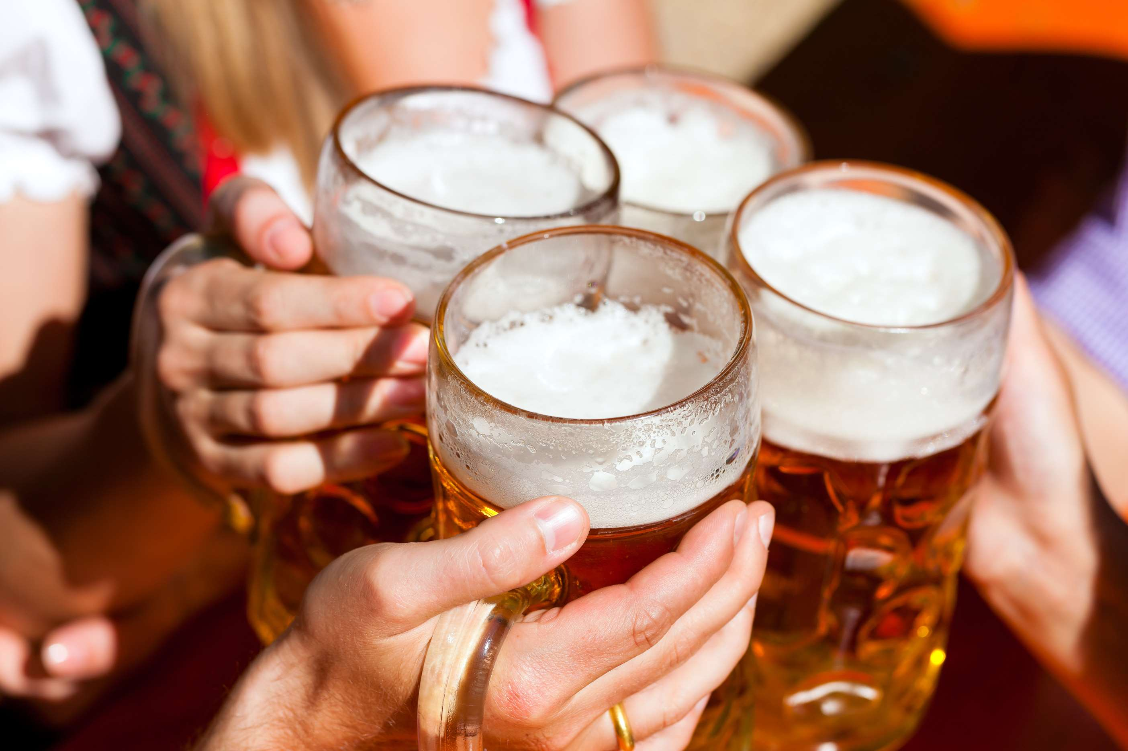
  Growing Environmental Awareness among Consumers to Increase the Demand Globally
  Changing Consumer Preferences to Propel Market Growth
Drivers
High Production Costs to Limit the Sales
Restraints

Slide 7
AUTHOR'S PERSPECTIVE
  The global Organic beer market will expand significantly by 7.90% CAGR between 2024 to 2031.
  Lager is the dominating category.
  They are known for their crisp, clean taste and are fermented at cooler temperatures using bottom-fermenting yeast strains, resulting in a smooth finish.
  Cereal grains dominate the category.
  These grains are the primary sources of fermentable sugars, contributing to the flavor, aroma, and character of organic beers.

Slide 8






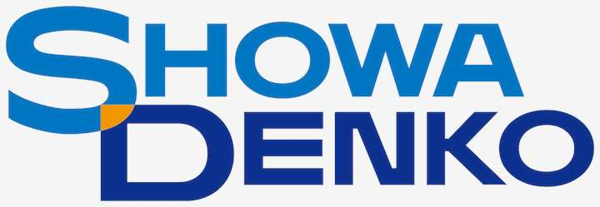

KEY PLAYERS

Slide 9


For Full Report
Contact us
COGNITIVE MARKET RESEARCH
Tel: +1 312-376-8303 | +44 020-8123-0732
India: (+91) 983-496-8611
sales@cognitivemarketresearch.com
Access the Full Report : https://tinyurl.com/yj7kbshw
Please visit our website:
https://www.cognitivemarketresearch.com

