Slide 1

GLOBAL
ORGANIC AVOCADO OIL
MARKET REPORT
2024
Global,Regional,CountryAnalysis

Slide 2
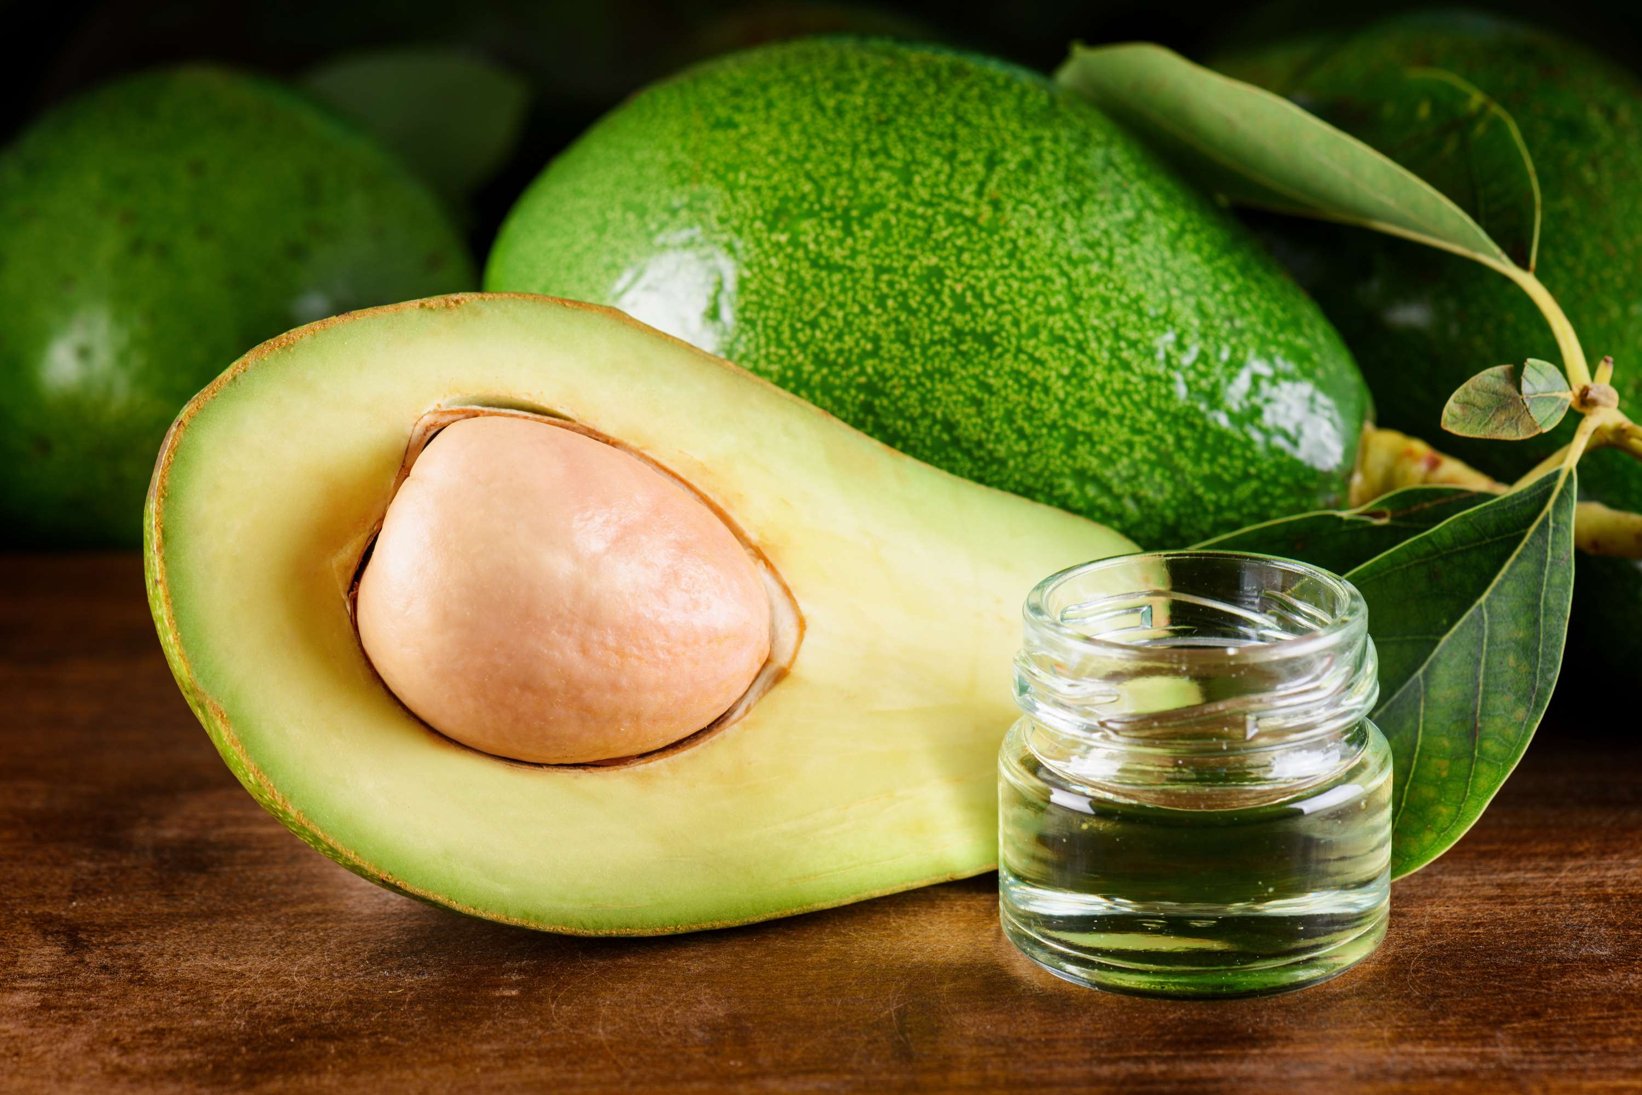
INTRODUCTION
Organic avocado oil is a premium culinary and cosmetic product derived from the fruit of the avocado tree (Persia Americana). Produced through a process of cold-pressing ripe avocados, this oil retains its natural nutrients, antioxidants, and beneficial fatty acids, such as oleic acid, which are renowned for their health and beauty benefits. As an organic product, it is cultivated without synthetic pesticides, herbicides, or fertilizers, ensuring a pure and environmentally friendly final product. With its rich, buttery texture and mild flavour, organic avocado oil is prized for its versatility in cooking, skincare, and haircare applications, making it a popular choice among health-conscious consumers.

Slide 3
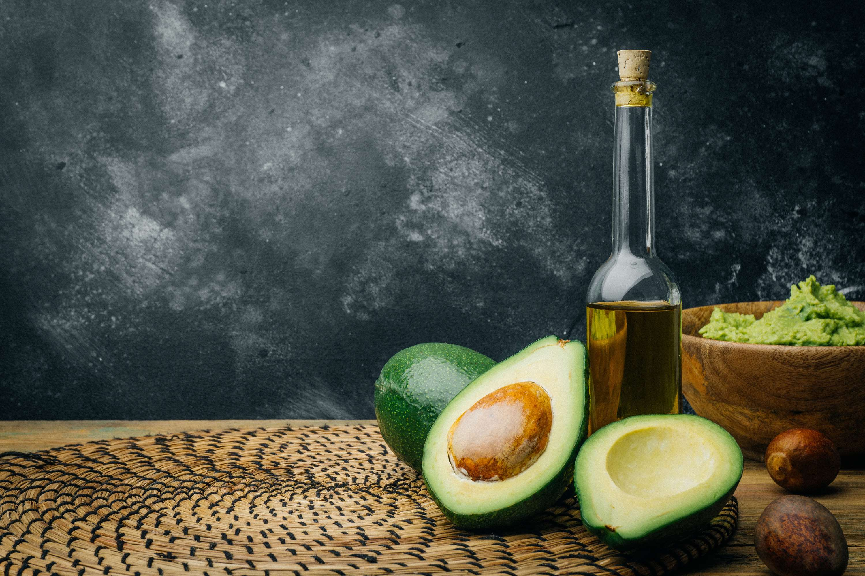

KEY INSIGHTS
CAGR
6.00%
2024- 2031

Slide 4
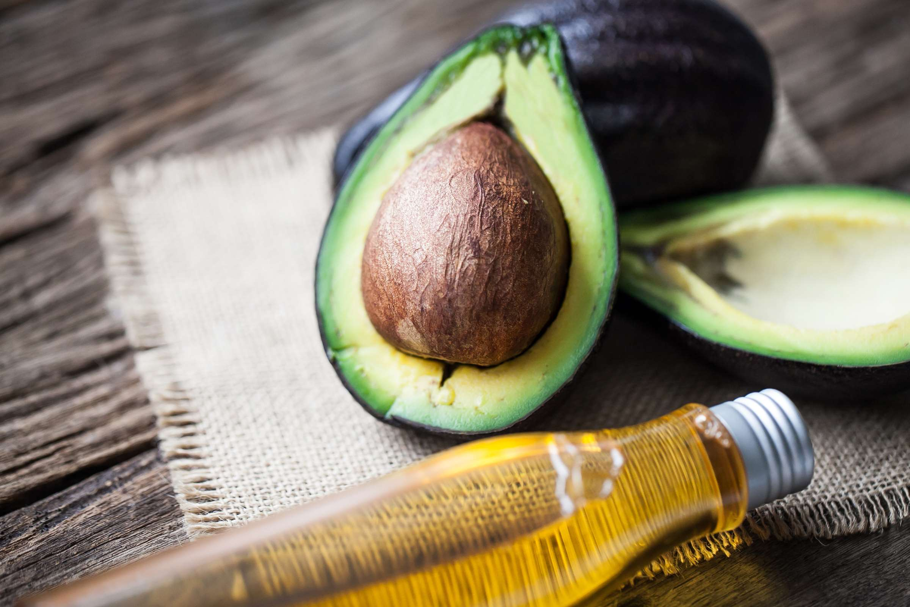
REVENUE MARKET SHARE BY SEGMENTS 2022
  Extra-virgin Oil
  Virgin Oil
  Pure Oil
  Blends Oil
  Hass
  Fuertes
Product Segment
Source Segment
  Retail
  Cosmetics and Personal Care
  Medicinal
  Specialty Stores
  Modern Trade
  Drug Stores
  Online Stores
Application Segment
Sales Channel Segment

Slide 5

Global Organic Avocado Oil Market Revenue share for 2024
North America
40%

Slide 6
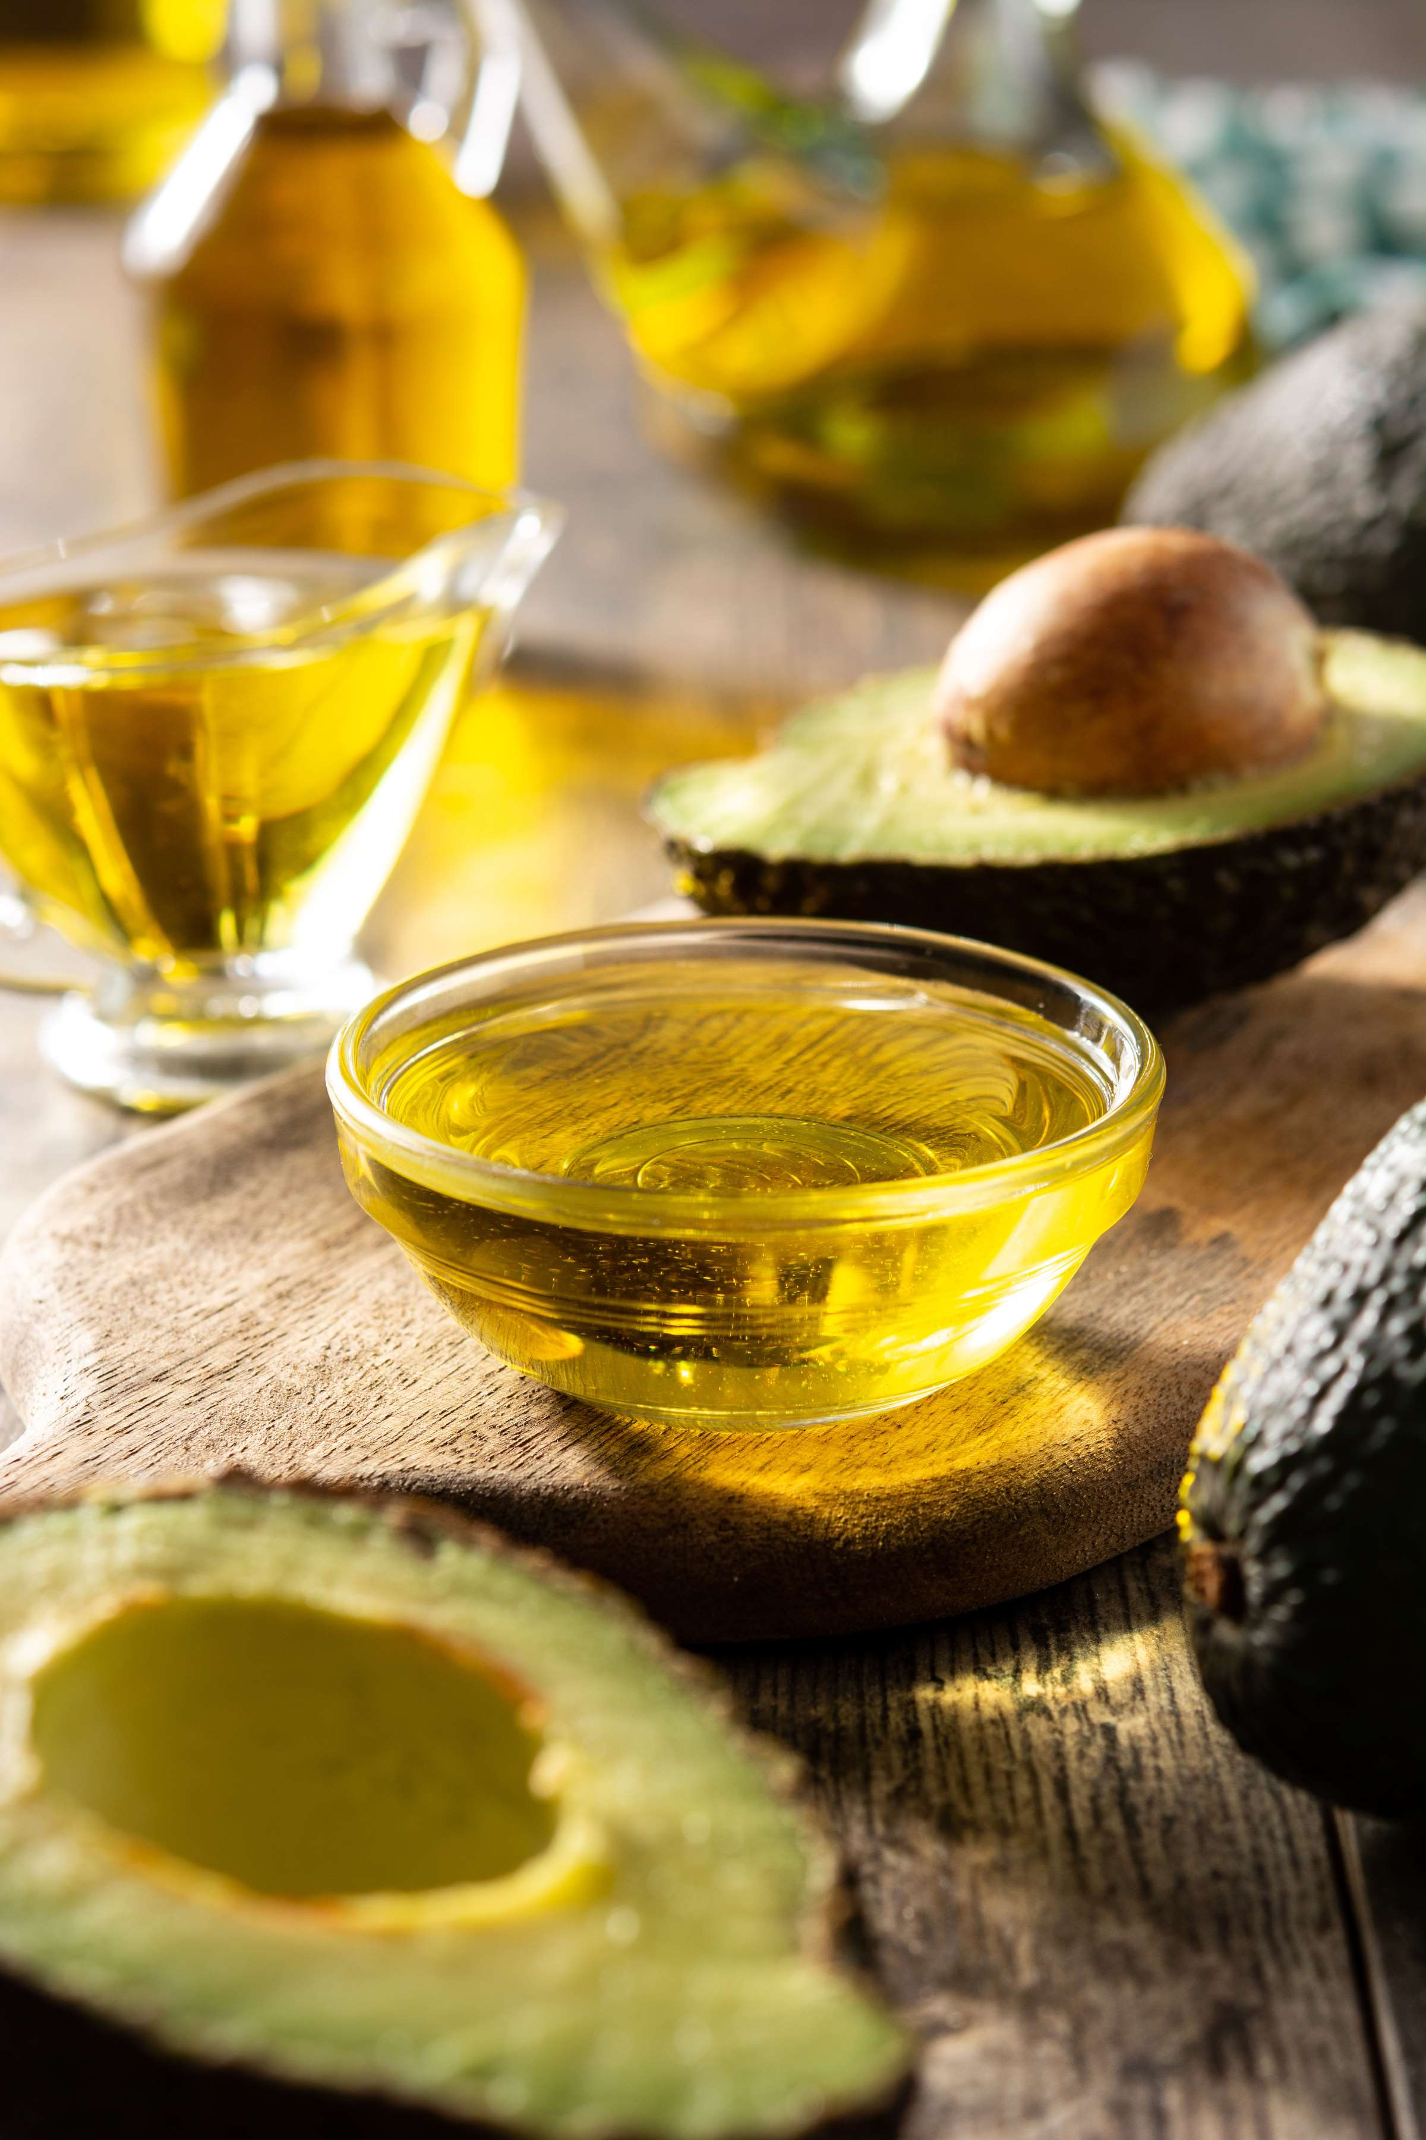
  Growing Awareness of the Health Benefits to Increase Sales
  Increasing Consumer Interest in Natural Skincare and Haircare Products to Propel the Market
Drivers
Seasonal Fluctuations in Avocado Production to Pose a Barrier
Restraints

Slide 7
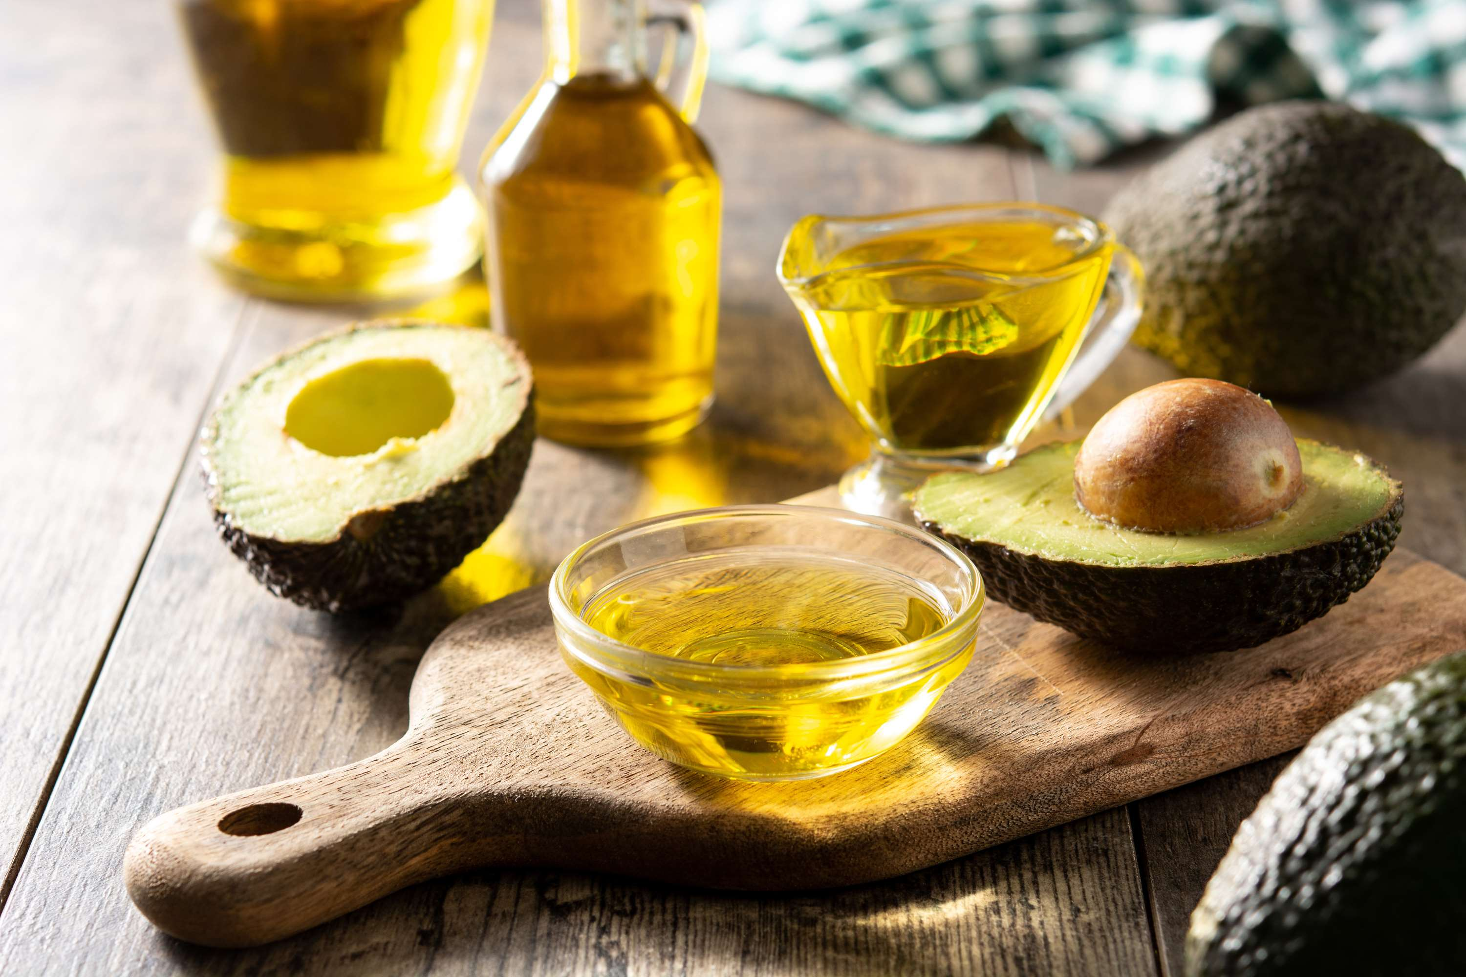
AUTHOR'S PERSPECTIVE
  The global organic avocado oil market will expand significantly by 6.00% CAGR between 2024 to 2031.
  The sales of extra-virgin oil are poised to increase due to growing consumer awareness of its superior quality, health benefits, and versatility in culinary and cosmetic applications.
  Retail sales are anticipated to surge owing to increased consumer demand for convenience, accessibility, and diverse product offerings, catering to a wide range of preferences and needs in the market.

Slide 8










KEY PLAYERS

Slide 9


For Full Report
Contact us
COGNITIVE MARKET RESEARCH
Tel: +1 312-376-8303 | +44 020-8123-0732
India: (+91) 983-496-8611
sales@cognitivemarketresearch.com
Access the Full Report : https://tinyurl.com/mr4c35ph
Please visit our website:
https://www.cognitivemarketresearch.com

