Slide 1

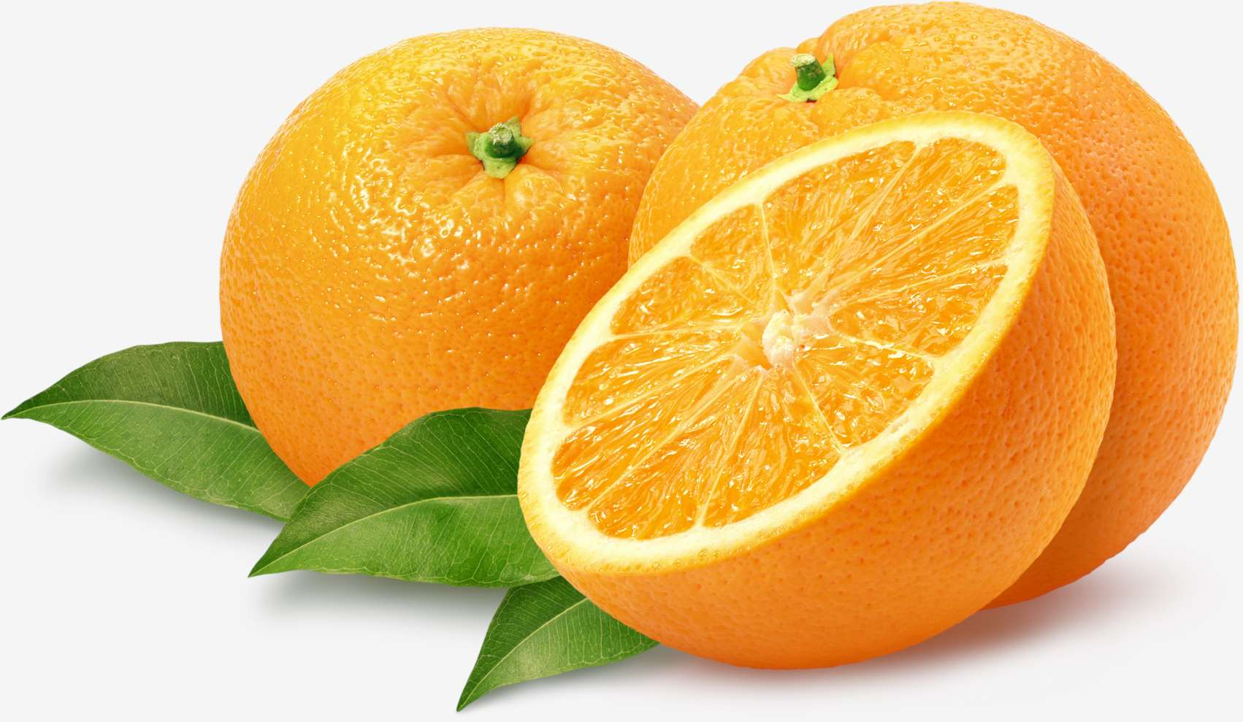
GLOBAL
ORANGES
MARKET REPORT
2024
Global,Regional,CountryAnalysis

Slide 2
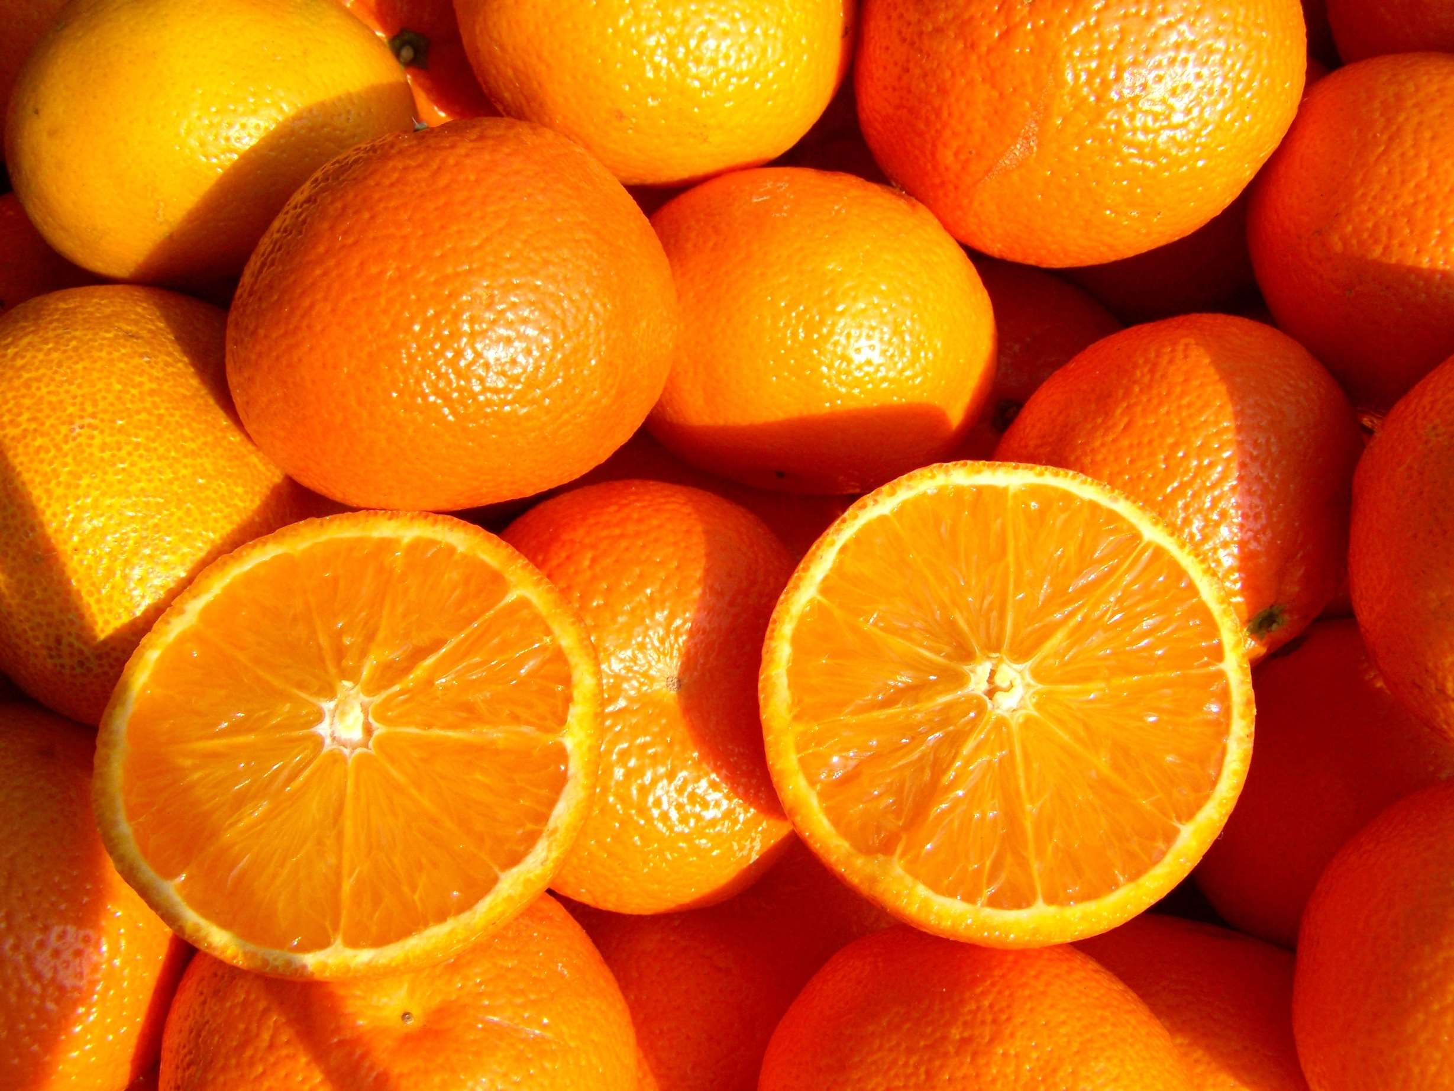
INTRODUCTION
Oranges, renowned for their vibrant color, refreshing taste, and nutritional richness, hold a prominent place in culinary traditions worldwide. As a significant source of essential vitamins, antioxidants, and fiber, oranges play a crucial role in promoting health and wellness among consumers. The oranges market encompasses a wide range of products, including fresh fruit, juices, concentrates, and extracts, catering to diverse consumer preferences and culinary applications. With a global supply chain spanning across continents, oranges are cultivated in various climatic regions, each contributing unique flavors and characteristics to the market.

Slide 3
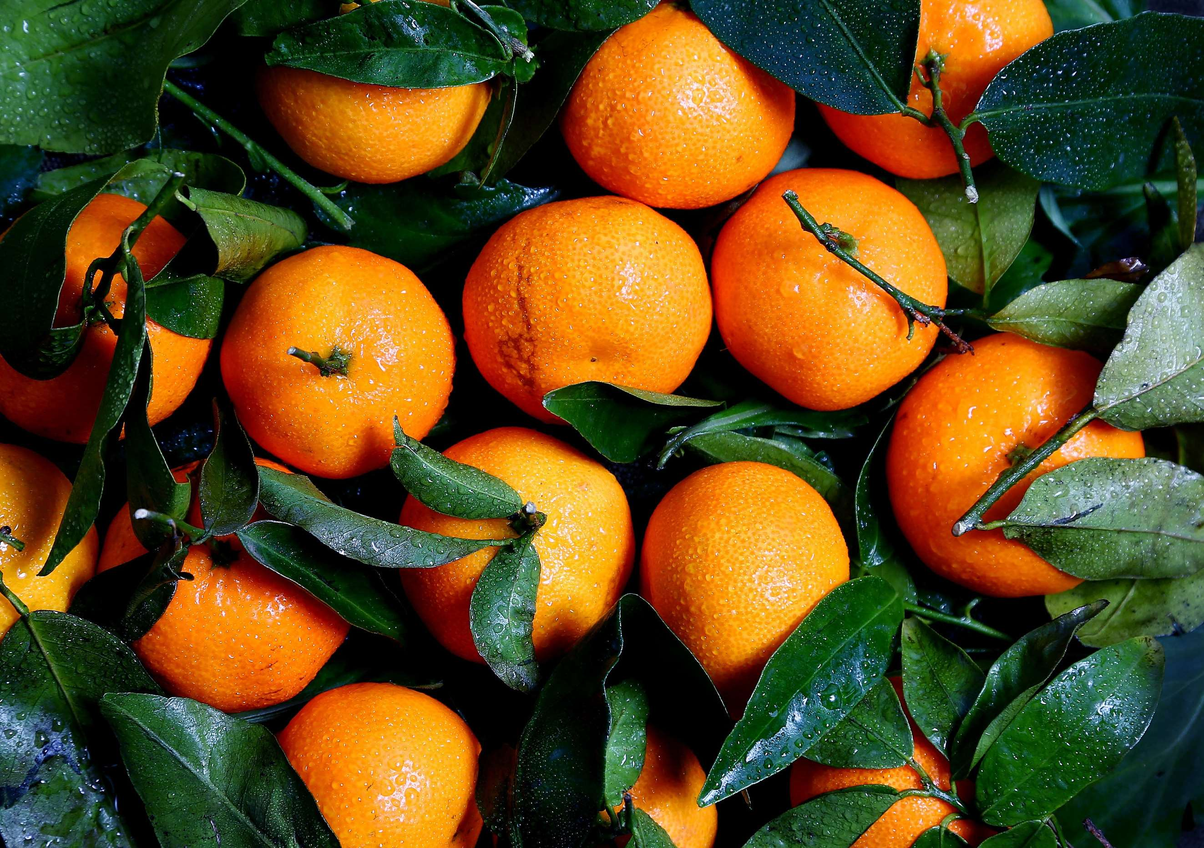

KEY INSIGHTS
MARKET SIZE
USD 3915.2 million
2024
CAGR
4.80%
2024- 2031

Slide 4
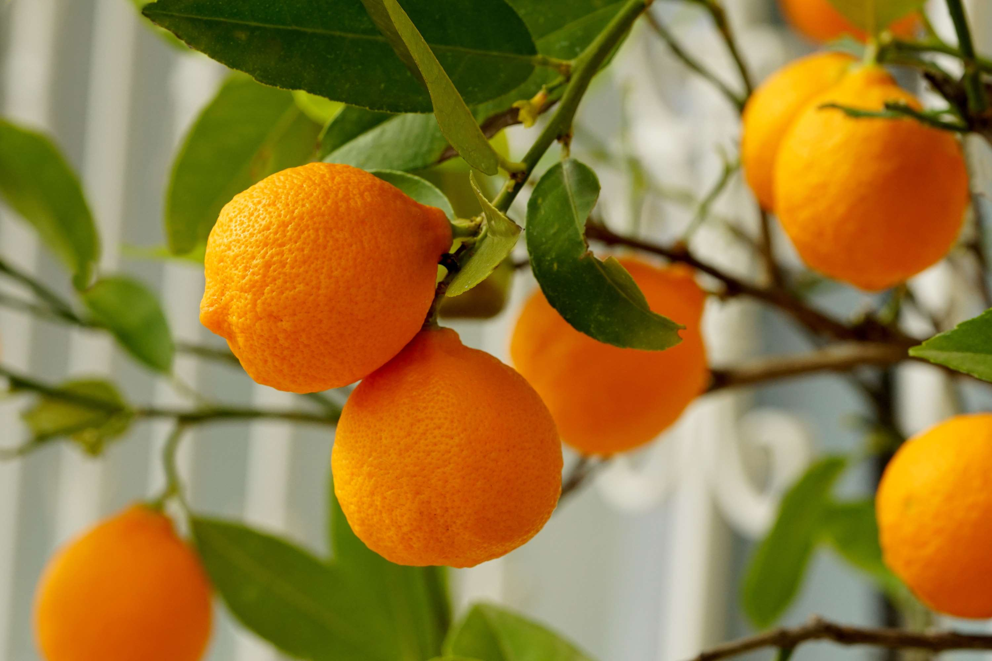
REVENUE MARKET SHARE BY SEGMENTS 2022
  Juice
  Concentrate
  Powder
  Fresh Consumption
  Candy
  Preservatives
Application Segment
  Households
  Food & Beverage Industry
  Pharmaceuticals
  Cosmetics
End-User Segment
  Supermarkets
  Convenience Stores
  Online Retail
  Farmer's Markets
Distribution Channel

Slide 5


Global Oranges Market Revenue share for 2024
North America
40%

Slide 6
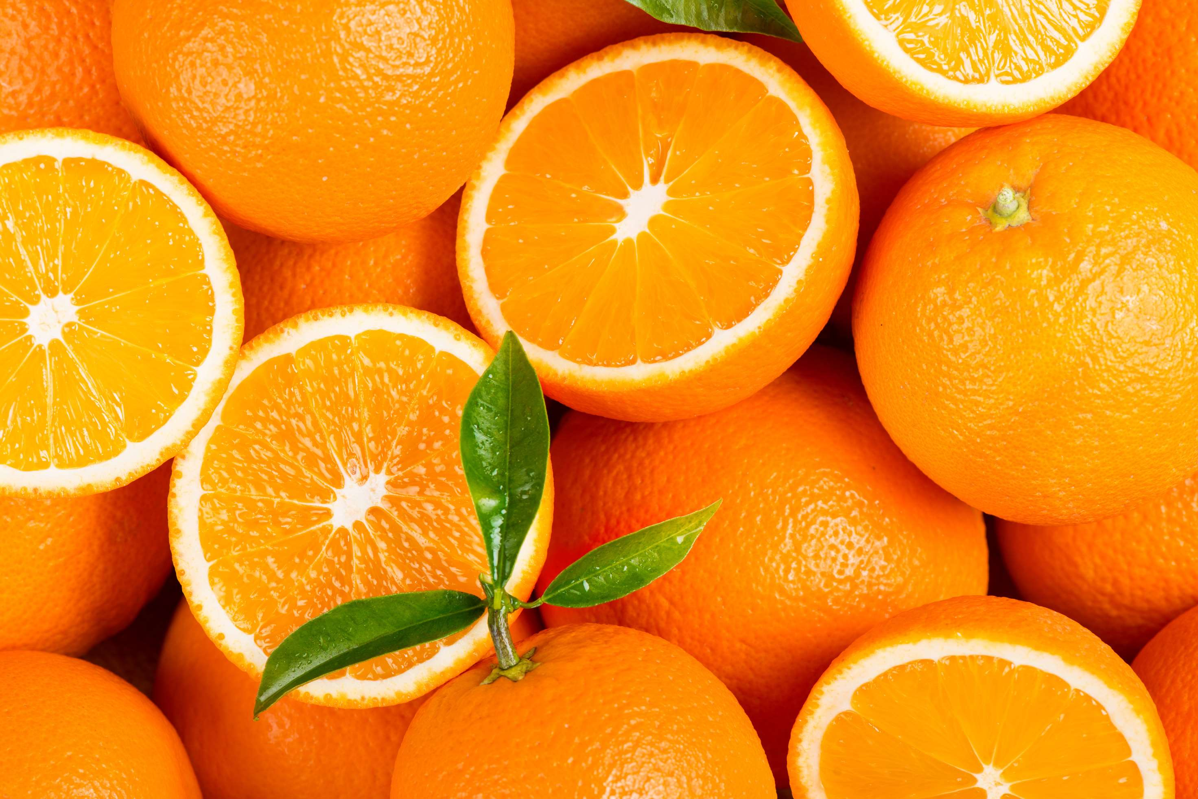
  Crop Yields and Supply Chain Efficiency to Increase the Demand Globally
  Health and Wellness Trends to Propel Market Growth
Drivers
Disease and Pest Outbreaks to Limit the Sales
Restraints

Slide 7
AUTHOR'S PERSPECTIVE
  The global Oranges Market will expand significantly by 4.80% CAGR between 2024 to 2031.
  The Sweet Orange segment is set to rise. Close-end Oranges, characterized by their fixed ends, are widely used in various applications such as apparel, bags, luggage, and accessories. Several factors contribute to the projected rise in demand for close-end Oranges.
  Consumer preferences and dietary habits play a significant role in driving demand for oranges. Factors such as increasing health consciousness, awareness of the nutritional benefits of oranges, and the popularity of orange-based products like juices and snacks can drive overall demand.

Slide 8





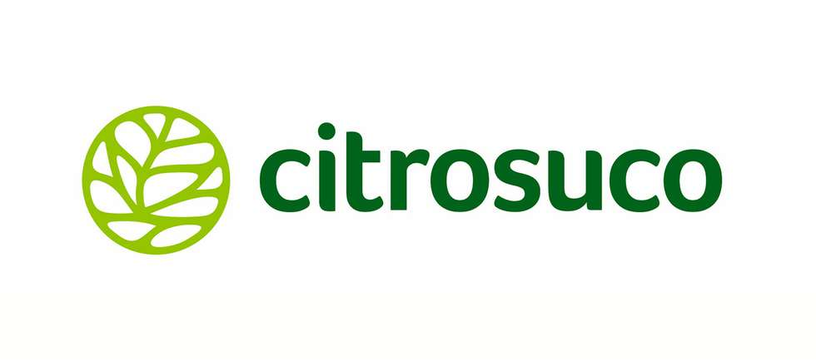



KEY PLAYERS

Slide 9


For Full Report
Contact us
COGNITIVE MARKET RESEARCH
Tel: +1 312-376-8303 | +44 020-8123-0732
India: (+91) 983-496-8611
sales@cognitivemarketresearch.com
Access the Full Report : https://tinyurl.com/jdn9cc54
Please visit our website:
https://www.cognitivemarketresearch.com

