Slide 1

GLOBAL
OPHTHALMIC OPERATING TABLES
MARKET REPORT 2024
Global,Regional,CountryAnalysis

Slide 2

INTRODUCTION
Ophthalmology operating tables are designed for ophthalmological operations or surgeries according to demand for hospitals, clinics. These ophthalmology OT tables can be adjusted to a lowered height from floor, which is convenient for surgeons or eye doctors. The adjustable lowered height Ophthalmological operating table decreases physical fatigue on eye surgeon.

Slide 3


KEY INSIGHTS
MARKET SIZE
USD 575.67 Million
2022
FORECAST
USD 872.56 Million
2028
CAGR
7.08%
2023- 2030

Slide 4

REVENUE MARKET SHARE BY SEGMENTS 2022
Type segment
Manual
USD 252.18 Million
End-user segment
Hospital
USD 344.90 Million

Slide 5

Global Ophthalmic Operating Tables Market Revenue share for 2022
Asia Pacific
USD 293.62 Million

Slide 6
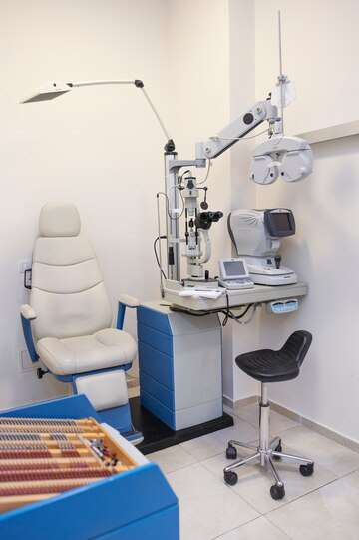
Benefits of ophthalmology operating tables in growing eye specialty clinics
Drivers
Lack of trained professionals in underdeveloped countries
Restraints

Slide 7
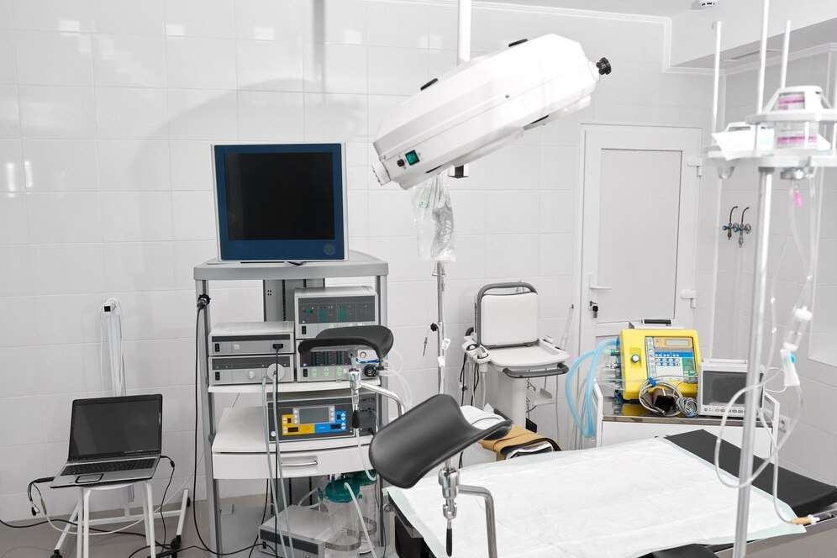
AUTHOR'S PERSPECTIVE
  The Global Ophthalmic Operating Tables Market revenue in 2016: USD 497.23 Million
  Manual held for the largest share of total revenue generated in 2019
  The hospital held the maximum share of the Ophthalmic Operating Tables market in 2019
  Growing eye specialty clinics around the world boost the demand for ophthalmic operating table market
  Lack of trained professionals in underdeveloped countries can hamper the growth of the ophthalmic operation table market
  Thus, rising improvements in the healthcare sector, and infrastructure especially in developing regions will create huge opportunities for the ophthalmic operation table market

Slide 8



















KEY PLAYERS

Slide 9


For Full Report
Contact us
COGNITIVE MARKET RESEARCH
Tel: +1 312-376-8303 | +44 020-8123-0732
India: (+91) 983-496-8611
sales@cognitivemarketresearch.com
Access the Full Report : https://tinyurl.com/2p8ex54j
Please visit our website:
https://www.cognitivemarketresearch.com

