Slide 1

GLOBAL
OPAL JEWELRY
MARKET REPORT
2024
Global,Regional,CountryAnalysis

Slide 2

INTRODUCTION
The market's expansion is linked to both increased consumer disposable income and expanding jewelry sector demand. The market for jewelry was estimated to be worth 28 billion euros in 2022. Globally, three nations accounted for the lion's share of the jewelry income in 2022: China was the largest, closely followed by India and the United States.Growth is anticipated to be boosted by evolving lifestyles and the view of jewelry as a status symbol. Men's growing acceptance of jewelry is also driving the market. Additionally, the industry is being driven by growing consumer knowledge regarding the authenticity of the metals and jewels used in jewelry pieces.

Slide 3


KEY INSIGHTS
CAGR
5.80%
2024- 2031

Slide 4

REVENUE MARKET SHARE BY SEGMENTS 2022
  Rings
  Necklace
  Earring
  Bracelets
Type Segment
  Online
  Offline
Distribution Channel
  Men
  Woman
Application Segment

Slide 5
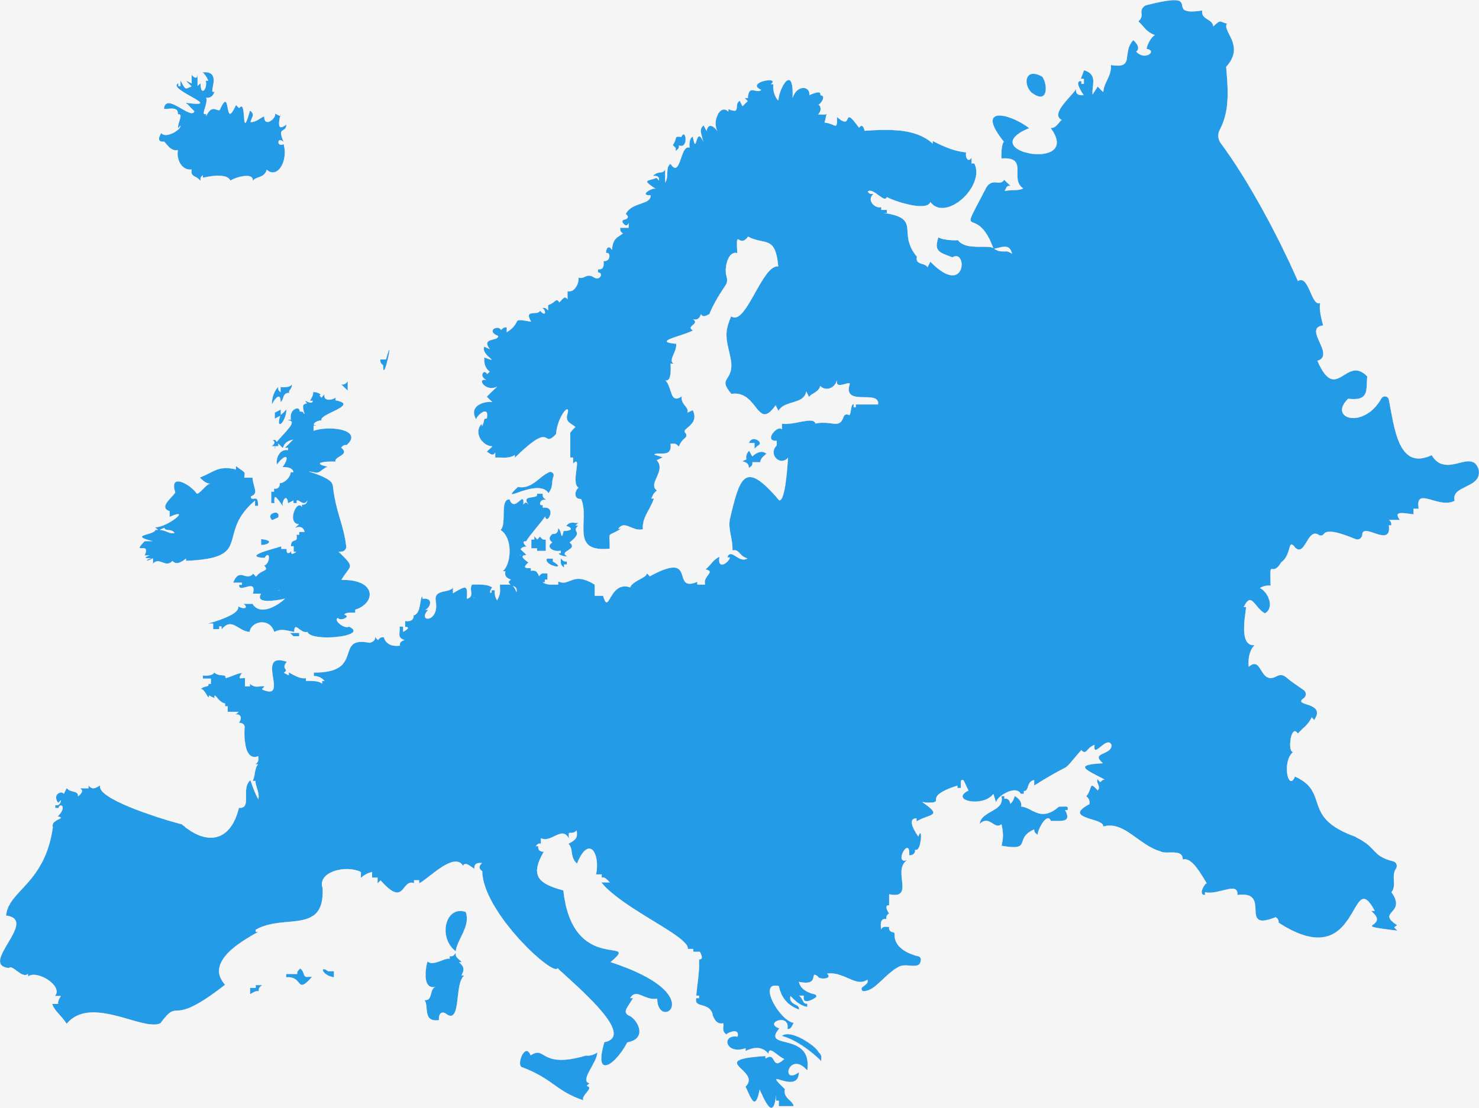
Global Opal Jewelry Market Revenue share for 2024
Europe
39%

Slide 6
Growing Return On Investment (ROI) to Propel Market Growth
Drivers
High Cost to Hinder Market Growth
Restraints

Slide 7
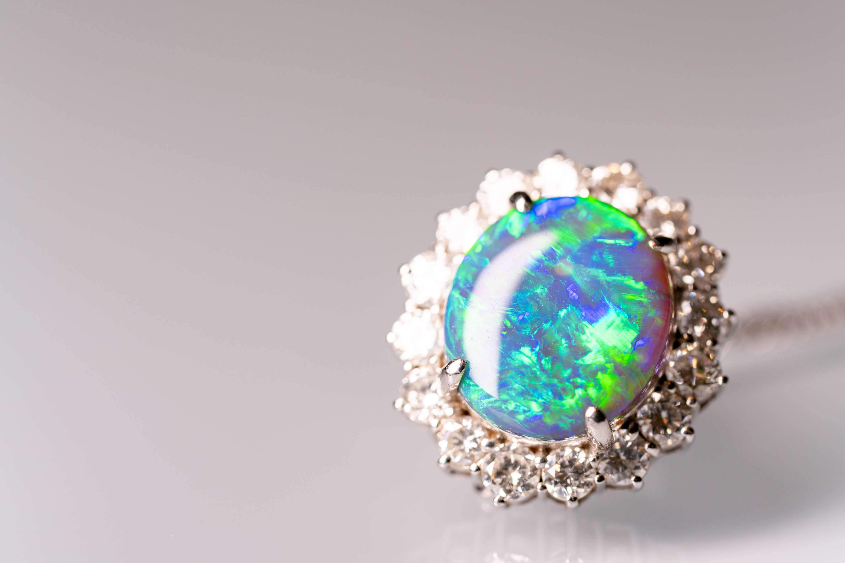
AUTHOR'S PERSPECTIVE
  The Global Opal Jewelry Market is witnessing significant growth in the near future.
  A chain of jewels strung together is the basis of necklaces.
  The industry for necklaces is expanding as a result of higher disposable incomes that increase consumers' purchasing power, the advent of delicate necklace designs, changes in fashion and style, and an increase in urbanites' awareness of fashion.
  Retail stores are the main media and the best place for opal jewelry producers to connect with clients and understand their demands.

Slide 8
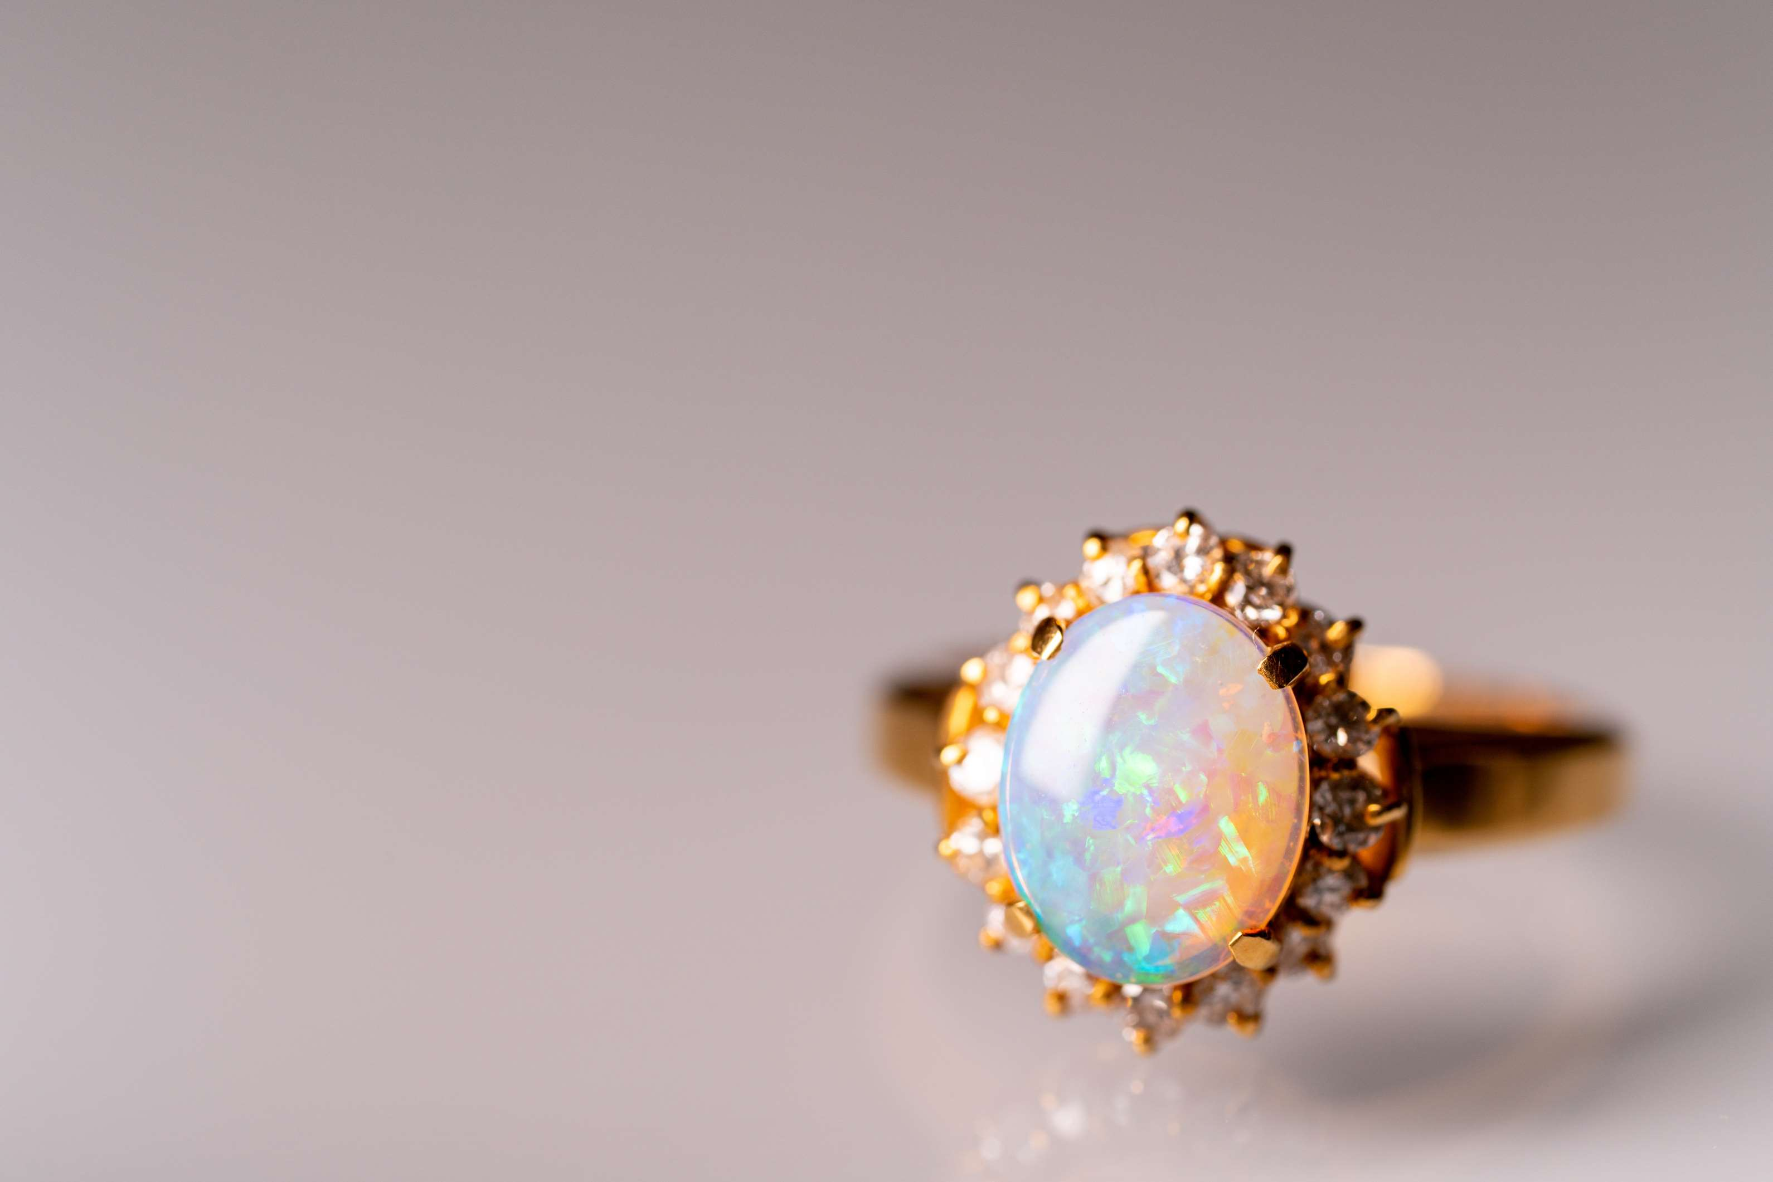









KEY PLAYERS

Slide 9


For Full Report
Contact us
COGNITIVE MARKET RESEARCH
Tel: +1 312-376-8303 | +44 020-8123-0732
India: (+91) 983-496-8611
sales@cognitivemarketresearch.com
Access the Full Report : https://tinyurl.com/yc3hd2zr
Please visit our website:
https://www.cognitivemarketresearch.com

