Slide 1
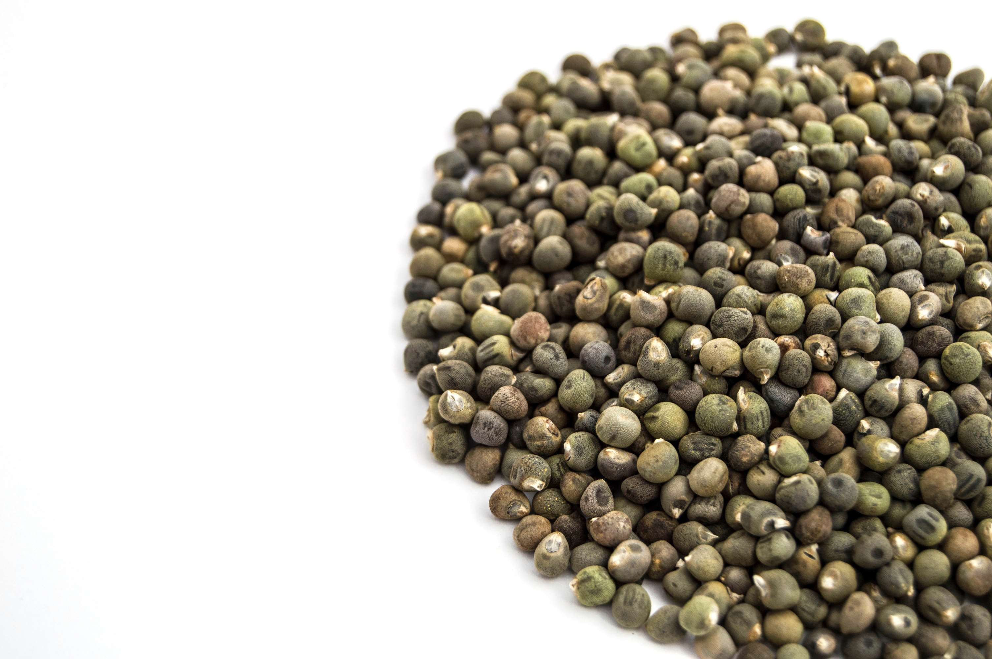
GLOBAL
OKRA SEEDS
MARKET REPORT
2024
Global,Regional,CountryAnalysis

Slide 2
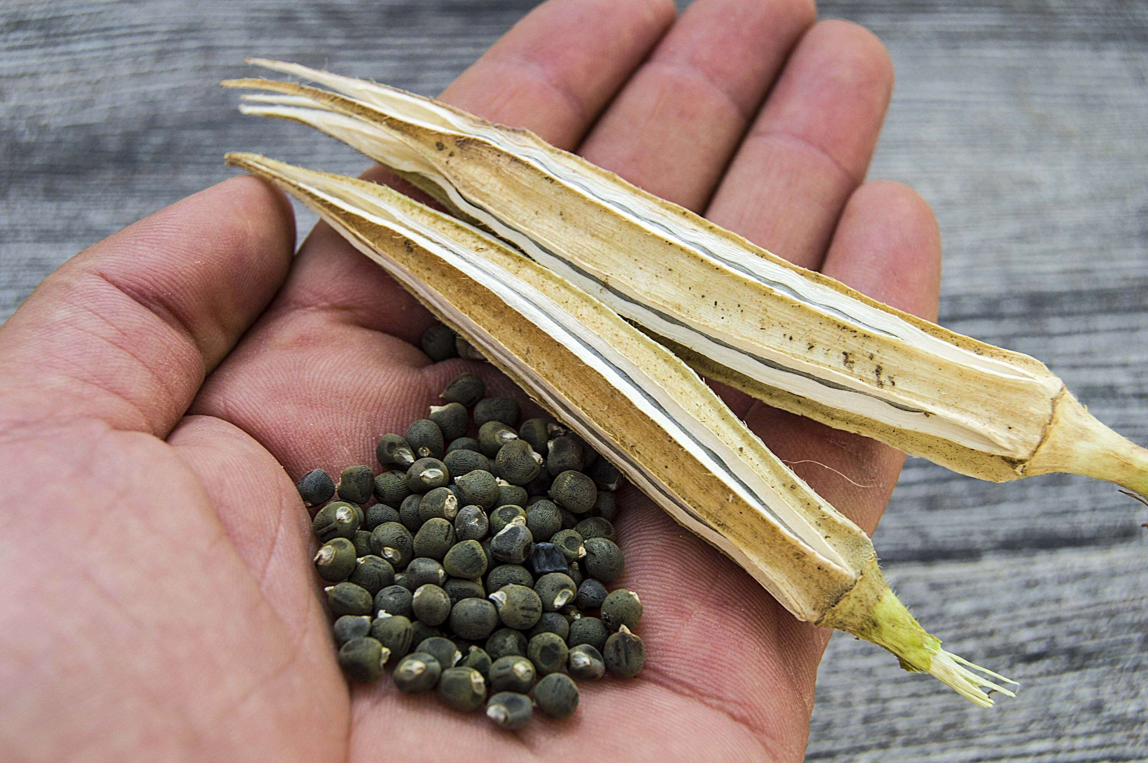
INTRODUCTION
The manufacturing, marketing, and distribution of seeds generated from the okra plant (Abelmoschus esculentus) are all included in the market for okra seeds. The main reasons okra seeds are grown are for their nutritional and culinary worth and possible medical uses. Because of its rich vitamin, mineral, and antioxidant content, okra seeds are becoming a more popular component for health-conscious cooking. Okra seeds are also utilized in traditional medicine due to their supposed advantages in treating ailments like diabetes, high cholesterol, and digestive problems. The demand for natural and organic products by consumers, dietary trends prioritizing plant-based foods, and agricultural practices and policies in important producing countries are some variables that impact the okra seed market. With more people becoming aware of the health benefits of okra seeds, the market is anticipated to increase and accommodate a wider range of customer preferences and uses.

Slide 3
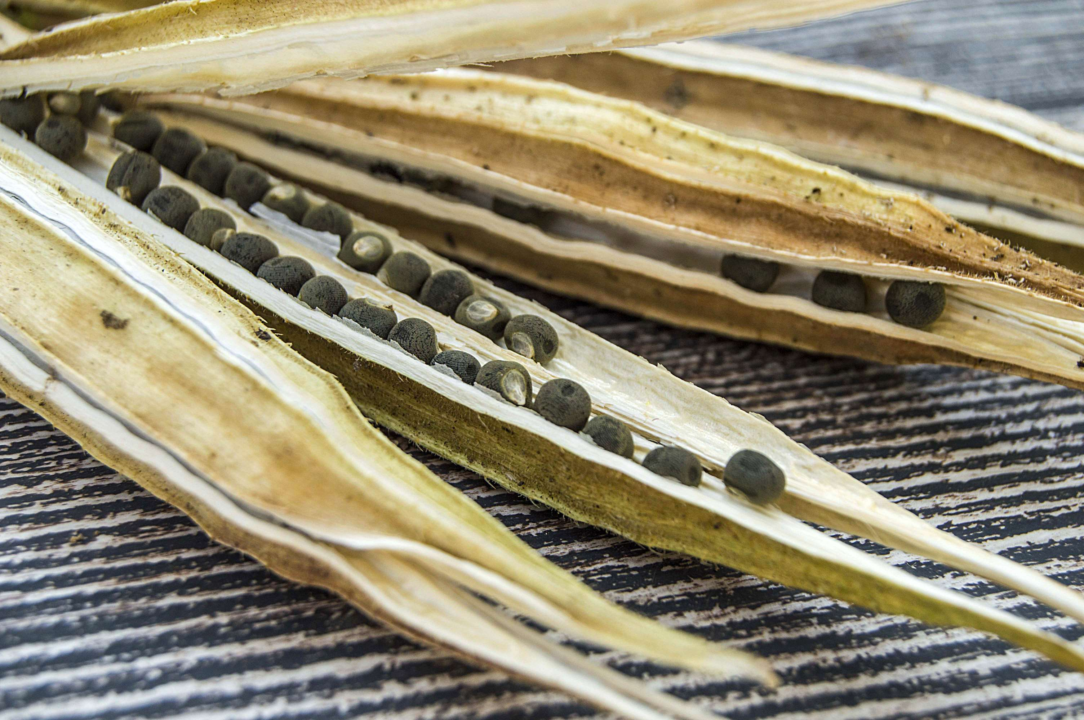

KEY INSIGHTS
MARKET SIZE
USD 215.8 million
2024
CAGR
10.80%
2024- 2031

Slide 4
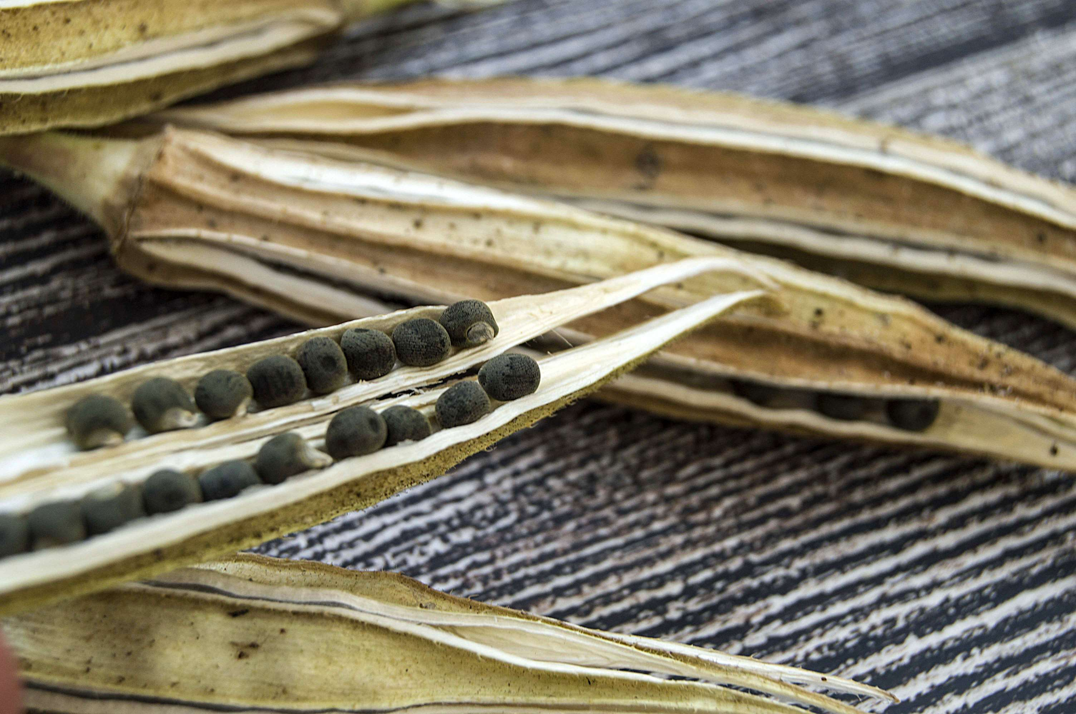
REVENUE MARKET SHARE BY SEGMENTS 2022
  Hybrid
  Open-Pollinated Varieties
Trait Segment
  Conventional
  Organic
Form Segment
  Food
  Agricultural Planting
  Pharmaceuticals
Application Segment

Slide 5

Global Okra Seeds Market Revenue share for 2024
North America
40%

Slide 6
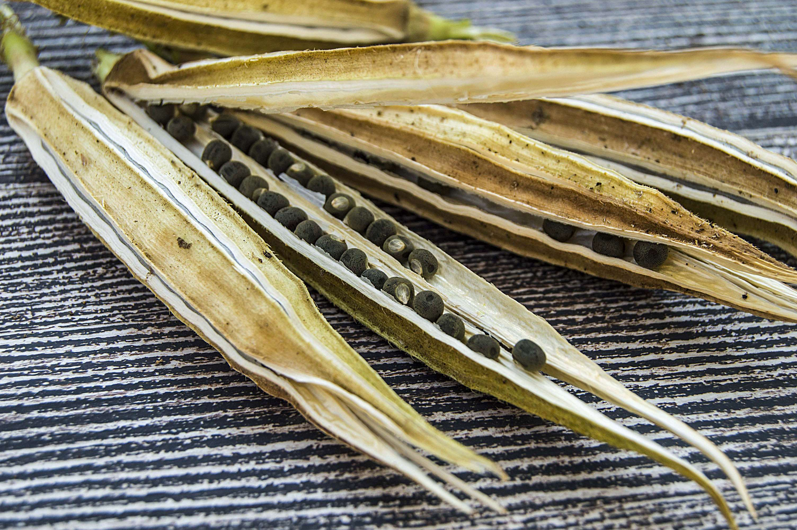
Growth of Organic Farming to Propel Market Growth
Drivers
Lack of Storage and Processing Facilities to Limit the Sales
Restraints

Slide 7
AUTHOR'S PERSPECTIVE
  The global Okra Seeds market will expand significantly by 10.80% CAGR between 2024 to 2031.
  Control towers are integrating technologies like AI, machine learning, and IoT to enable automated decision-making and provide deeper insights.
  The market is expanding as more companies realize the advantages of control towers and invest in their implementation.
  The Food held the highest Okra Seeds market revenue share in 2024.

Slide 8







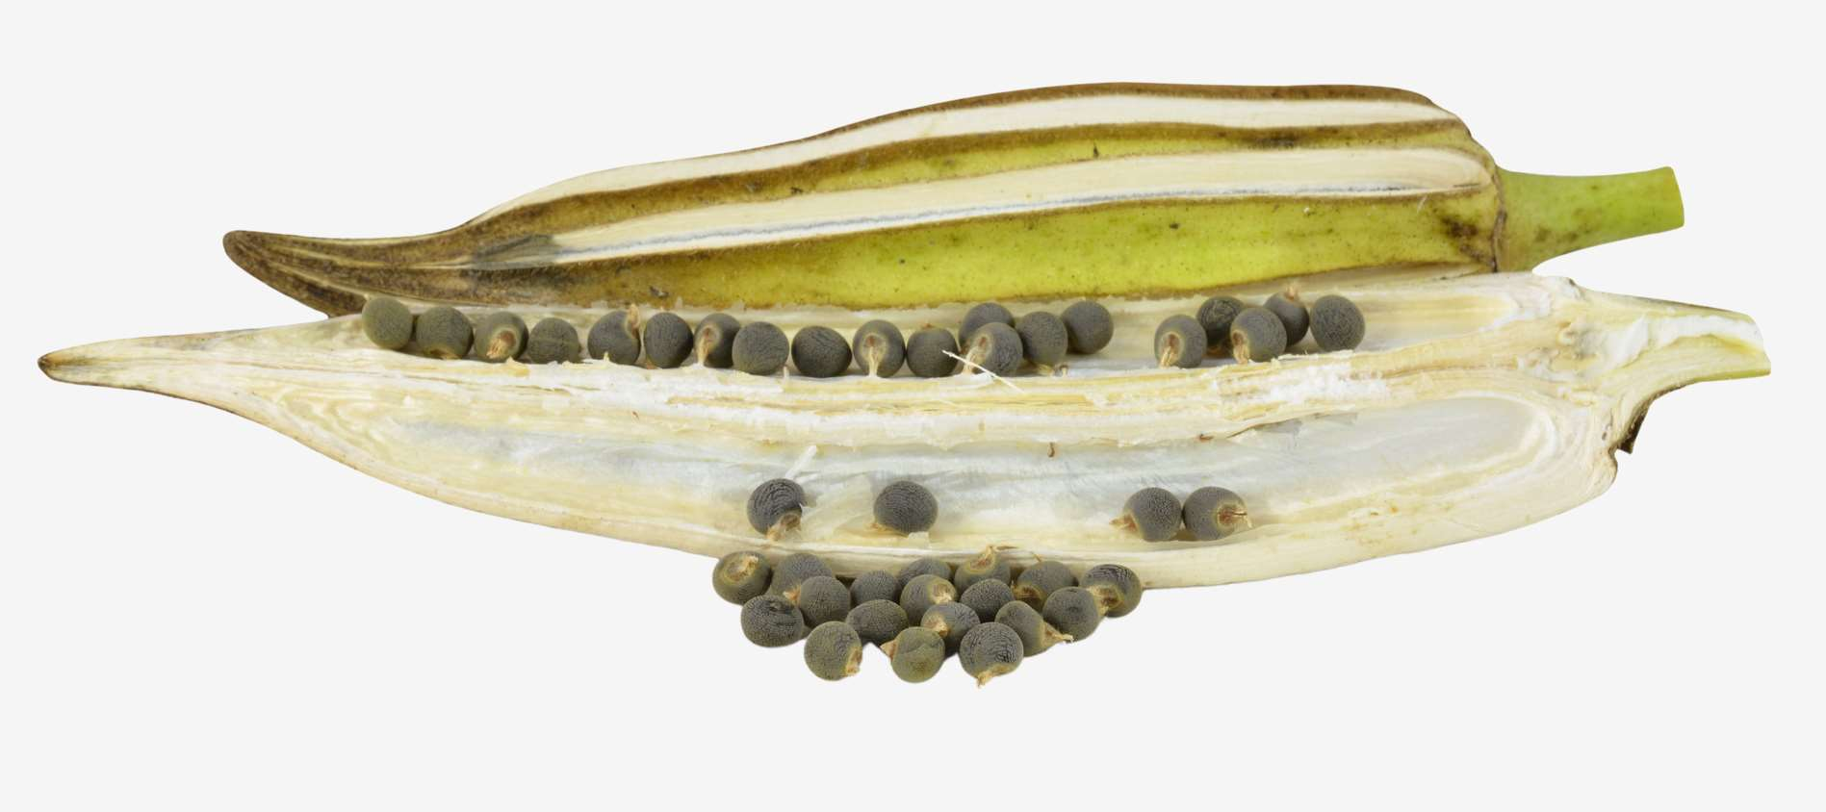


KEY PLAYERS

Slide 9


For Full Report
Contact us
COGNITIVE MARKET RESEARCH
Tel: +1 312-376-8303 | +44 020-8123-0732
India: (+91) 983-496-8611
sales@cognitivemarketresearch.com
Access the Full Report : https://tinyurl.com/3emkyper
Please visit our website:
https://www.cognitivemarketresearch.com

