Slide 1
OFFICE CHAIRS
MARKET REPORT 2024
Qualitative Analysis + Quantitative Analysis

Slide 2
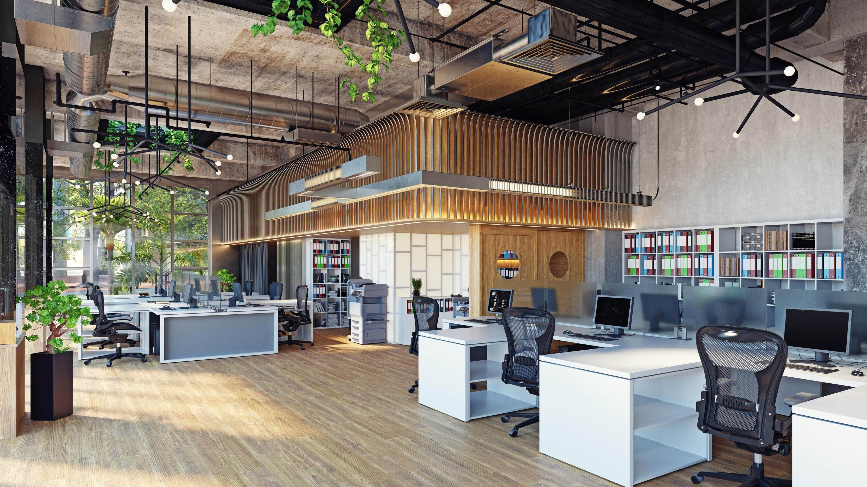

INTRODUCTION
The office chairs market encompasses a segment of the ergonomic office chair is commonly used in various businesses and industries where employees sit for long periods. Ergonomic chairs have adjustable seats, brackets, and natural postures to reduce back strain and tension during long periods of sitting.
Currently, organizations are choosing ergonomic office chairs over ordinary office chairs to make the workplace healthier, happier, and more productive for employers. The growing workforce, rising employee health and well-being concerns, increased awareness of obesity, and an increase in the number of occupational injury complaints worldwide are all key drivers of the ergonomic office chair industry. The COVID-19 epidemic had a partial detrimental impact on the ergonomic office chair market.

Slide 3
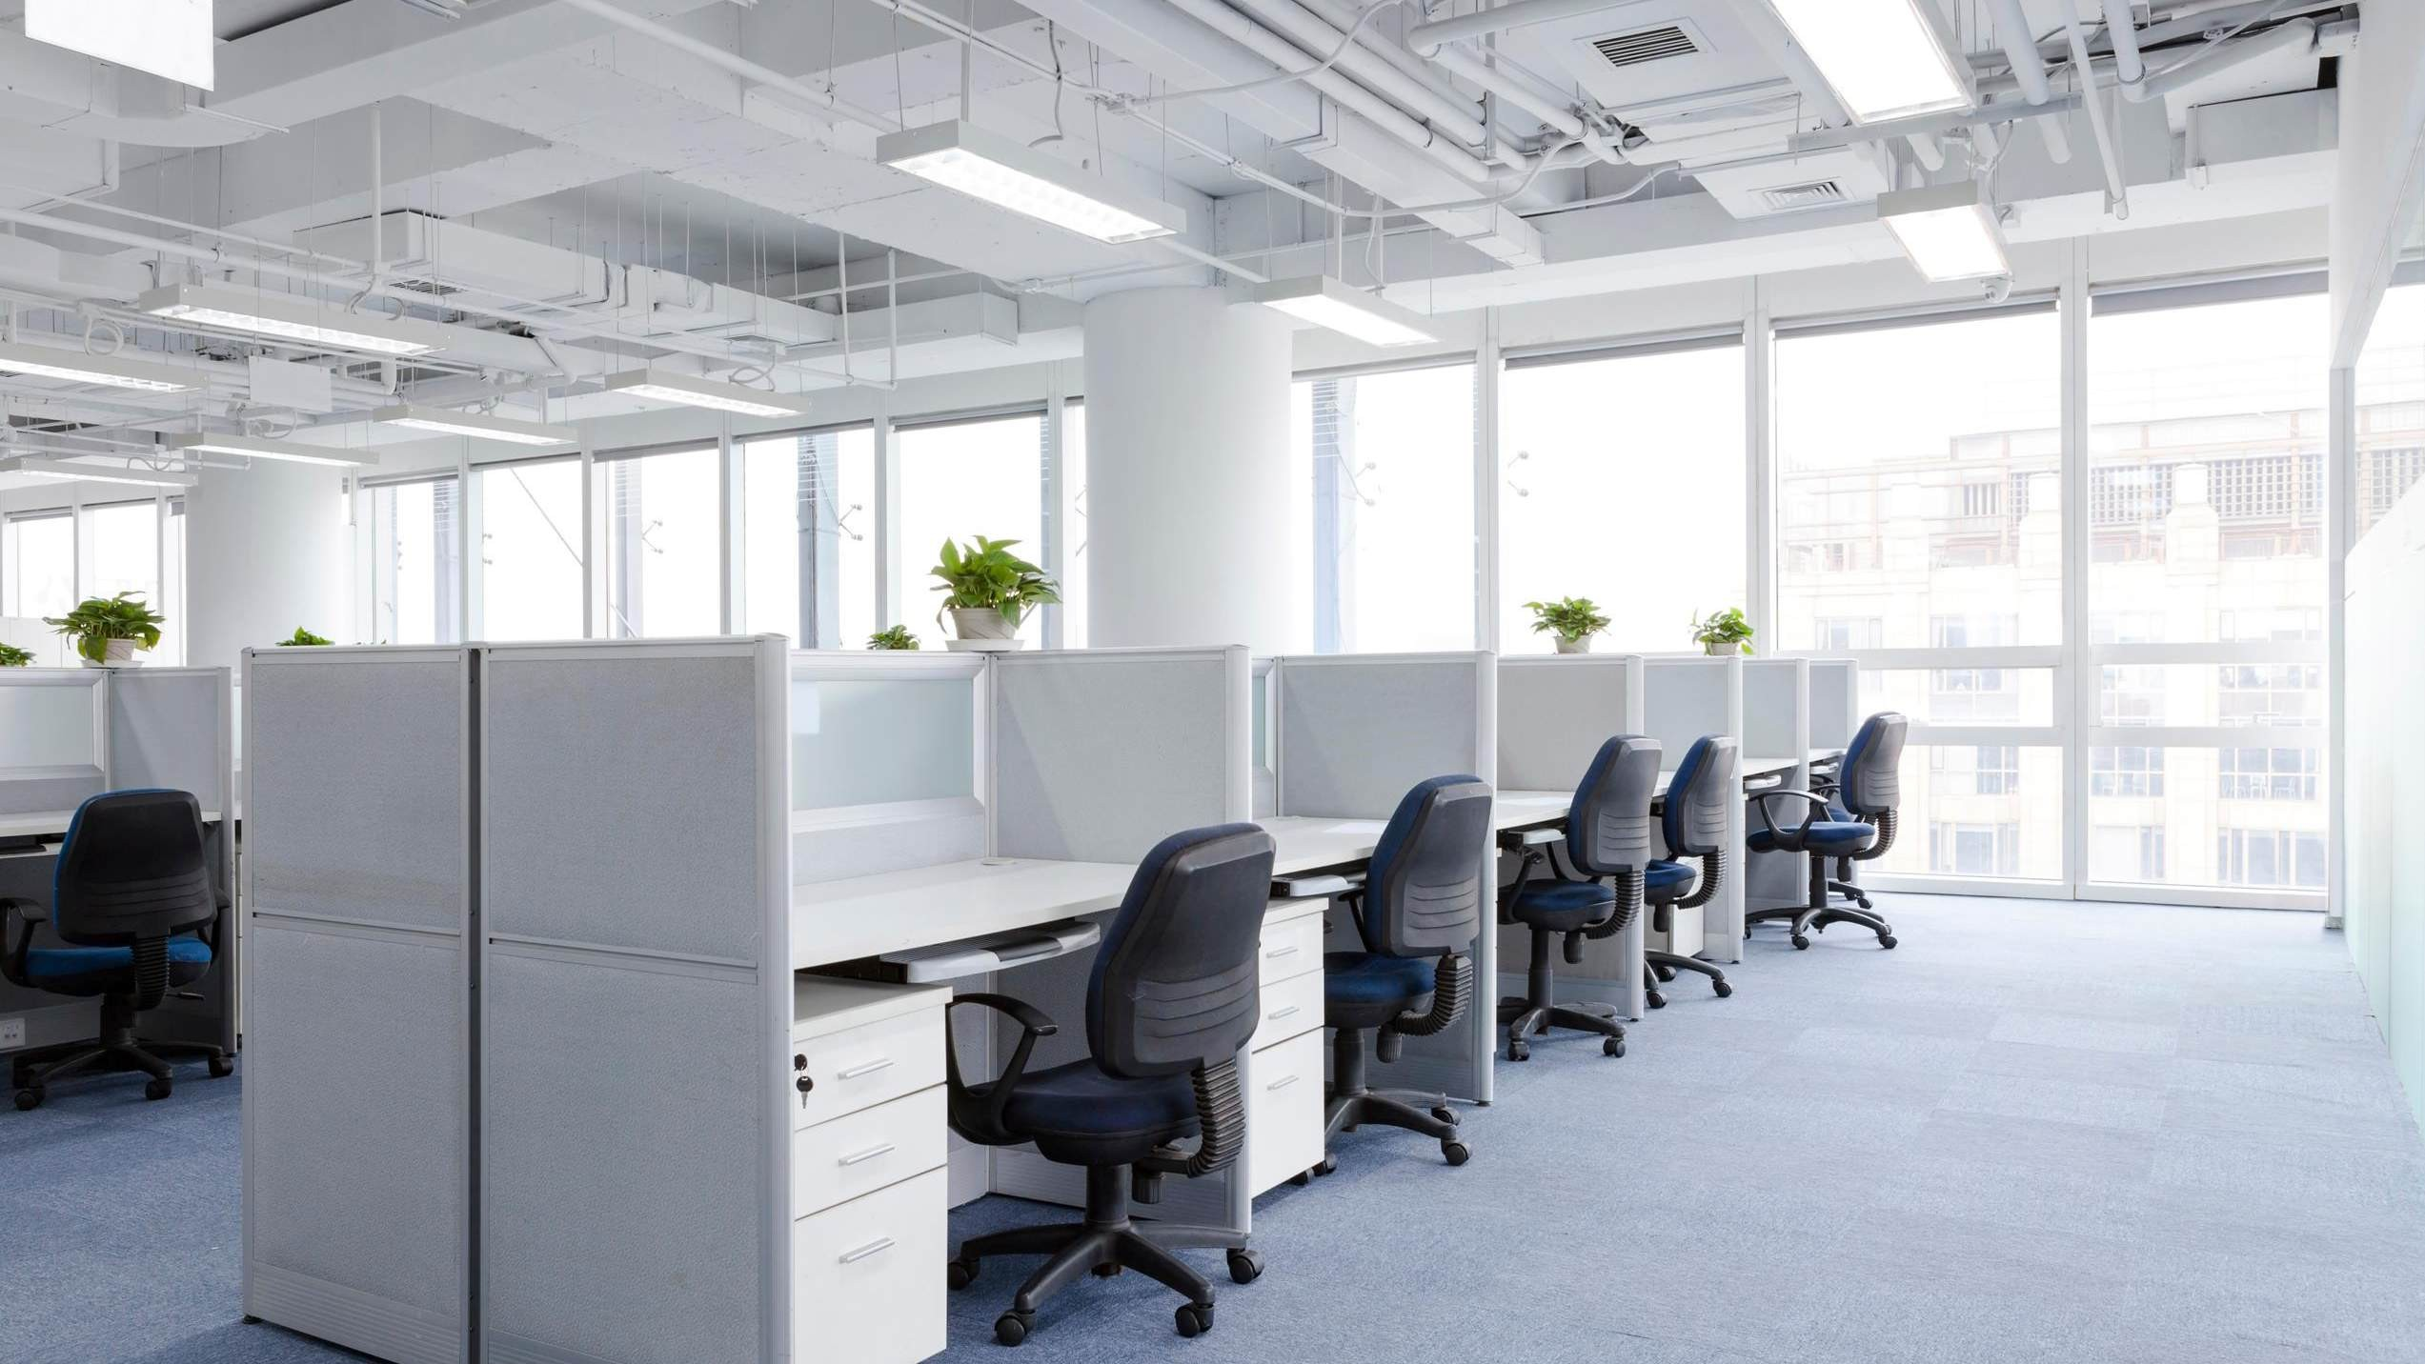


KEY INSIGHTS
MARKET SIZE
USD 14258.2 million
2024
20₋24
CAGR 5.20%
2031

Slide 4
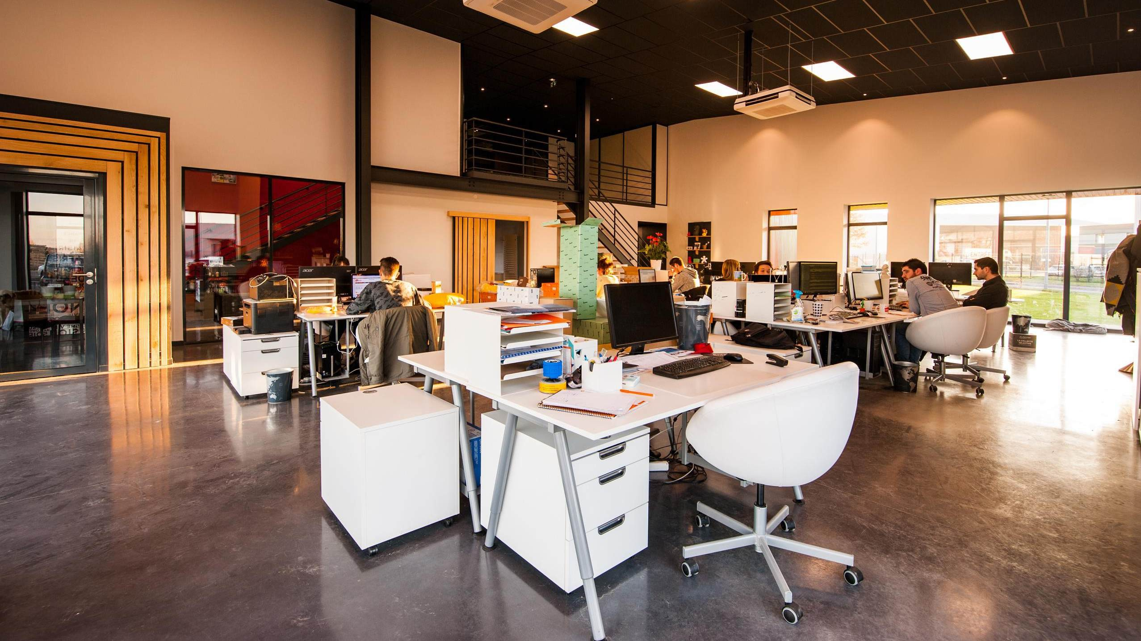

REVENUE MARKET SHARE BY SEGMENTS 2024
Executive Product Type stands out as the dominating category.
Conference Product Type emerges as the fastest- growing category in the office chairs market.
By Product Type
The dominating category is mesh. While plastic, fabric, and leather are all alternatives, mesh chairs now have the highest global market share.
The fastest-growing category in the office chairs
market is Leather. In the office, leather seats are frequently viewed as a symbol of luxury and status.
Material Segment

Slide 5
REVENUE MARKET SHARE BY SEGMENTS 2024
School
Enterprise
Households
Industrials
Application Segment
Sales Channel Segment
Offline
Online

Slide 6


REGION ANALYSIS
NORTH AMERICA | 40 %
Europe | 30 %
Asia Pacific | 23 %
Latin America | 5%
MIDDLE EAST AFRICA | 2%
North America Office Chairs Market Revenue share for 2024 is 40%

Slide 7
Increased Emphasis on Ergonomics and Comfort to Increase the Demand Globally
Expanding Corporate Wellness Initiatives to Propel Market Growth
Drivers
Expanding Corporate Wellness Initiatives to Propel Market Growth
Restraints

Slide 8


AUTHOR'S PERSPECTIVE
The global office chairs market will expand significantly by 5.20% CAGR between 2024 to 2031.
Executive Product Type stands out as the dominating category.
People are working longer hours at desks, and there is an increasing emphasis on employee health and ergonomics in the workplace.
The dominating category is mesh.
While plastic, fabric, and leather are all alternatives, mesh chairs now have the highest global market share.
This is owing to their breathability and comfort throughout extended work hours.

Slide 9
KEY PLAYERS

Slide 10


Contact us
For Full Report
COGNITIVE MARKET RESEARCH
Tel: + 1 312 - 376- 8303 | + 44 020 - 8123 - 0732
India: ( + 91 ) 983 - 496- 8611
sales@ cognitivemarketresearch. com
Access the Full Report : https://tinyurl.com/bkyw7xjz
Please visit our website:
https://www.cognitivemarketresearch.com

