Slide 1

GLOBAL OAT FIBER
MARKET REPORT 2024
Global,Regional,CountryAnalysis

Slide 2
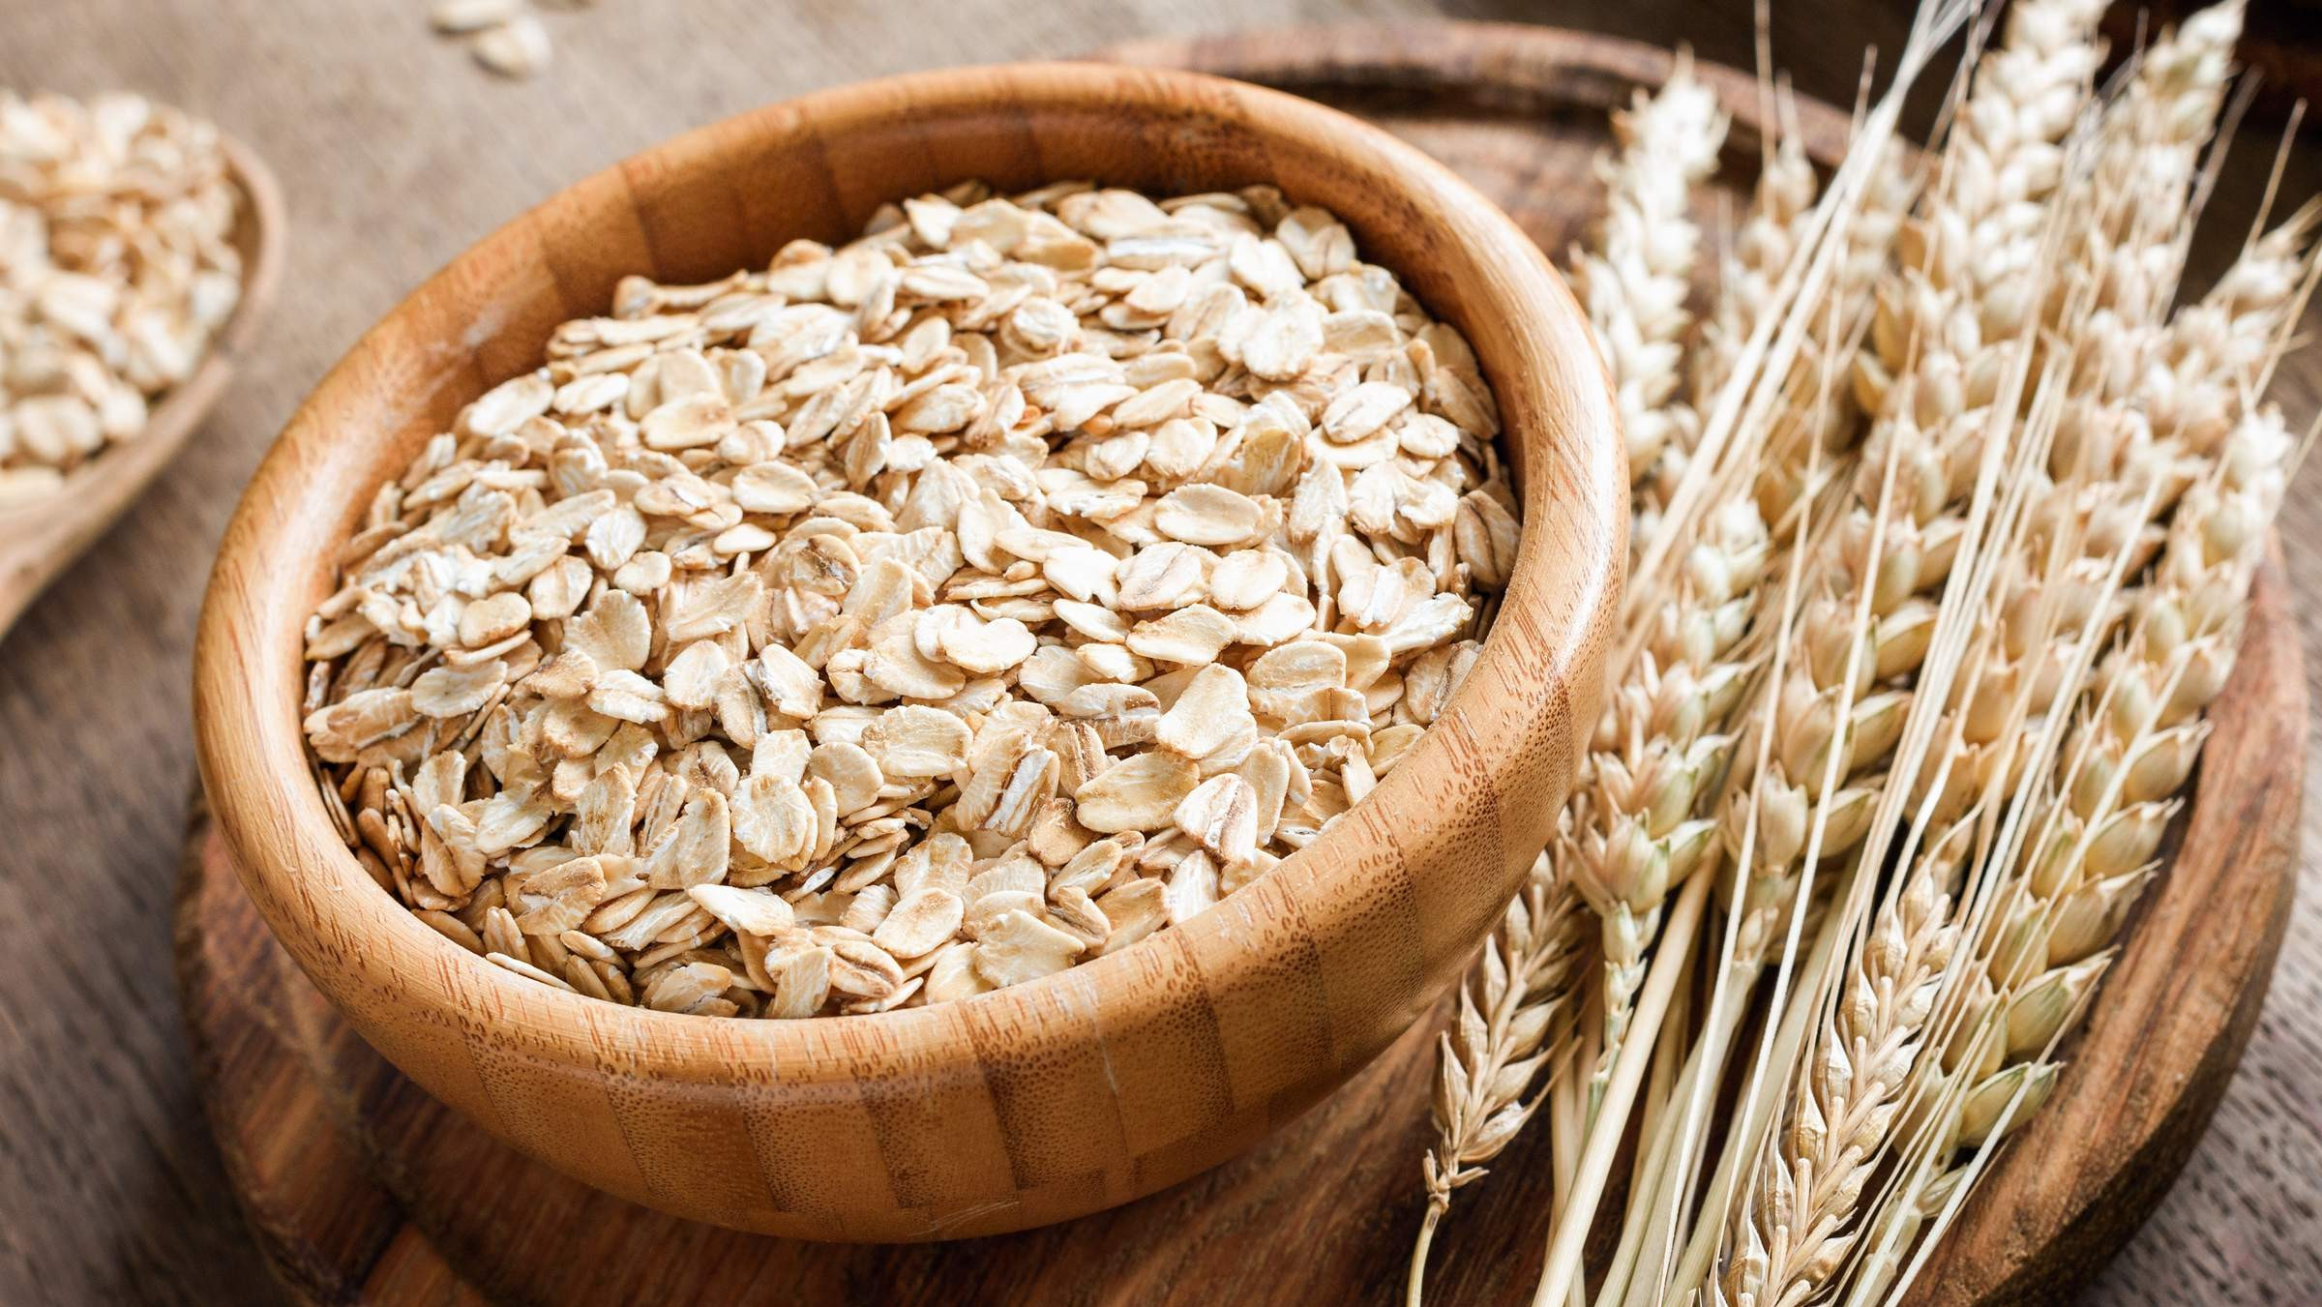
INTRODUCTION
The Global Oat Fiber market refers to assessing trends, demand, and factors influencing the production, distribution, and consumption of oat-derived fiber products worldwide, focusing on applications in the food and beverage industry. The rising in demand for oat fibre from bakery and snack end users is a many driving factor for the global oat fibre market. Using oat fibre to replace flour in low-carb diets is gaining popularity among health-conscious consumers. These strategies help key players capture a significant market share and competitive in the dynamic Oat Fiber market.

Slide 3
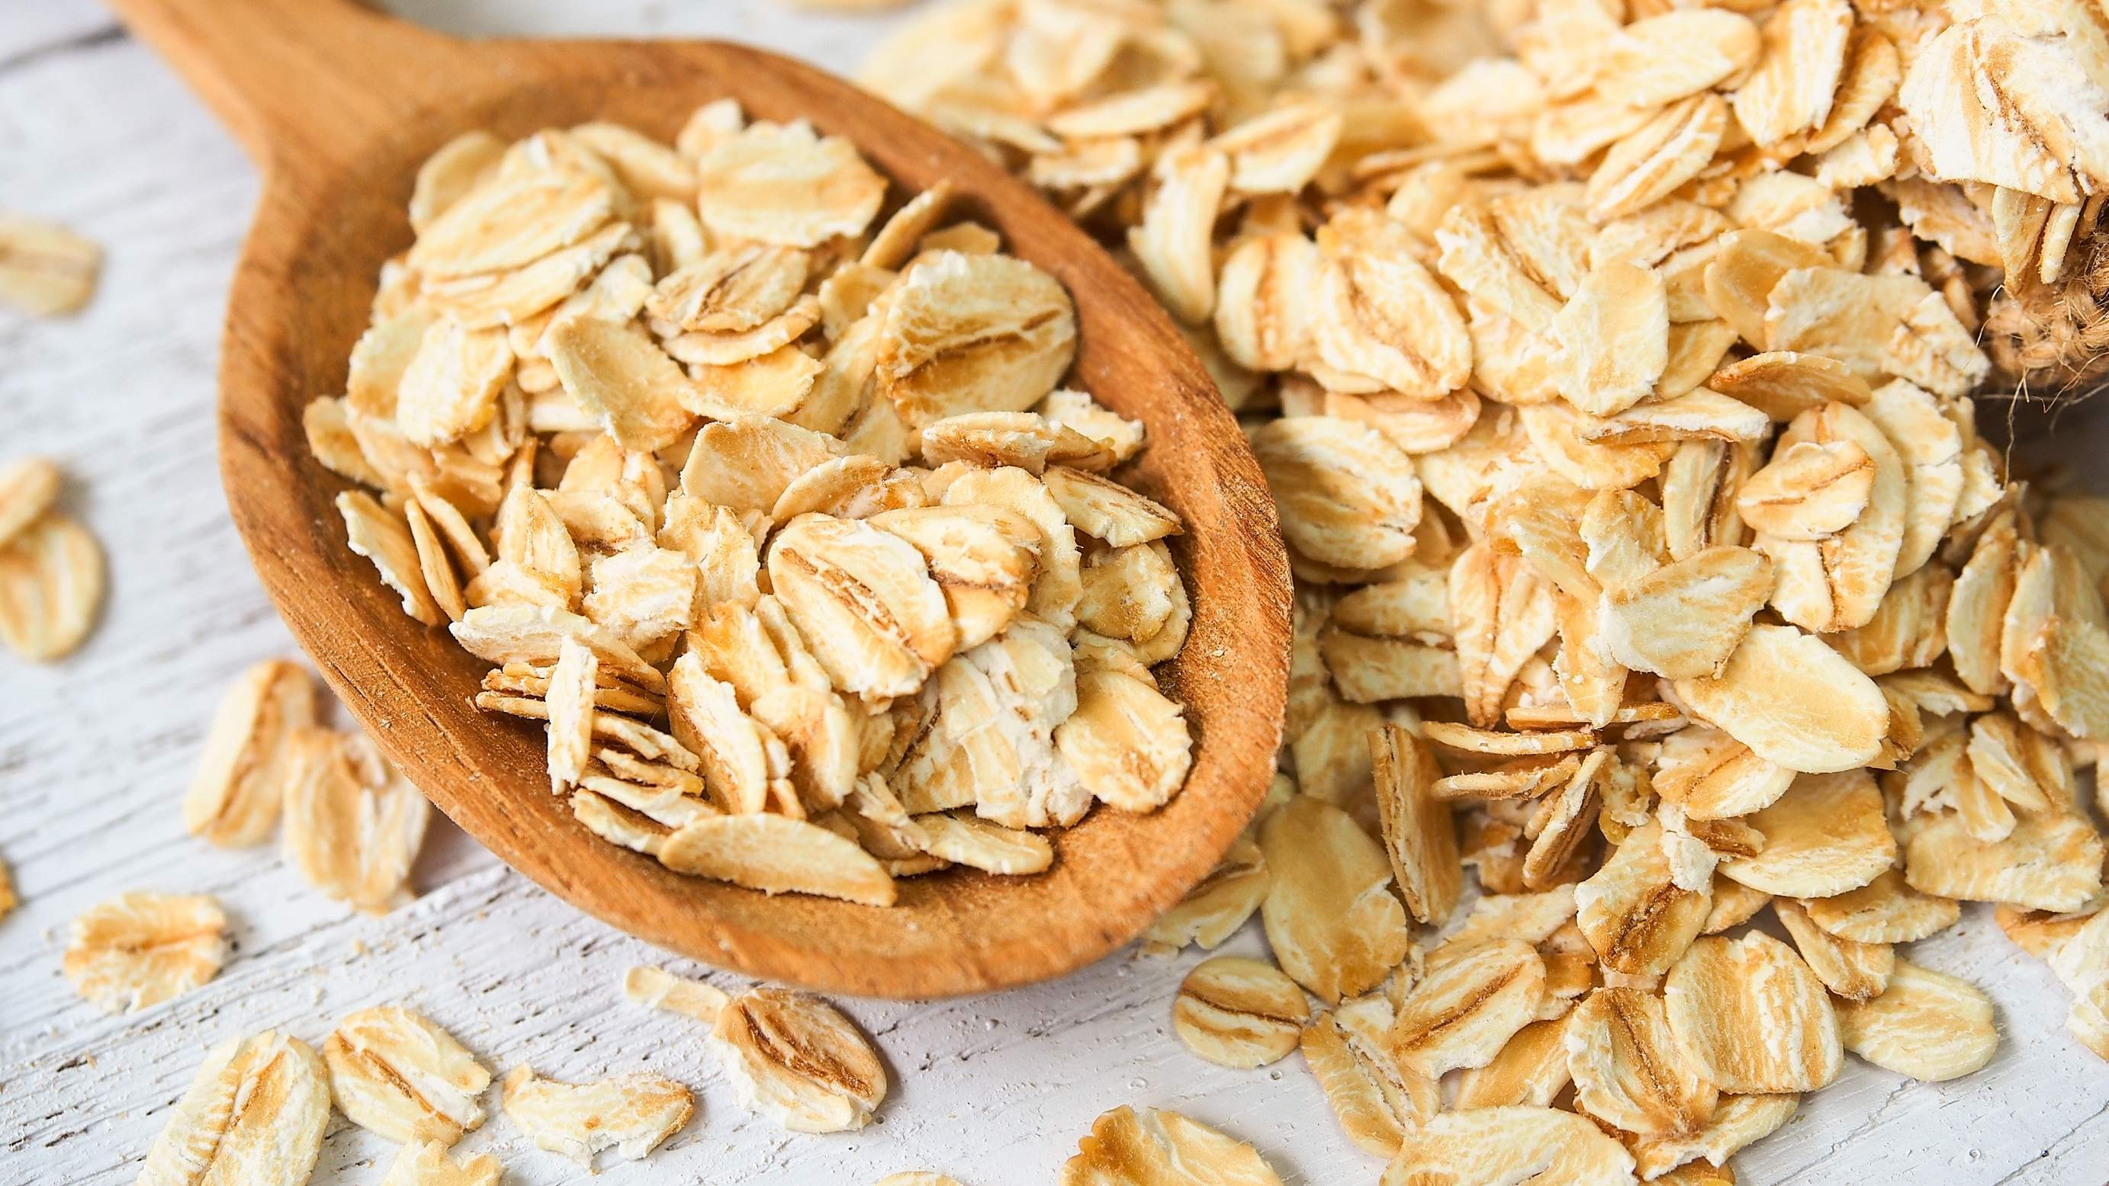

KEY INSIGHTS
MARKET SIZE
USD 0.328 billion
2030
2023
CAGR 8.00%
-
2030

Slide 4
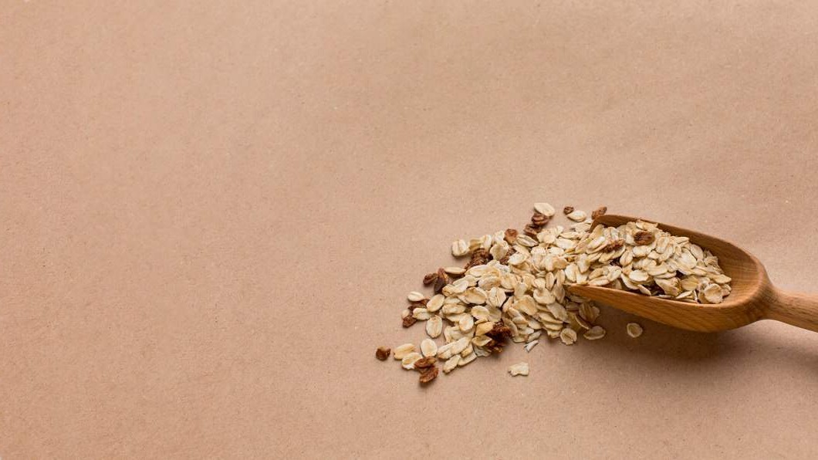
REVENUE MARKET SHARE BY SEGMENTS 2022
Powder Tablet
Form Segment
Bakery & Confectionery Meat Products Beverages
End-Use Segment
Food & Beverage Industry Dietary Supplements Pharmaceuticals Industry
Dietary Supplements

Slide 5

Global Oat Fiber Market Revenue share for 2022
North America
40%

Slide 6
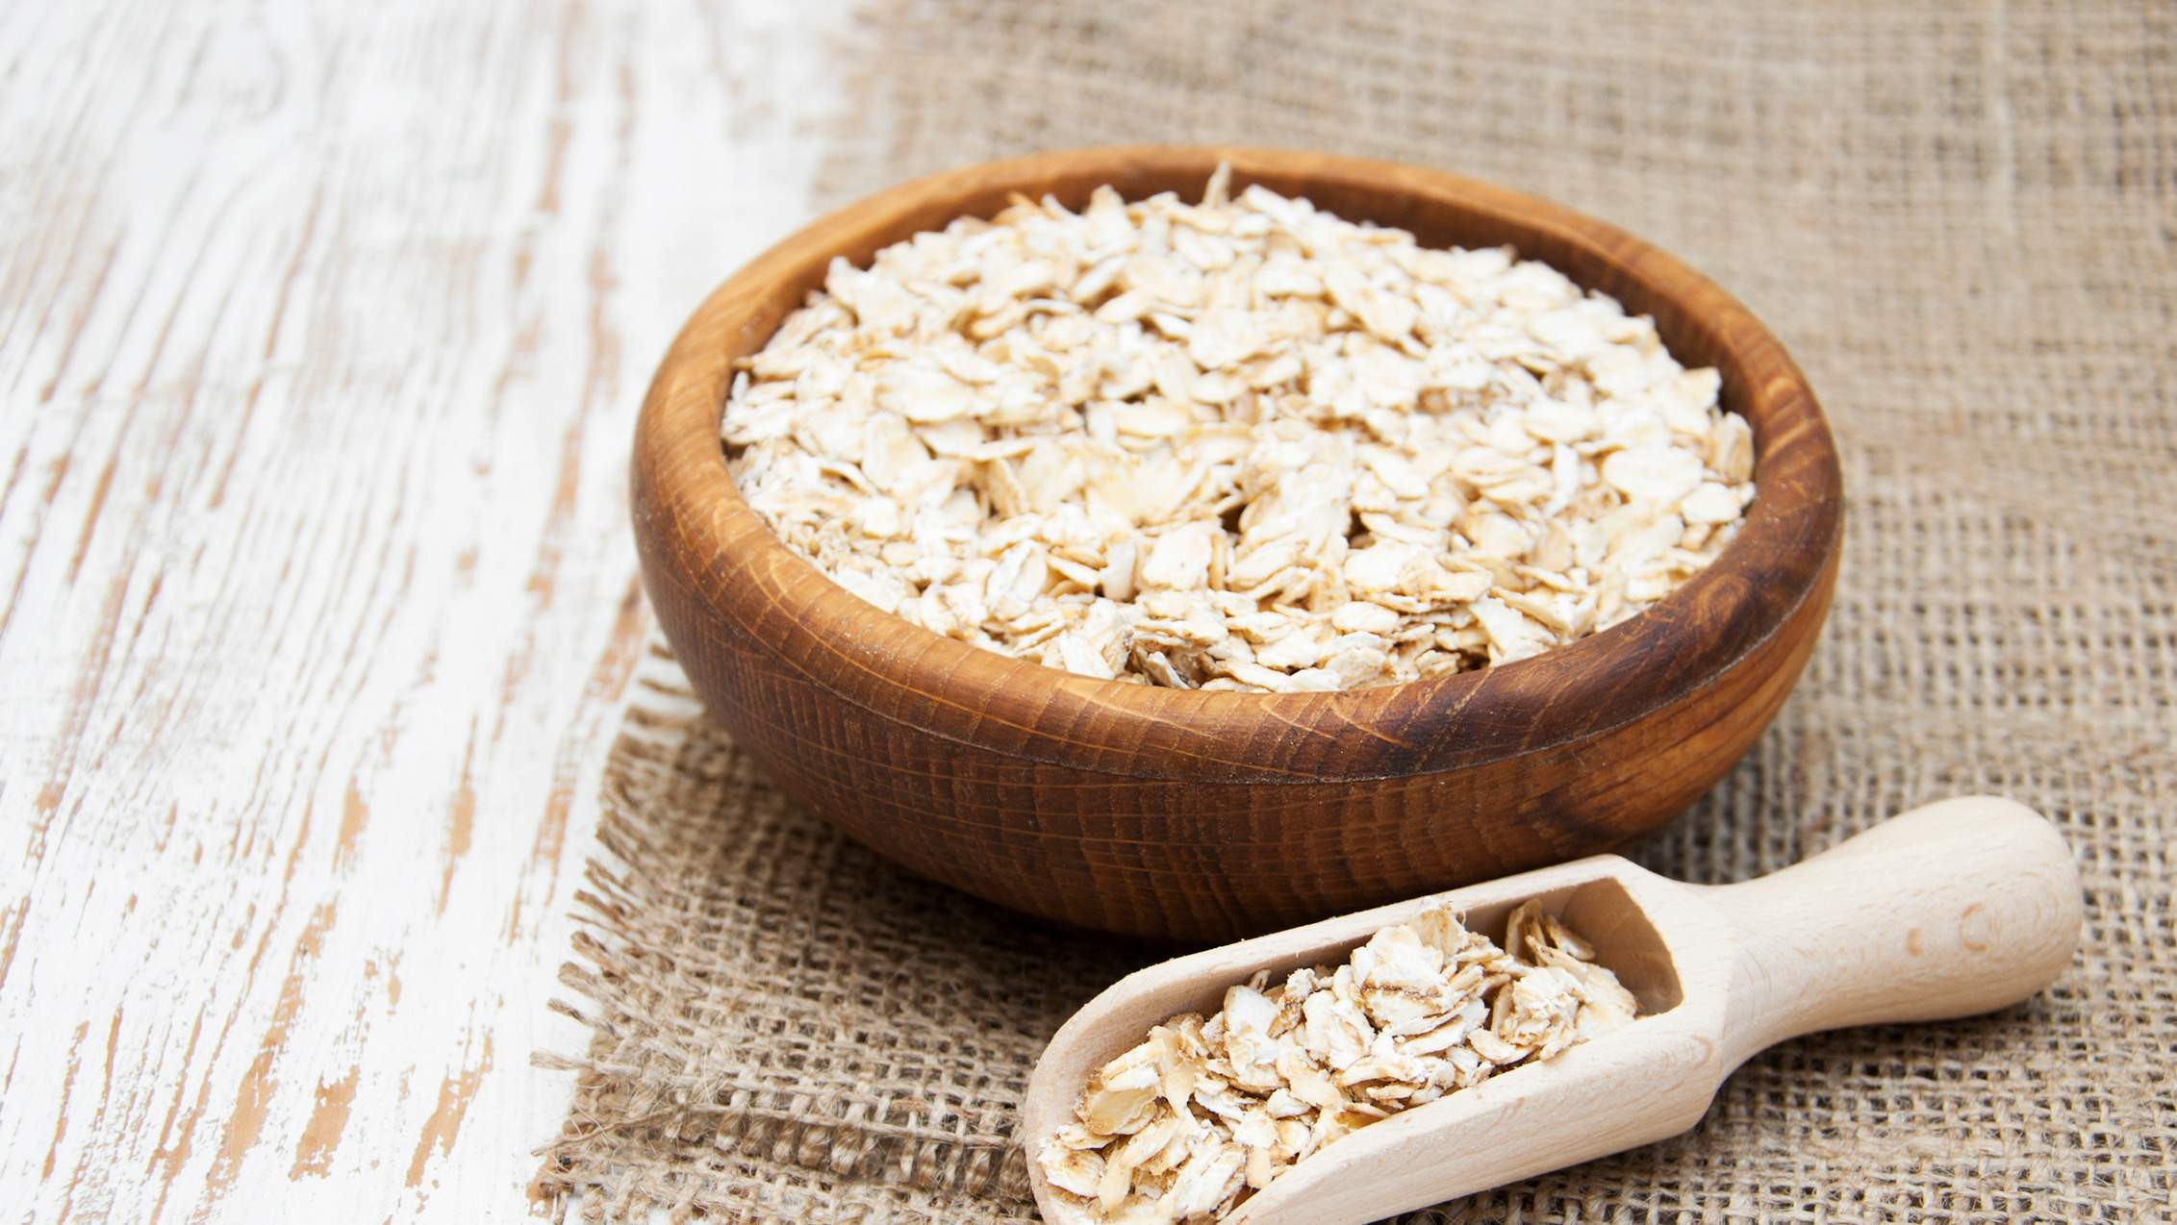
Consumption of Multiple Purposes by Consumers to Propel Market Growth
Drivers
Psyllium Dusk Powder Emerged To Certain Ingredients to Restrict Market Growth
Restraints

Slide 7
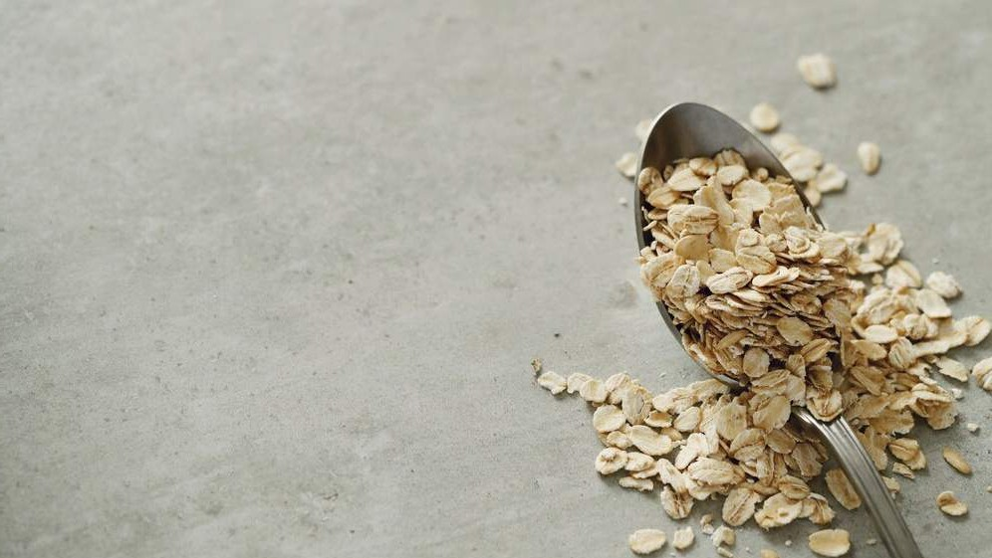
AUTHOR'S PERSPECTIVE
The Global Oat Fiber Market is witnessing significant growth in the near future.
Organic oat fiber caters to health-conscious consumers seeking clean-label and environmentally sustainable options.
Soluble oat fibre, derived from the soluble fraction of oats, offers unique health benefits, including lowering cholesterol levels and improving heart health.
Tablets provide a compact and easily consumable format, making them suitable for the health and wellness sector.
In the food and beverage industry, oat fiber is widely utilized as a versatile ingredient in various products, including baked goods, cereals, and snacks.

Slide 8
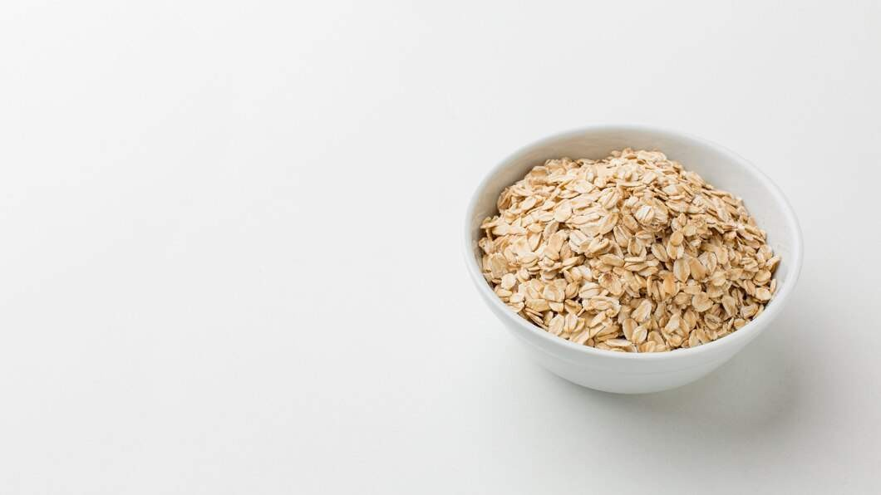














KEY PLAYERS

Slide 9


Contact us
For Full Report
COGNITIVE MARKET RESEARCH
Tel: + 1 312 - 376 - 8303 | + 44 020 - 8123 - 0732
India: ( + 91 ) 983 - 496 - 8611
sales@ cognitivemarketresearch. com
Access the Full Report : http://tinyurl.com/bdz7dtrb
Please visit our website:
https://www.cognitivemarketresearch.com

