Slide 1
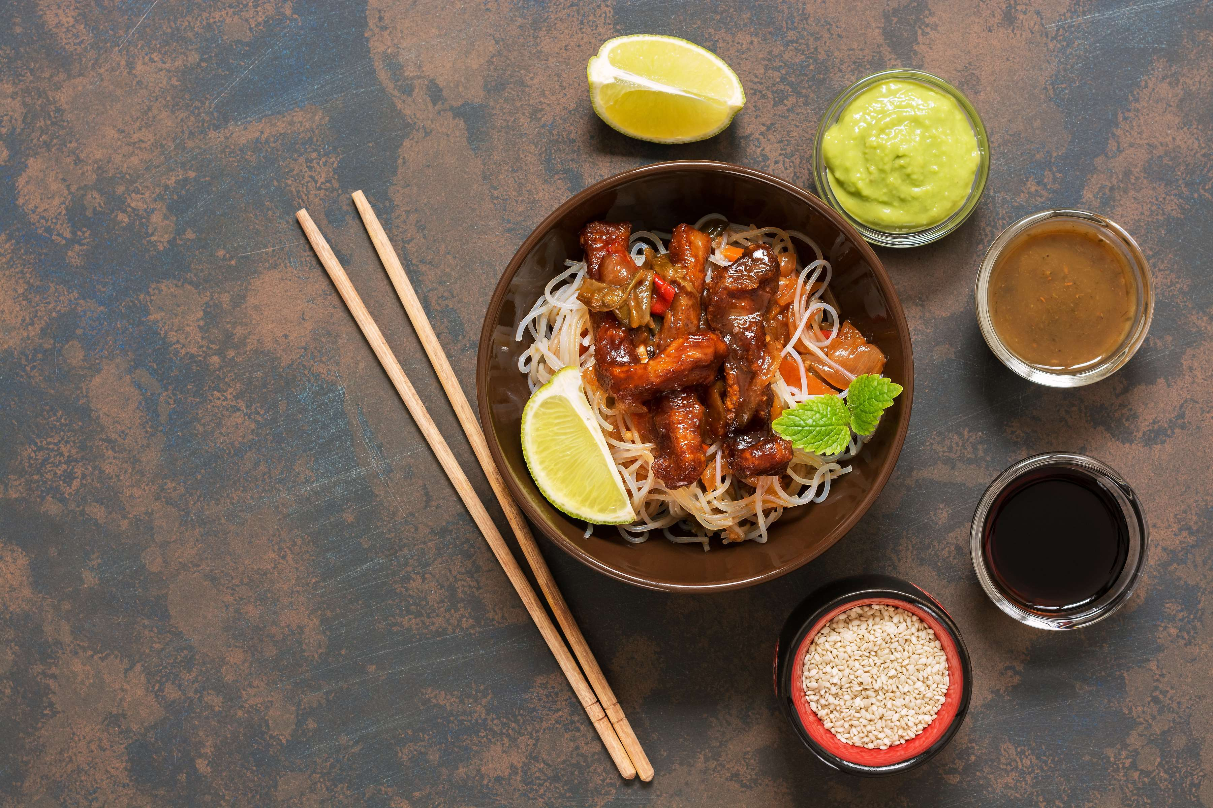
GLOBAL
NOODLES
MARKET REPORT
2024
Global,Regional,CountryAnalysis

Slide 2
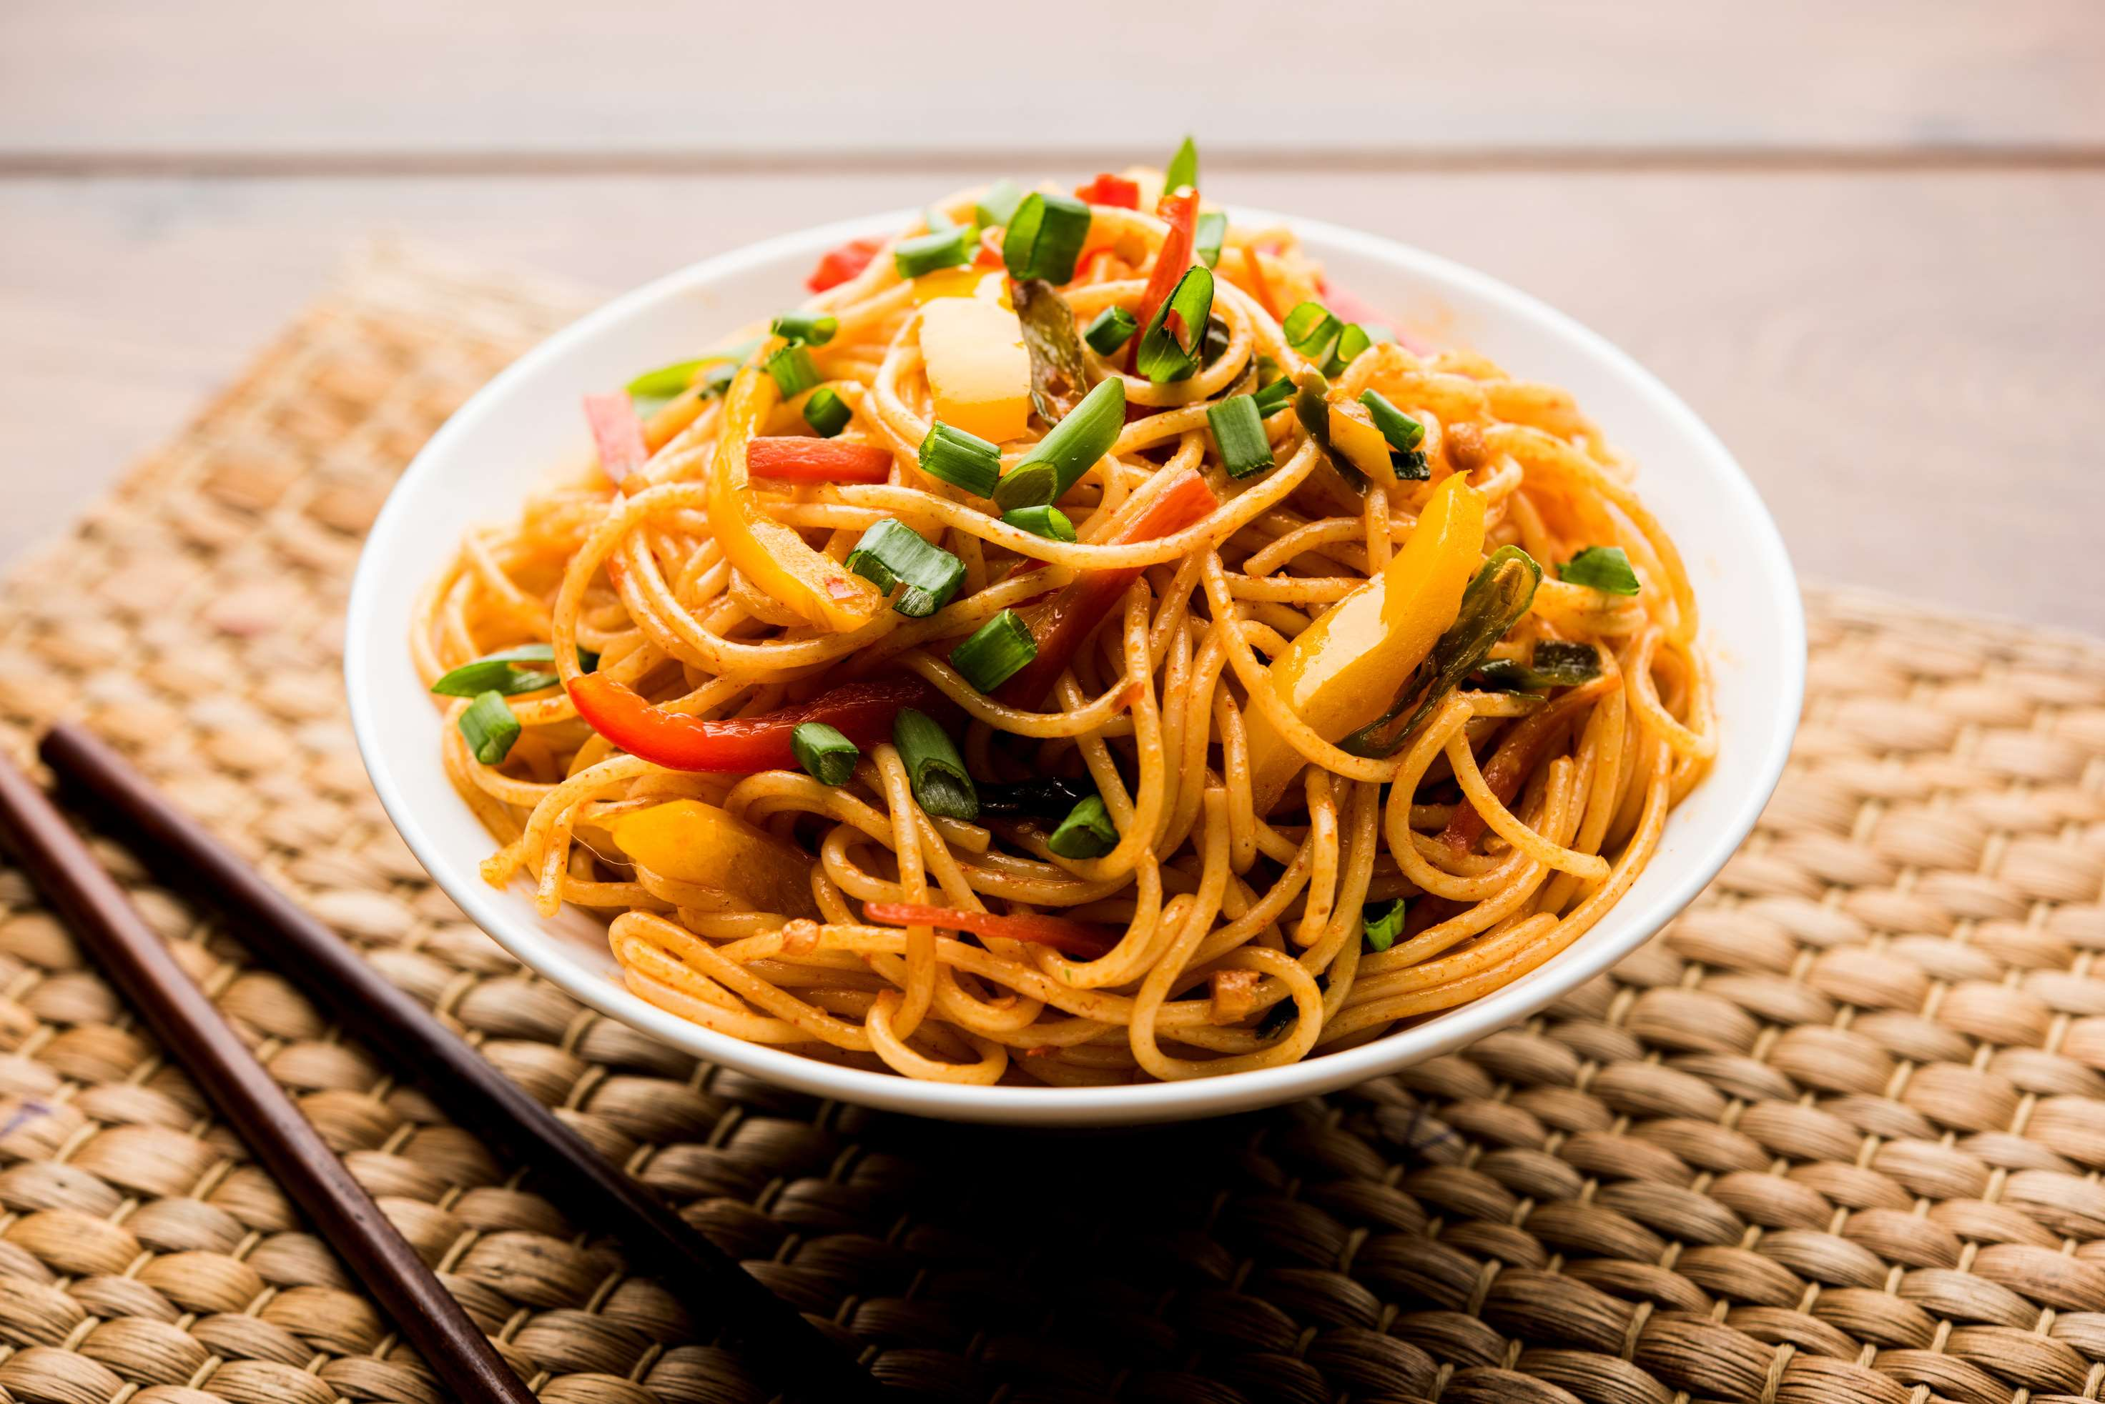
INTRODUCTION
The global noodles market comprises a vast array of items such as pasta, instant noodles, and other types of noodles, which are designed to satisfy a wide range of gastronomic tastes. Due to their price and ease of use, instant noodles are the market leader in this niche, drawing in customers on a tight budget as well as busy professionals and students. Pasta is a versatile food that can be found in a broad variety of shapes and flavors, making it suitable for both traditional and modern tastes. It is a mainstay in many cuisines. The diversity of the market is further enhanced by the addition of other noodle varieties like udon and rice noodles. Globalization, the rise in popularity of Asian food, and shifting consumer lifestyles are all factors contributing to the market's growth. But health worries about excessive sodium content and processed additives in some noodle products present difficulties, forcing producers to come up with new ideas and adjust to changing consumer tastes.

Slide 3


KEY INSIGHTS
MARKET SIZE
USD 58541.2 million
2023
CAGR
4.00%
2023- 2030

Slide 4
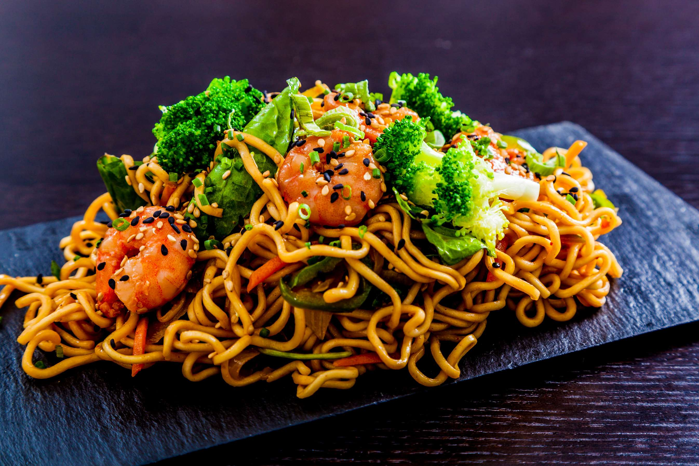
REVENUE MARKET SHARE BY SEGMENTS 2022
  Vegetarian Noodles
  Non-veg Noodles
  Cup/Bowl
  Packet
Packaging Type Segment
Source Type Segment
  Oat
  Rice
  Wheat
  Buckwheat
  Corn
  Millet
  Online Channels
  Supermarkets/ Hypermarkets
  Specialty Stores
  Convenience Store
  Traditional Grocery Stores
Raw Material Type Segment
Distribution Channel

Slide 5

Global Noodles Market Revenue share for 2024
North America
40%

Slide 6
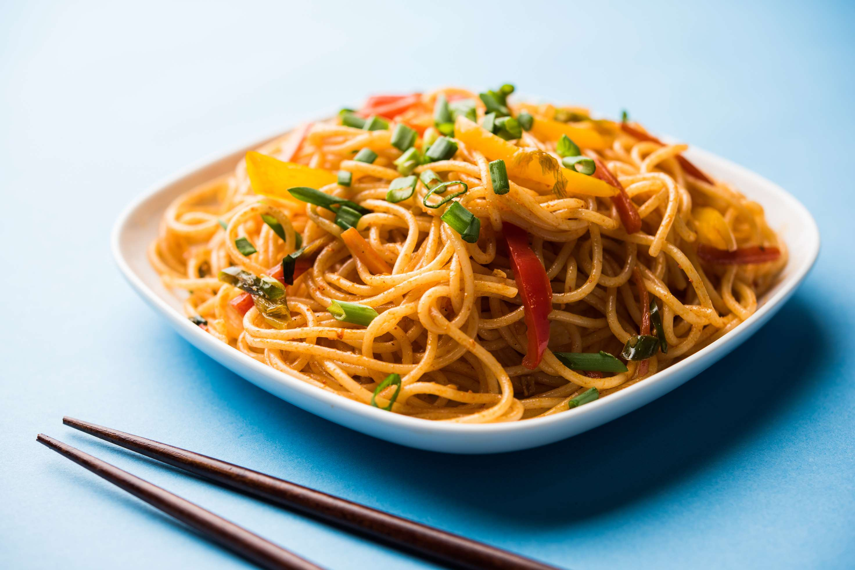
  Convenience and Affordability to Increase the Demand Globally
  Busy Lifestyles to Propel Market Growth
Drivers
Health Concerns to Limit the Sales
Restraints

Slide 7
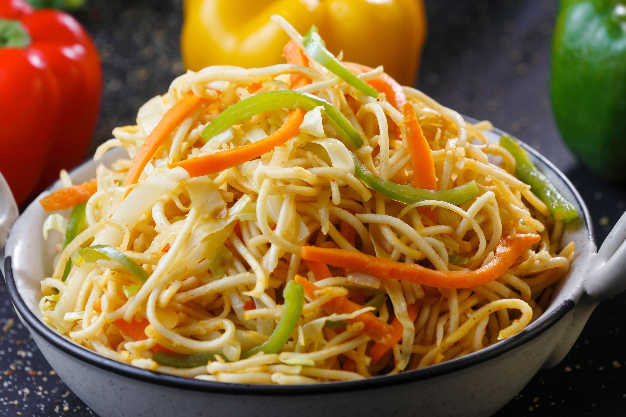
AUTHOR'S PERSPECTIVE
  The global Noodles market will expand significantly by 4.00% CAGR between 2024 to 2031.
  New varieties, flavors, and ingredients for noodles are continually entering the market.
  To appeal to consumers who are concerned about their health, manufacturers are providing better options that include whole grains, veggies, and lean proteins.
  Noodles can be made to fit a wide range of dietary requirements and cuisines.
  They are a well-liked option for both home cooks and restaurants because of their adaptability.

Slide 8



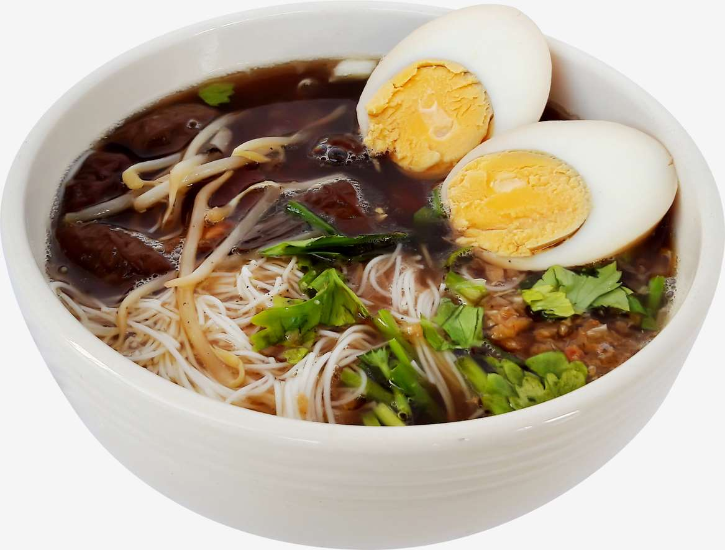




KEY PLAYERS

Slide 9


For Full Report
Contact us
COGNITIVE MARKET RESEARCH
Tel: +1 312-376-8303 | +44 020-8123-0732
India: (+91) 983-496-8611
sales@cognitivemarketresearch.com
Access the Full Report : https://tinyurl.com/2ccur25s
Please visit our website:
https://www.cognitivemarketresearch.com

