Slide 1
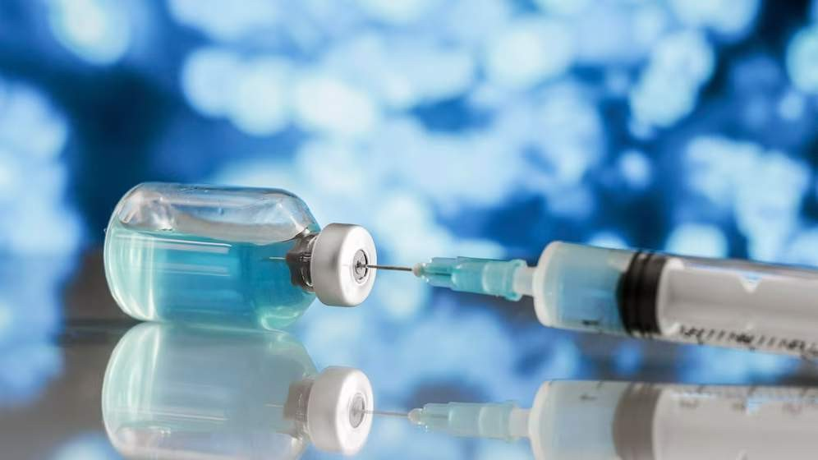
NEEDLESTICK SAFETY INJECTION DEVICES
MARKET REPORT2024

Slide 2
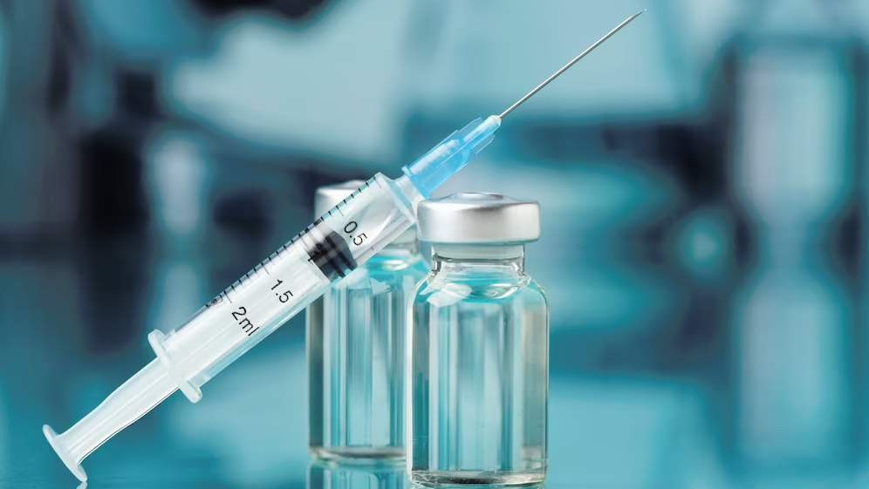
INTRODUCTION
Needlestick safety injection devices are the type of equipment that helps to prevent injury occurrence owing to unintended needle pricks. These devices are retractable needle features, which are automatically retracted after the completion of injection. Needlestick safety injection devices are an important tool for a healthcare worker to protect from injuries.

Slide 3
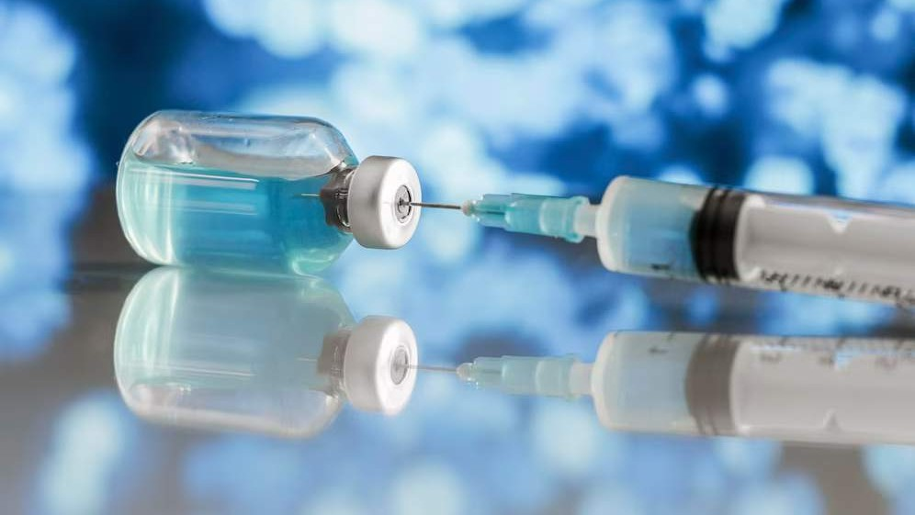






KEY INSIGHTS
MARKET SIZE
1.26 Billion
2022
FORECAST
1.84 Billion
2030
2023-
2030
CAGR 4.8%

Slide 4
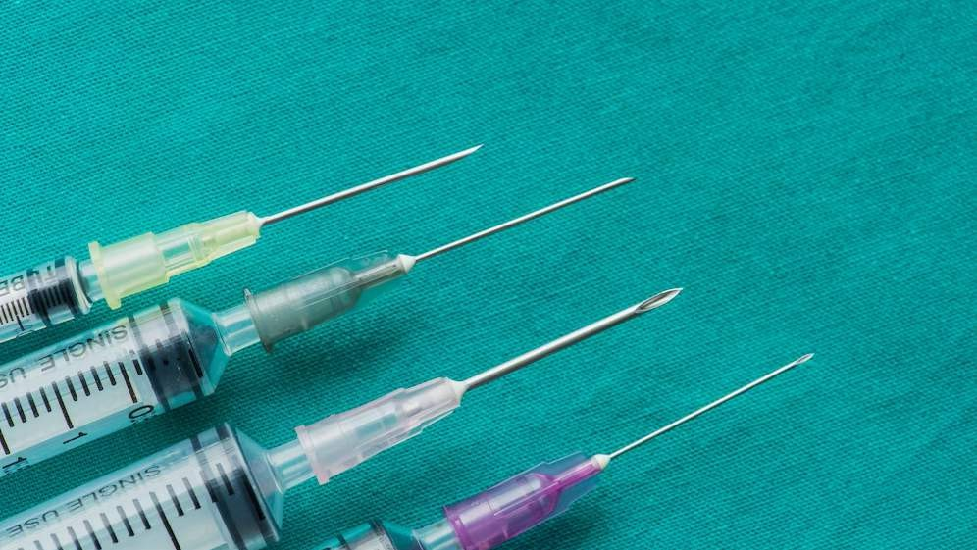





REVENUE MARKET SHARE BY SEGMENTS 2022
By Types: Safety Needles, Safety Syringes (dominated type is Safety Syringe)
By Application: Hospitals, Ambulatory Surgical Centres, Specialty Clinics, Diagnostic Centres, and Others (Dominated application: Hospitals)

Slide 5
GLOBAL NEEDLESTICK SAFETY INJECTION DEVICES MARKET REVENUE SHARE FOR 2022
North America
41.5%

Slide 6
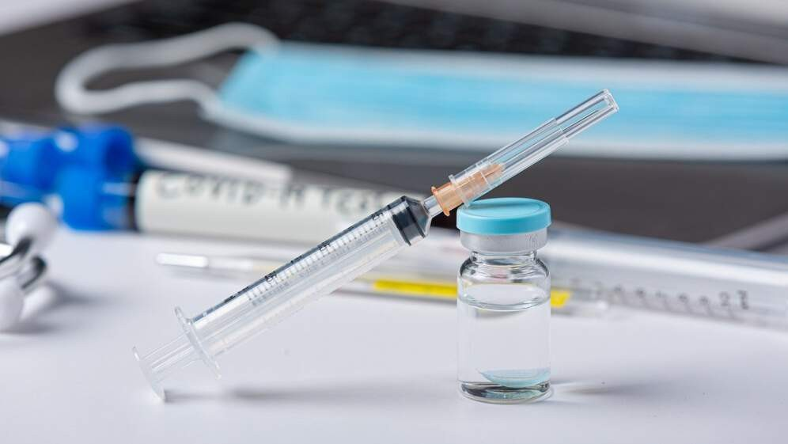
Increasing prevalence of the needlestick
safety injection devices
Drivers
The increasing cost of
^{Restraints} needlestick safety
injection devices

Slide 7

AUTHOR'S PERSPECTIVE
The market for Needlestick Safety Injection Devices is expected to grow significantly due to Increasing awareness regarding the working hazards and the rising number of stick needle injuries among healthcare workers
The Hospitals segment is expected to expand at the significant CAGR retaining position throughout the forecast period.

Slide 8
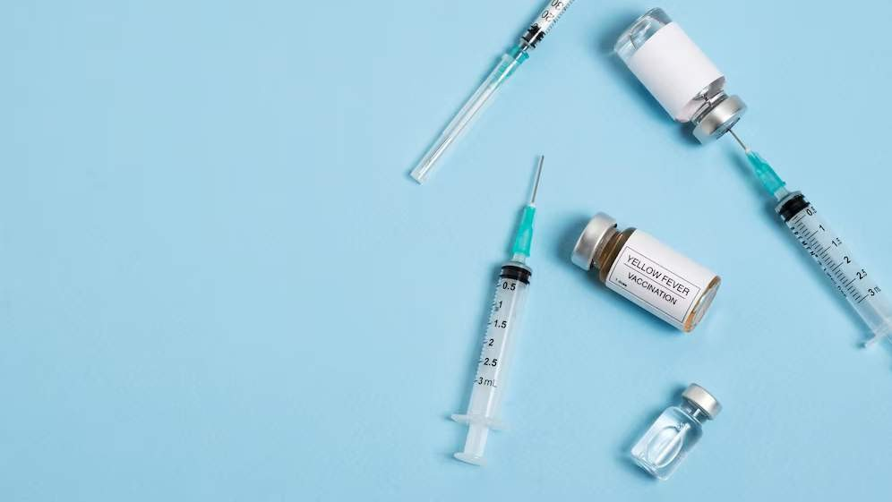


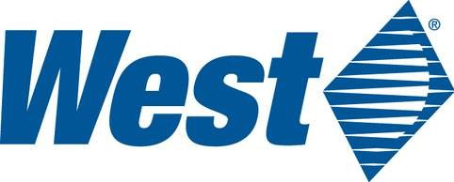
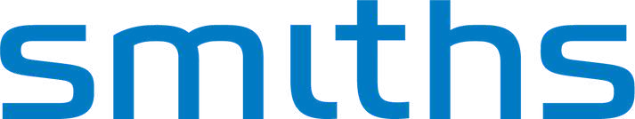




KEY PLAYERS

Slide 9
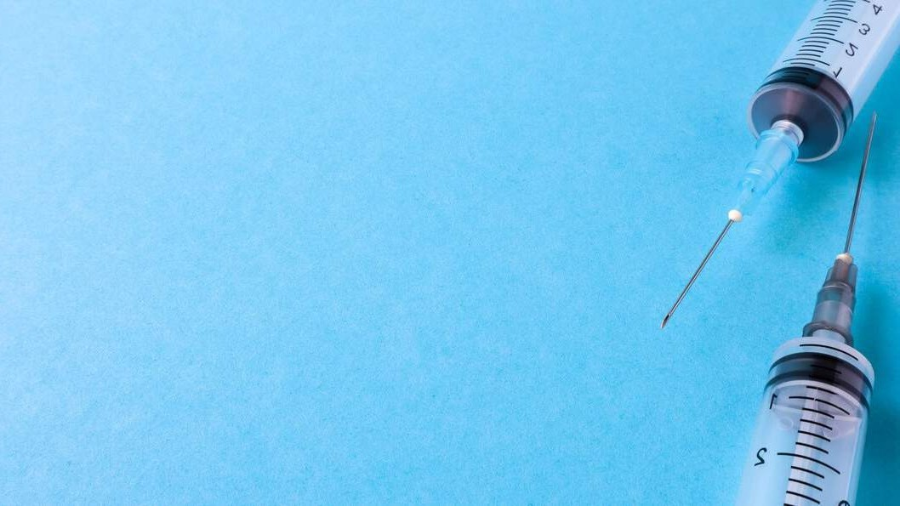

Contact us
For Full Report
COGNITIVE MARKET RESEARCH
Tel: + 1 312 - 376 - 8303 | + 44 020 - 8123 - 0732
India: ( + 91 ) 983 - 496 - 8611
sales@ cognitivemarketresearch. com
Access the Full Report : http://tinyurl.com/553tcucp
Please visit our website:
https://www.cognitivemarketresearch.com

