Slide 1
GLOBAL NAIL POLISH
MARKET REPORT 2024
Global,Regional,CountryAnalysis

Slide 2
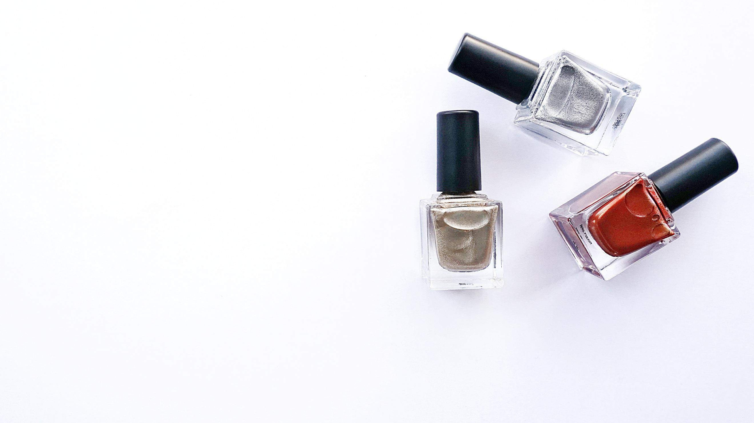
INTRODUCTION
Nail polish is a thick, colorful lacquer applied to toes and fingernails to adorn and protect them. It is made by combining several chemical compositions, such as pigments, resins, pearls, film formers, solvents, plasticizers, and thickening agents, such as stearalkonium hectorite, to bind other ingredients, making the nail polish easier to apply. There are several different varieties of nail polishes on the market, including normal, gel, matte, glitter, and chrome. Creating novel textures and effects for nail products such as enamel, varnish, and lacquer is predicted to be the fastest-growing section of the color cosmetics industry. Nail care services are quickly expanding due to the high quality of services provided by professional salons. The market for liquid enamel is predicted to rise steadily due to behavioral factors such as frequent design changes and increased beauty consciousness.

Slide 3
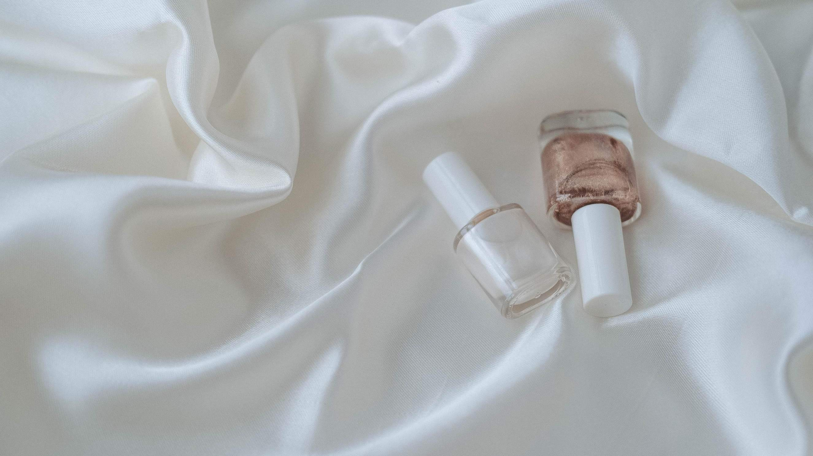

KEY INSIGHTS
MARKET SIZE
USD 15.5 billion
2024
CAGR 7.20%
2024
-
2031

Slide 4
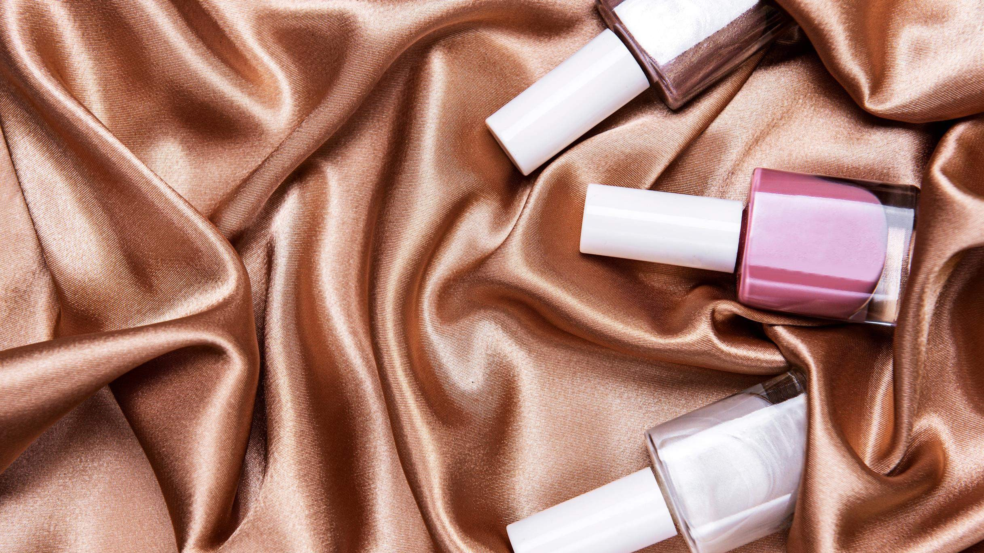
REVENUE MARKET SHARE BY SEGMENTS 2022
Base Coat
Top Coat
Others
Type Segment
Glossy
Matte
Glitter
Satin
Others
Finish Segment
End-User Segment
Female
Male
Supermarket and Hypermarkets
Independent Stores
Specialty Stores
E-Commerce
Distribution Channel
Product Segment
Liquid
Gel

Slide 5
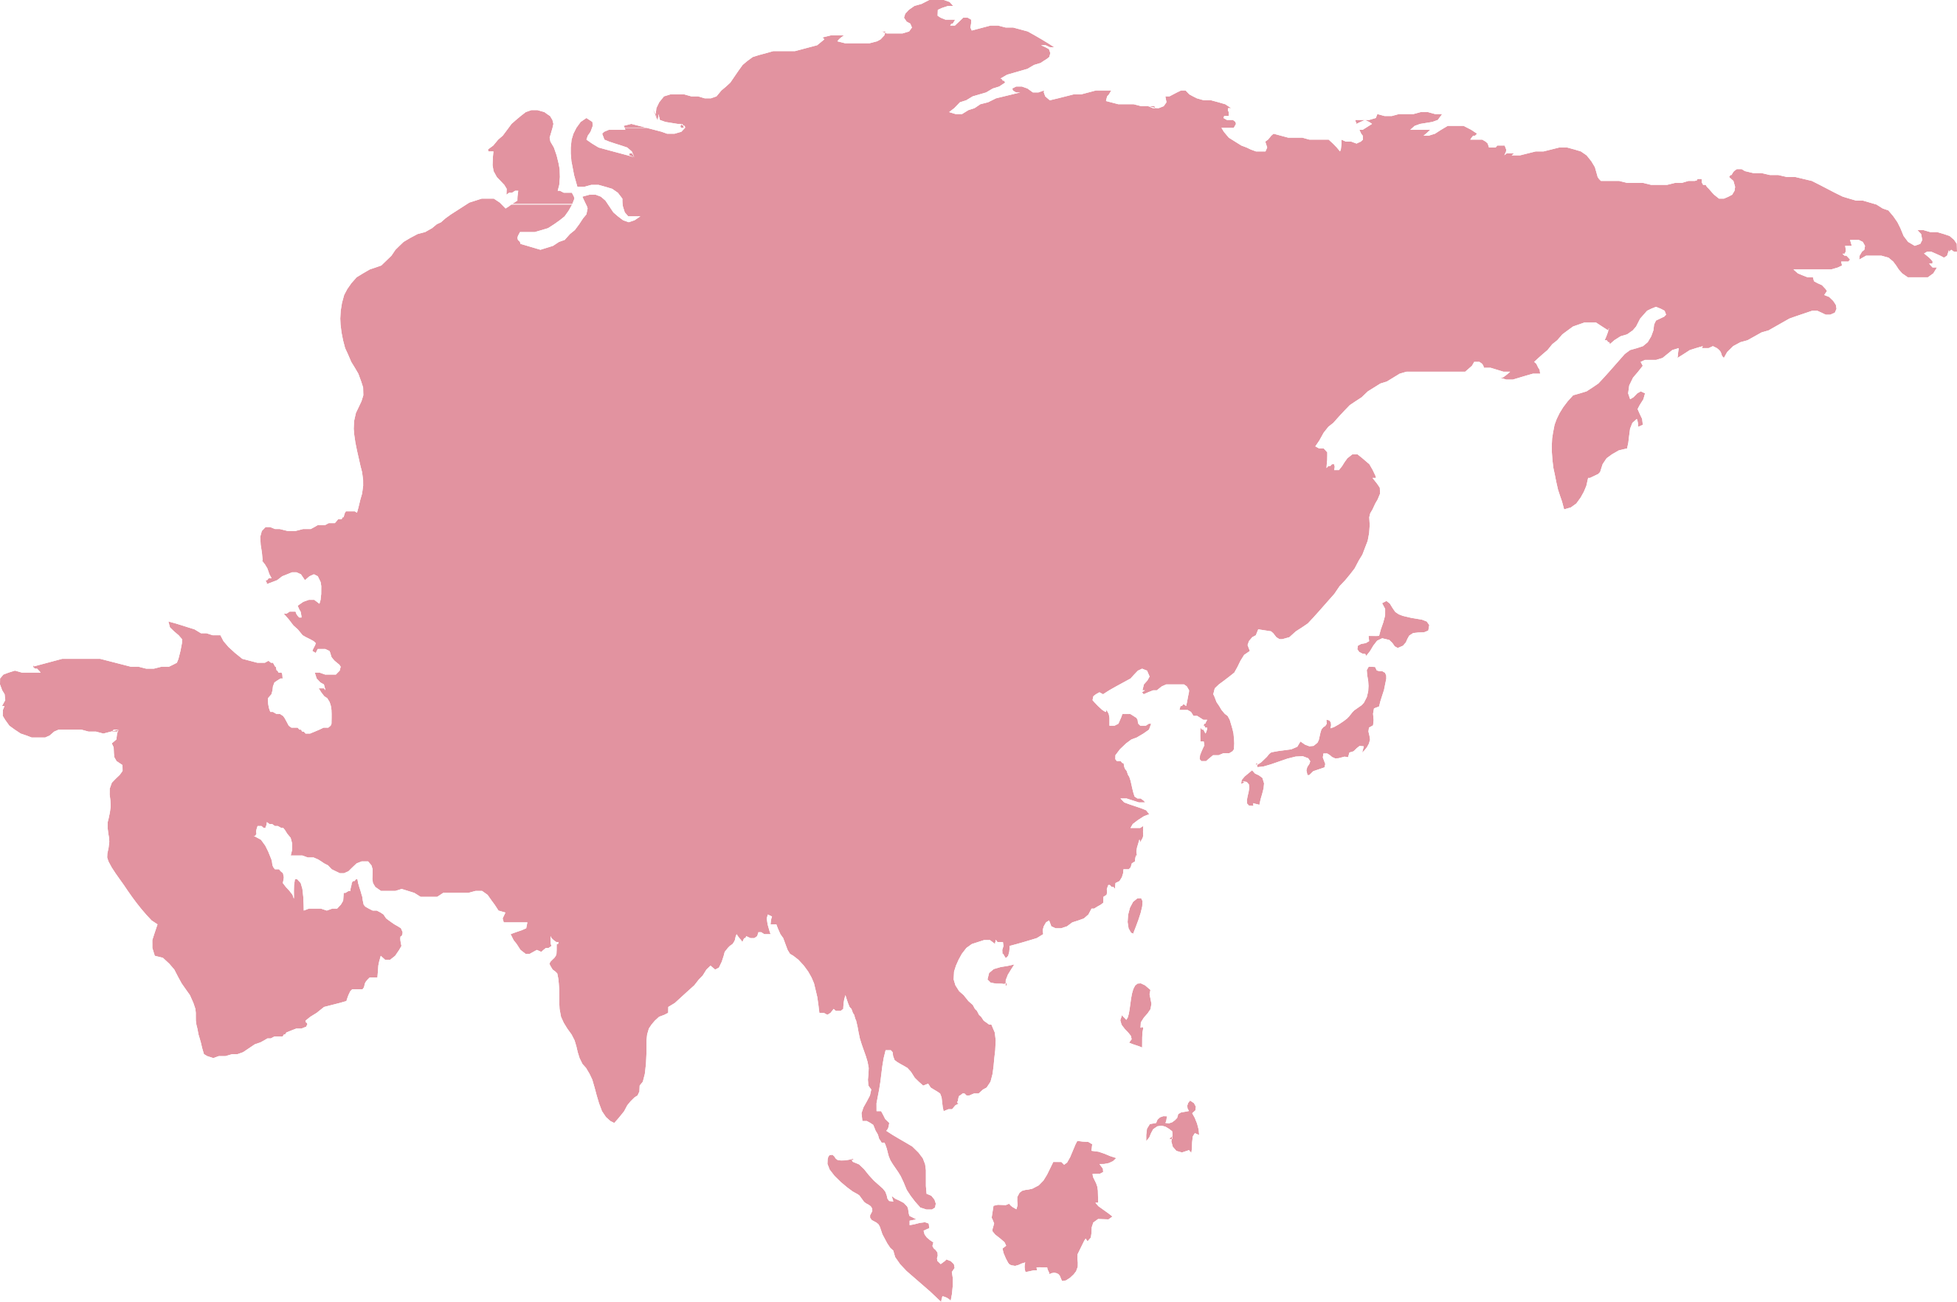
Global Nail Polish Market Revenue share for 2024
Asia Pacific 38%

Slide 6
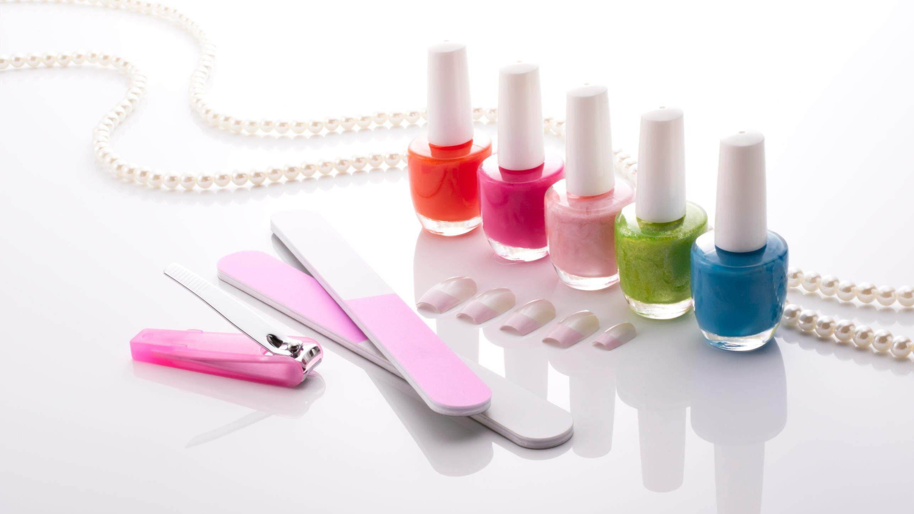


Consumer Interaction on Social Media to Propel Market Growth
Rising Skin Problem to Restrict Market Growth

Slide 7
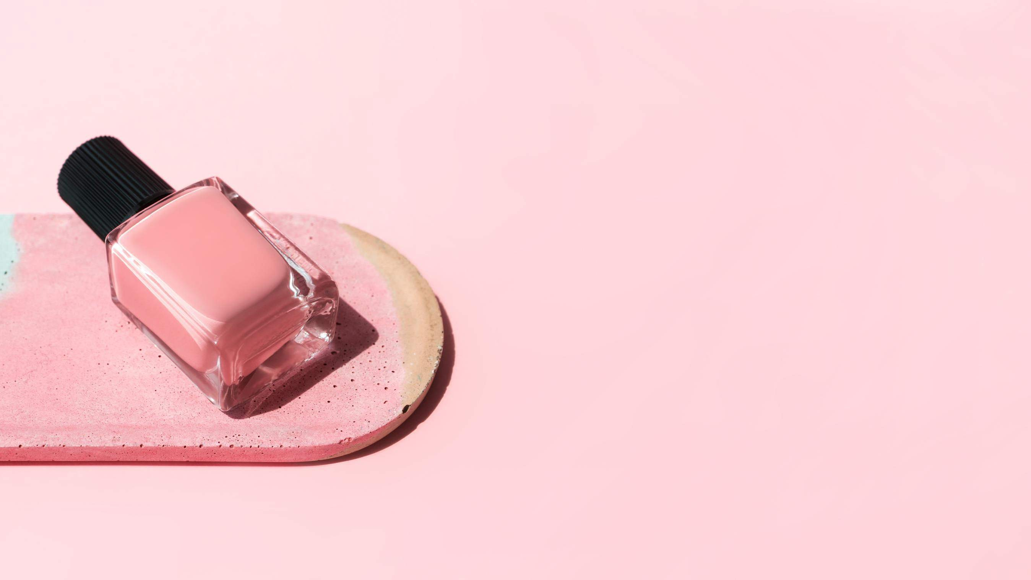
AUTHOR'S PERSPECTIVE
The Global Nail Polish Market is witnessing significant growth in the near future.
The base coat acts as a thick buffer layer that prevents the pigments in nail polish from penetrating and staining your nail plate.
Female customers frequently emphasize nail health and beauty, making them a steady and prominent sector in the Nail Polish industry, driving demand for new hues, formulas, and nail
care products.
Gel nail polish contains photo-initiators that react to LED light, curing the polish quickly and providing a lasting, glossy finish.

Slide 8
KEY PLAYERS

Slide 9


Contact us
For Full Report
COGNITIVE MARKET RESEARCH
Tel: + 1 312 - 376 - 8303 | + 44 020 - 8123 - 0732
India: ( + 91 ) 983 - 496 - 8611
sales@ cognitivemarketresearch. com
Access the Full Report : http://tinyurl.com/9x8bv2fs
Please visit our website:
https://www.cognitivemarketresearch.com

