Slide 1
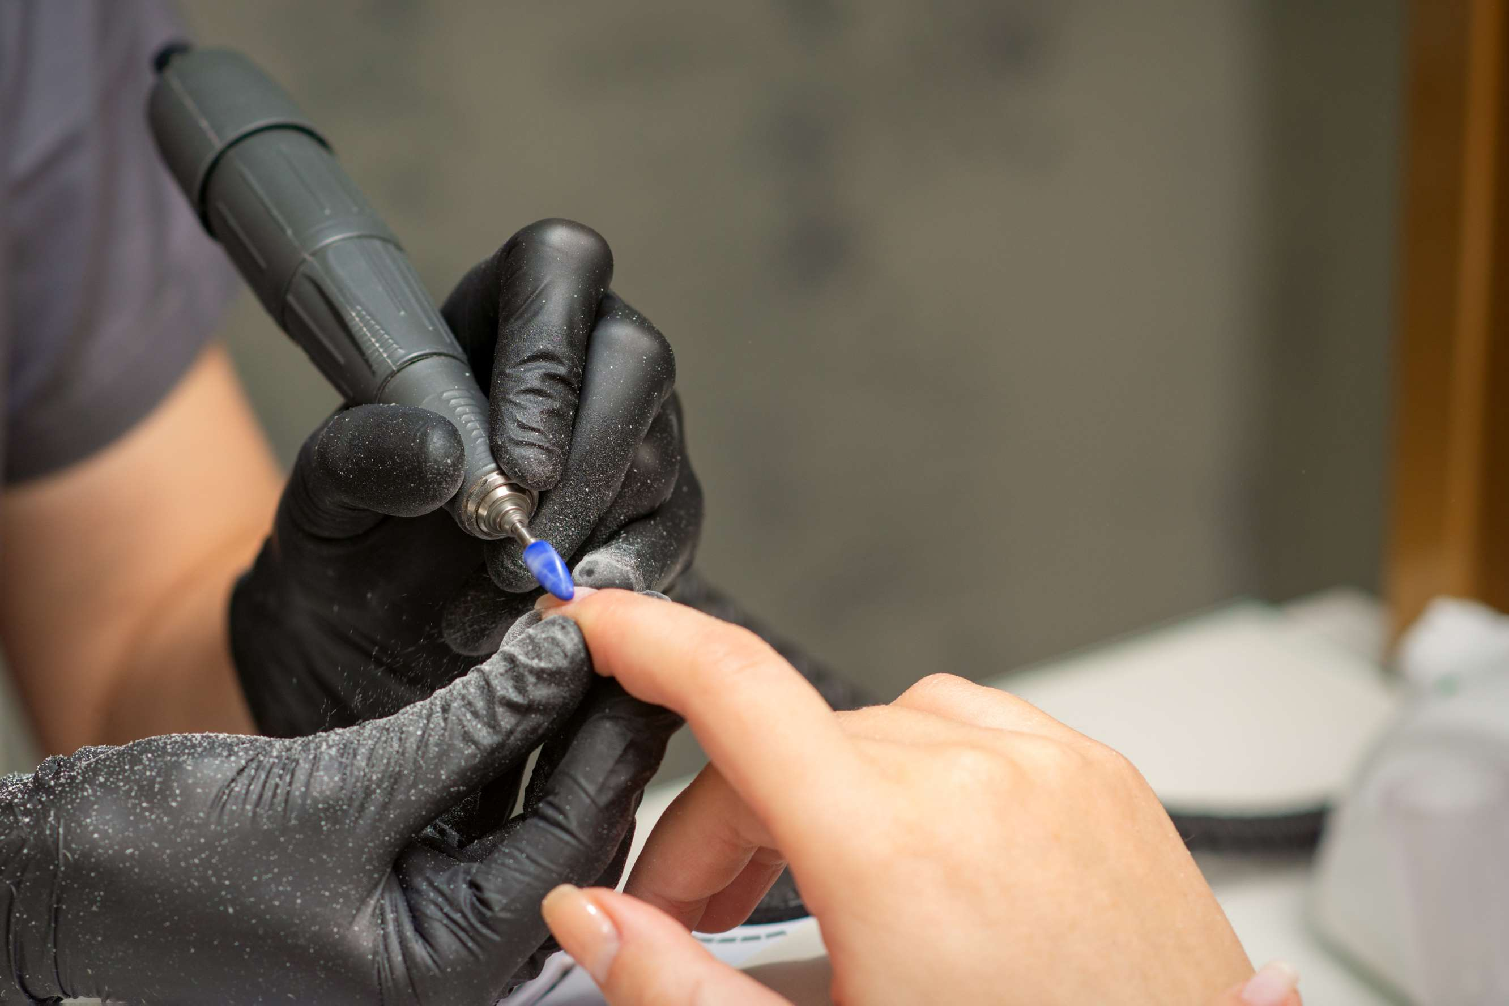
GLOBAL
NAIL DRILL MACHINES
MARKET REPORT 2024
Global,Regional,CountryAnalysis

Slide 2

INTRODUCTION
Nail drill machines are multi-purpose equipment that comes with a variety of replaceable heads for filing, buffing, and polishing both natural and synthetic nails. These nail drill machines are ergonomically constructed, making it simple to control the drills for professional accuracy from the comfort of home.

Slide 3
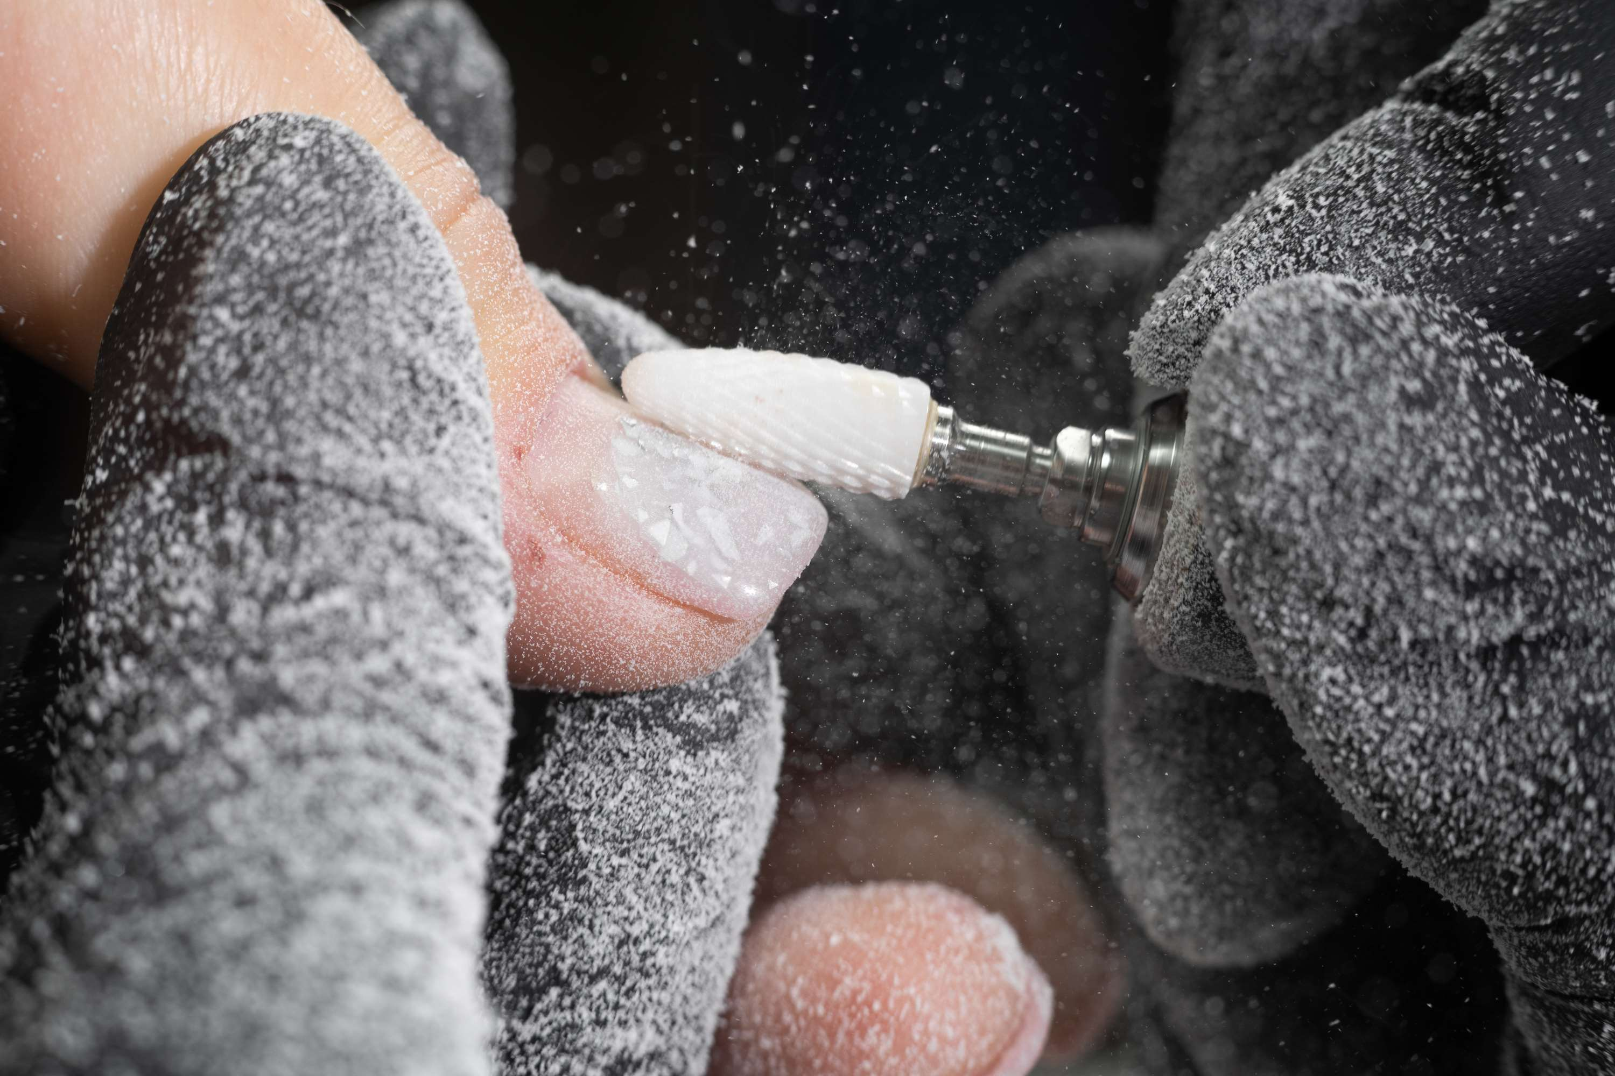

KEY INSIGHTS
FORECAST
$293.60 Million
2028
CAGR
5.22%
2023- 2030

Slide 4
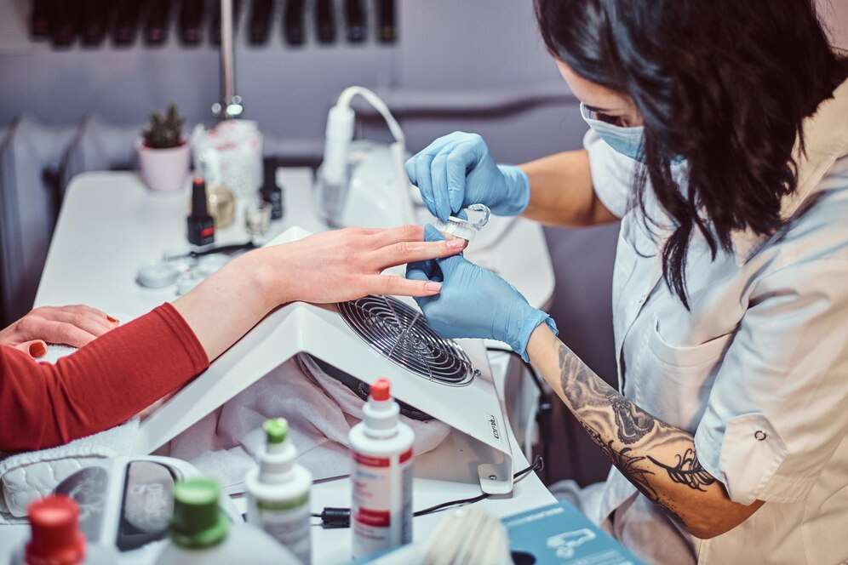
REVENUE MARKET SHARE BY SEGMENTS 2022
Type segment
Corded Nail Drill
USD 161.65 Million
Application segment
Online Sales
USD 119.46 Million

Slide 5

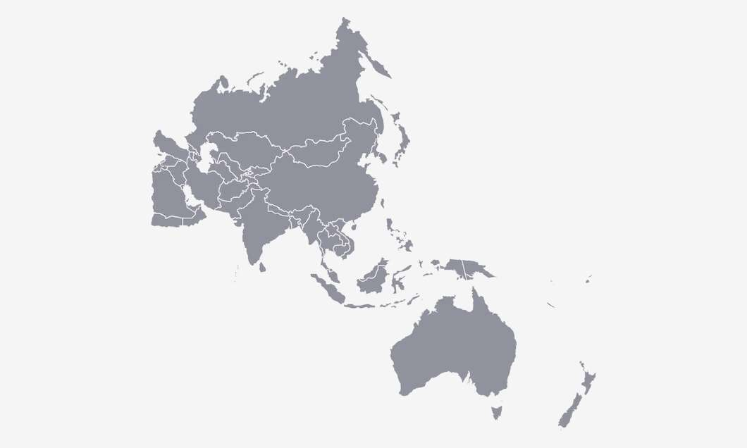
Global Nail Drill Machines Market Revenue share for 2022
Asia Pacific
USD 101.37 Million

Slide 6

Rising Demand for Nail Care and Cosmetic Products
Drivers
Fluctuations in the prices of raw materials used in processing and manufacturing of the nail drill machines
Restraints

Slide 7
AUTHOR'S PERSPECTIVE
  Global Nail Drill Machines Market Report 2023 talks about crucial market insights with the help of segments and sub-segments analysis.
  Corded nail drills keep the machine plugged in and require a continual power source
  In 2023, the Corded Nail Drill segment accounted for noticeable share of global Nail Drill Machines Market and is projected to experience significant growth in the near future.
  The Online Sales segment is expected to expand at the significant CAGR retaining position throughout the forecast period.
  Some of the key companies Beurer, PureNails and others are focusing on its strategy building model to strengthen its product portfolio and expand its business in the global market.

Slide 8
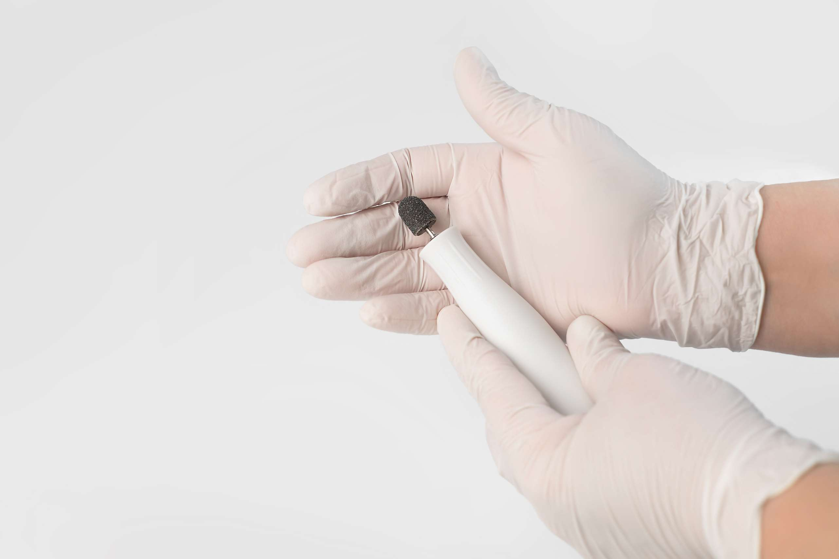

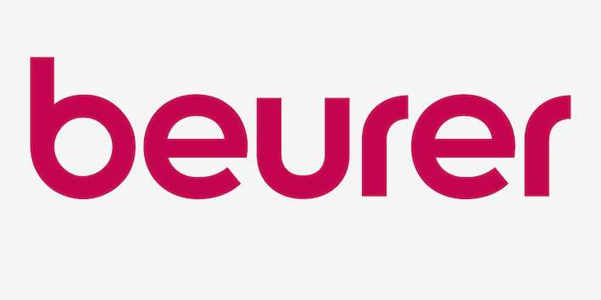




KEY PLAYERS

Slide 9
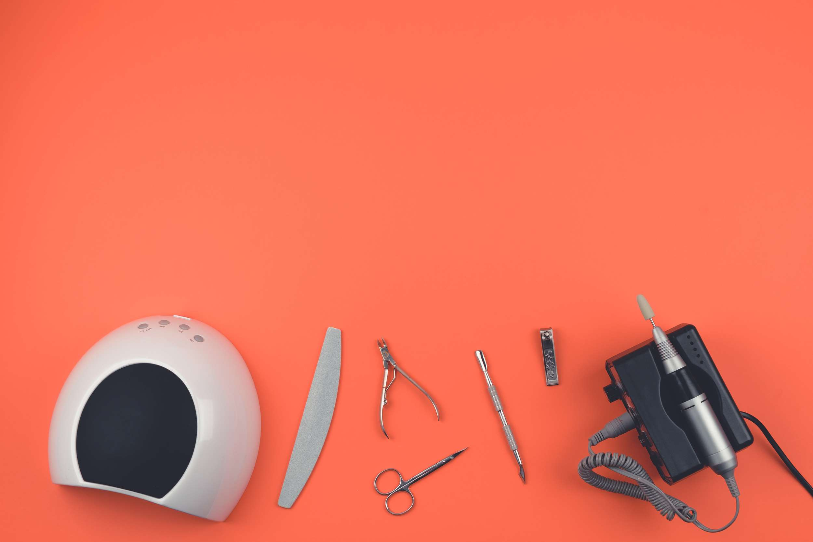

For Full Report
Contact us
COGNITIVE MARKET RESEARCH
Tel: +1 312-376-8303 | +44 020-8123-0732
India: (+91) 983-496-8611
sales@cognitivemarketresearch.com
Access the Full Report : https://tinyurl.com/fujrzm4t
Please visit our website:
https://www.cognitivemarketresearch.com

