Slide 1
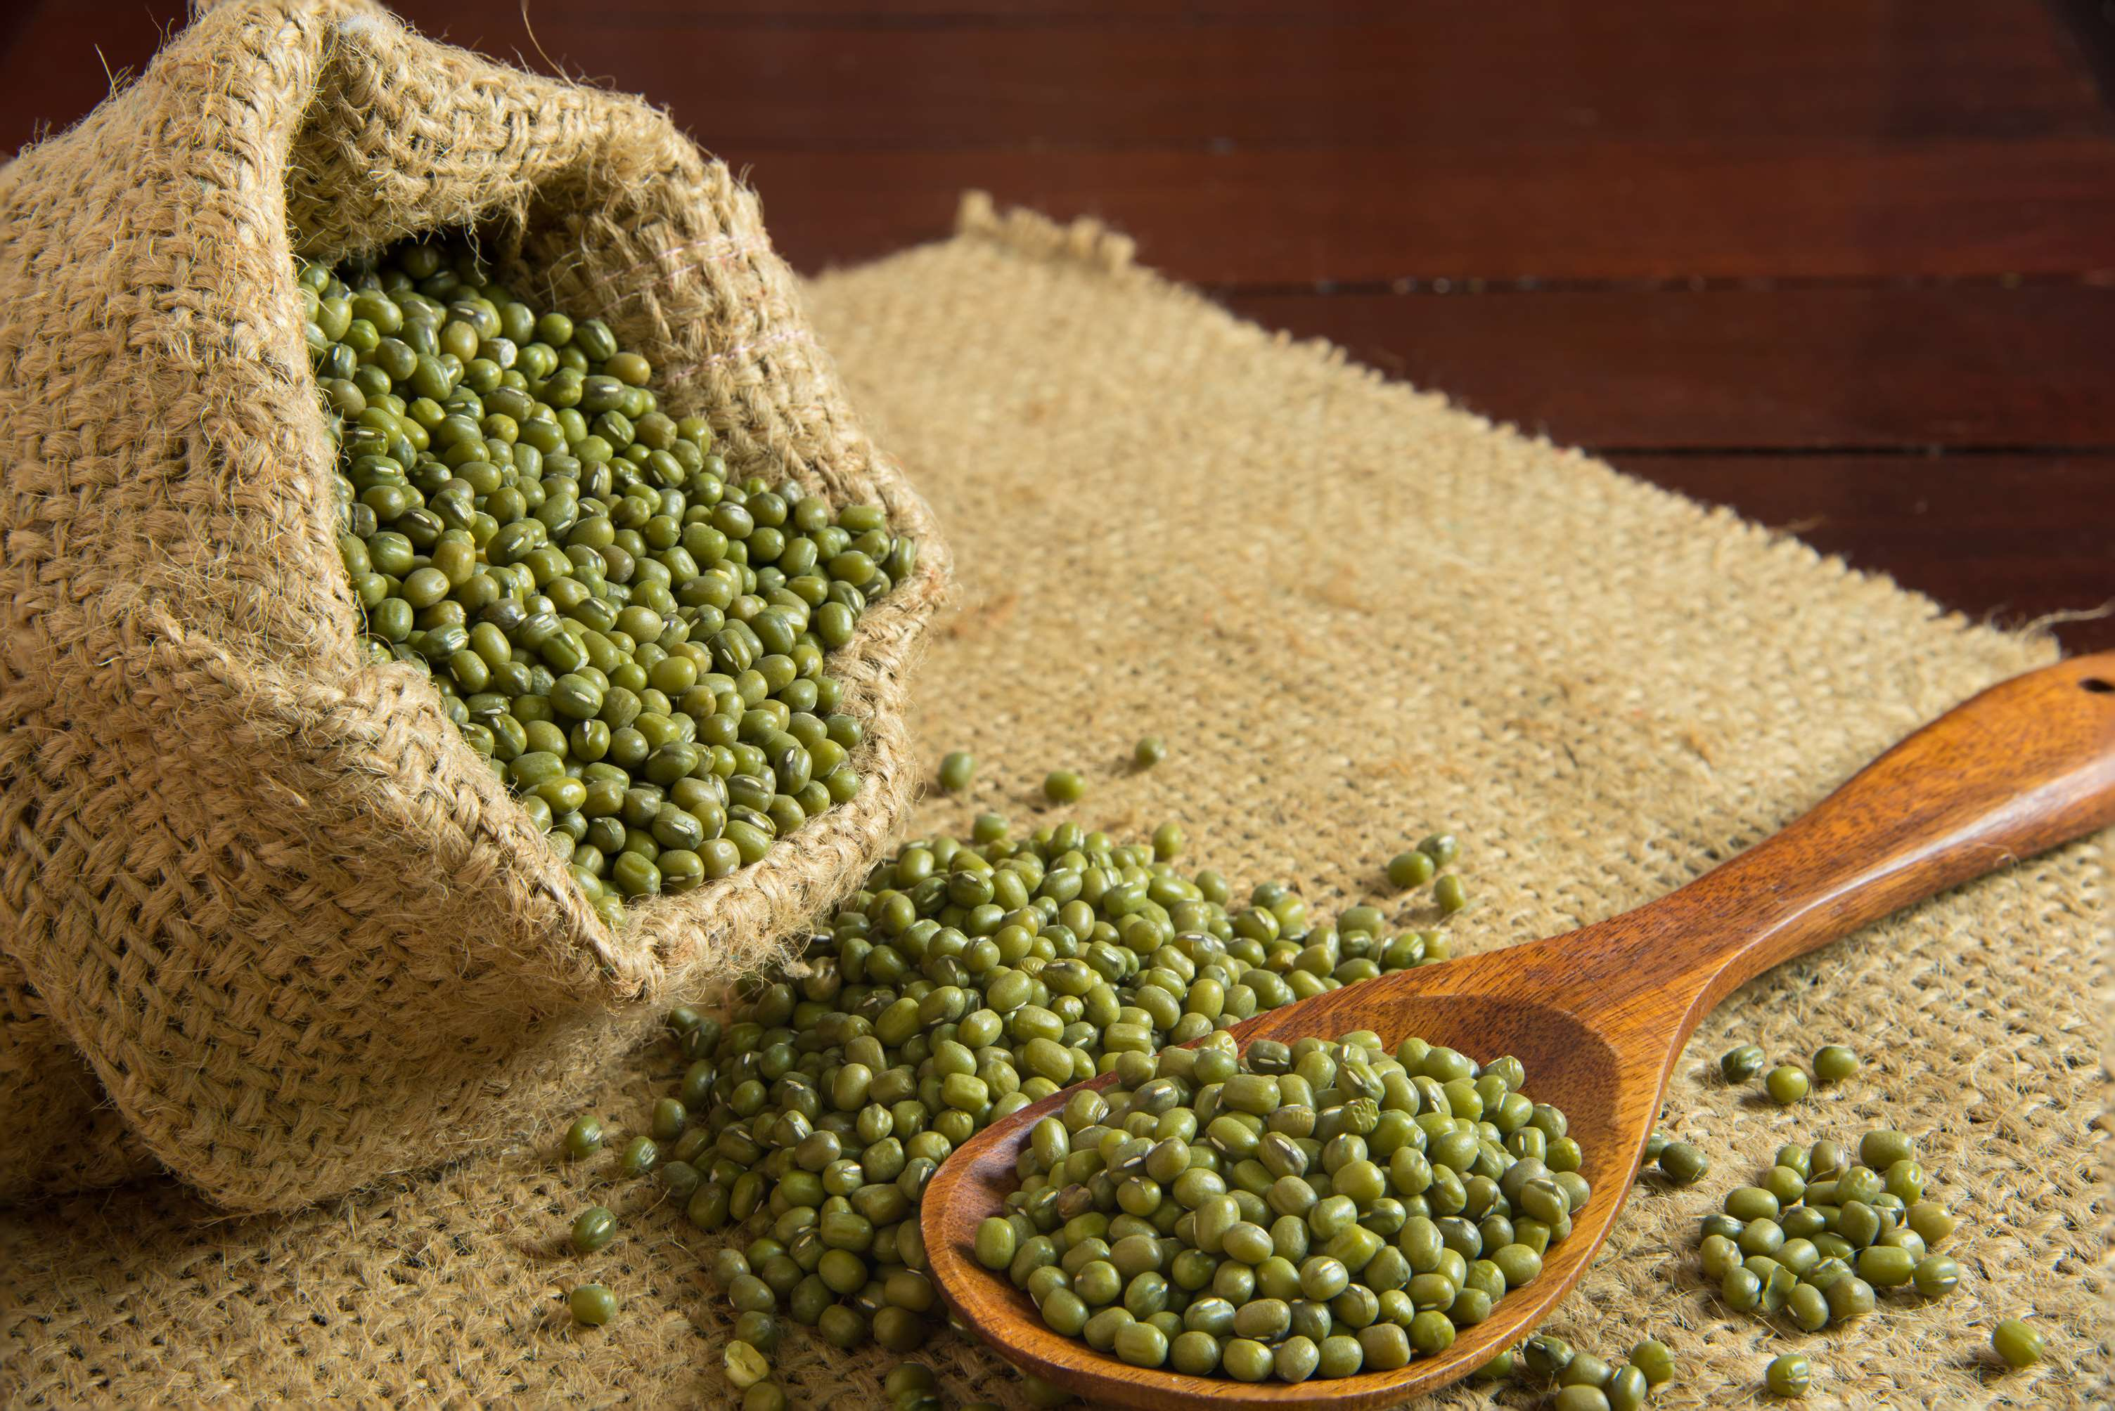
GLOBAL
MUNG BEAN
MARKET REPORT
2024
Global,Regional,CountryAnalysis

Slide 2
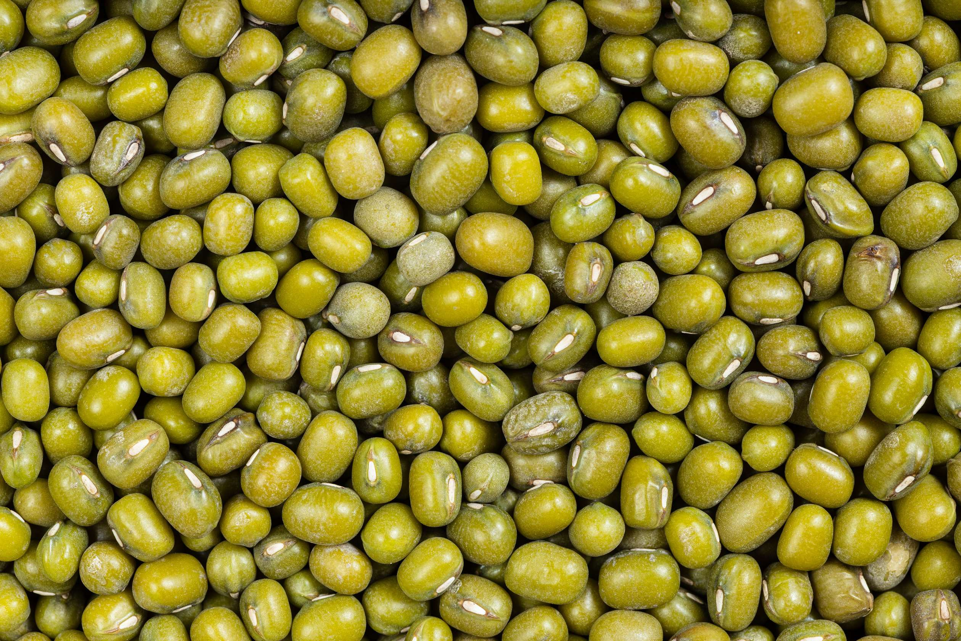
INTRODUCTION
Mung beans, scientifically known as Vigna radiata, are small, green legumes widely cultivated and consumed across the globe for their nutritional value and culinary versatility. Belonging to the Fabaceae family, they are a significant source of plant-based protein, fiber, vitamins, and minerals, including folate, iron, and potassium. With a history dating back thousands of years, mung beans are integral to various cuisines, often used in soups, salads, and curries, and sprouted for salads and sandwiches. In addition to their culinary uses, mung beans play a vital role in sustainable agriculture due to their ability to fix nitrogen in the soil.

Slide 3
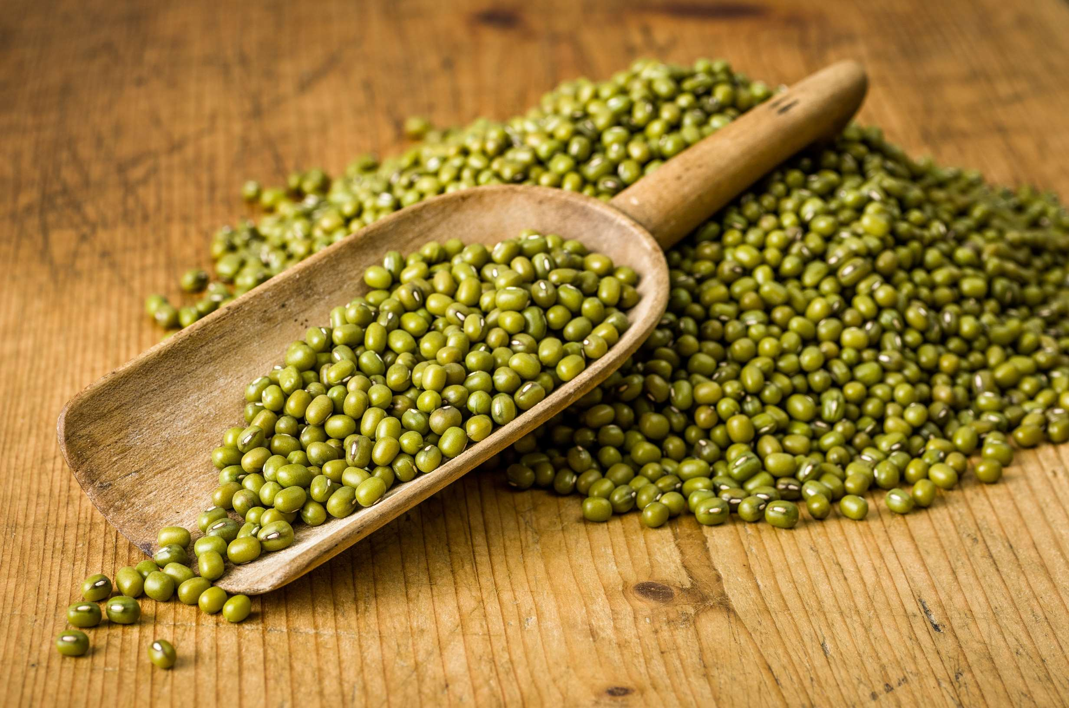

KEY INSIGHTS
MARKET SIZE
USD 4351.2 million
2024
CAGR
3.50%
2024- 2031

Slide 4
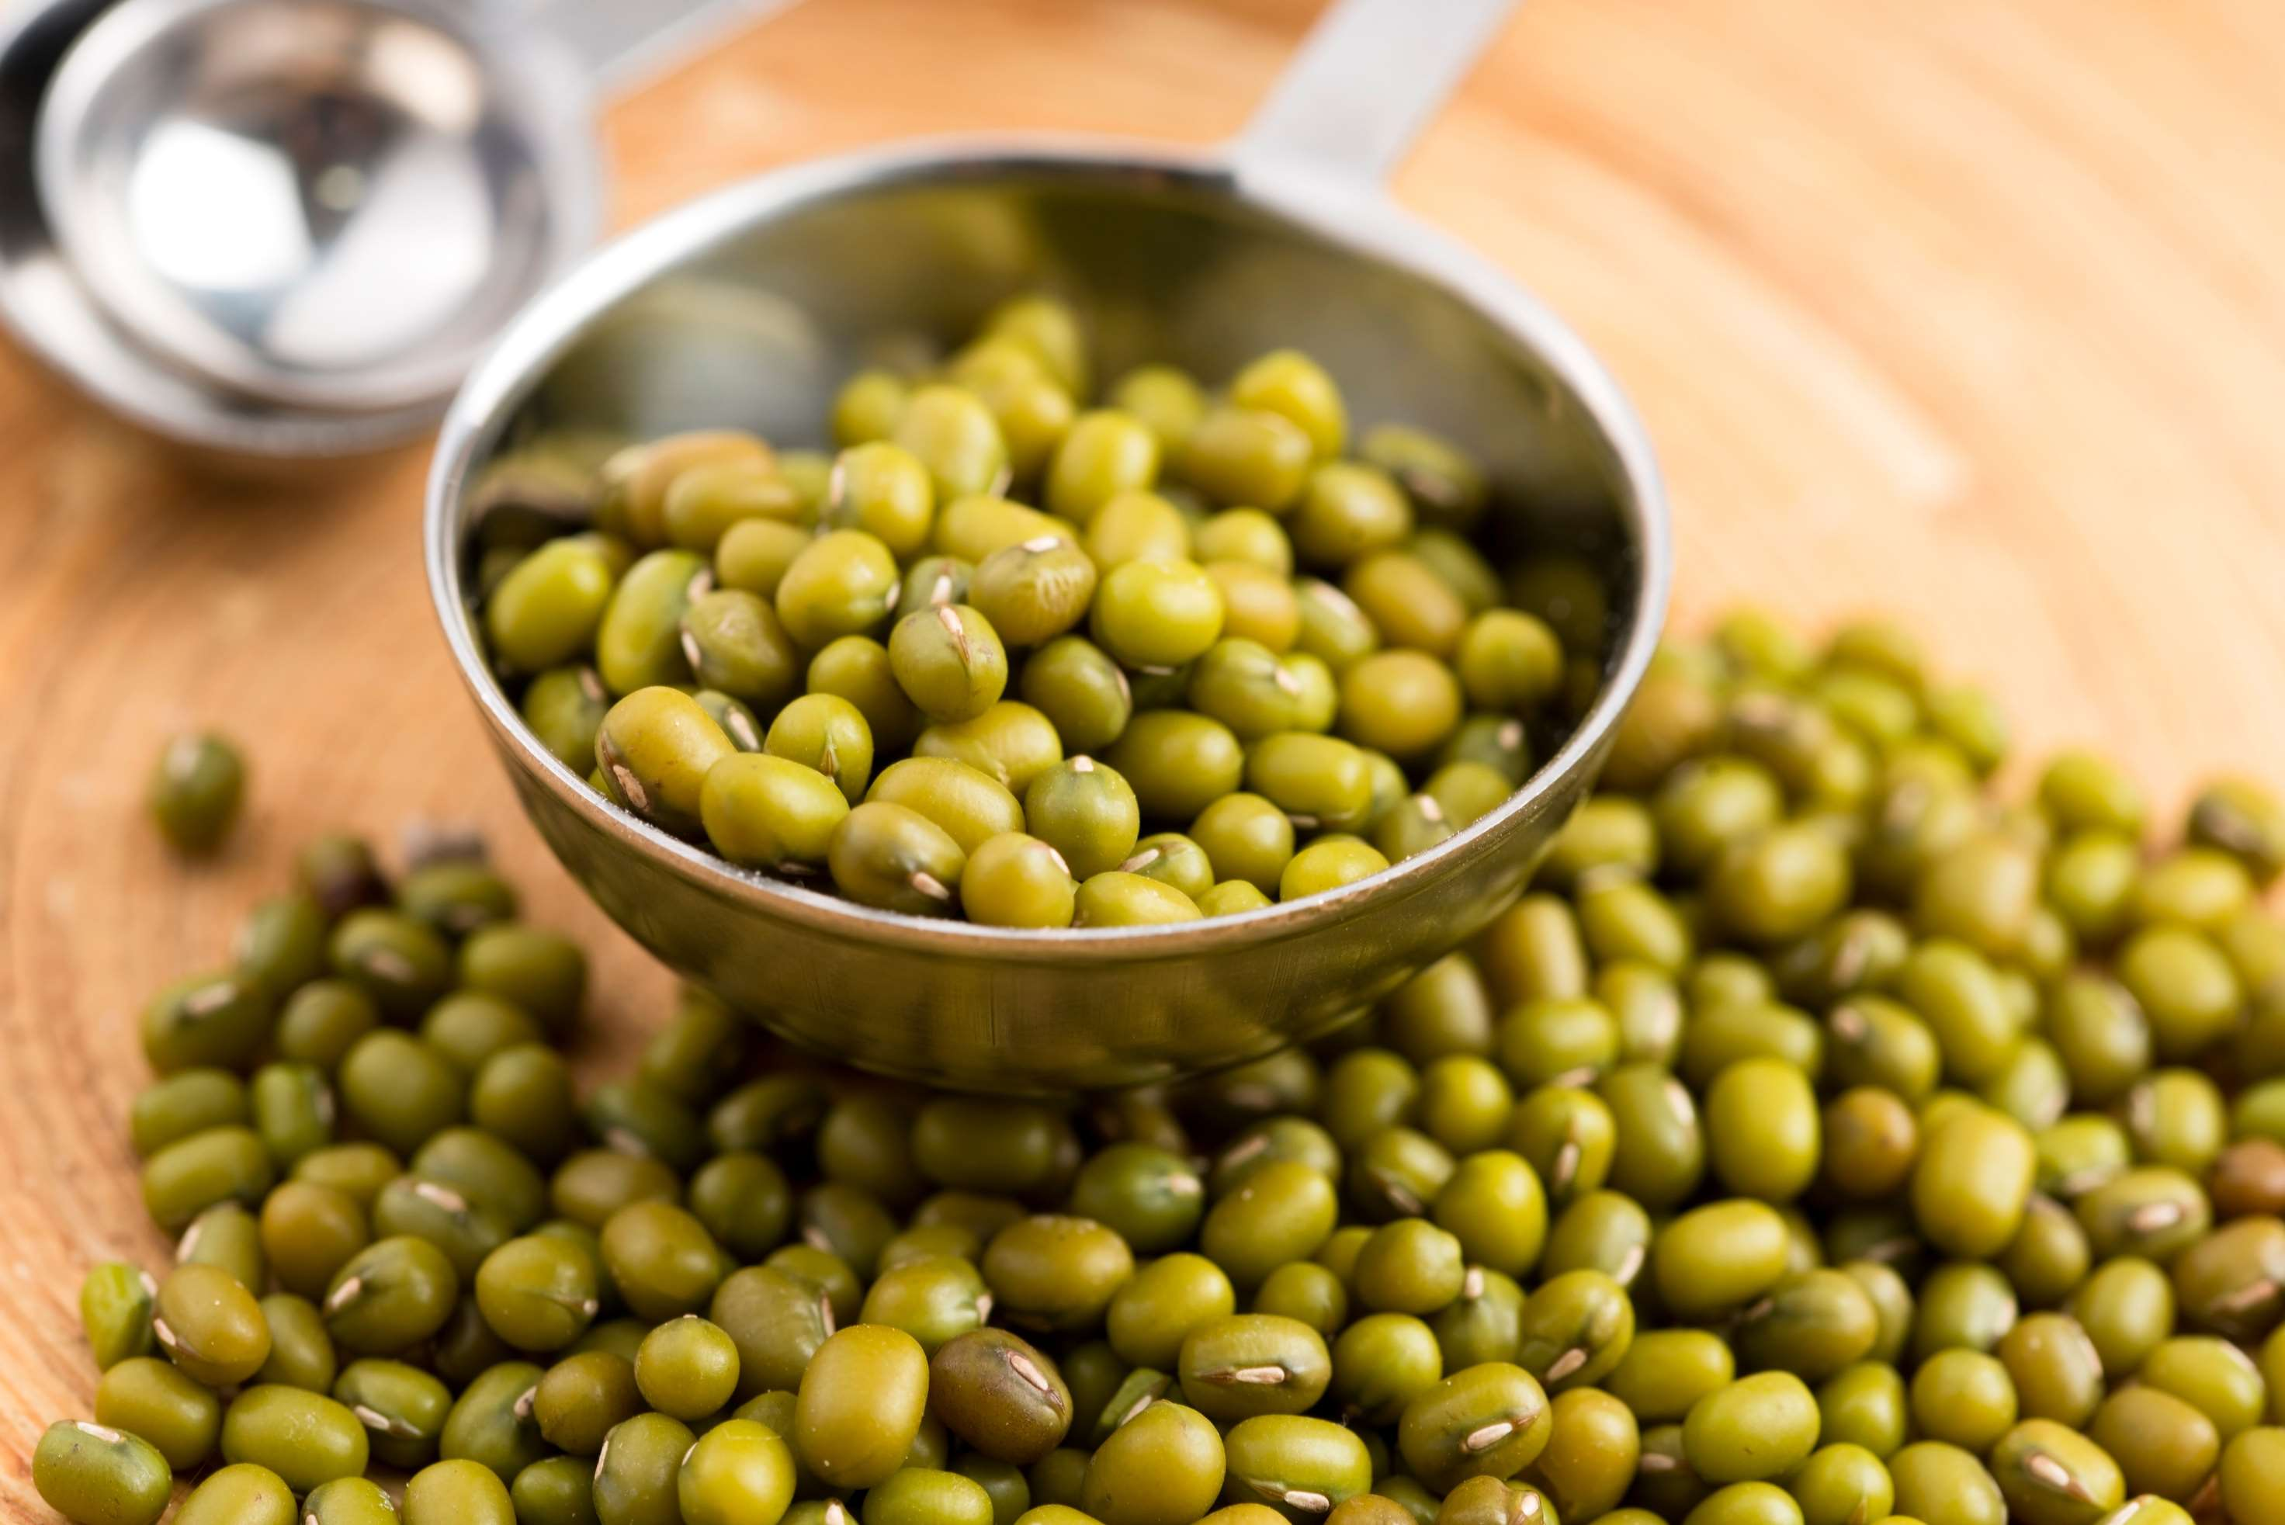
REVENUE MARKET SHARE BY SEGMENTS 2022
  Whole
  Splited
  Sprout
  Organic
  Conventional
Type Segment
Form Segment
  Retail Packaging
  Bulk Packaging
  Residential
  Commercial
Application Segment
Packaging Segment

Slide 5

Global Mung Bean Market Revenue share for 2024
North America

Slide 6
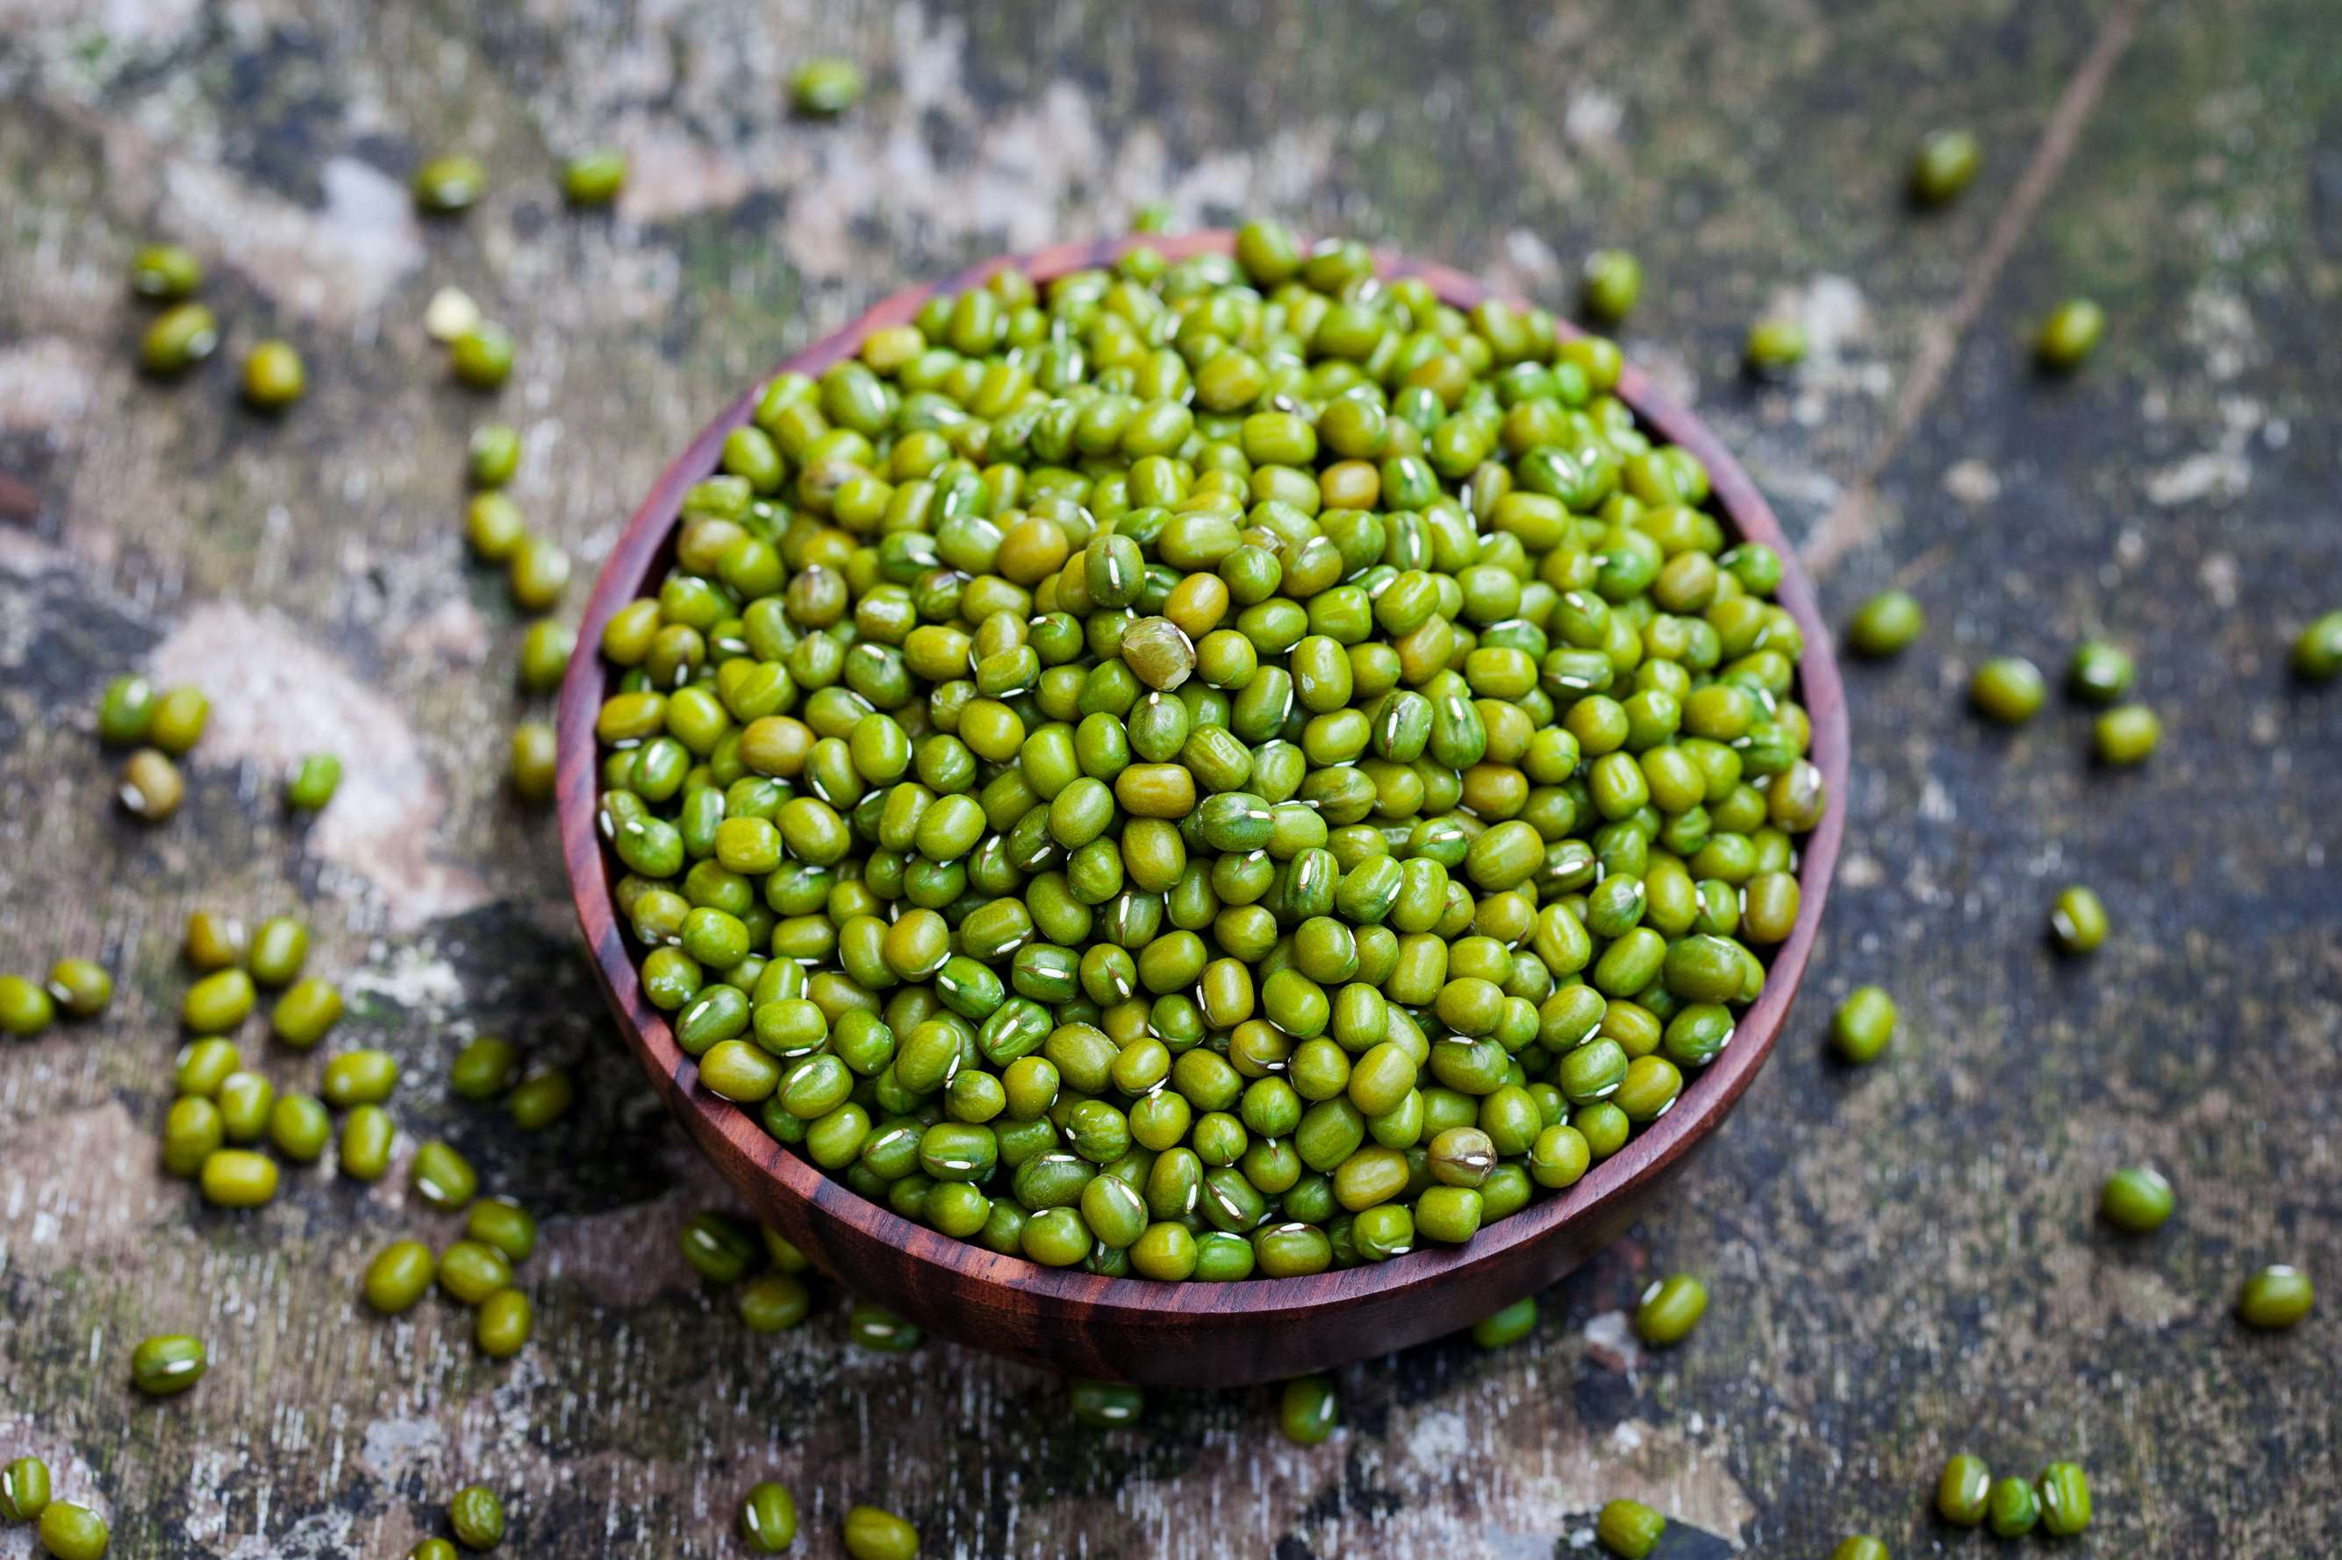
Growing Vegetarian and Vegan Population to Propel the Market
Drivers
Limited Awareness and Familiarity to Lack Widespread Recognition
Restraints

Slide 7
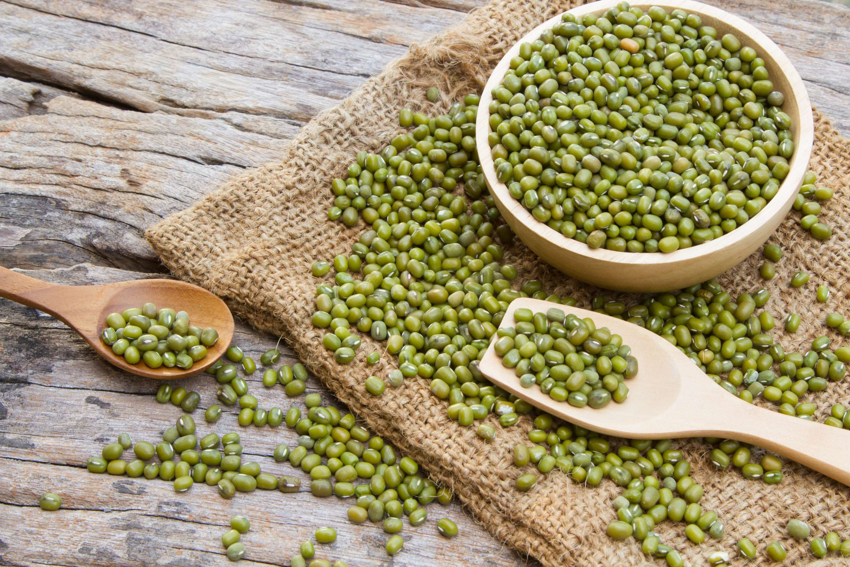
AUTHOR'S PERSPECTIVE
  Global Mung bean market size is USD 4351.2 million in 2024 and will expand at a compound annual growth rate (CAGR) of 3.50% from 2024 to 2031.
  Residential is the fastest-growing category over the forecast period as more individuals embrace home cooking and healthier eating habits.
  The sales of conventional mung beans are likely to increase due to their lower price point, established supply chains, familiarity among consumers, and less stringent production requirements compared to organic varieties.
  The sales of commercial mung beans are poised to rise due to the growing demand from restaurants, cafeterias, and food service industries for use in diverse dishes, driving bulk purchasing and consumption.

Slide 8



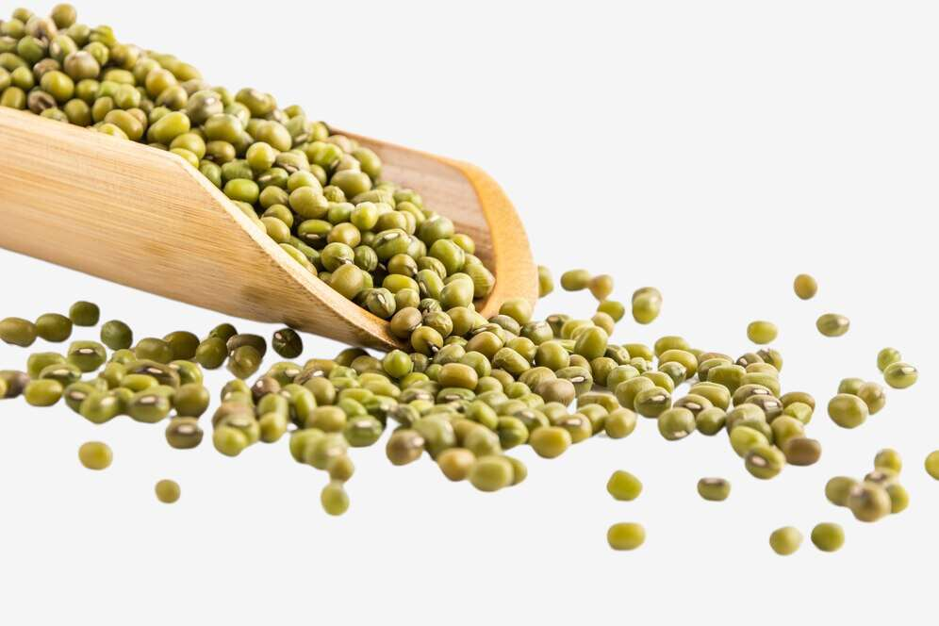




KEY PLAYERS

Slide 9


For Full Report
Contact us
COGNITIVE MARKET RESEARCH
Tel: +1 312-376-8303 | +44 020-8123-0732
India: (+91) 983-496-8611
sales@cognitivemarketresearch.com
Access the Full Report : https://tinyurl.com/djxcjkyb
Please visit our website:
https://www.cognitivemarketresearch.com

