Slide 1
MULTIFUNCTIONAL BREAKFAST MACHINE MARKET REPORT

Slide 2
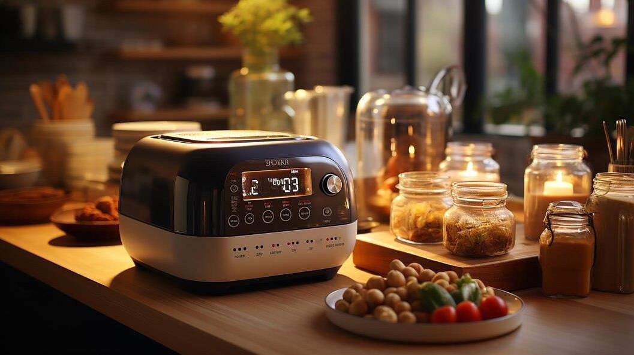
Introduction
Breakfast is considered the most important meal of the day. A multifunctional breakfast machine combines all the necessary breakfast equipment in one. It saves space, is time-efficient, and offers a wide range of models for various needs. These machines are used for household as well as commercial purposes, and some brands provide tailor-made options and services after sales.

Slide 3
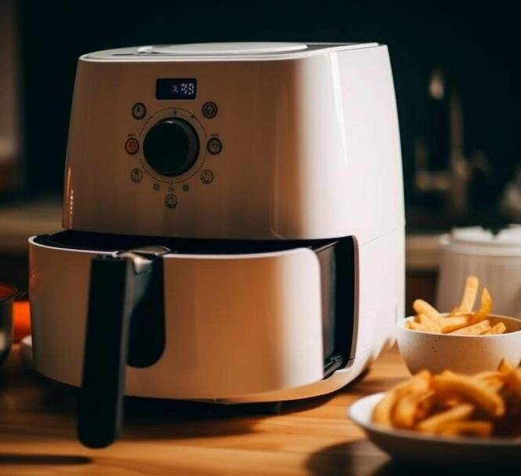
KEY INSIGHTS
MARKET SIZE
s2,016.38 Million
2028
2023-
2030
CAGR 4.69%

Slide 4
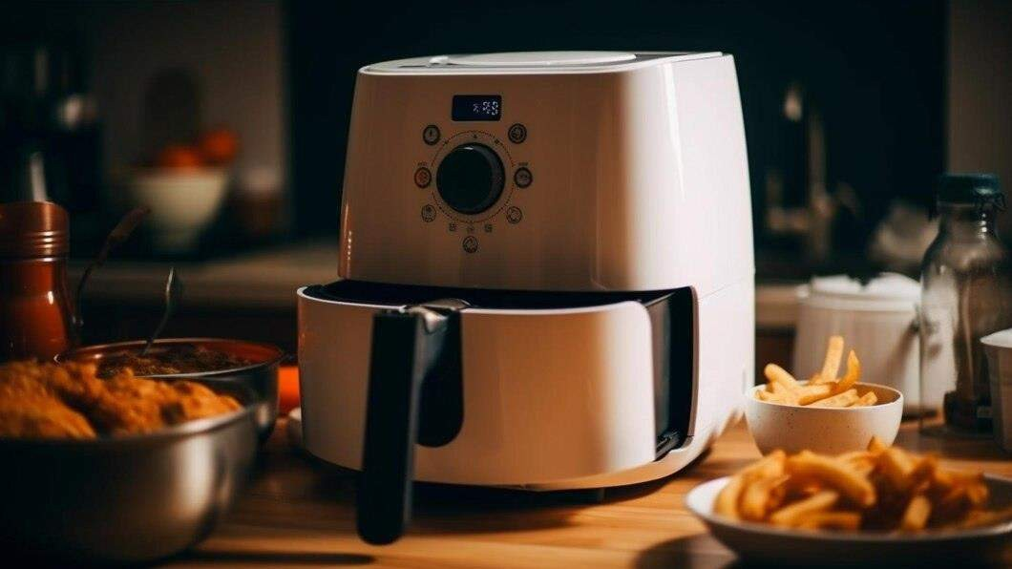
REVENUE MARKET SHARE BY SEGMENTS 2022
by type
Vertical structure USD 771.48 Million
Application Segment
Household
USD 1,064.73 Million
Channel Segment
Online
USD 829.61 Million

Slide 5

Global Multifunctional Breakfast Machine Market Revenue share for 2022
North America USD 715.82 Million

Slide 6
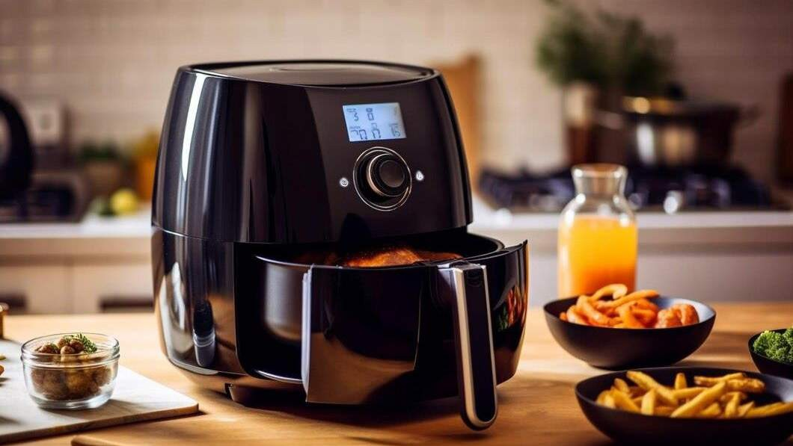


Rising Disposable Income
Disruption in Supply Chain

Slide 7
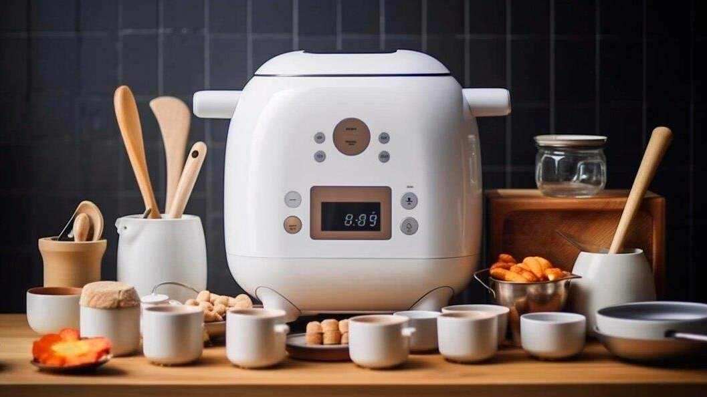
Author's Perspective
Global Multifunctional Breakfast Machine Market Report 2023 talks about crucial market insights with the help of segments and sub-segments analysis
The cylindrical shape is provided by vertically constructed multifunctional breakfast machines.
Horizontal structured multifunctional breakfast machines can be operated easily and can
work simultaneously or individually.
A multifunctional breakfast machine is a power supply machine or device for the usage of individuals and families every morning so that they can have a great breakfast.
The selection of an eCommerce channel mix means the selection of a suitable combination
of websites, social media communities, and local partners become an essential aspect in the breakfast machines.

Slide 8







KEY PLAYERS
®

Slide 9


Contact us
For Full Report
COGNITIVE MARKET RESEARCH
Tel: + 1 312 - 376 - 8303 | + 44 020 - 8123 - 0732
India: ( + 91 ) 983 - 496 - 8611
sales@ cognitivemarketresearch. com
Access the Full Report : https://tinyurl.com/5fux54pc
Please visit our website:
https://www.cognitivemarketresearch.com

