Slide 1
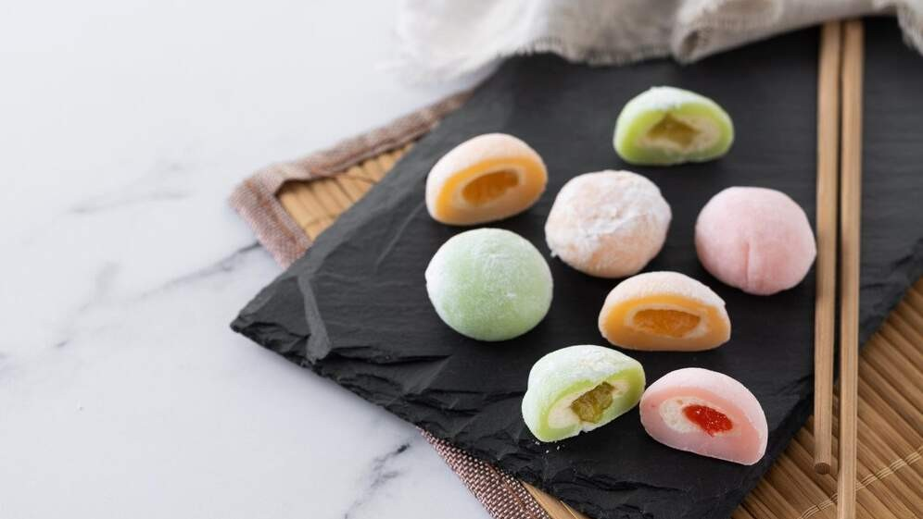
GLOBAL MOCHI
MARKET REPORT
2024
Global,Regional,CountryAnalysis

Slide 2
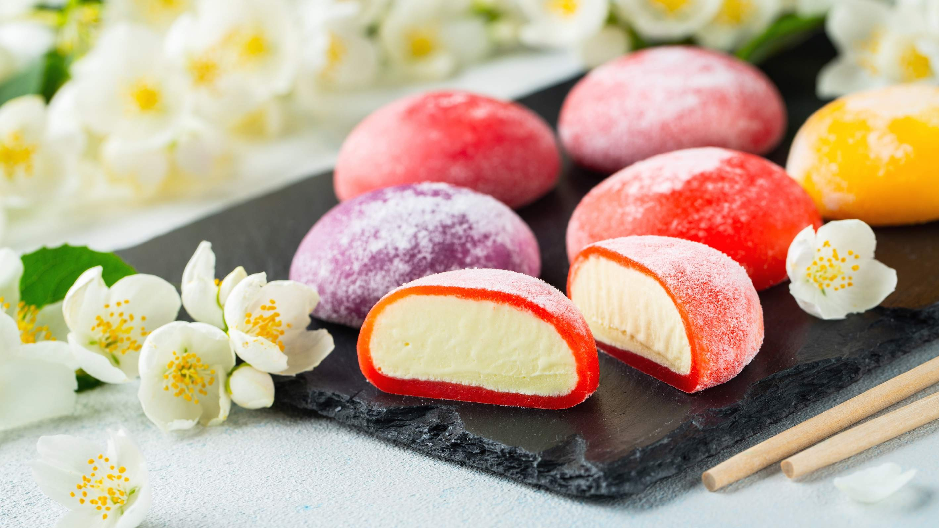
INTRODUCTION
Mochi, a classic Japanese delicacy, is created by pounding glutinous rice into a delightful mixture that is sticky, stretchy, and chewy. This versatile ingredient is widely utilized in Japanese cuisine, adding flavor and texture to a variety of dishes, desserts, and snacks. The traditional mochi preparation involves soaking glutinous rice overnight, then steaming and pounding it until it achieves a smooth and elastic consistency. Several factors, including the rising demand for healthier dining options with reduced levels of saturated fat and cholesterol and the increasing prevalence of online sales platforms have driven the popularity of mochi.

Slide 3
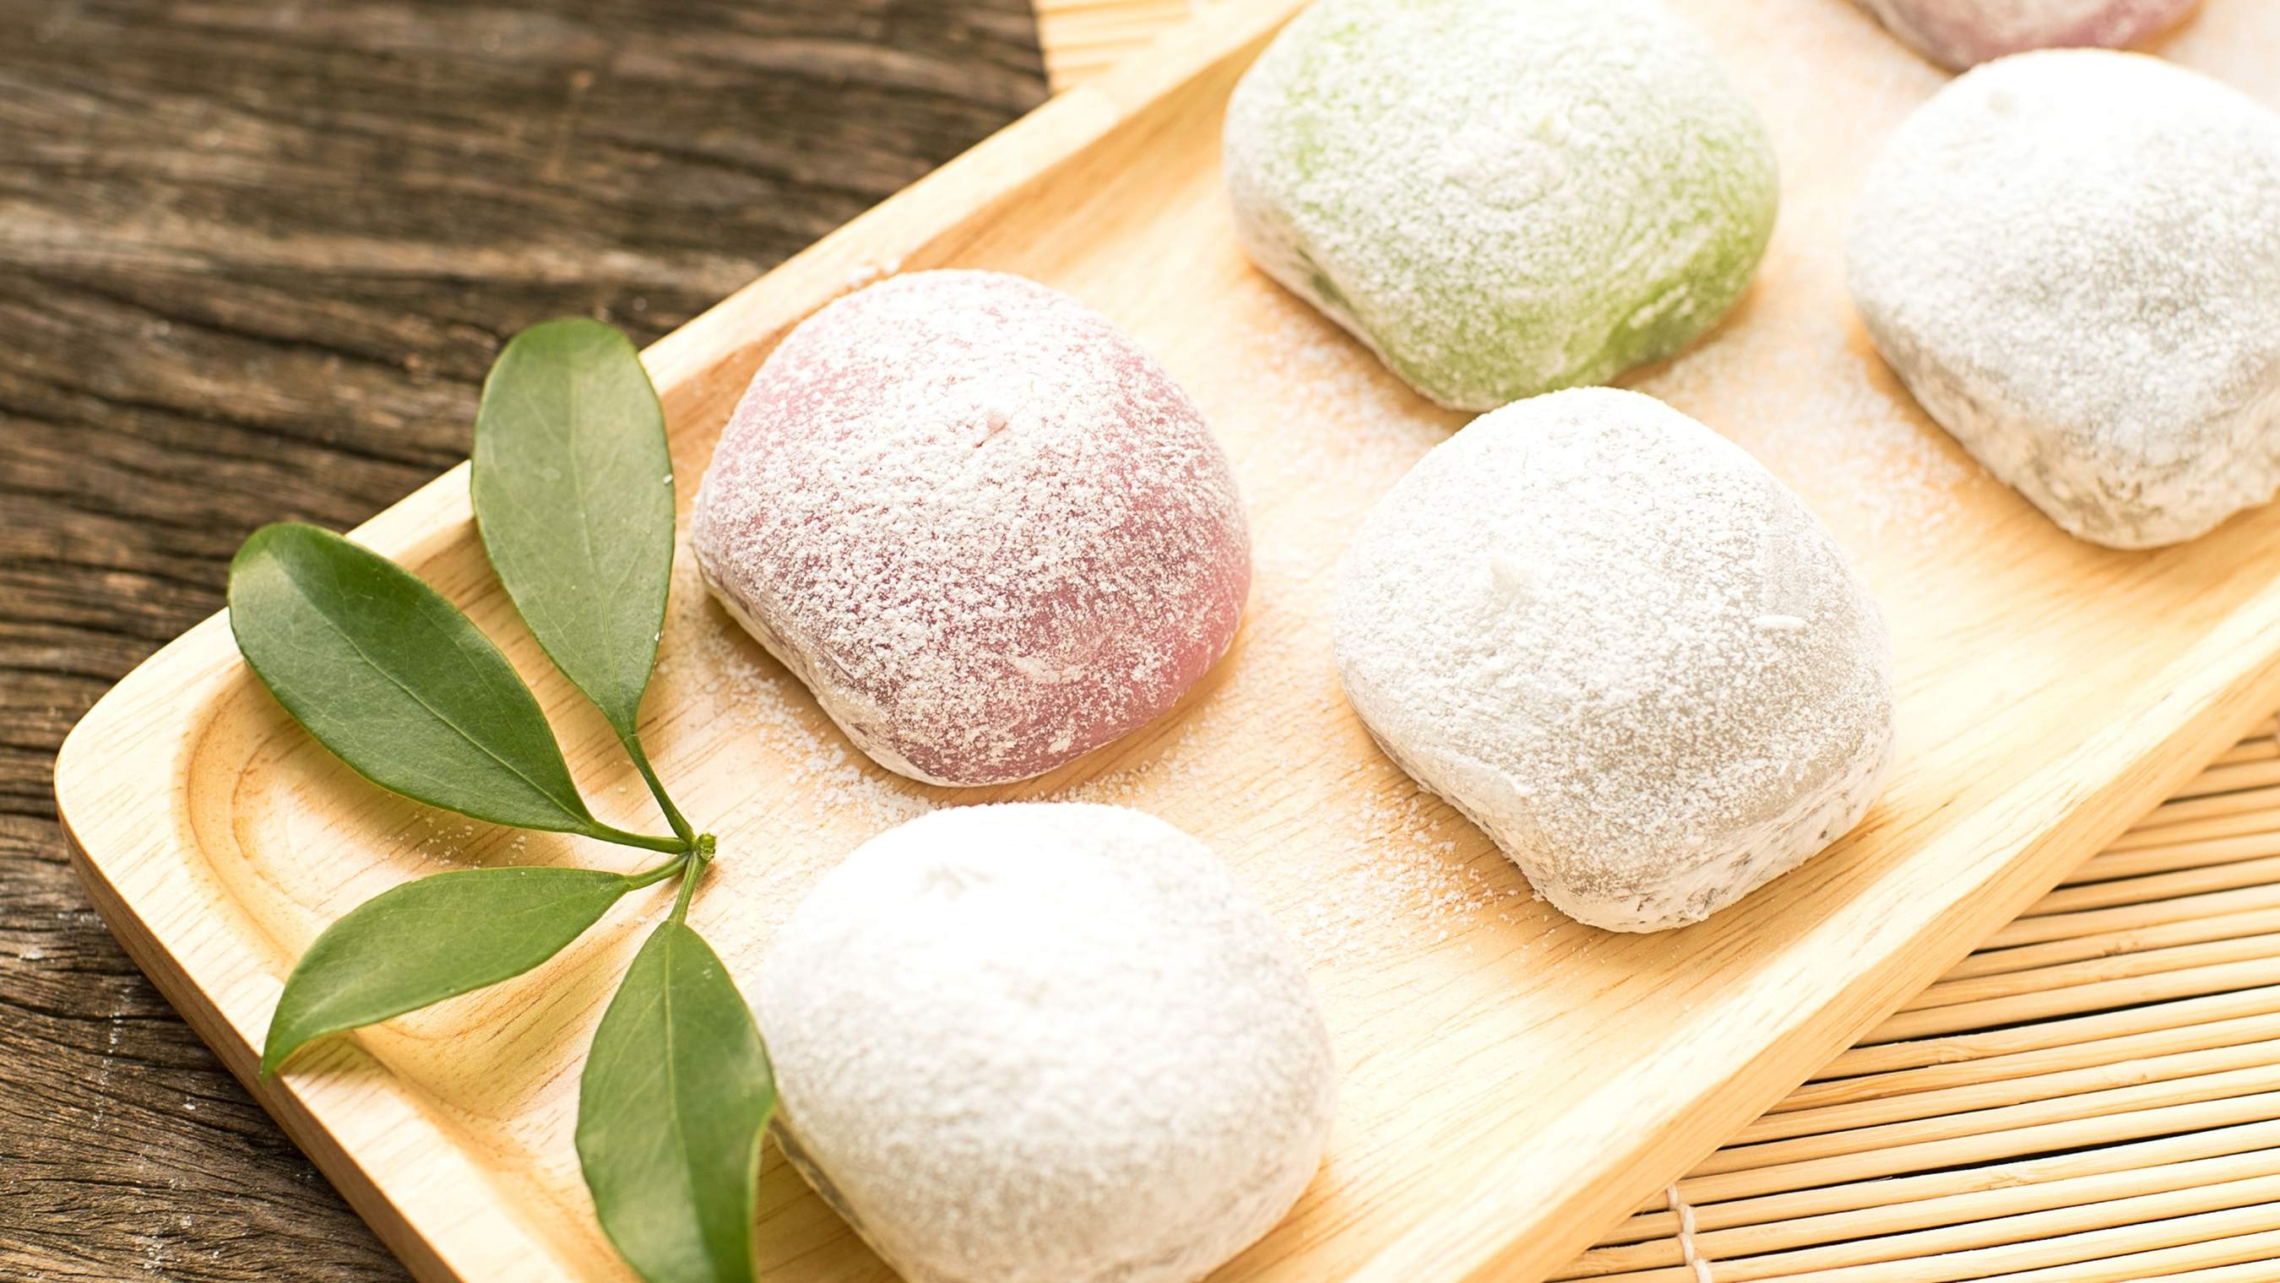

KEY INSIGHTS
MARKET SIZE
USD 0.381 billion
2022
20₋23
CAGR 12.50%
2030

Slide 4
REVENUE MARKET SHARE BY SEGMENTS 2022
Strip Mochi Spherical Mochi
Shape Segment
Online Sales Supermarket Retails
Distribution Channel

Slide 5
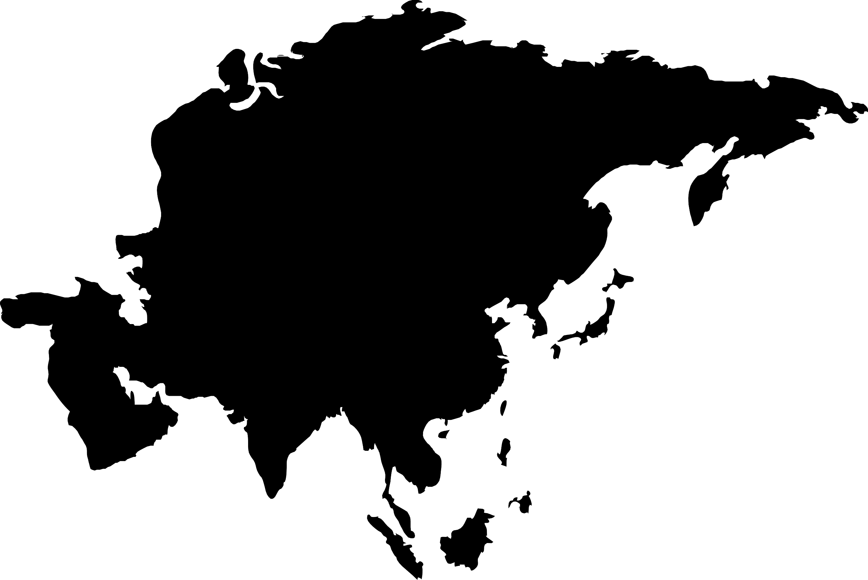
Global Mochi Market Revenue share for 2022
Asia Pacific 42%

Slide 6
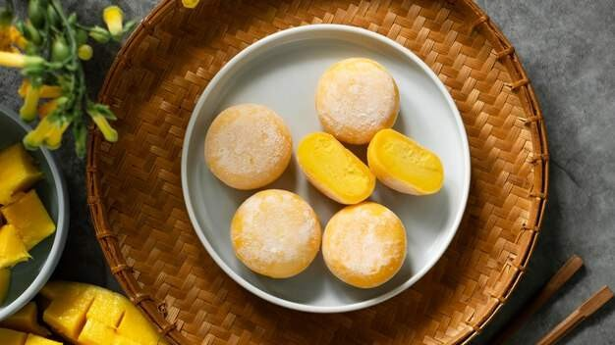
Health and Wellness Trends to Propel Market Growth
Drivers
Rising Competition in the Industry to Hinder Market Growth
Restraints

Slide 7
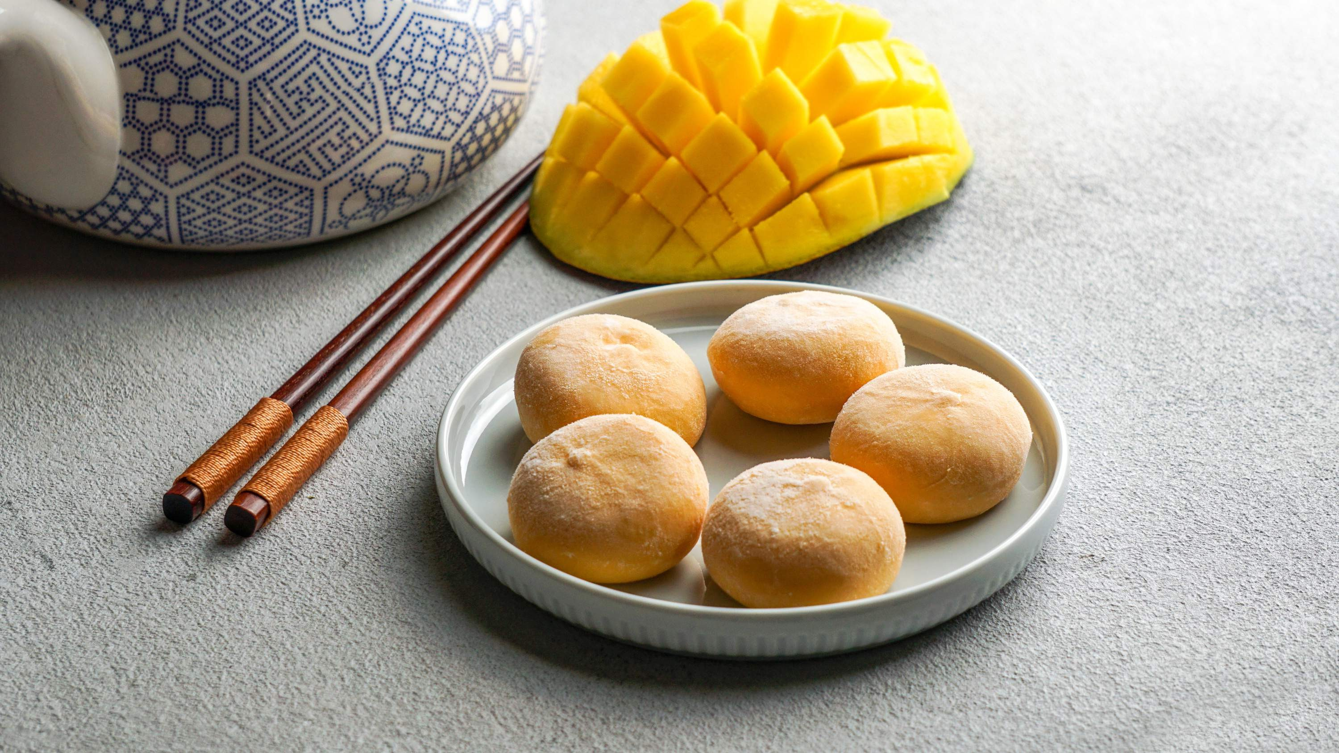
AUTHOR'S PERSPECTIVE
The Global Mochi Market is witnessing significant growth in the near future. Spherical mochi encapsulates the essence of traditional Japanese confectionery, offering a delightful chewy texture and often filled with sweet fillings like red bean paste or ice cream.
Supermarkets provide a one-stop shopping experience, allowing customers to find an extensive range of mochi brands, flavors, and types under a single roof. In 2023, the Strip Mochi segment accounted for noticeable share of global Mochi Market and is projected to experience significant growth in the near future.
The Online Sales segment is expected to expand at the significant CAGR retaining position throughout the forecast period.

Slide 8


KEY PLAYERS

Slide 9


Contact us
For Full Report
COGNITIVE MARKET RESEARCH
Tel: + 1 312 - 376 - 8303 | + 44 020 - 8123 - 0732
India: ( + 91 ) 983 - 496 - 8611
sales@ cognitivemarketresearch. com
Access the Full Report : http://tinyurl.com/2euxrhks
Please visit our website:
https://www.cognitivemarketresearch.com

