Slide 1
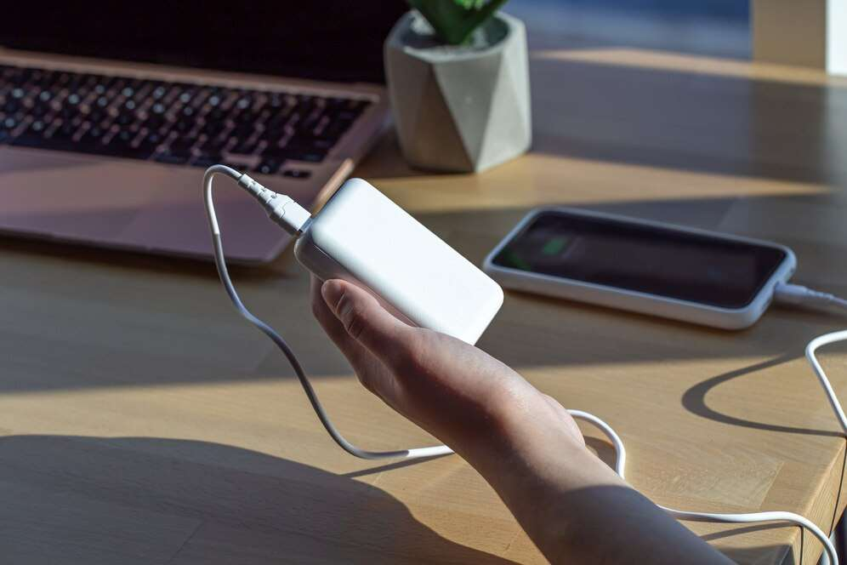
GLOBAL
MOBILE PHONE CONNECTOR
MARKET REPORT 2024
Global,Regional,CountryAnalysis

Slide 2
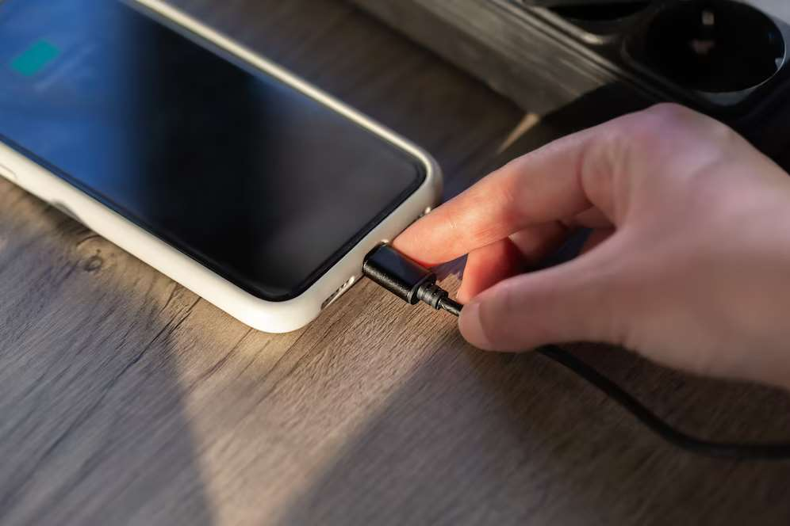
INTRODUCTION
Mobile Phone Connector plays a role in connecting the various components inside the phone. A phone connector, also known as phone jack, audio jack, headphone jack, or jack plug, is a family of electrical connectors typically used for analog audio signals. The standard is that a plug (described as the male connector) will connect with a jack (described as female).

Slide 3
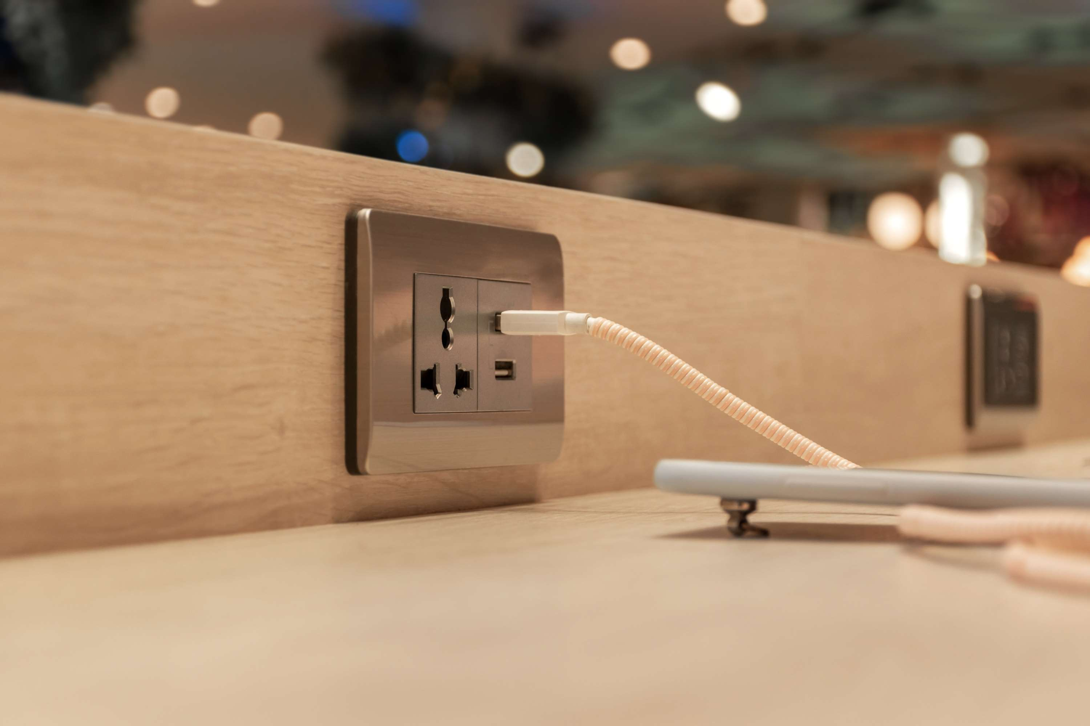

KEY INSIGHTS
MARKET SIZE
USD 4,570.26 Million
2028
CAGR
6.04%
2023- 2030

Slide 4
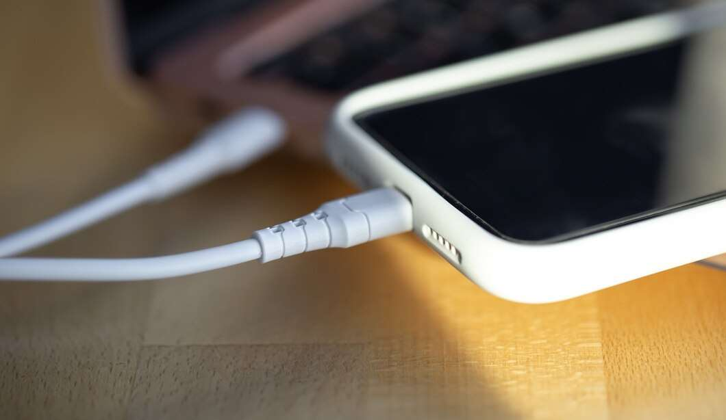
REVENUE MARKET SHARE BY SEGMENTS 2022
FPC Connector
USD 500.05 Million
Type segment
Feature Phone
USD 1,430.40 Million
Application segment
Distribution channel
Online
USD 1,322.01 Million

Slide 5

Global Mobile Phone Connector Market Revenue share for 2022
Asia Pacific
USD 1,872.44 Million

Slide 6
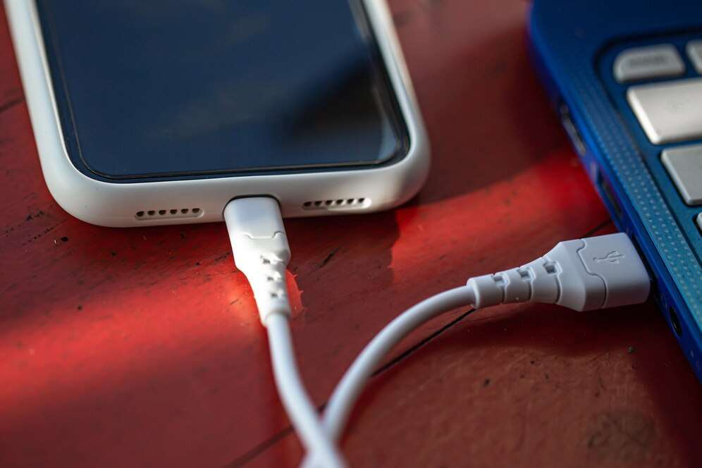
Growing adoption of smartphones
Drivers
Restraints
Emergence of wireless technologies

Slide 7

AUTHOR'S PERSPECTIVE
  Global Mobile Phone Connector Market Report 2023 talks about crucial market insights with the help of segments and sub-segments analysis.
  FPC Connectors offers multiple configuration options. Flexible printed cables (FPC) are appropriate for applications where bulkier wire-to-board solutions are unfeasible due to tiny centerline spacing.
  Feature phones are phones that have more functions than basic phones but are not as sophisticated as smartphones.
  Distribution refers to the advertisement, presentation, and/or sale of products in a physical store setting and/or any other setting in which the people participating in the commercial activity contact face to face.

Slide 8







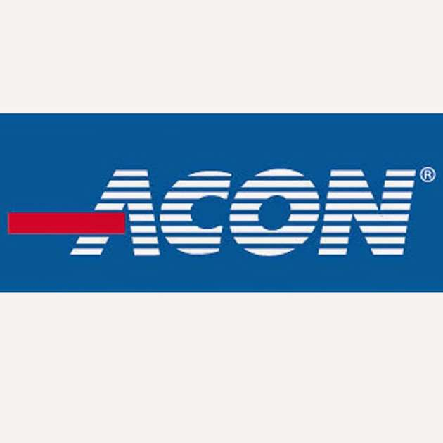


KEY PLAYERS

Slide 9


For Full Report
Contact us
COGNITIVE MARKET RESEARCH
Tel: +1 312-376-8303 | +44 020-8123-0732
India: (+91) 983-496-8611
sales@cognitivemarketresearch.com
Access the Full Report : https://tinyurl.com/yke9a8v6
Please visit our website:
https://www.cognitivemarketresearch.com

