Slide 1
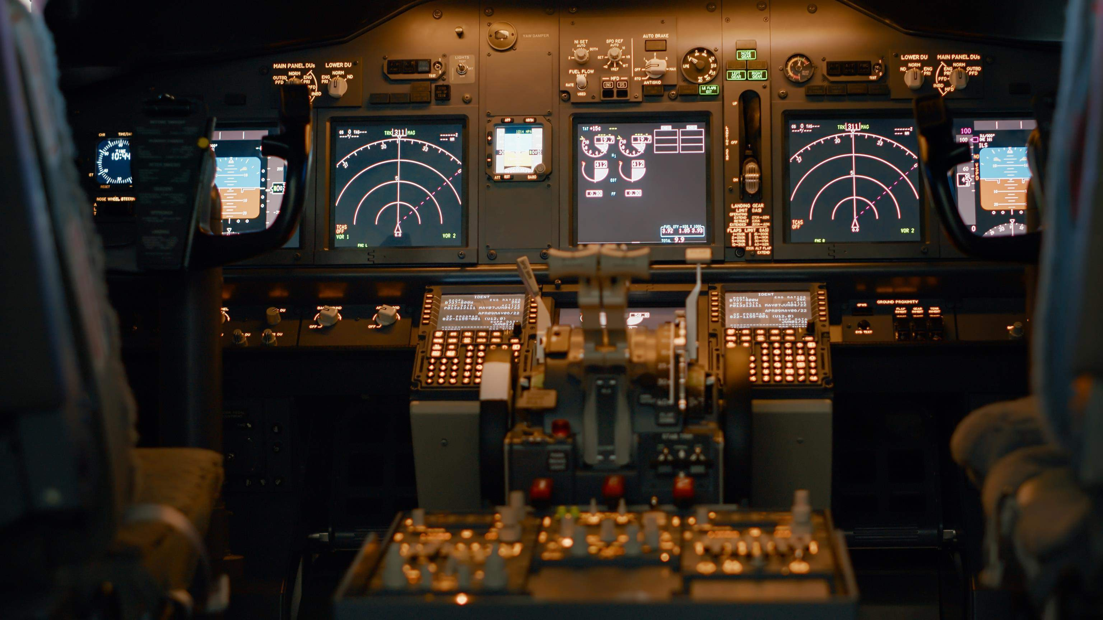

GLOBAL
MILITARY AIRCRAFT COMMUNICATION AVIONICS
MARKET REPORT
2024

Slide 2
INTRODUCTIO
Military Aircraft Communication Avionics

Slide 3

KEY INSIGHTS
MARKET SIZE
$31.05
Bn
2023
FORECAS
$35.27 Bn
CAGR
4.4%
2023
2030
TO
2030

Slide 4
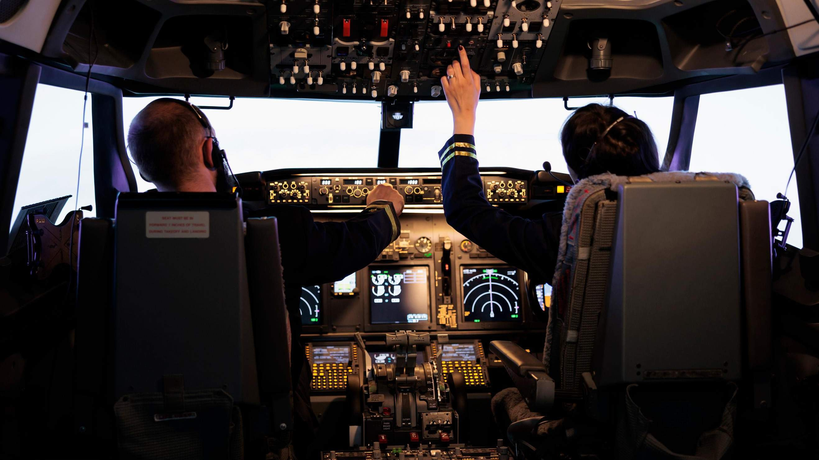

Aircraft Type
Combat Aircraft 51.3%
Sales
OEM 64.1%
REVENUE MARKET SHARE BY SEGMENTS 2022
Component
Display & Processors 24.2%
Solution
SATCOM 58.9%

Slide 5

North America: 36.7%
North America shows highest market share in military aircraft communication avionics due to the U.S. dominance in defense sector. The U.S. possesses largest
aerospace industrial complex. Government of the United States invests huge amount in their military systems.

Slide 6
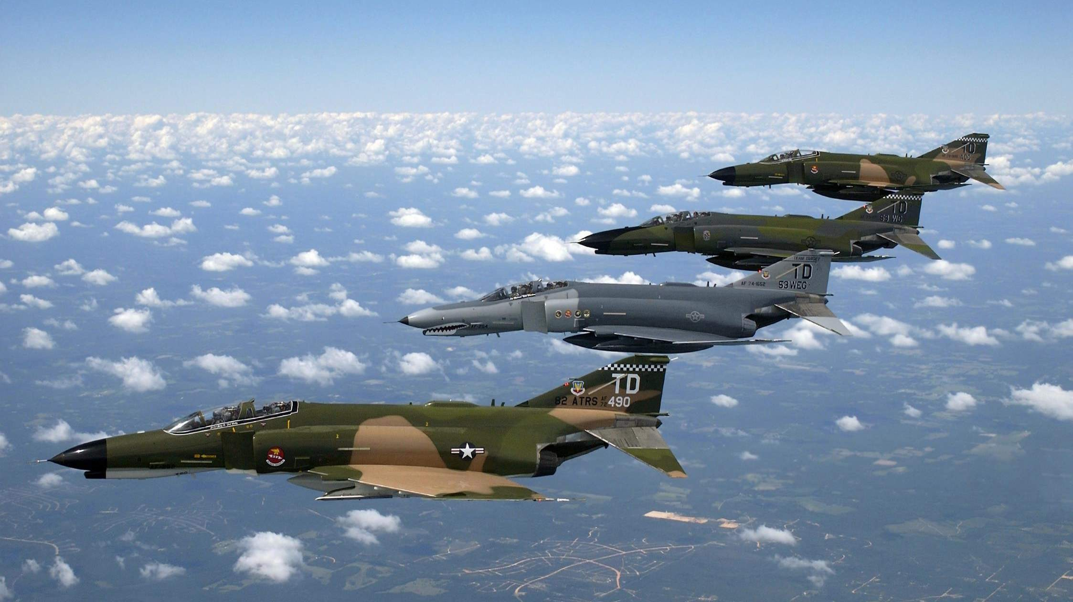


Supply chain disruption for electronics chips hampers the growth of market
Increasing adaption of technological advancement in defense sector

Slide 7


SATCOM solution is dominating the military aircraft communication avionics market
OEM sales dominates the market in terms of revenue model.
North America shows highest market share in military aircraft communication avionics market

Slide 8










KEY PLAYERS

Slide 9


Contact us
For Full Report
COGNITIVE MARKET RESEARCH
Tel: + 1 312 - 376 - 8303 | + 44 020 - 8123 - 0732
India: ( + 91 ) 983 - 496 - 8611
sales@ cognitivemarketresearch. com
Access the Full Report : https://shorturl.at/dlIZ2
Please visit our website:
https://www.cognitivemarketresearch.com

