Slide 1

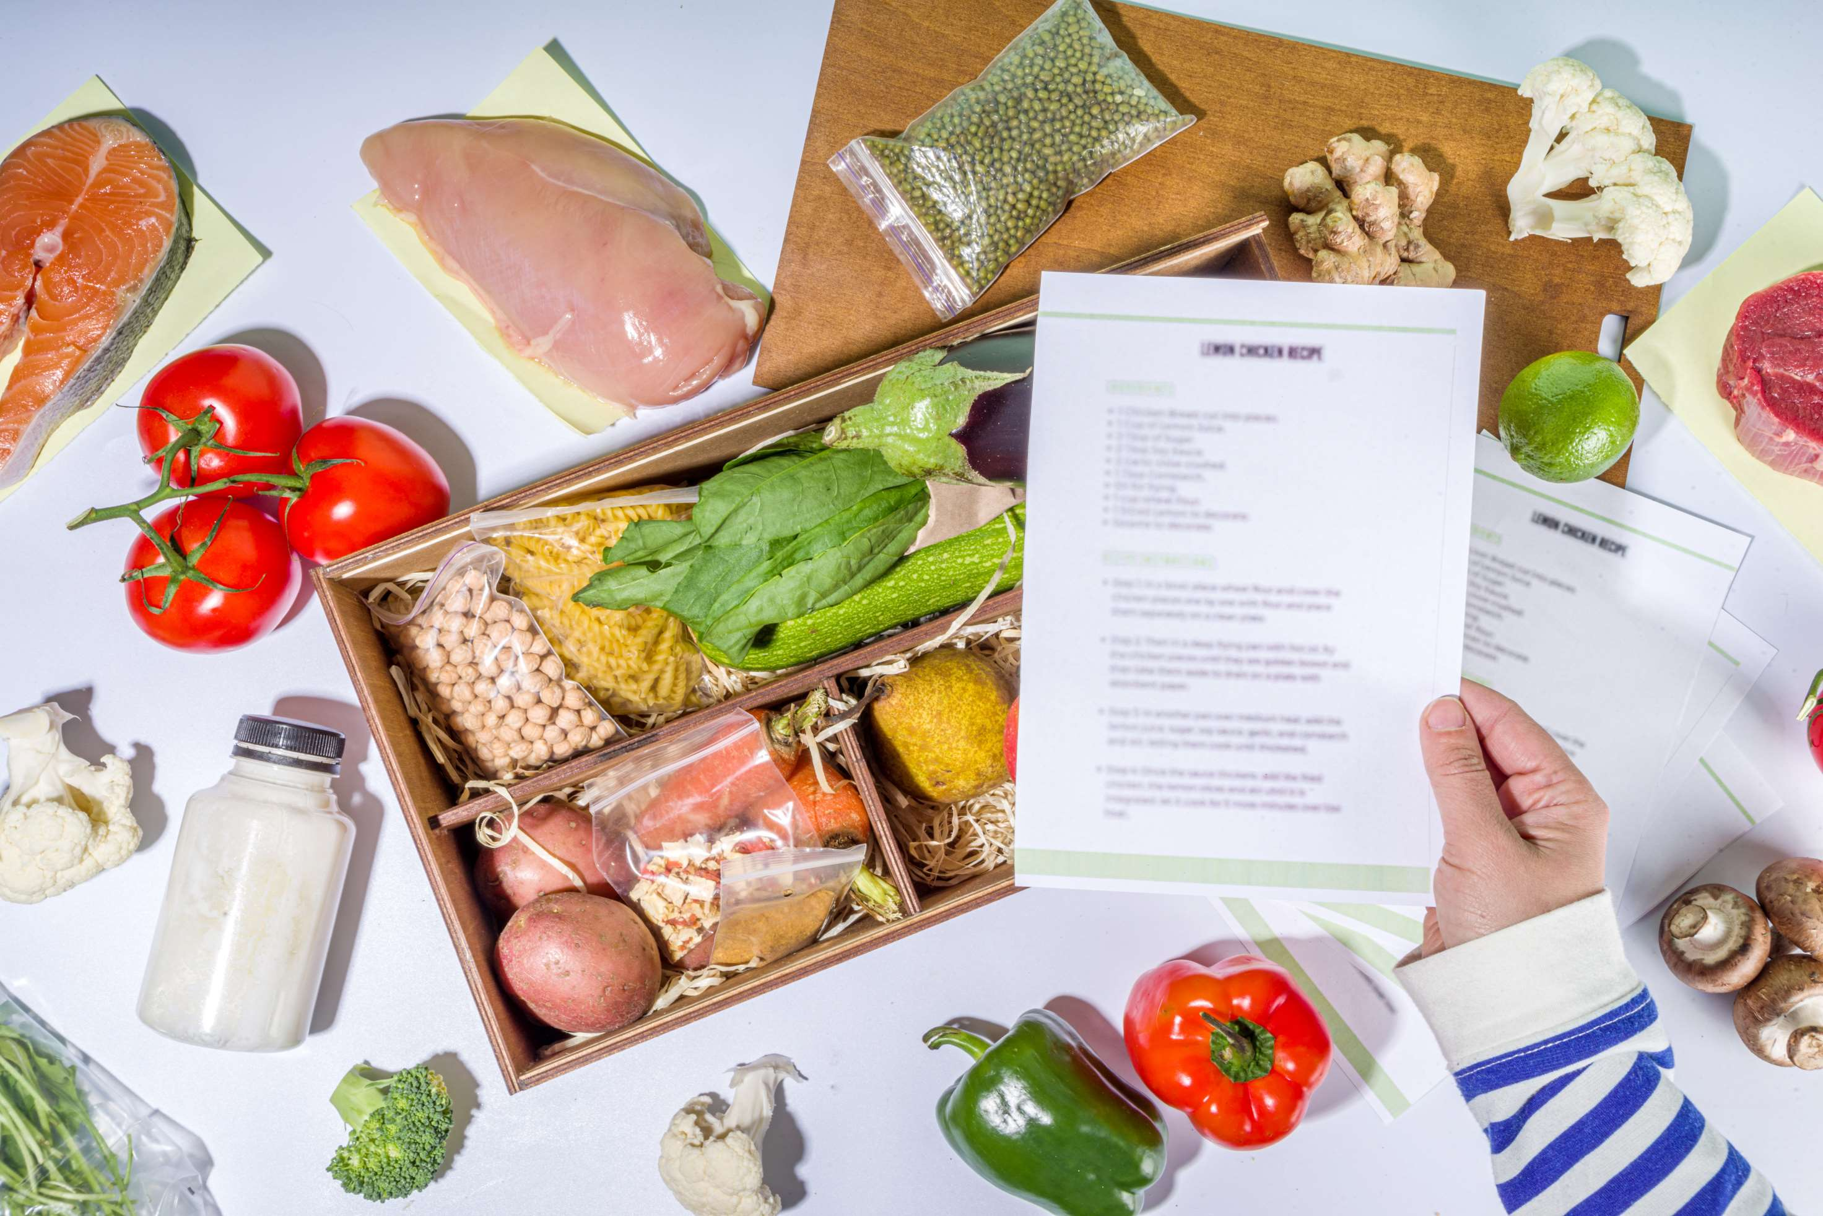
GLOBAL
MEAL KIT SERVICE
MARKET REPORT
2024
Global,Regional,CountryAnalysis

Slide 2

INTRODUCTION
A subscription meal service known as a "meal kit" sends customers pre-portioned or partially prepared food items and recipes so they may prepare meals at home. The growing preference for cuisine made by chefs and at home among millennials is one of the major factors propelling the market's growth.The delivery service is particularly well-liked and widely used by Generations Y and Z. The advantages of cooked meals, which are more affordable than takeaway and home delivery services, are causing consumers to favor the product more and more.

Slide 3
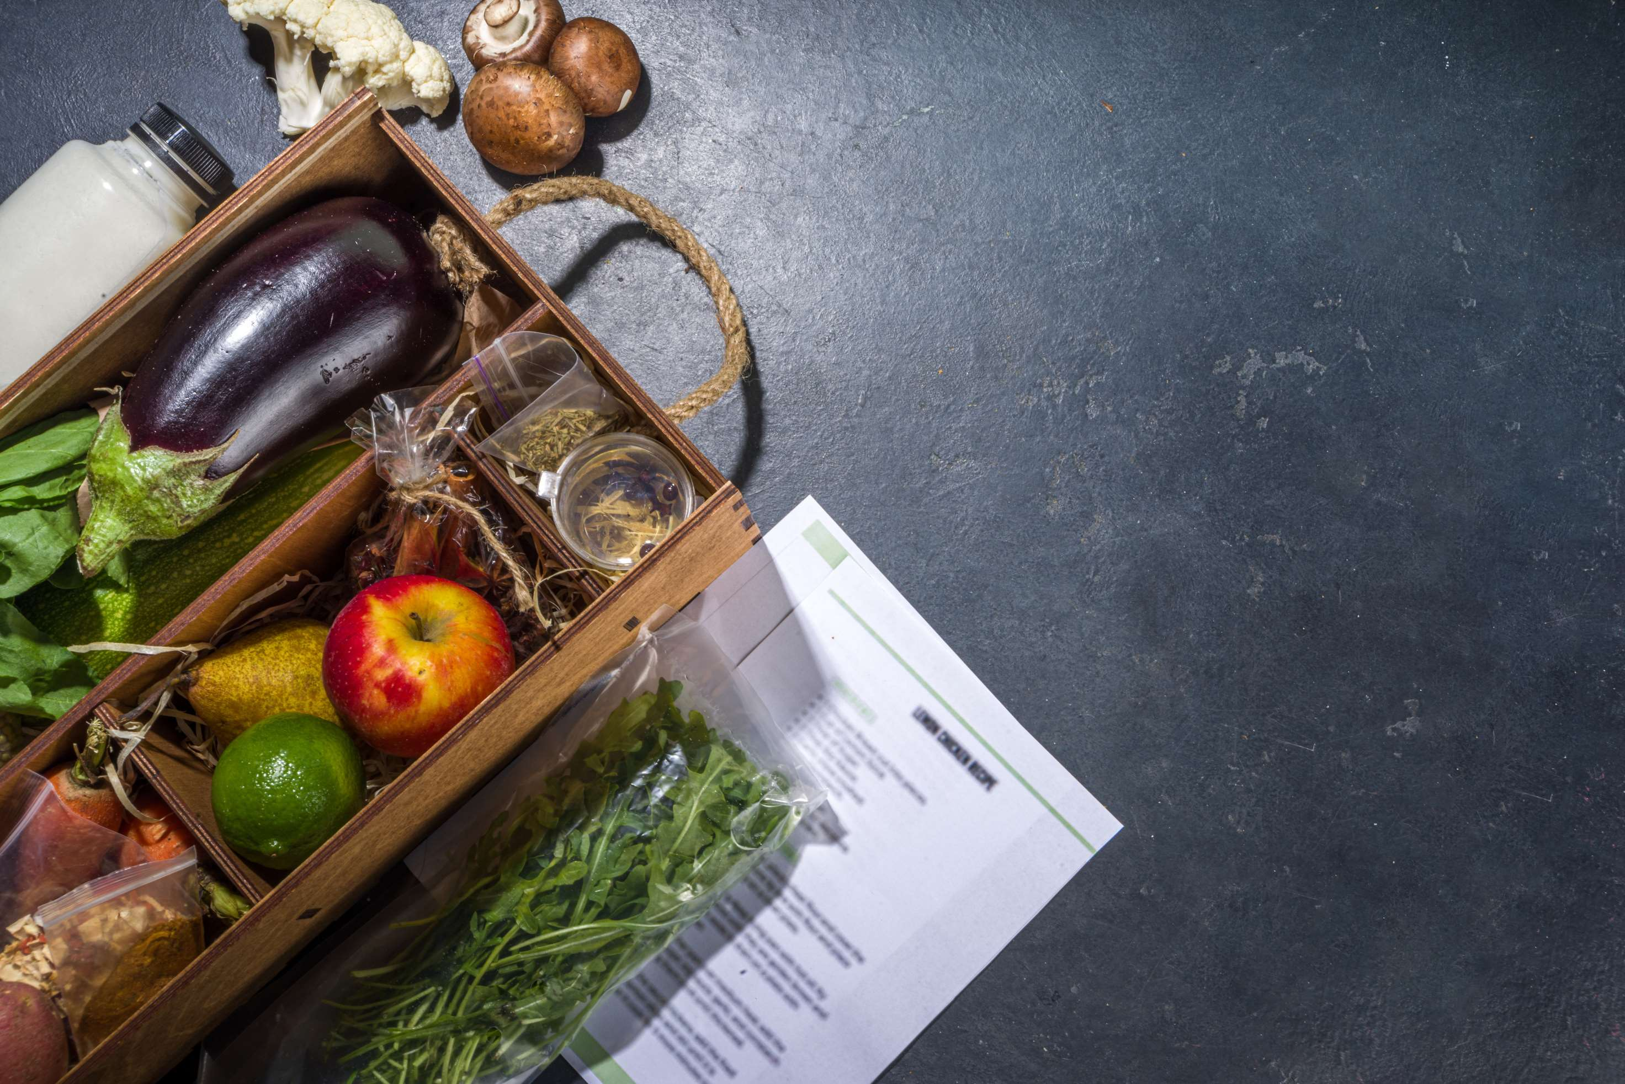

KEY INSIGHTS
MARKET SIZE
USD 251 billion
2022
CAGR
15.50%
2023- 2030

Slide 4

REVENUE MARKET SHARE BY SEGMENTS 2022
  Heat & Eat
  Cook & Eat
By Offering
  Single
  Multiple
By Service
  Vegan
  Vegetarian
  Non-Vegetarian
By Meal Type

Slide 5

Global Meal Kit Service Market Revenue share for 2022
North America

Slide 6
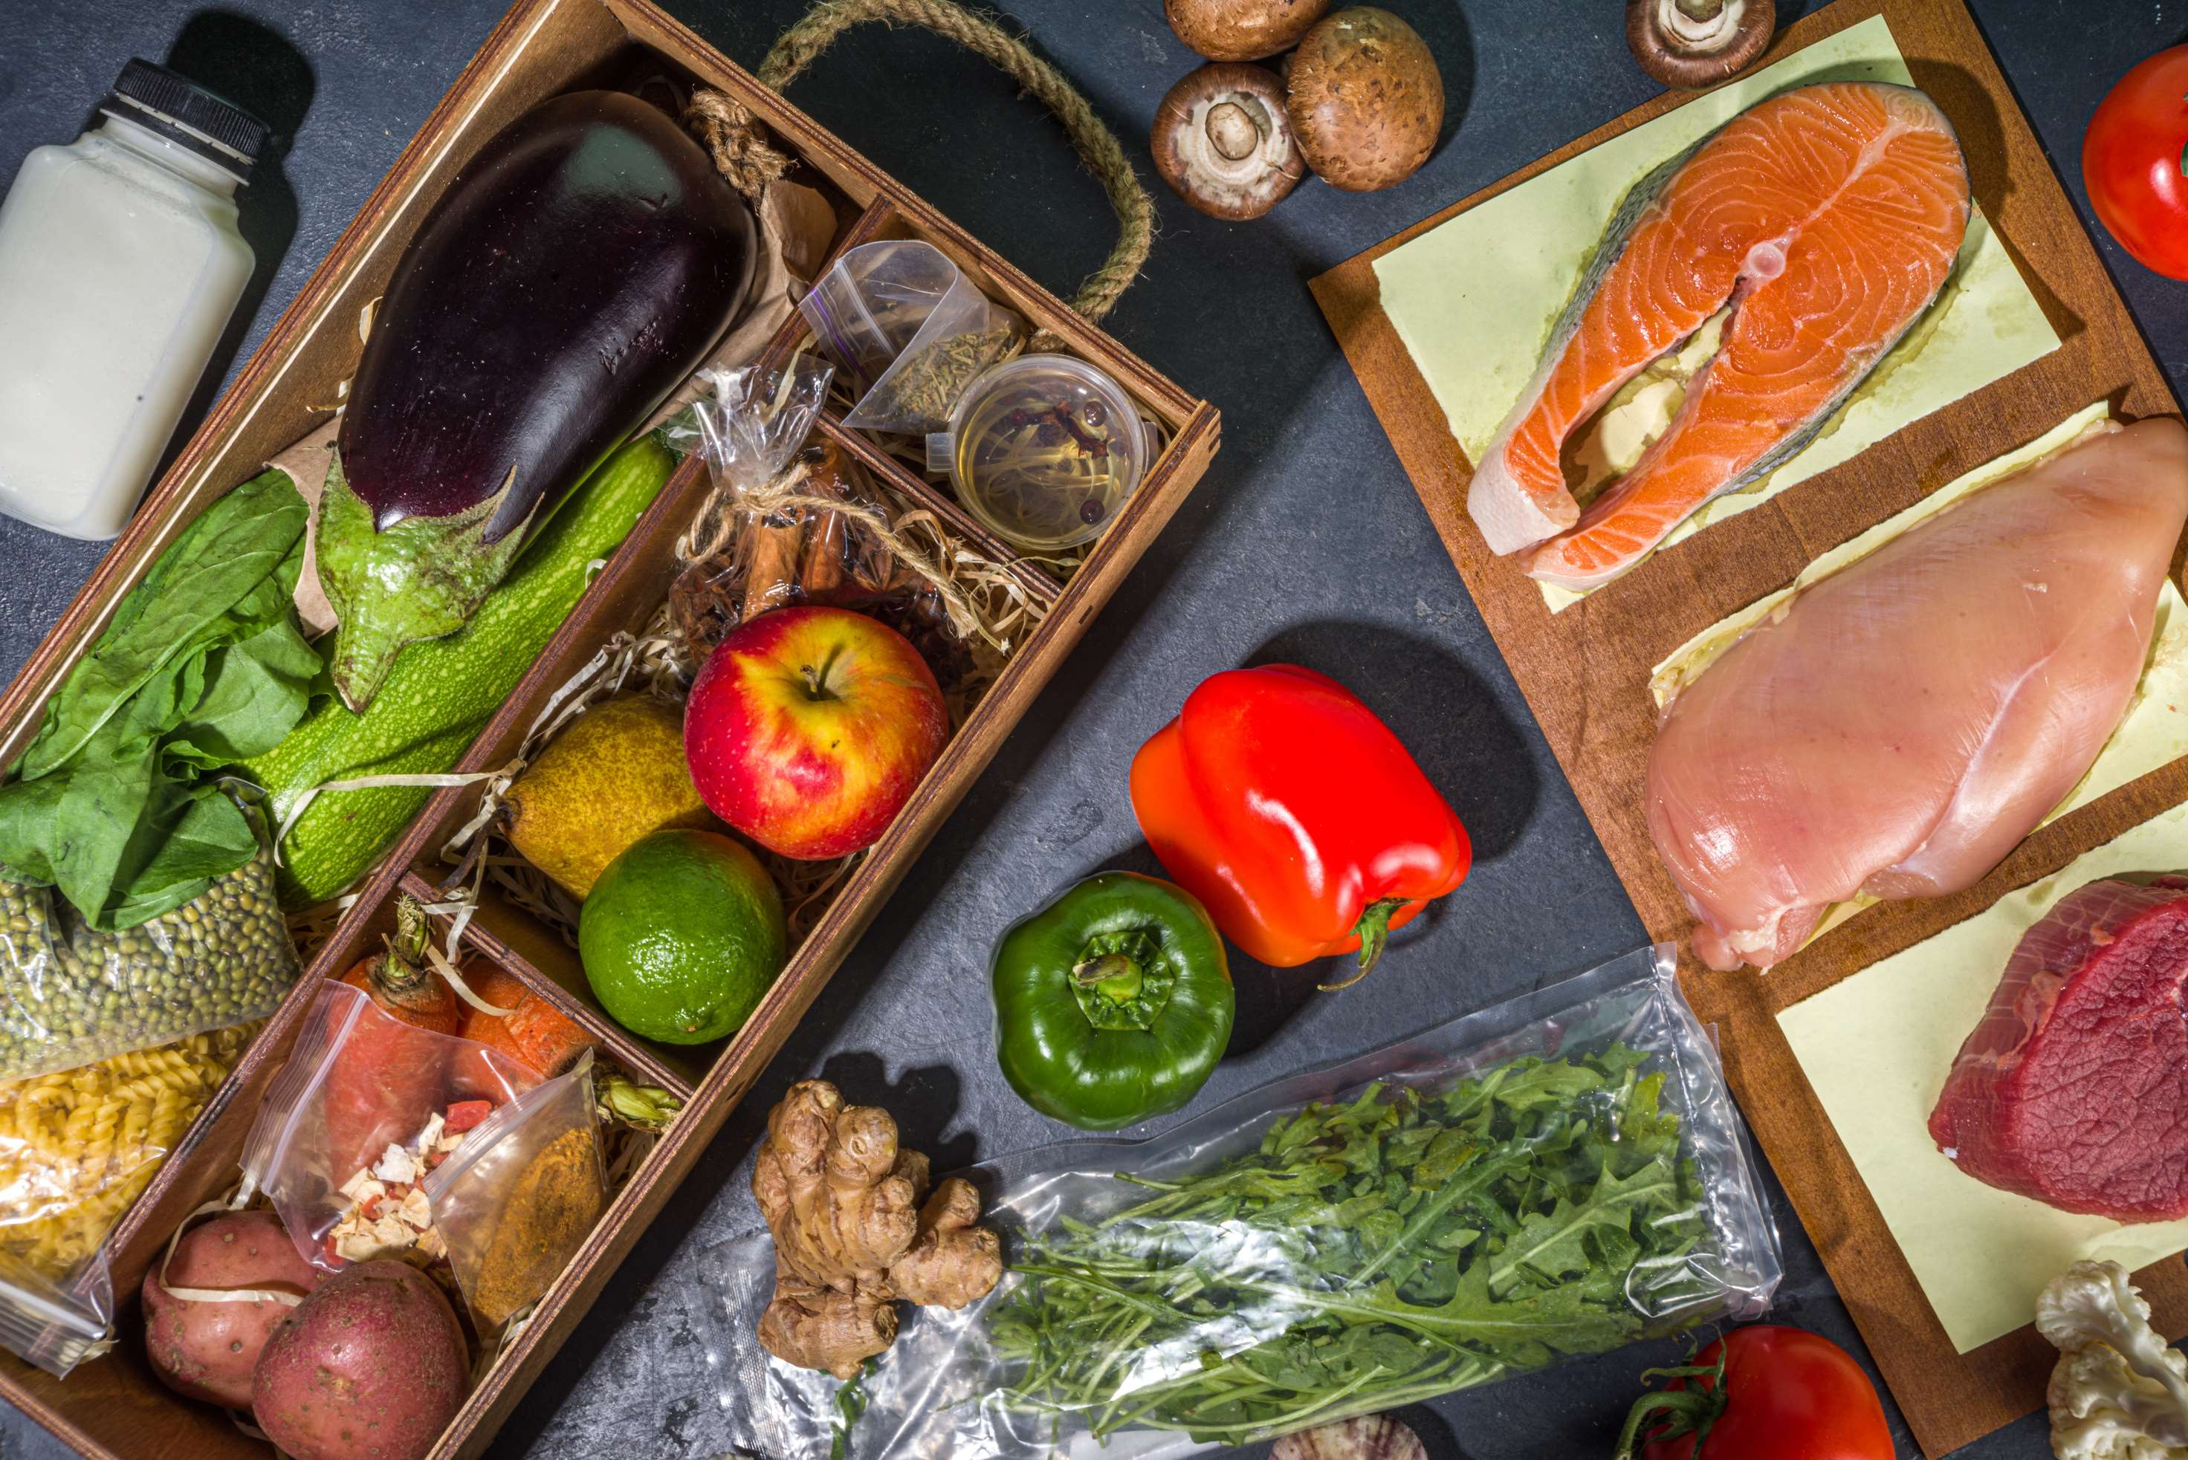
Cost-Effective Solutions and Availability of Diverse Choices to Provide Viable Market Output
Drivers
Preference for Home-Cooked Food to Impede Market Growth
Restraints

Slide 7

AUTHOR'S PERSPECTIVE
  The Global Meal Kit Service Market is witnessing significant growth in the near future.
  Households use these delivery services, which offer suitable answers to labor- and time-intensive cooking duties, to lessen this strain.
  One of the main reasons so many individuals adopt a vegetarian diet is that they favor consuming many nutritious, fresh plant-based meals, which offer antioxidants, fiber, and other long-term health advantages.
  In 2023, the Heat & Eat segment accounted for noticeable share of global Meal Kit Service Market and is projected to experience significant growth in the near future.
  The Single segment is expected to expand at the significant CAGR retaining position throughout the forecast period.

Slide 8














KEY PLAYERS

Slide 9


For Full Report
Contact us
COGNITIVE MARKET RESEARCH
Tel: +1 312-376-8303 | +44 020-8123-0732
India: (+91) 983-496-8611
sales@cognitivemarketresearch.com
Access the Full Report : http://tinyurl.com/4c7jrnp
Please visit our website:
https://www.cognitivemarketresearch.com

