Slide 1

GLOBAL
MANUKA HONEY
MARKET REPORT
2024
Global,Regional,CountryAnalysis

Slide 2

INTRODUCTION
Manuka honey is a dark monofloral honey that is derived from the nectar of the Manuka shrub or tree, Leptospermum scoparium of the Myrtaceae family. It is primarily composed of methylglyoxal, which is an organic compound that has antibacterial properties as well as numerous health benefits. In addition to being sweet and strong in flavor, manuka honey is also characterized by its antioxidant properties. As an enzymatic substrate, methylglyoxal present in manuka honey is tolerant of light, heat, and body fluids.

Slide 3


KEY INSIGHTS
MARKET SIZE
USD 781.2 million
2024
CAGR
6.10%
2024- 2031

Slide 4
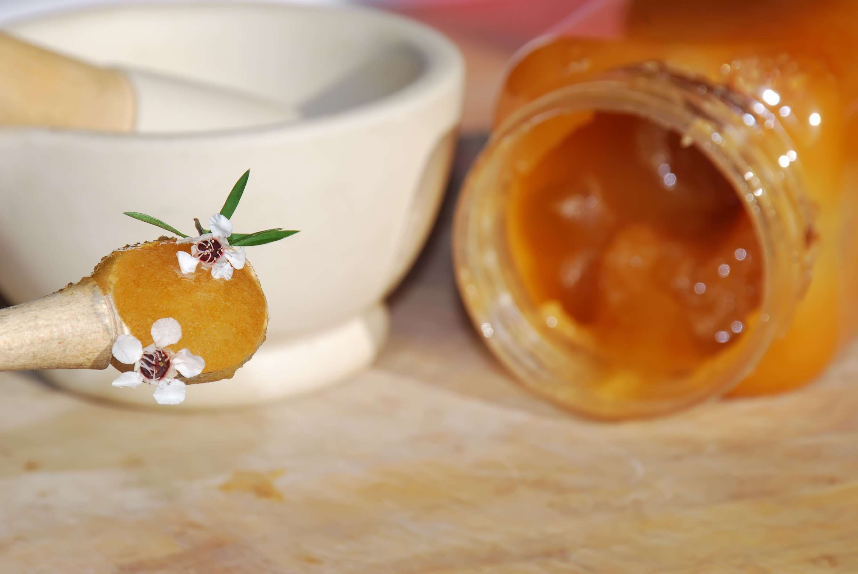
REVENUE MARKET SHARE BY SEGMENTS 2022
  UMF 5+ / MGO 83 mg/kg ppm
  UMF 10+ / MGO 263 mg/kg ppm
  UMF 15+ / MGO 514 mg/kg ppm
  UMF 20+ / MGO 829 mg/kg ppm
  Conventional Manuka Honey
  Organic Manuka Honey
Base Segment
Category Segment
  Digestion Inflammation Treatment
  Wound care
  Skincare Products
  Food & Beverages
  Bakery & Confectionery
  Dairy Products
  Pharmaceuticals
  Cosmetics & Personal Care
Application Segment
End-Use Segment

Slide 5

Global Manuka Honey Market Revenue share for 2024
North America
40%

Slide 6

  Manuka Honey's Health Benefits to Propel the Market Growth
  Low-fat Content of Manuka Honey to Drive the Market Growth
Drivers
Global Manuka Honey Market has High Prices to Restrict the Market Growth
Restraints

Slide 7
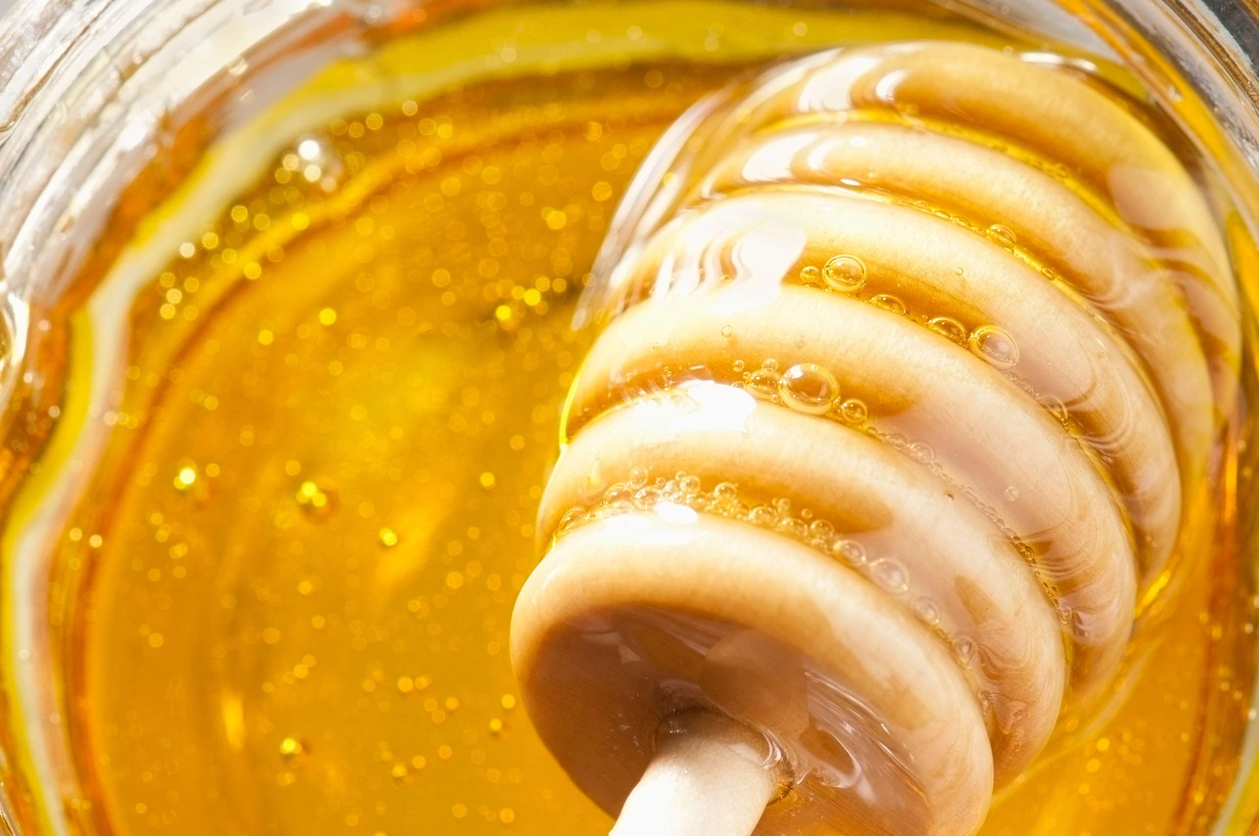
AUTHOR'S PERSPECTIVE
  The global Manuka Honey market will expand significantly by 6.10% CAGR between 2024 and 2031.
  The Wound Care Skincare Products segment signifies the integration of Manuka Honey into advanced skincare formulations tailored for healing and maintaining skin health.
  The Conventional Manuka Honey segment reflects a balance between authenticity and affordability, making Manuka Honey accessible to a wider audience in the European market.

Slide 8





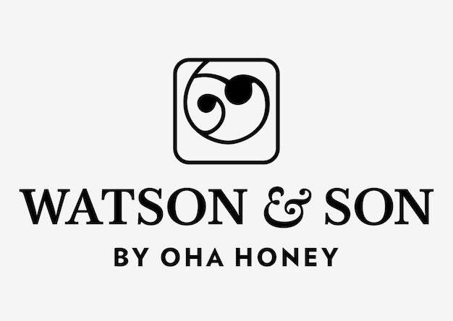

KEY PLAYERS

Slide 9


For Full Report
Contact us
COGNITIVE MARKET RESEARCH
Tel: +1 312-376-8303 | +44 020-8123-0732
India: (+91) 983-496-8611
sales@cognitivemarketresearch.com
Access the Full Report : https://tinyurl.com/2nexjp36
Please visit our website:
https://www.cognitivemarketresearch.com

