Slide 1

GLOBAL
MANGO PULP
MARKET REPORT
2024
Global,Regional,CountryAnalysis

Slide 2
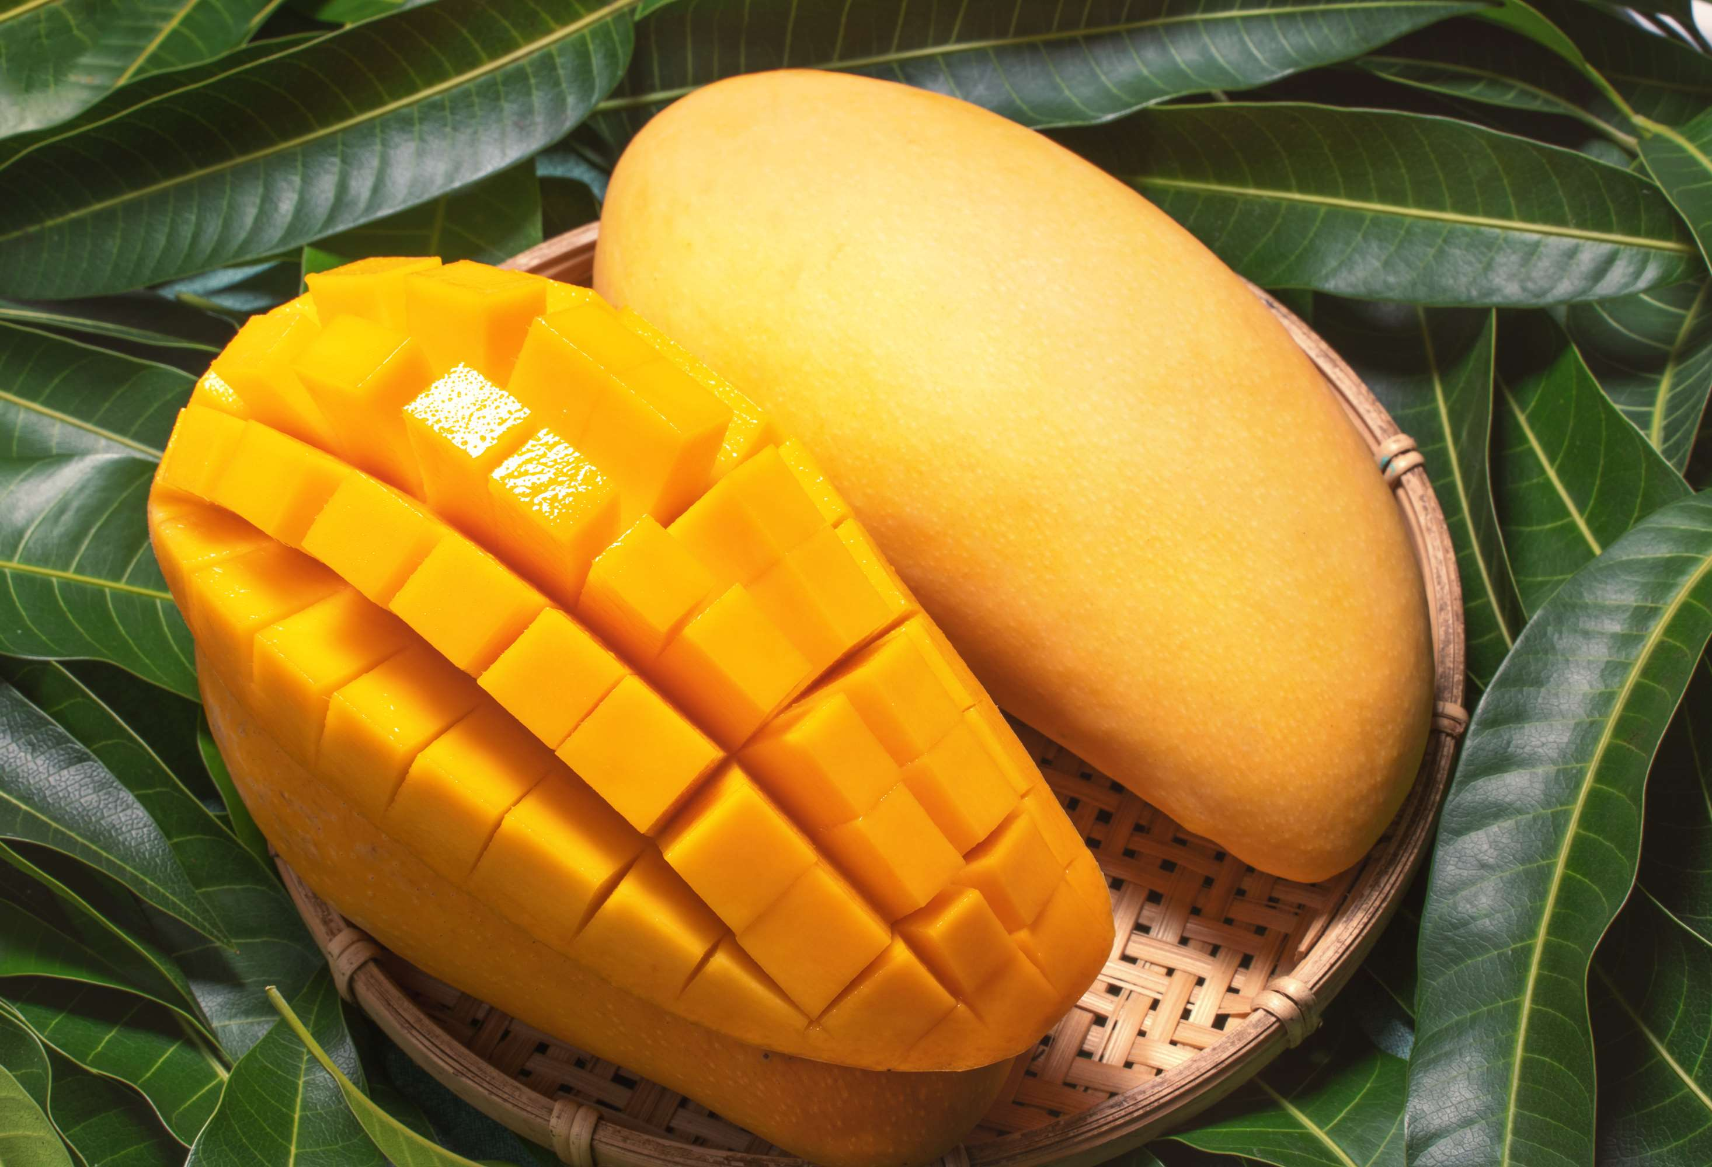
INTRODUCTION
Mango pulp is a concentrated form of ripe mango fruit flesh, extracted through processing techniques such as pulping, heating, and refining. It embodies the essence and flavour of fresh mangoes, typically devoid of any additives or preservatives. Mango pulp serves as a versatile ingredient in various culinary applications, including beverages, desserts, jams, sauces, and snacks. Renowned for its vibrant colour, rich sweetness, and tropical aroma, mango pulp is favoured for its convenience and year-round availability, especially in regions where fresh mangoes are seasonal. It offers a convenient solution for enjoying the taste of mangoes in off-seasons or in areas where fresh fruit is scarce.

Slide 3
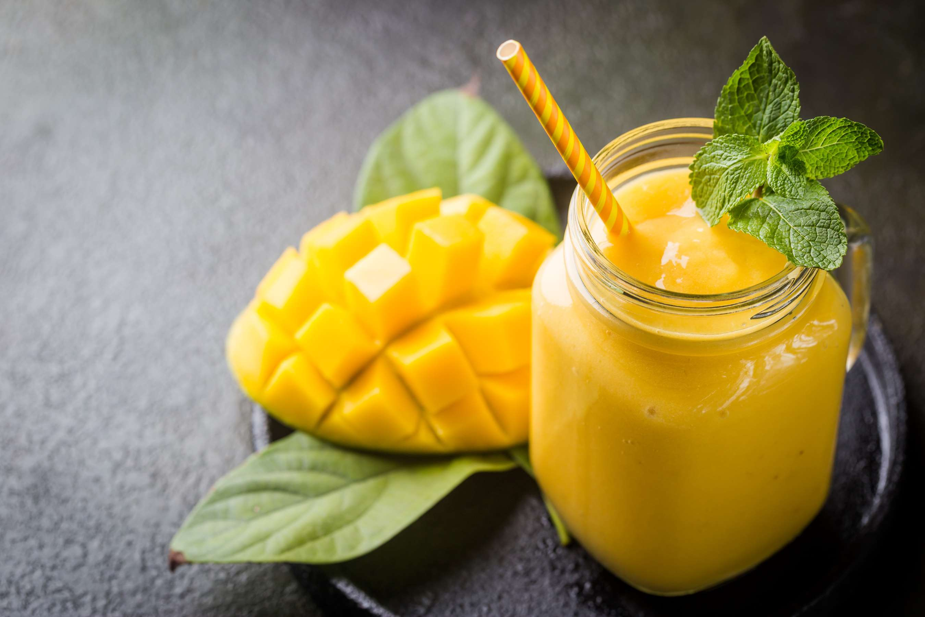

KEY INSIGHTS
CAGR
7.00%
2024- 2031

Slide 4
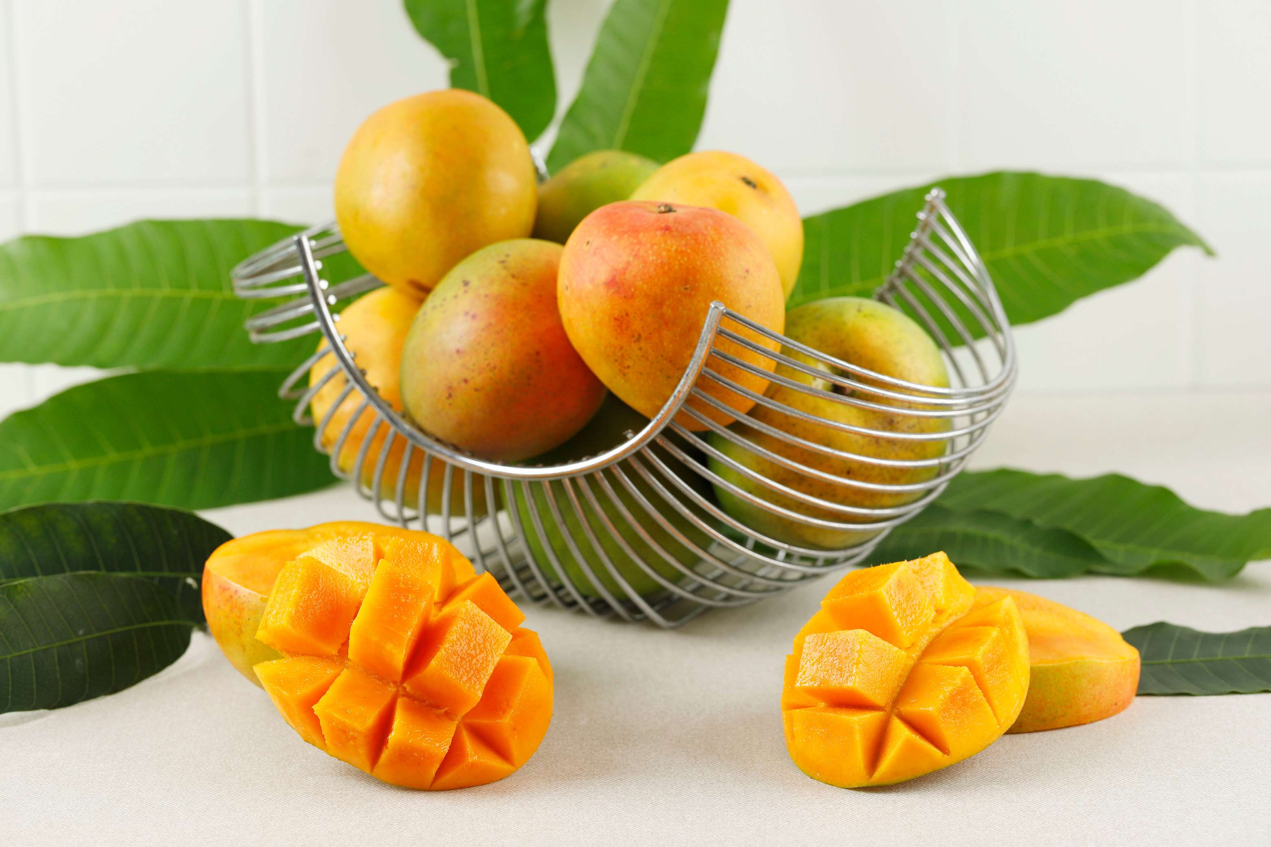
REVENUE MARKET SHARE BY SEGMENTS 2022
  Organic Mango Pulp
  Conventional Mango Pulp
Type Segment
  Cans
  Pouches
  P.E.T.Jars
Packaging Segment
  Beverages
  Infant Food
  Ice Cream Yoghurt
  Dressings Sauces
  Bakery Snacks
  Personal Care
Application Segment

Slide 5
Global Mango Pulp Market Revenue share for 2024
North America
40%

Slide 6
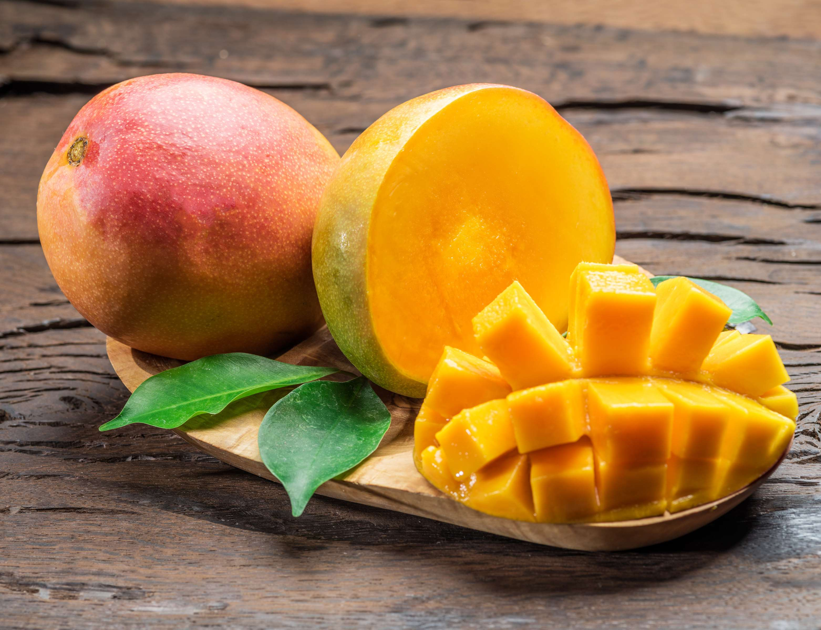
  Growing Demand for Convenient and Ready-to-use Fruit Products to Increase Sales
  Increasing Consumer Preference for Natural and Healthy Food Options to Propel the Growth
Drivers
Seasonal Availability and Dependence on Mango Harvest to Limit the Sales
Restraints

Slide 7
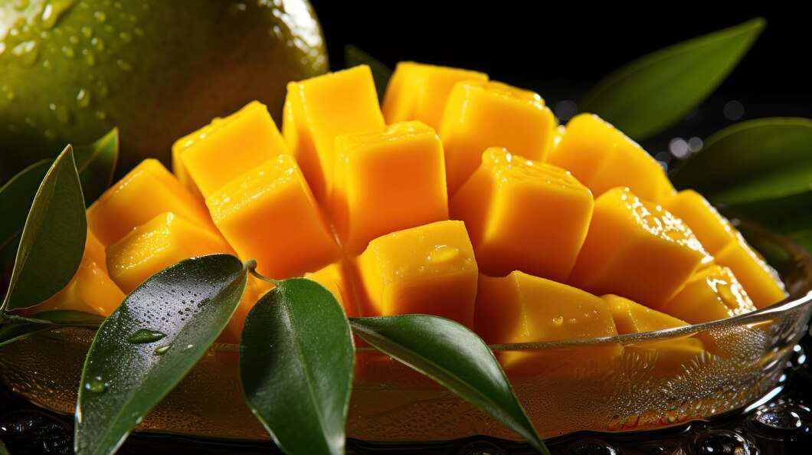
AUTHOR'S PERSPECTIVE
  The global mango pulp market will expand significantly by 7.00% CAGR between 2024 to 2031.
  The sales of conventional mango pulp are likely to increase due to its affordability, widespread availability, familiarity among consumers, and the growing demand for processed mango products in various culinary applications.
  The sales of beverages are poised to increase due to changing consumer preferences favouring convenient and refreshing options, expanding product variety, innovative flavours, and increasing health-consciousness among consumers.

Slide 8
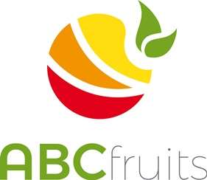



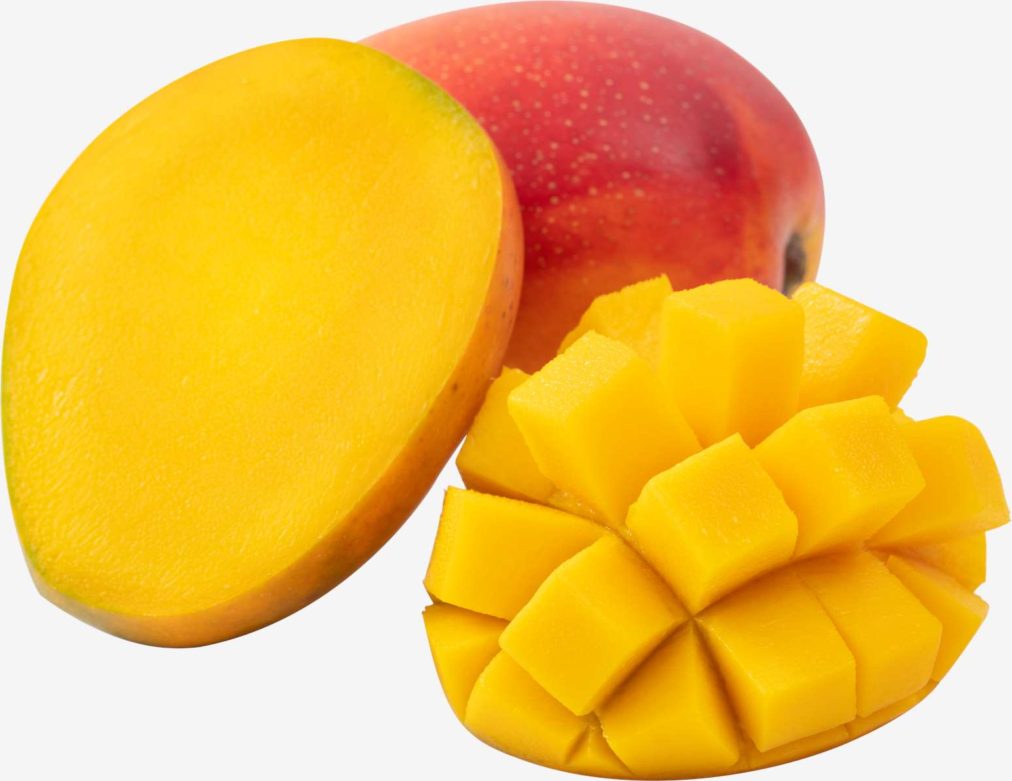

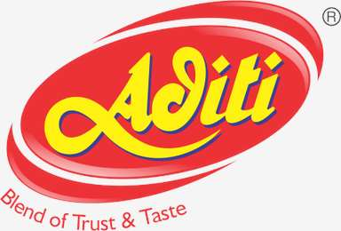





KEY PLAYERS

Slide 9


For Full Report
Contact us
COGNITIVE MARKET RESEARCH
Tel: +1 312-376-8303 | +44 020-8123-0732
India: (+91) 983-496-8611
sales@cognitivemarketresearch.com
Access the Full Report : https://tinyurl.com/mr3a5phd
Please visit our website:
https://www.cognitivemarketresearch.com

