Slide 1

GLOBAL
MALT WHISKY
MARKET REPORT
2024
Global,Regional,CountryAnalysis

Slide 2

INTRODUCTION
Malt whisky is a type of whisky produced from malted barley. It is distilled in pot stills and then matured in oak casks for at least three years. Malt whisky is distinguished by its rich flavor profile, which can range from fruity and flowery to smokey and peaty. A few significant businesses dominate the malt whisky market, including Diageo, Pernod Ricard, and Beam Suntory. However, there is an increasing number of tiny, independent malt whisky manufacturers. These producers frequently provide consumers with unusual and new products.

Slide 3


KEY INSIGHTS
MARKET SIZE
USD 4681.2 million
2024
CAGR
5.20%
2024- 2031

Slide 4

REVENUE MARKET SHARE BY SEGMENTS 2022
  Scotch Whisky
  American Whisky
  Irish Whiskey
  Canadian Whisky
Type Segment
  On Trade
  Off Trade
Distribution channel
  Domestic and Personal Consumption
  Commercial Consuming
Application Segment

Slide 5

Global Malt Whisky Market Revenue share for 2024
North America
40%

Slide 6

  Increasing Levels of Disposable Income to Increase the Demand Globally
  Alterations in Consumer Inclinations to Propel Market Growth
Drivers
Growing Expenses of Production to Limit the Sales
Restraints

Slide 7
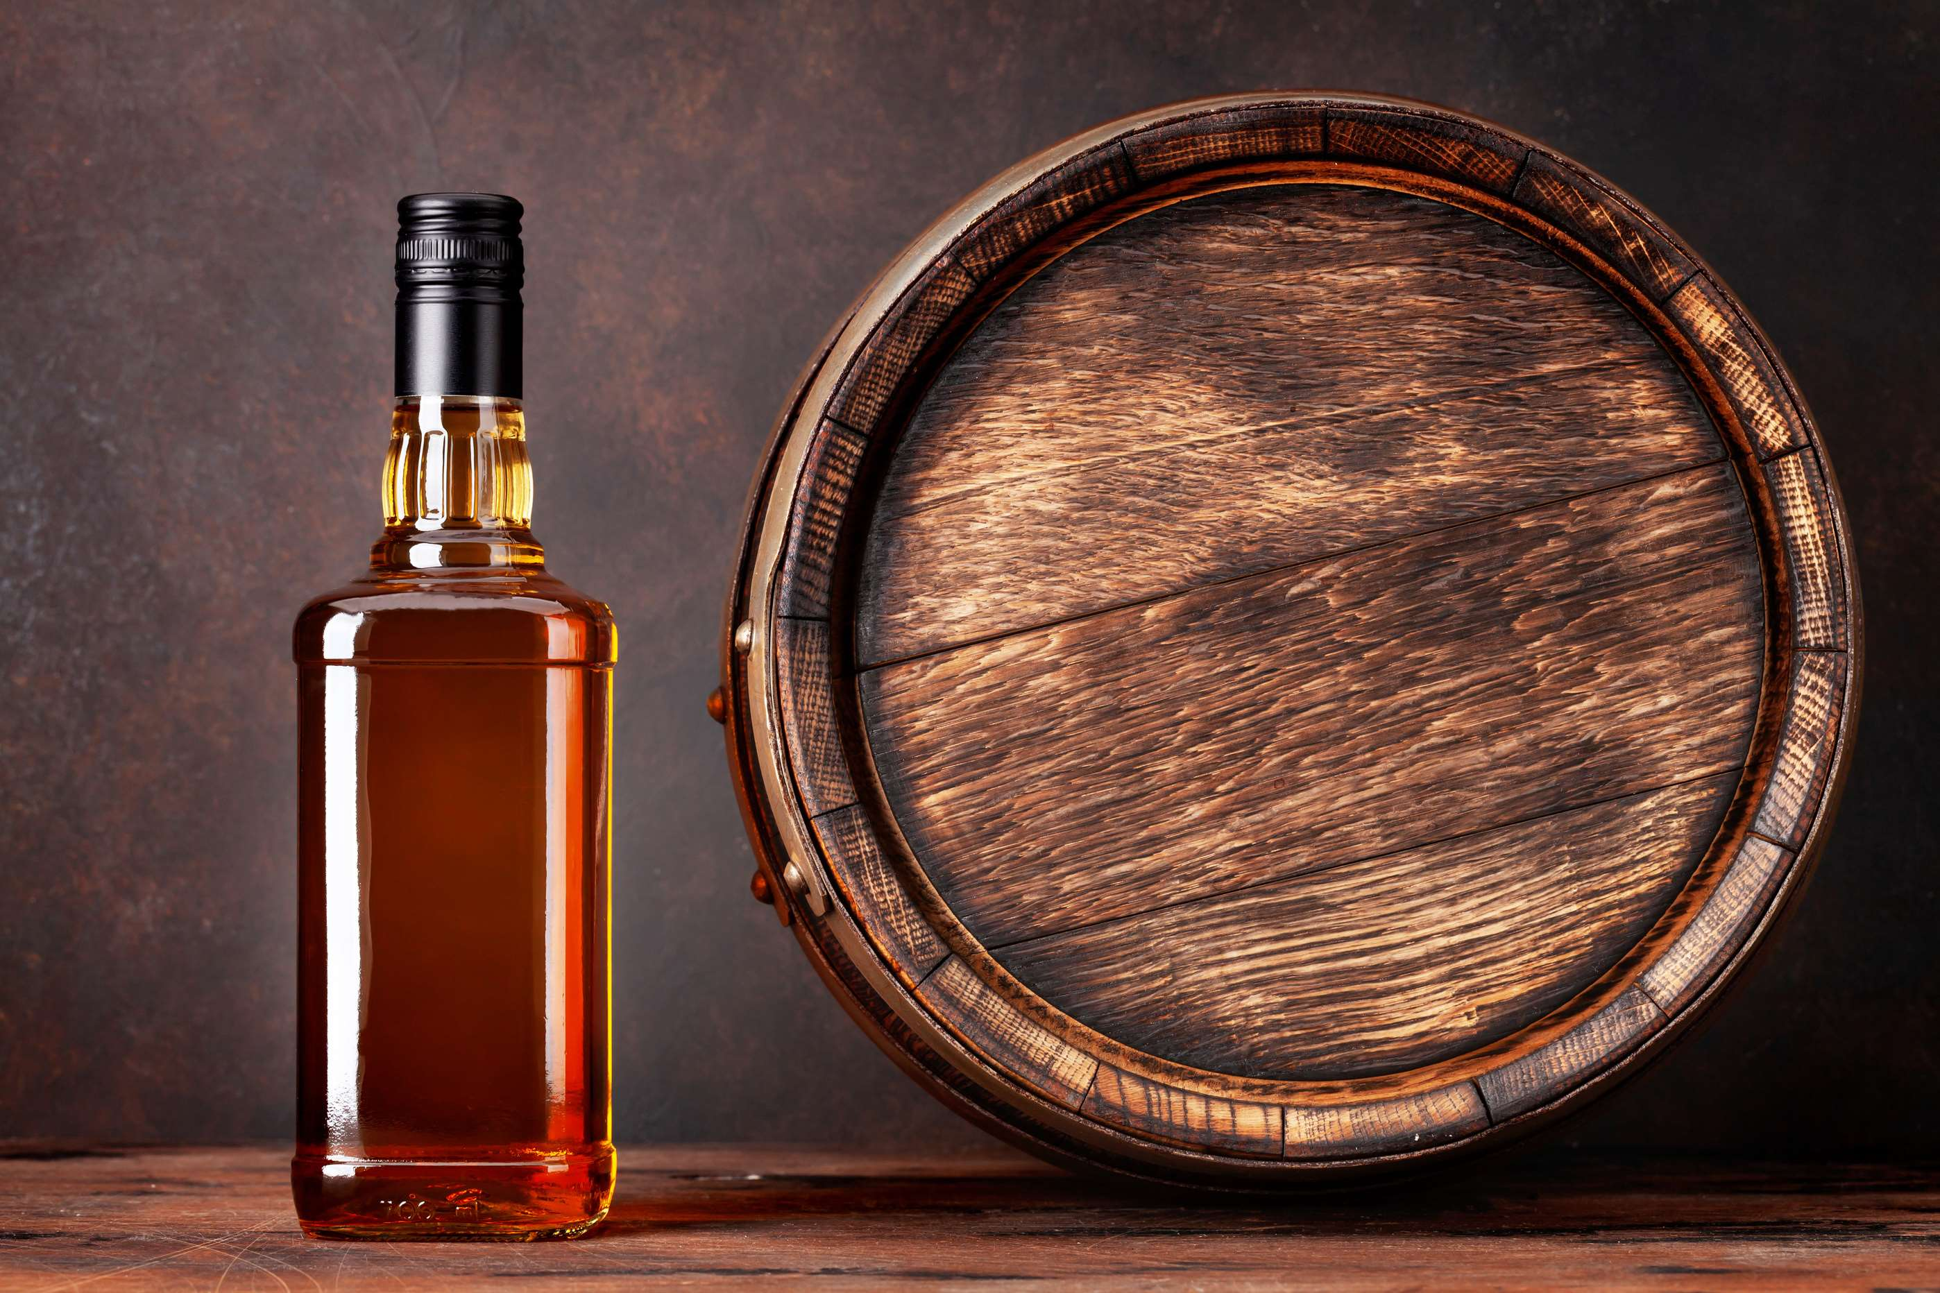
AUTHOR'S PERSPECTIVE
  The global malt whisky market will expand significantly by 5.20% CAGR between 2024 to 2031.
  The Scotch Whisky segment is set to rise as there is a great demand for it among consumers. Whisky production enterprises offer the widest range of products.
  The domestic and personal consumption category usually makes up the greatest portion of the malt whisky market. Consumer tastes, disposable income, and the rising popularity of whisky connoisseurship and appreciation are the main drivers of this market.

Slide 8










KEY PLAYERS

Slide 9


For Full Report
Contact us
COGNITIVE MARKET RESEARCH
Tel: +1 312-376-8303 | +44 020-8123-0732
India: (+91) 983-496-8611
sales@cognitivemarketresearch.com
Access the Full Report : https://tinyurl.com/2bbhp5ph
Please visit our website:
https://www.cognitivemarketresearch.com

