Slide 1

GLOBAL
MAKEUP BAGS
MARKET REPORT 2024
Global,Regional,CountryAnalysis

Slide 2
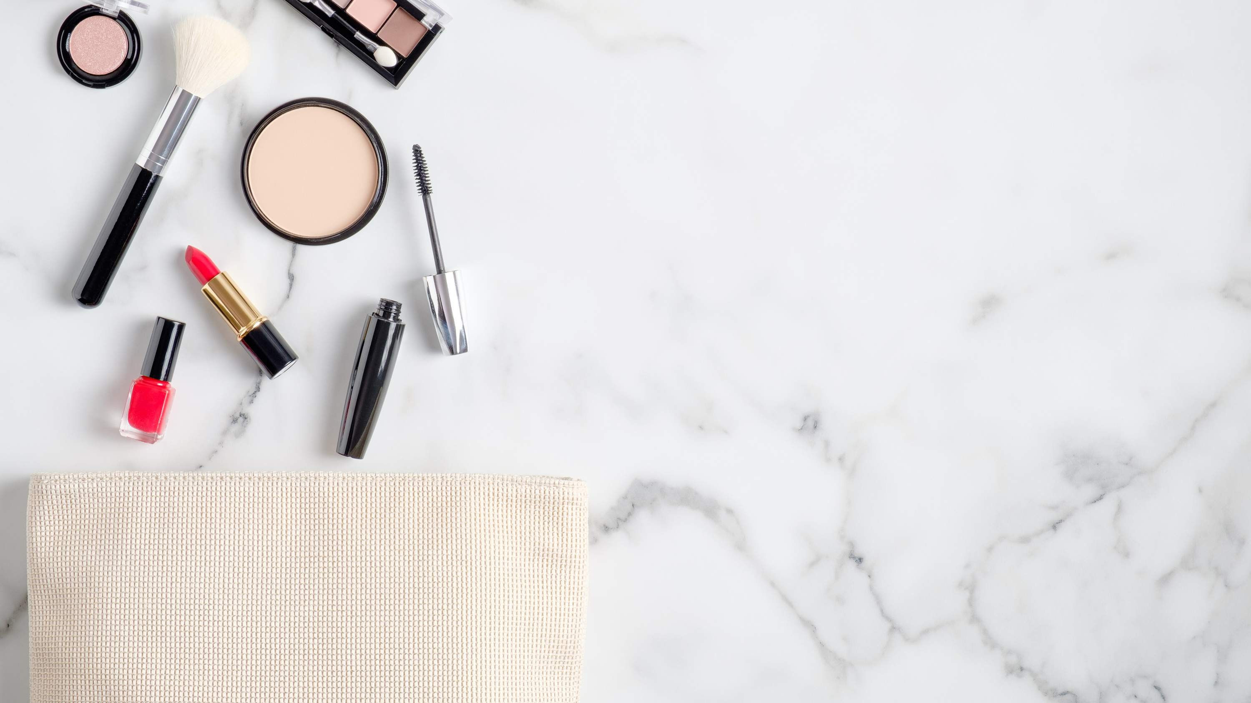
INTRODUCTION
A makeup bag is a compact pouch or container, usually lined with fabric that is utilized for the storage and transport of cosmetic items. It is alternatively referred to as a cosmetic case, makeup bag, or beauty case. Typically, women carry these bags to store and transport their cosmetics. The growth of the makeup bag market can be attributed to the rising demand for makeup products, the increased disposable income of women, and the growing popularity of online shopping.

Slide 3


KEY INSIGHTS
20₋23
CAGR 5.80%
2030

Slide 4
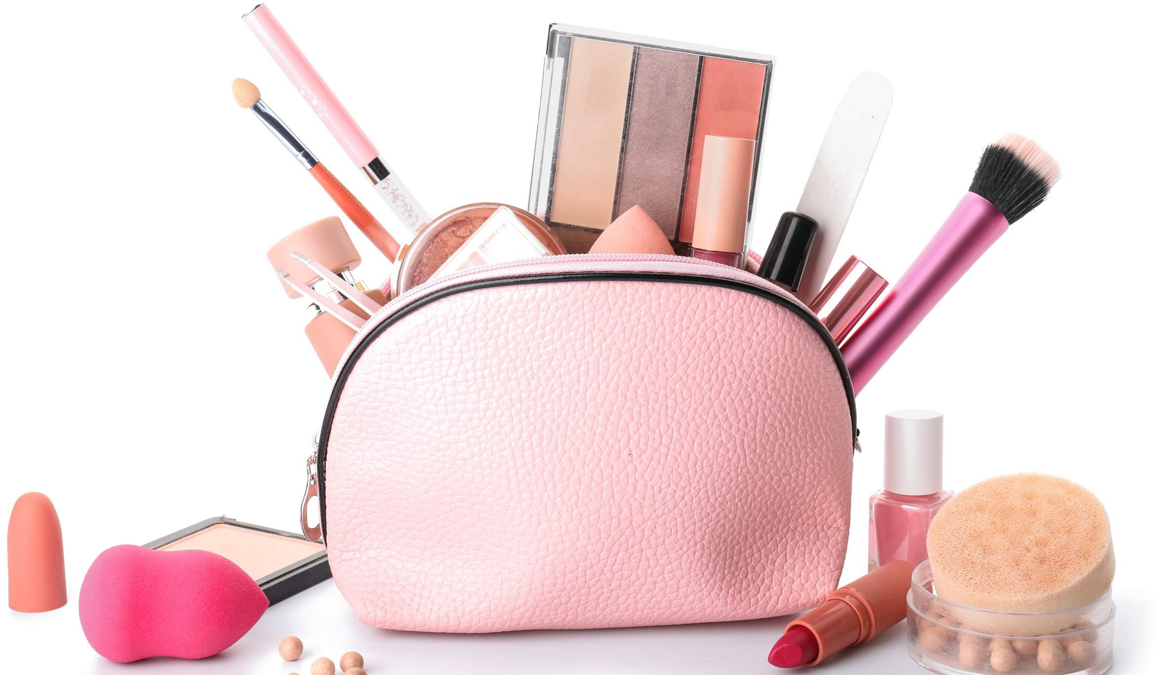
REVENUE MARKET SHARE BY SEGMENTS 2022
PVC Makeup Cases Nylon Makeup Cases Aluminum Makeup Cases
Type Segment
Personal Use Commercial Use
Application Segment

Slide 5
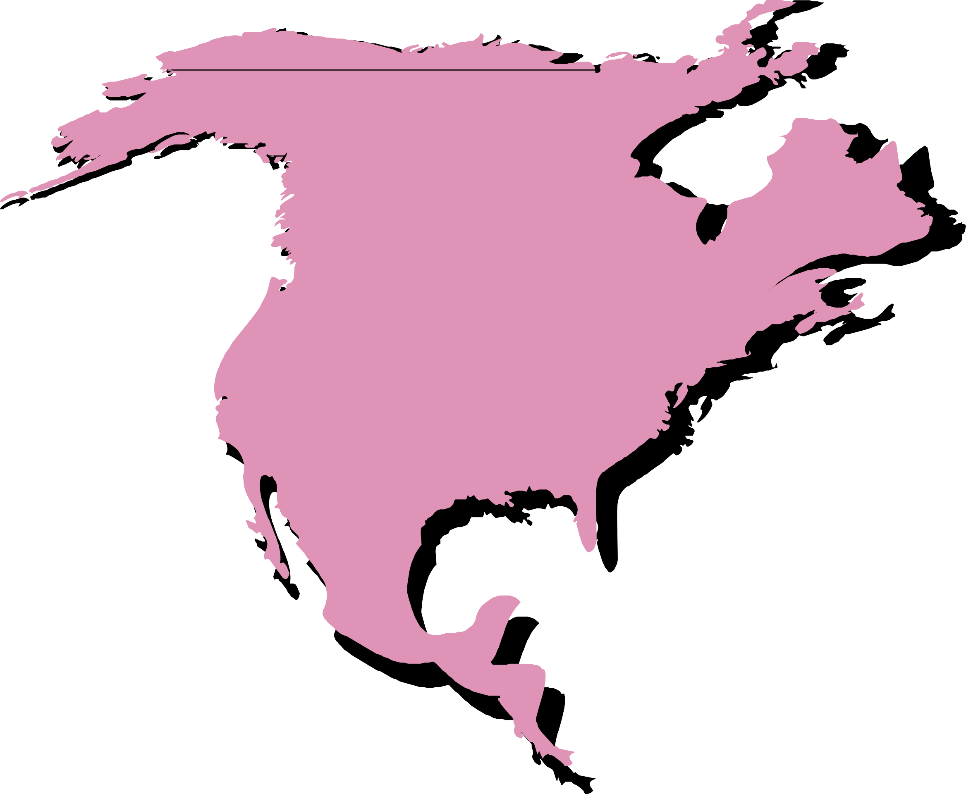
Global Makeup Bags Market Revenue share for 2022
North America 35%

Slide 6
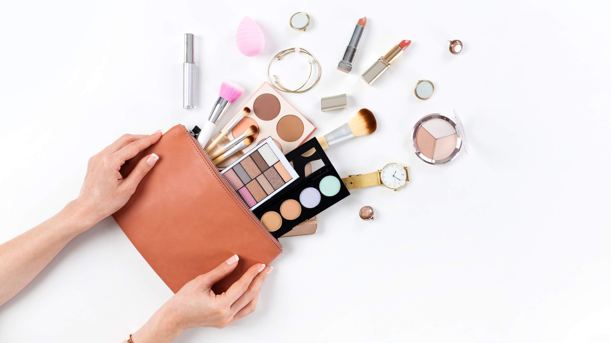
Rising Demand for Travel- Friendly and Compact Solutions to Propel Market Growth
Drivers
Saturation and Intense Competition to Hinder Market Growth
Restraints

Slide 7

AUTHOR'S PERSPECTIVE
The Global Makeup Bags Market is witnessing significant growth in the near future.
Nylon is a preferred material for makeup cases
because it offers excellent resistance against wear and tear, making it suitable for daily use.
The professional makeup artist community, in
particular, highly values Aluminum Makeup Cases
for their robustness and sophisticated appearance.
For personal use, makeup bags are essential
accessories that help individuals organize and carry their cosmetics and beauty products
conveniently.
Personal users seek makeup bags that align with their style preferences, offering functionality,
portability, and fashion appeal. Makeup artists
working in the film, television, fashion, and theater sectors require specialized and durable makeup
bags to carry a wide range of products, catering to diverse clientele and demanding environments.

Slide 8
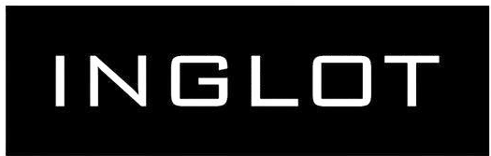
KEY PLAYERS

Slide 9


Contact us
For Full Report
COGNITIVE MARKET RESEARCH
Tel: + 1 312 - 376 - 8303 | + 44 020 - 8123 - 0732
India: ( + 91 ) 983 - 496 - 8611
sales@ cognitivemarketresearch. com
Access the Full Report : http://tinyurl.com/2e6j26mj
Please visit our website:
https://www.cognitivemarketresearch.com

