Slide 1
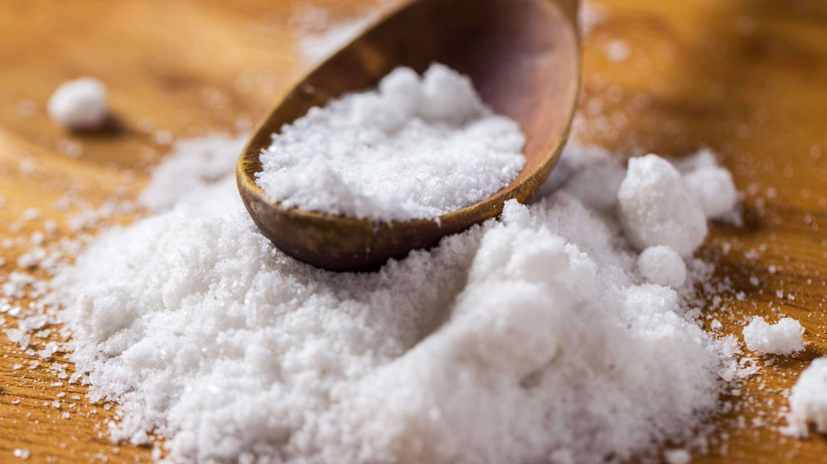
MAGNESIUM SULFATE MARKET REPORT

Slide 2
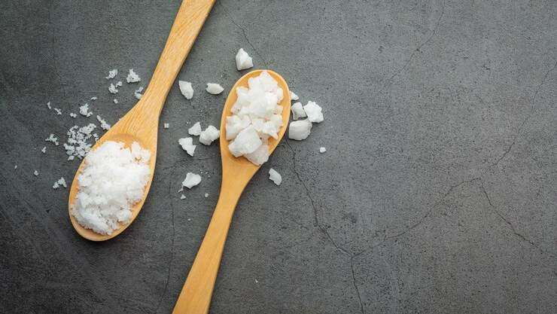
INTRODUCTION
Magnesium sulfate is a small colorless crystal used as an anticonvulsant, a cathartic, and an electrolyte replenisher in the treatment of pre- eclampsia and eclampsia.

Slide 3
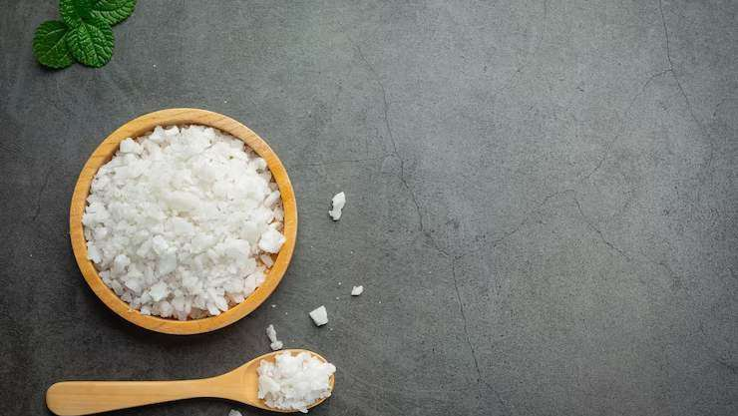






KEY INSIGHTS
MARKET SIZE
962. 6 million
2022
FORECAST
1,636.1 million
2030
CAGR 6.7%
2030

Slide 4
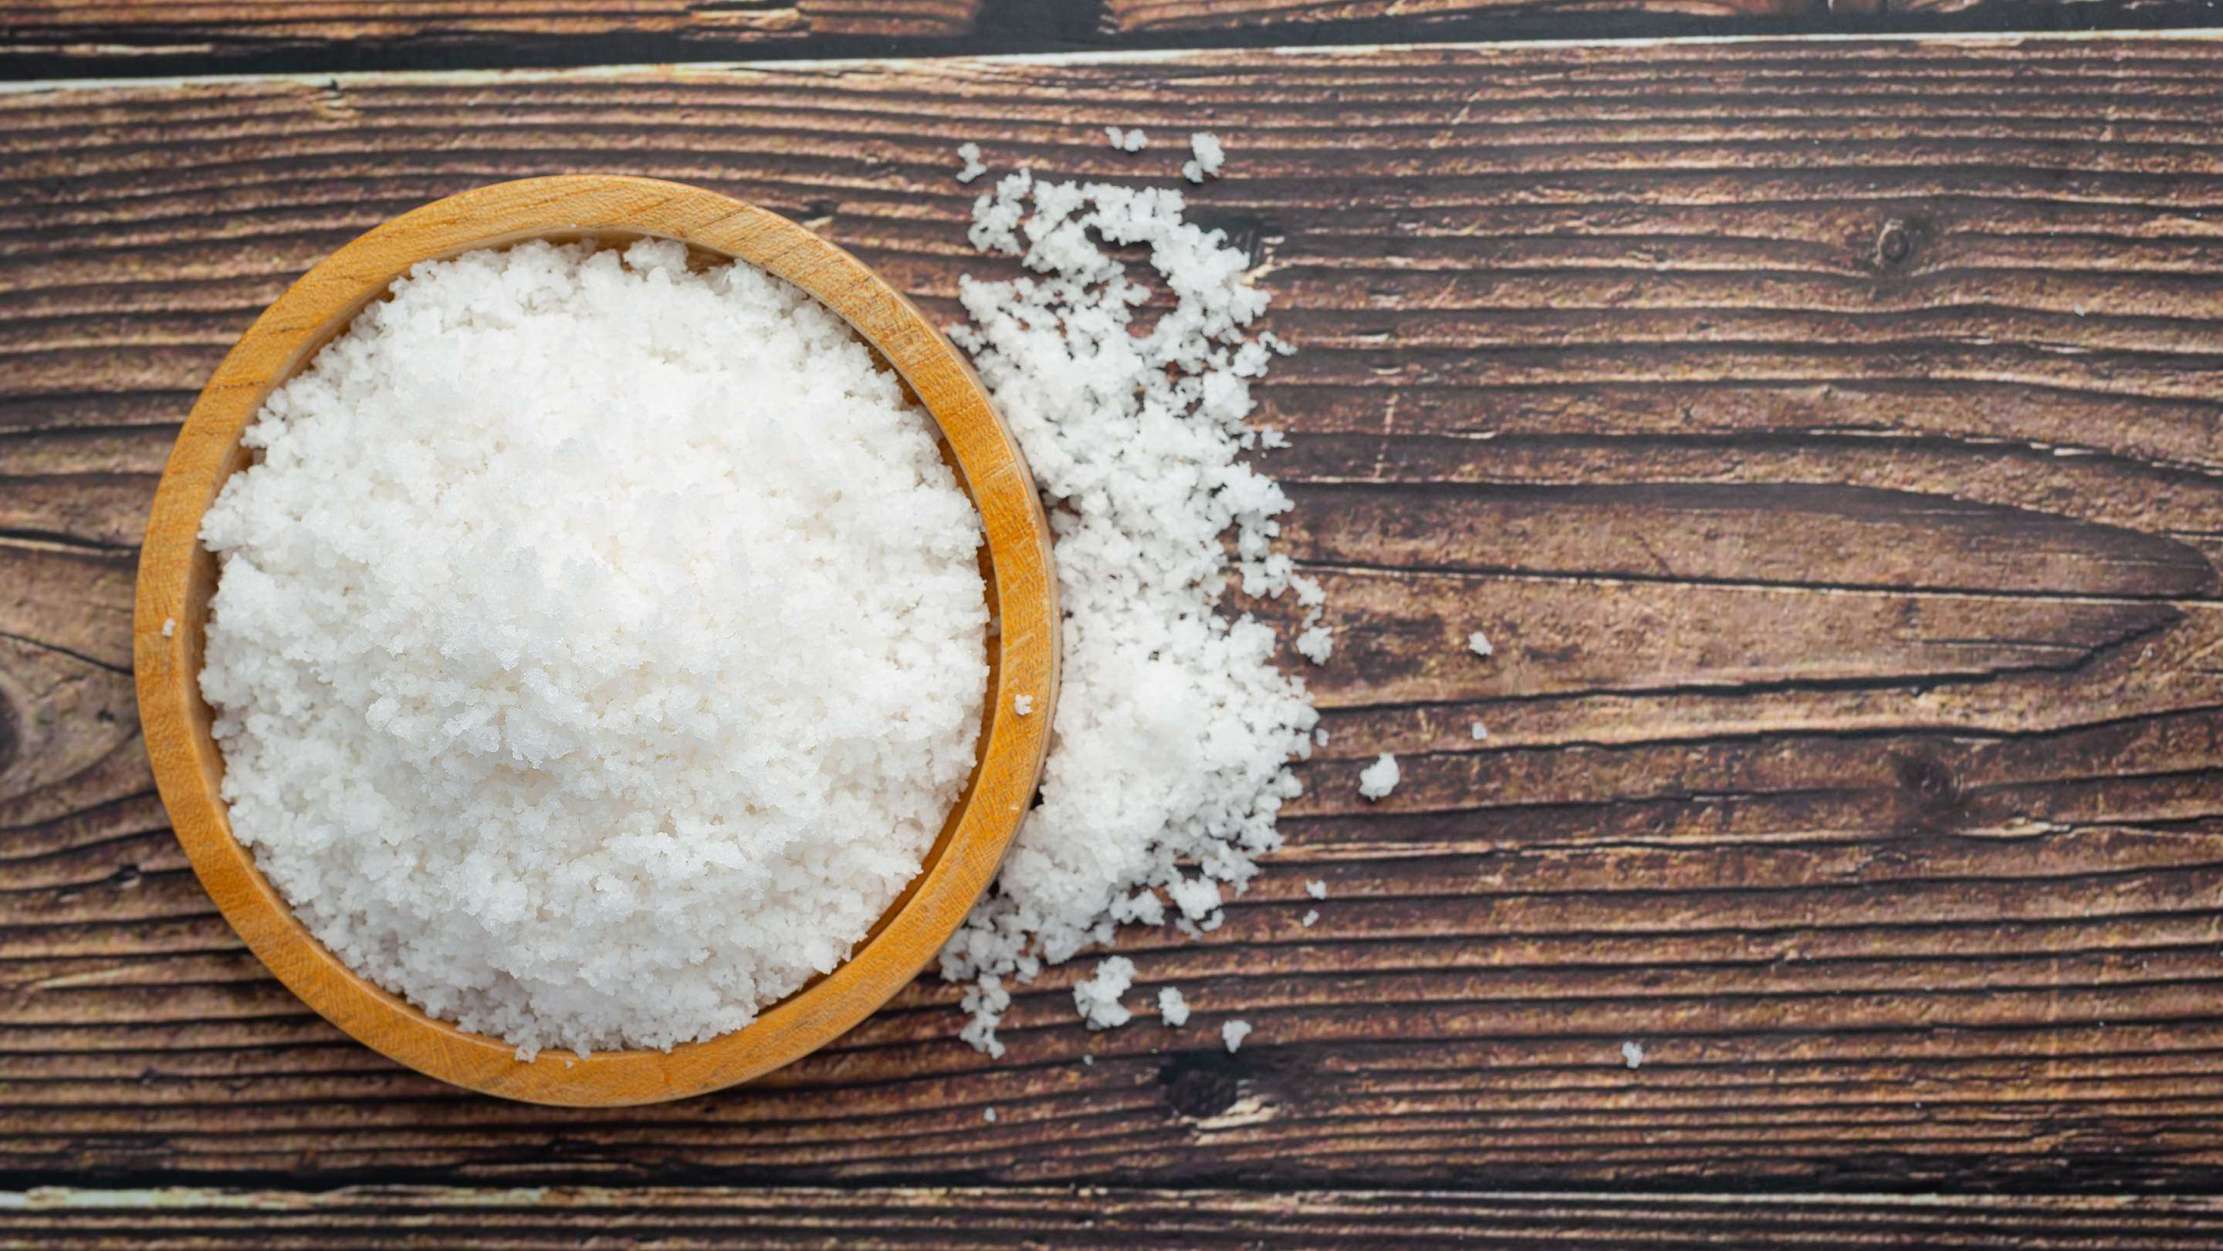

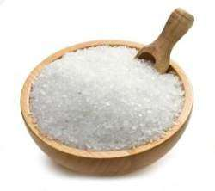

REVENUE MARKET SHARE BY SEGMENTS 2022
Form : Crystal: 42.43%
Type: Heptahydrate: 38.21%
Application: Fertilizer: 18.23%

Slide 5
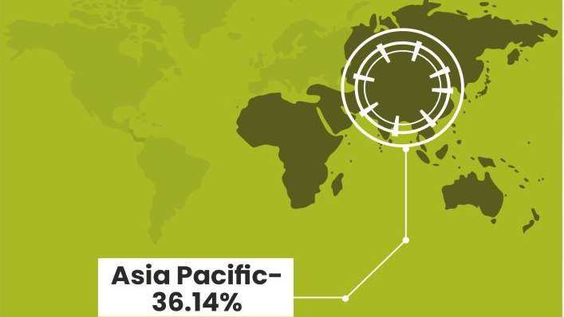
GLOBALMAGNESIUM SULFATE MARKET
REVENUE SHARE FOR 2022

Slide 6
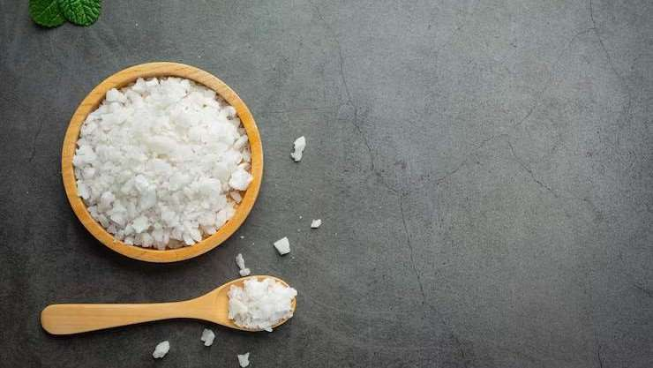
The need to increase production due to rising
global food demand due to population growth. Increasing penetration in new applications
Drivers
within nutraceuticals along with a
consistently increasing demand from the end- use industries.
Restraints
The volatility in prices of magnesium salt

Slide 7
AUTHOR'S PERSPECTIVE
Magnesium sulfate demand will likely increase for the production of fertilisers during the forecast period due to the expansion of the agricultural industry globally and the growing requirement to achieve high agricultural yields.
The other key factor expected to significantly contribute to the growth of the global market is the rising use of magnesium sulphate as a first-line drug for the treatment of severe pre-eclampsia and eclampsia.

Slide 8
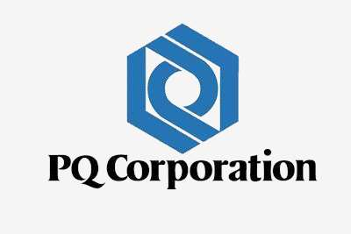
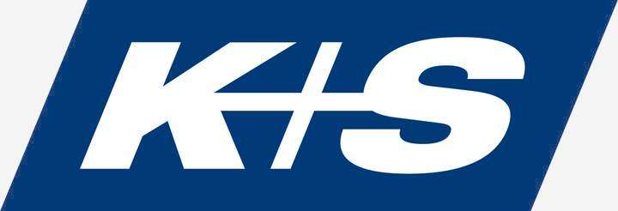
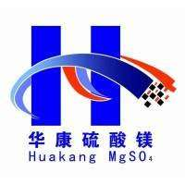

KEY PLAYERS

Slide 9


Contact us
For Full Report
COGNITIVE MARKET RESEARCH
Tel: +1 312-376-8303 | +44 020-8123-0732
India: (+91) 983-496-8611
sales@cognitivemarketresearch.com
Access the Full Report : https://shorturl.at/vBDR0
Please visit our website: https://www.cognitivemarketresearch.com

